Slide 1
Unit-2
Stack & Queue

Slide 2
Unit-2
Stack
Introduction
Operations
Applications of Stack
Recursion
Polish notations
Queue
Introduction
Types of Queue
Simple Queue and its operations

Slide 3
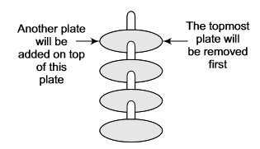
Stack
Stack is an important data structure which stores its elements in an ordered manner.
Take an analogy of a pile of plates where one plate is placed on top of the other as shown in the following figure.
A plate can be removed from the topmost position. Hence, you can add and remove the plate only at/from one position that is, the topmost position

Slide 4
Stack
“A stack is a linear data structure which can be implemented either using an array or a linked list”.
The elements in a stack are added and removed only from one end, which is called top.
Hence, a stack is called a LIFO (Last In First Out) data structure as the element that was inserted last is the first one to be taken out.

Slide 5
Array representation of Stack
In computer memory, stacks can be represented as a linear array.
Every stack has a variable TOP associated with it.
TOP is used to store the address of topmost element of the stack.
There is another variable named MAX which will be used to store the maximum number of elements that the stack can hold.
If TOP=NULL means that the stack is Empty.
If TOP=MAX-1 means that the stack is Full.

Slide 6
Array representation of Stack
An example stack :
The stack in above figure shows that TOP=4, so insertions and deletions will be done at this position.
In this stack, five more elements can still be stored.

Slide 7
Operations on a Stack
A stack has four basic operations:
Push: adds an element to the top of the stack.
Pop: removes the element from the top of the stack.
Peek: returns the value of the topmost element of the stack.
Update: changes the value of element given by user of the stack.

Slide 8
1. Push Operation
The PUSH operation is used to insert an element into the stack.
The new element is added at the topmost position of the stack.
However before inserting the value, we must first check if TOP=MAX-1, as it would mean that the stack is full and no further insertions can be done on it.
If an attempt is made to insert an element in a stack that is already full, an OVERFLOW message is printed.

Slide 9
1. Push Operation
An example of stack:
Stack after insertion:

Slide 10
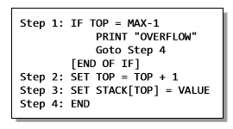
1. Push Operation
Algorithm to insert an element in a stack:

Slide 11
2. Pop Operation
The POP operation is used to delete an element from the stack.
However before deleting the value, we must check if TOP=NULL, as it would mean that the stack is empty and therefore no further deletions can be done on it.
If an attempt to delete a value from a stack that is already empty is made, an UNDERFLOW message is printed.

Slide 12

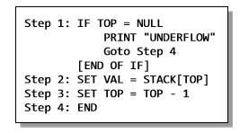
2. Pop Operation
Stack after deletion:
Algorithm to delete an element from the stack:

Slide 13
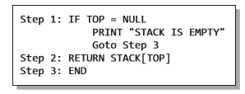
3. Peek Operation
PEEK is an operation that returns the value of the topmost element of the stack without deleting it from the stack.
The algorithm for the peep operation is given as follows:

Slide 14
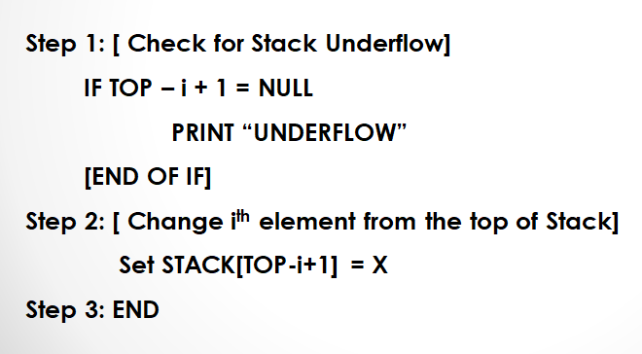
4. Update Operation
UPDATE is an operation that updates or changes the value of specified element with specific index.
However, the update operation first checks if the stack is empty or contains some element.

Slide 15
Applications of Stack
Recursion
Polish Notations

Slide 16
Recursion
A function calls itself is called Recursion.
Recursion is a repetitive process in which function calls itself repeatedly until some predefined condition is met.
The recursive function must have a stopping condition (Termination/ Anchor Condition) or else the function would never terminate. So ultimately program goes into infinite loop.
Examples where recursion has been used are:
Factorial of a given number, Fibonacci series up to given term, etc…

Slide 17
Recursion
#include<stdio.h>
#include<conio.h>
int factorial(int n);
void main()
{
int n,z;
clrscr();
printf("\n Enter Value : ");
scanf("%d",&n);
z=factorial(n);
printf("\n Factorial is : %d",z);
}

Slide 18
Recursion
int factorial(int n)
{
int f;
if(n==1)
return 1;
else
f=n*factorial(n-1);
return f;
}

Slide 19
Iteration Vs. Recursion
Sr . No. | Basis for Comparison | Recursion | Iteration
1 | Basic | The statement in a body of function calls the function itself. | Allows the set of instructions to be repeatedly executed.
2 | Format | In recursive function, only termination condition (base case) is specified. | Iteration includes initialization, condition, execution of statement within loop and update (increments and decrements) the control variable.
3 | Termination | A conditional statement is included in the body of the function to force the function to return without recursion call being executed. | The iteration statement is repeatedly executed until a certain condition is reached.

Slide 20
Iteration Vs. Recursion
Sr . No. | Basis for Comparison | Recursion | Iteration
4 | Condition | If the function does not coverage to some condition called (base case), it leads to infinite recursion. | If the control condition in the iteration statement never become false, it leads to infinite iteration.
5 | Infinite Repetition | Infinite recursion can crash the system. | Infinite loop uses CPU cycles repeatedly.
6 | Applied | Recursion is always applied to functions. | Iteration is applied to iteration statements or "loops".
7 | Speed | Slow in execution. | Fast in execution.

Slide 21
Iteration Vs. Recursion
Sr . No. | Basis for Comparison | Recursion | Iteration
8 | Stack | The stack is used to store the set of new local variables and parameters each time the function is called. | Does not uses stack.
9 | Overhead | Recursion possesses the overhead of repeated function calls. | No overhead of repeated function call.
10 | Size of Code | Recursion reduces the size of the code. | Iteration makes the code longer.

Slide 22
Polish Notations
Following are three different but equivalent notations od writing algebraic expression:
Infix Notation A+B
Postfix Notation AB+
Prefix Notation +AB

Slide 23
Infix Notation
In the infix notation, the operator is placed between the operands.
For example, A + B; here, the plus operator is place between the two operands A and B.
Although we find it easy to write expressions using the infix notation, computers find them difficult to parse as they need a lot information such as operator precedence, associativity rules and brackets which dictate the rules, to evaluate the expression.
So computers work more efficiently with expressions written using prefix and postfix notations.

Slide 24
Postfix Notation
In the postfix notation, as the name suggests the operator is placed after the operands.
For example, if an expression is written as A+B in infix notation, the same expression is written as AB+ in the postfix notation.
The order of evaluation of a postfix expression is always from left to right. Even brackets cannot alter the order of evaluation.
Expression (A + B) * C is written is postfix notation as:
AB+C*

Slide 25
Postfix Notation
Postfix operation does not even follow the rules of operator precedence.
The operator that occurs first in the expression is operated first on the operands.
For example, given a postfix notation AB+C*; while evaluation addition will be performed prior to multiplication.
Exercise: Convert following Infix expressions into Postfix expressions:
(A – B) * (C + D)

Slide 26
Prefix Notation
Prefix notation is same as postfix notation but having only a difference: the operator is placed before the operands.
For example: if A + B is an expression in the infix notation, then the corresponding expression in a prefix notation is given by: +AB
Exercise: Convert following Infix expressions into Prefix expressions:
(A + B) * C
(A – B) * (C + D)

Slide 27
Convert Infix to Postfix Notation
Let I be an algebraic expression written in infix notation.
I may contain parentheses, operands, and operators.
For simplicity of the algorithm, only +,-,*,/ and % operators have been used.
Given algorithm will transform an infix expression into postfix expression.

Slide 28
Convert Infix to Postfix Notation
The algorithm accepts an infix expression that may contain operators, operands and parentheses.
The operators with the same precedence are performed from left-to-right.
The algorithm uses a stack to temporarily holds operators.
The postfix expression is obtained from left to right using the operands from the infix expression and the operators are removed from the stack.
The very first step is to push a left parenthesis in the stack and add a corresponding right parenthesis at the end of the infix expression.
The algorithm is repeated until the stack is empty.

Slide 29
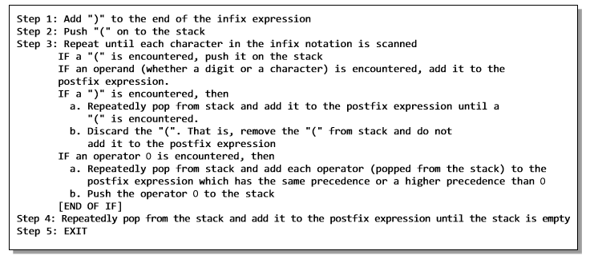
Convert Infix to Postfix Notation

Slide 30
Convert Infix to Postfix Notation
Operator | PRIORITY
^ , % | 1
* , / | 2
+ , - | 3
Rules
No Two Operator of same priority can stay together in the stack column.
If Previous Operator having the higher priority then current operator then previous operator will be poped out.
○
○
○
30

Slide 31
Convert Infix to Postfix Notation
(A+B/C*(D+E)-F)
Infix Character Scanned | STACK | Postfix Expression
( | (
A | ( | A
+ | (+ | A
B | (+ | AB
/ | (+/ | AB
C | (+/ | ABC
* | (+* | ABC/
( | (+*( | ABC/
D | (+*( | ABC/D
+ | (+*(+ | ABC/D
E | (+*(+ | ABC/DE
) | (+* | ABC/DE+
- | (- | ABC/DE+*+
F | (- | ABC/DE+*+F
) |  | ABC/DE+*+F-

Slide 32
Convert Infix to Postfix Notation
(A*B+C/(D-E))
Infix Character Scanned | STACK | Postfix Expression
( | (
A | ( | A
* | (* | A
B | (* | AB
+ | (+ | AB*
C | (+ | AB*C
/ | (+/ | AB*C
( | (+/( | AB*C
D | (+/( | AB*CD
- | (+/(- | AB*CD
E | (+/(- | AB*CDE
) | (+/ | AB*CDE-
) |  | AB*CDE-/+

Slide 33
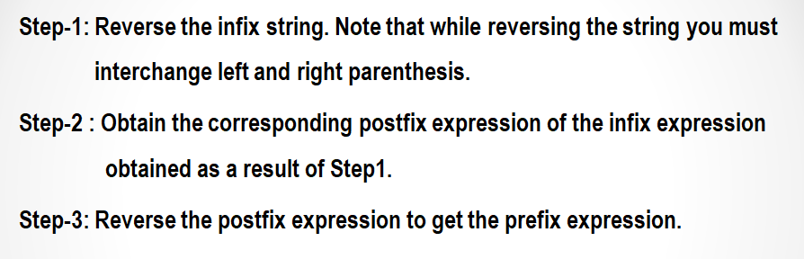
Convert Infix to Prefix Notation

Slide 34
(A*B+C/(D-E))
((E-D)/C+B*A)
Infix Character Scanned | STACK | Postfix Expression
( | (
( | ((
E | (( | E
- | ((- | E
D | ((- | ED
) | ( | ED-
/ | (/ | ED-
C | (/ | ED-C
+ | (+ | ED-C/
B | (+ | ED-C/B
* | (+* | ED-C/B
A | (+* | ED-C/BA
) |  | ED-C/BA*+
+*AB/C-DE

Slide 35
Queue
Like stacks, queues are also one of the important data structures which store their elements in an ordered manner.
Examples :
People moving in an escalator.
People waiting for bus.
People standing outside the ticketing window of a cinema hall
Luggage kept on conveyor belt.
Cars lined for filling petrol.
Cars lined at a toll bridge.
Same is the case with data structure.

Slide 36
Queue
A queue is a FIFO (First In First Out) data structure in which each element that was inserted first is the first one to be taken out.
The elements in a queue are added at one end called the rear and removed from the other end called the front.
Queues can be implemented using either arrays or linked list.

Slide 37
Types of Queues
There are four types of Queue:
Simple Queue
Circular Queue
Priority Queue
Dequeue (Double Ended Queue)

Slide 38

Simple Queue
Queues can easily be represented using linear arrays.
Every queue will have front and rear variables that will point to the position from where deletions and insertions can be performed respectively.
Front : 0, rear: 5

Slide 39

Operations on a simple Queue: Insertion
Now if new value is needed to be added, say 45: then rear would be incremented by 1.
Front : 0, rear: 6
Every time a new element has to be added, the same procedure is repeated.
An overflow will occur when we try to insert an element into a queue that is already full.
When rear=MAX-1, where MAX is the size of a queue overflow occurs.
Note that MAX-1 has been written as array index starts from 0.

Slide 40
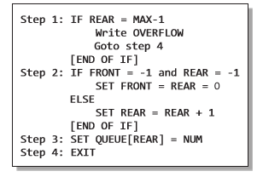
An algorithm to insert an element in a simple queue

Slide 41

Operations on a simple Queue: Deletion
Now if we want to delete an element from the queue, then the value of front will be incremented.
Deletions are done from this one end of the queue only.
Front : 1, rear: 6
An underflow condition occurs when we try to delete an element from a queue that is already empty.
If front=-1 and rear=-1, this means there is no element in the queue.

Slide 42
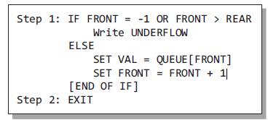
An algorithm to delete an element from a simple queue

Slide 43
Stack Vs. Queue
# | STACK | QUEUE
1 | Objects are inserted and removed at the same end. | Objects are inserted and removed from different ends.
2 | In stacks only one variable is used. It points to the top of the stack. | In queues, two different variables are used for front and rear ends.
3 | In stacks, the last inserted object is first to come out. | In queues, the object inserted first is first deleted.
4 | Stacks follow Last In First Out (LIFO) order. | Queues following First In First Out (FIFO) order.
5 | Stack operations are called push and pop. | Queue operations are called enqueue and dequeue.
6 | Stacks are visualized as vertical collections. | Queues are visualized as horizontal collections.
7 | Collection of dinner plates at a wedding reception is an example of stack. | People standing in a file to board a bus is an example of queue.

Slide 44
Thank You...!!!!

