Slide 1

Digital Marketing Campaign Conversion Prediction
Welcome to this presentation on predicting customer conversions in digital marketing campaigns. We'll explore a data-driven approach to optimize your marketing strategies for better results.
DEVAN D S

Slide 2
Contents
1
Introduction
2
Data Collection & Preprocessing
3
Exploratory Data Analysis (EDA)
4
Feature Selection
5
Model Selection
6
Hyper Parameter Tuning

Slide 3


Introduction
Companies spend millions on digital marketing—through emails, social media,
PPC (pay-per-click) ads, SEO, and Referrals. However, only a small percentage
of customers actually convert (make a purchase, sign up, or take a desired action).
The Challenge
Our Objective
Optimizing campaign strategies to improve ROI.
Analyzing the effectiveness of different marketing channels and campaign types.
Develop a machine learning model to accurately predict customer conversions.

Slide 4



Data Collection
Source
Features
Target
Kaggle
8000 rows
20 columns
Demographic Information
Whether a Customer is converted or not
Market-specific Variables
Customer Engagement Metrics
Historical Data

Slide 5




DATA PREPROCESSING
Checked for Missing values
Filled missing values with
mode and mean
Label Encoding
Used Label Encoding to convert object to numeric datatype
Assorted Datatypes
The majority of columns are of the int64 data type., 5 columns are float64 and 5 are of object type.
Standardization
Used MinMaxScaler to scale
the features

Slide 6
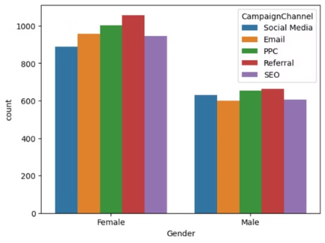
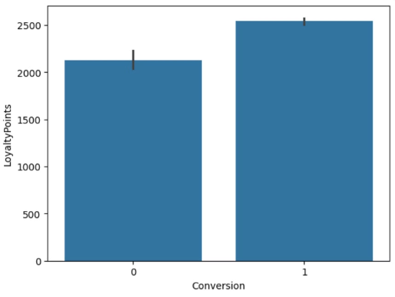
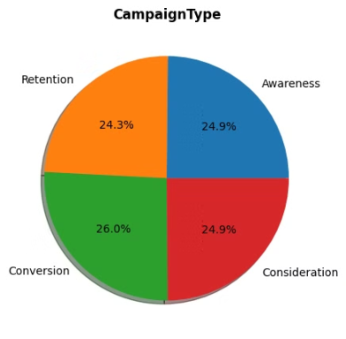



Exploratory Data Analysis (EDA)
Gender
Loyalty Points
Campaign Type
The dataset has significantly more females than males.
Higher Loyalty Points correlate with higher Conversion.
The campaign types are nearly equally balanced, each around 25%.
Referral appears to be the best
Campaign Channel
The consistent distribution suggests a well-rounded marketing strategy.

Slide 7



Feature Selection
DROPPED
IRRELEVANT
COLUMNS
FEATURE SELECTION MAINTAINED SAME PERFORMANCE
USED CORRELATION FOR FEATURE SELECTION
FEATEURE SELECTION
Used Correlation for Feature Selection
Dropped Irrelevant columns
Feature selection maintained same performance

Slide 8
Feature Selection
DROPPED
IRRELEVANT
COLUMNS
USED CORRELATION FOR FEATURE SELECTION
FEATURE SELECTION MAINTAINED SAME PERFORMANCE
FEATEURE SELECTION
Used Correlation for Feature Selection
Dropped Irrelevant columns
Feature selection maintained same performance

Slide 9



Model Building
Data Splitting
Models
The data is split into 70% for training and
30% for testing
KNN, SVC, Naive Bayes, Decision Tree
Random Forest, AdaBoost, GradientBoost, XGBoost
Imbalanced Data
Used Oversampling to balance the dataset
SMOTE
Balanced Data
Imbalanced Data

Slide 10
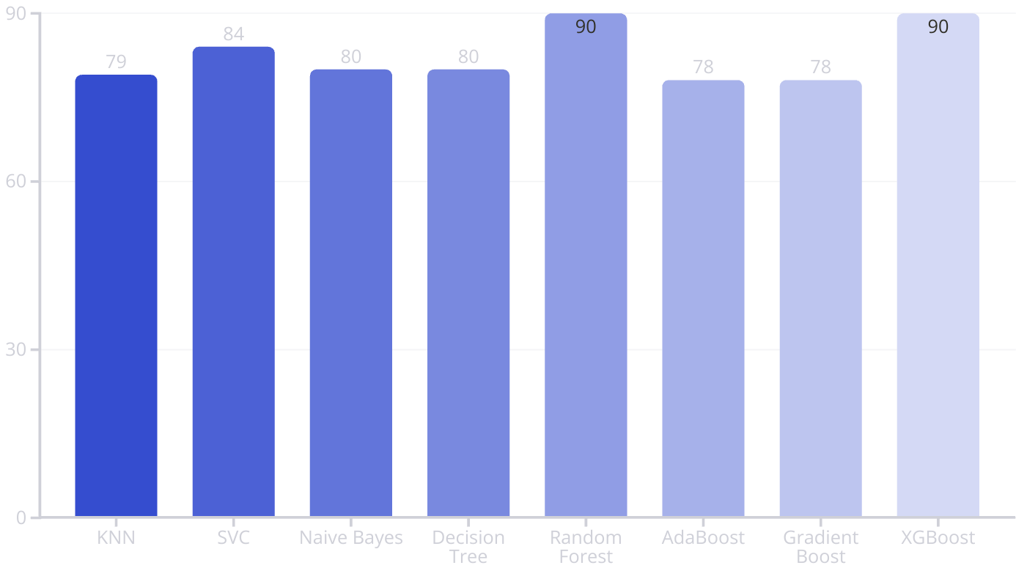
Model Selection
Compared the performance of different models after Oversampling

Slide 11


Hyper Parameter Tuning
Used GridSearchCV for Parameter Refinement
n_estimators: 150
Criterion: gini
Random_state=3
Before Tuning
After Tuning
Accuracy Score: 90%
Accuracy Score: 97%

Slide 12

CONCLUSION
Random Forest appears to be the best model for predicting a customer
Campaign Efficiency: Referrals and Pay-Per-Click campaigns are the most effective channels.
Conversion Rate: Female customers have a higher conversion rate

Slide 13
THANK YOU
"Harnessing data-driven strategies ensures better marketing efficiency."

