Slide 1
MBAP
Final Presentation
Devananda Thayyullathil
2503060B
PC04

Slide 2
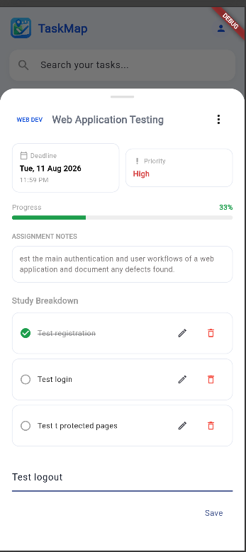
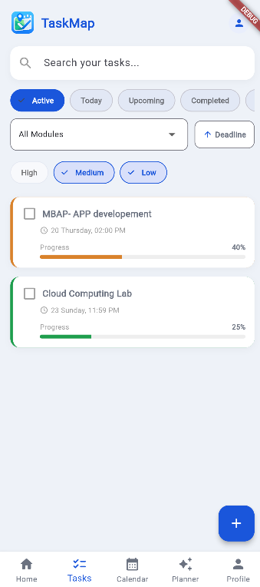
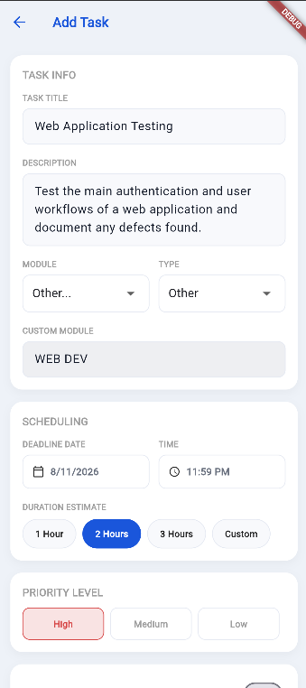
Implemented Functionalities – Part 3
CRUD Related:
Task Management
Full CRUD using Cloud Firestore
Create, view, edit and delete tasks
Toggle tasks between active and completed
Filter and sort tasks using Firestore queries
AI Study Plan Management
Save generated study plans to Firestore
Update individual study sessions
Delete and regenerate study plans

Slide 3
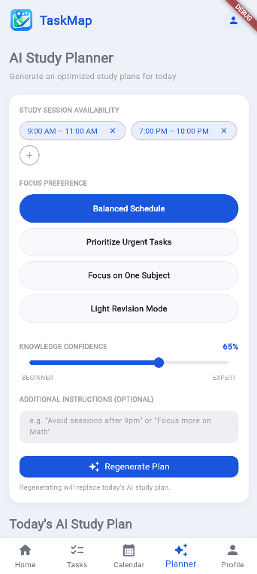
Implemented Functionalities – Part 3
AI Study Planner – Groq / Llama 3.1
Generates personalised study schedules based on:
  Student tasks and deadlines
  Available study time
  Focus preference
  Confidence level
Produces a session-by-session study plan with durations and breaks
Generated plans can be saved and managed in Firestore
Uses a rule-based scheduler as a fallback when the AI service is unavailable

Slide 4
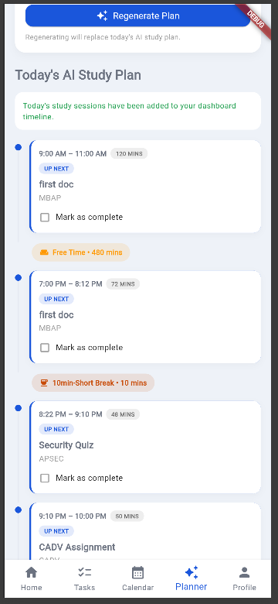
Additional Features
NETS QR Payment Implementation
Students can scan a NETS QR code to upgrade to TaskMap Pro
Multiple subscription plans are available
Successful payment activates Pro membership in Firestore
Pro users unlock unlimited AI study plan generations
Subscription status and expiry are stored and reflected in the app

Slide 5
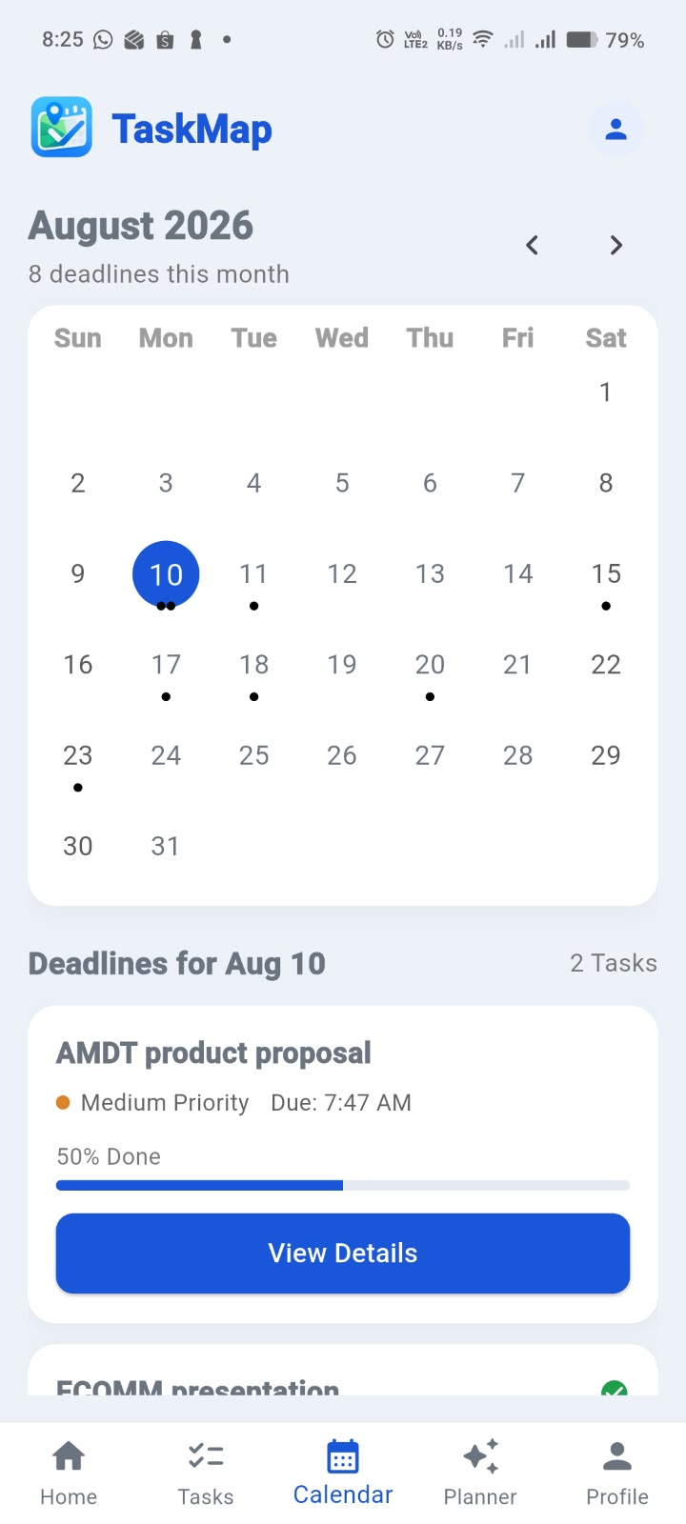
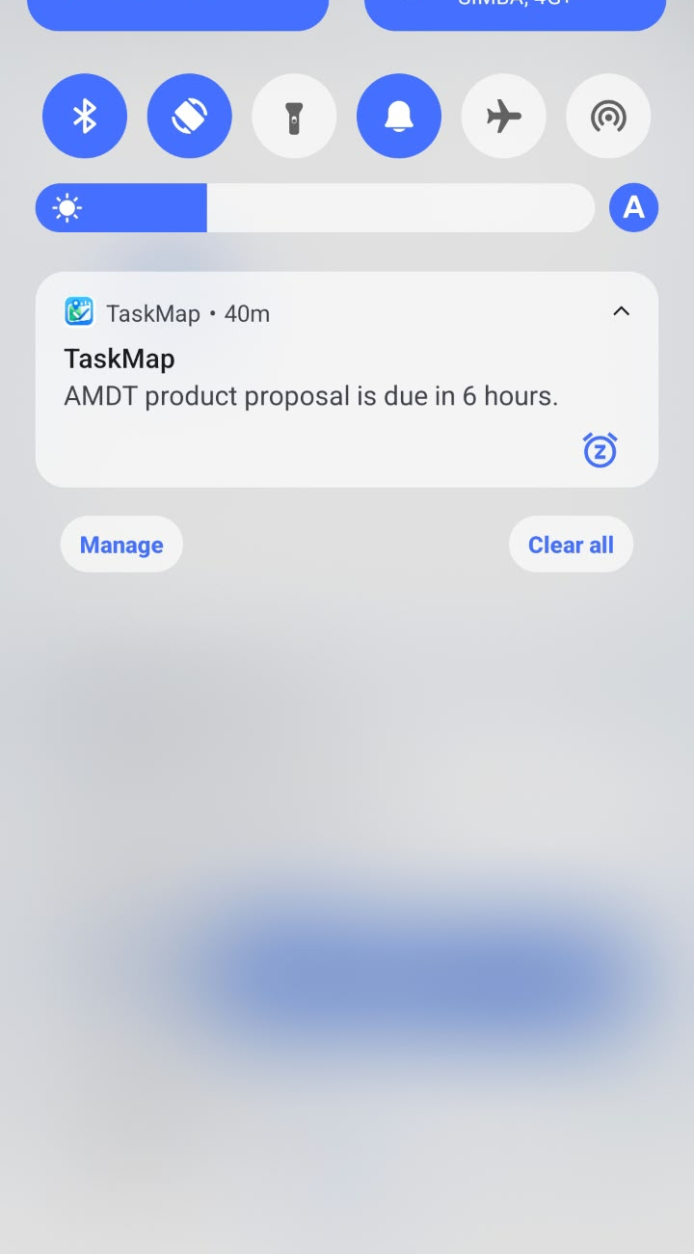
Additional Features
Other Additional Features
Calendar Integration
View tasks and deadlines by date
Filter tasks based on selected day
Local Notifications
Automatic deadline reminders
2 days, 1 day, 6 hours and 1 hour before the deadline

Slide 6
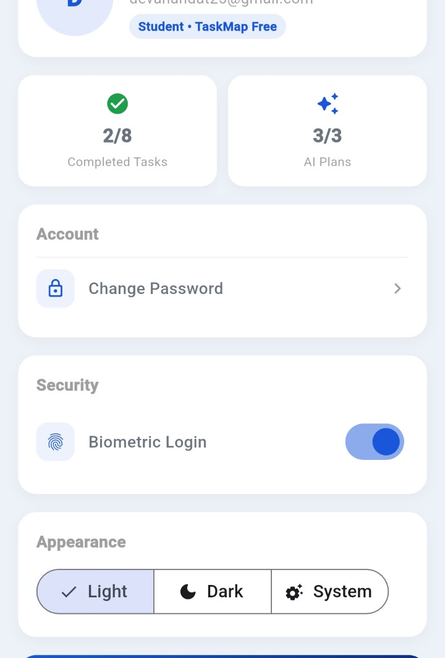
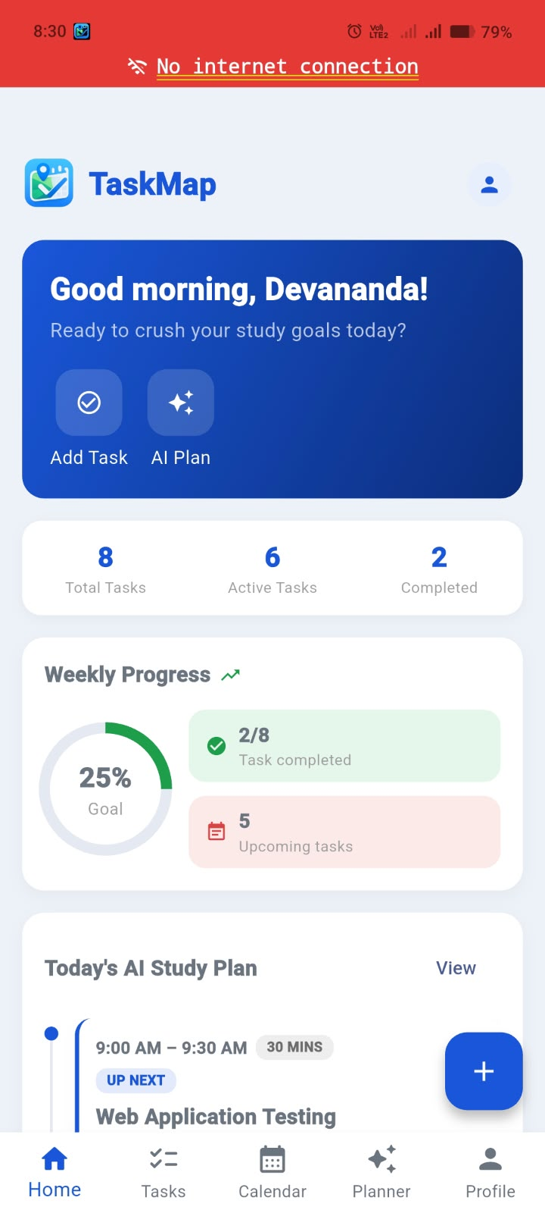
Additional Features
Biometric Login
Fingerprint unlock for quick and secure access
Offline Detection
Displays a connectivity status banner when the device loses internet access
Light / Dark Theme
User can switch between light and dark themes
UI components adapt to the selected theme

Slide 7
Video Recording
YouTube link:
https://youtube.com/shorts/QZoW5nYi03w?is=QX0uNG8qvkxpfq85

Slide 8
References
List any external resources, references, or materials used in the implementation of Project Part 3, if applicable.
https://docs.flutter.dev/
https://pub.dev/packages/table_calendar
https://pub.dev/packages/flutter_local_notifications
https://pub.dev/packages/local_auth
https://pub.dev/packages/connectivity_plus

