Slide 1
Beyond Accuracy:
What Happens When AI Meets Real-World Data?

Slide 2
Who Am I?
Devanandha Vellaramkuzhiyil Shaji
Amazon Marketplace Consultant – Denman International Ltd., UK
Educational Background
MSc in AI – Ulster University, UK
BSc in Computer Applications [Triple Main] - Mathematics, Statistics and Computer Science – Sacred Heart College, Thevara

Slide 3
My work spans AI, analytics and software development
Applied AI & Research
Wheat Rust AI — image classification, cross-dataset evaluation and explainability.
Business Intelligence & Analytics
Amazon PPC Intelligence Hub and Superstore Business Intelligence — advertising analysis, data pipelines and reporting.
Software & Community Platforms
Bloodline RP — developed and launched a live FiveM roleplay server with custom gameplay systems and an active player community.

Slide 4
Where the story began: Wheat Rust?
What is Wheat Rust?
-A fungal disease affecting wheat!
Could AI help recognise signs of disease from a leaf image?

Slide 5
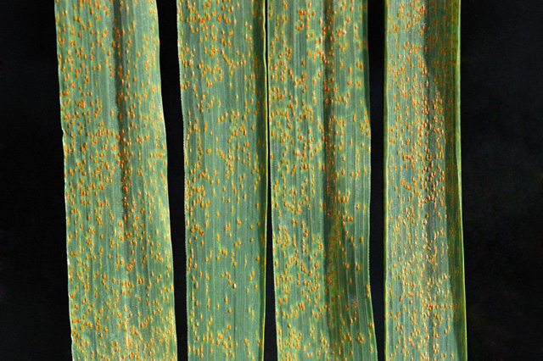
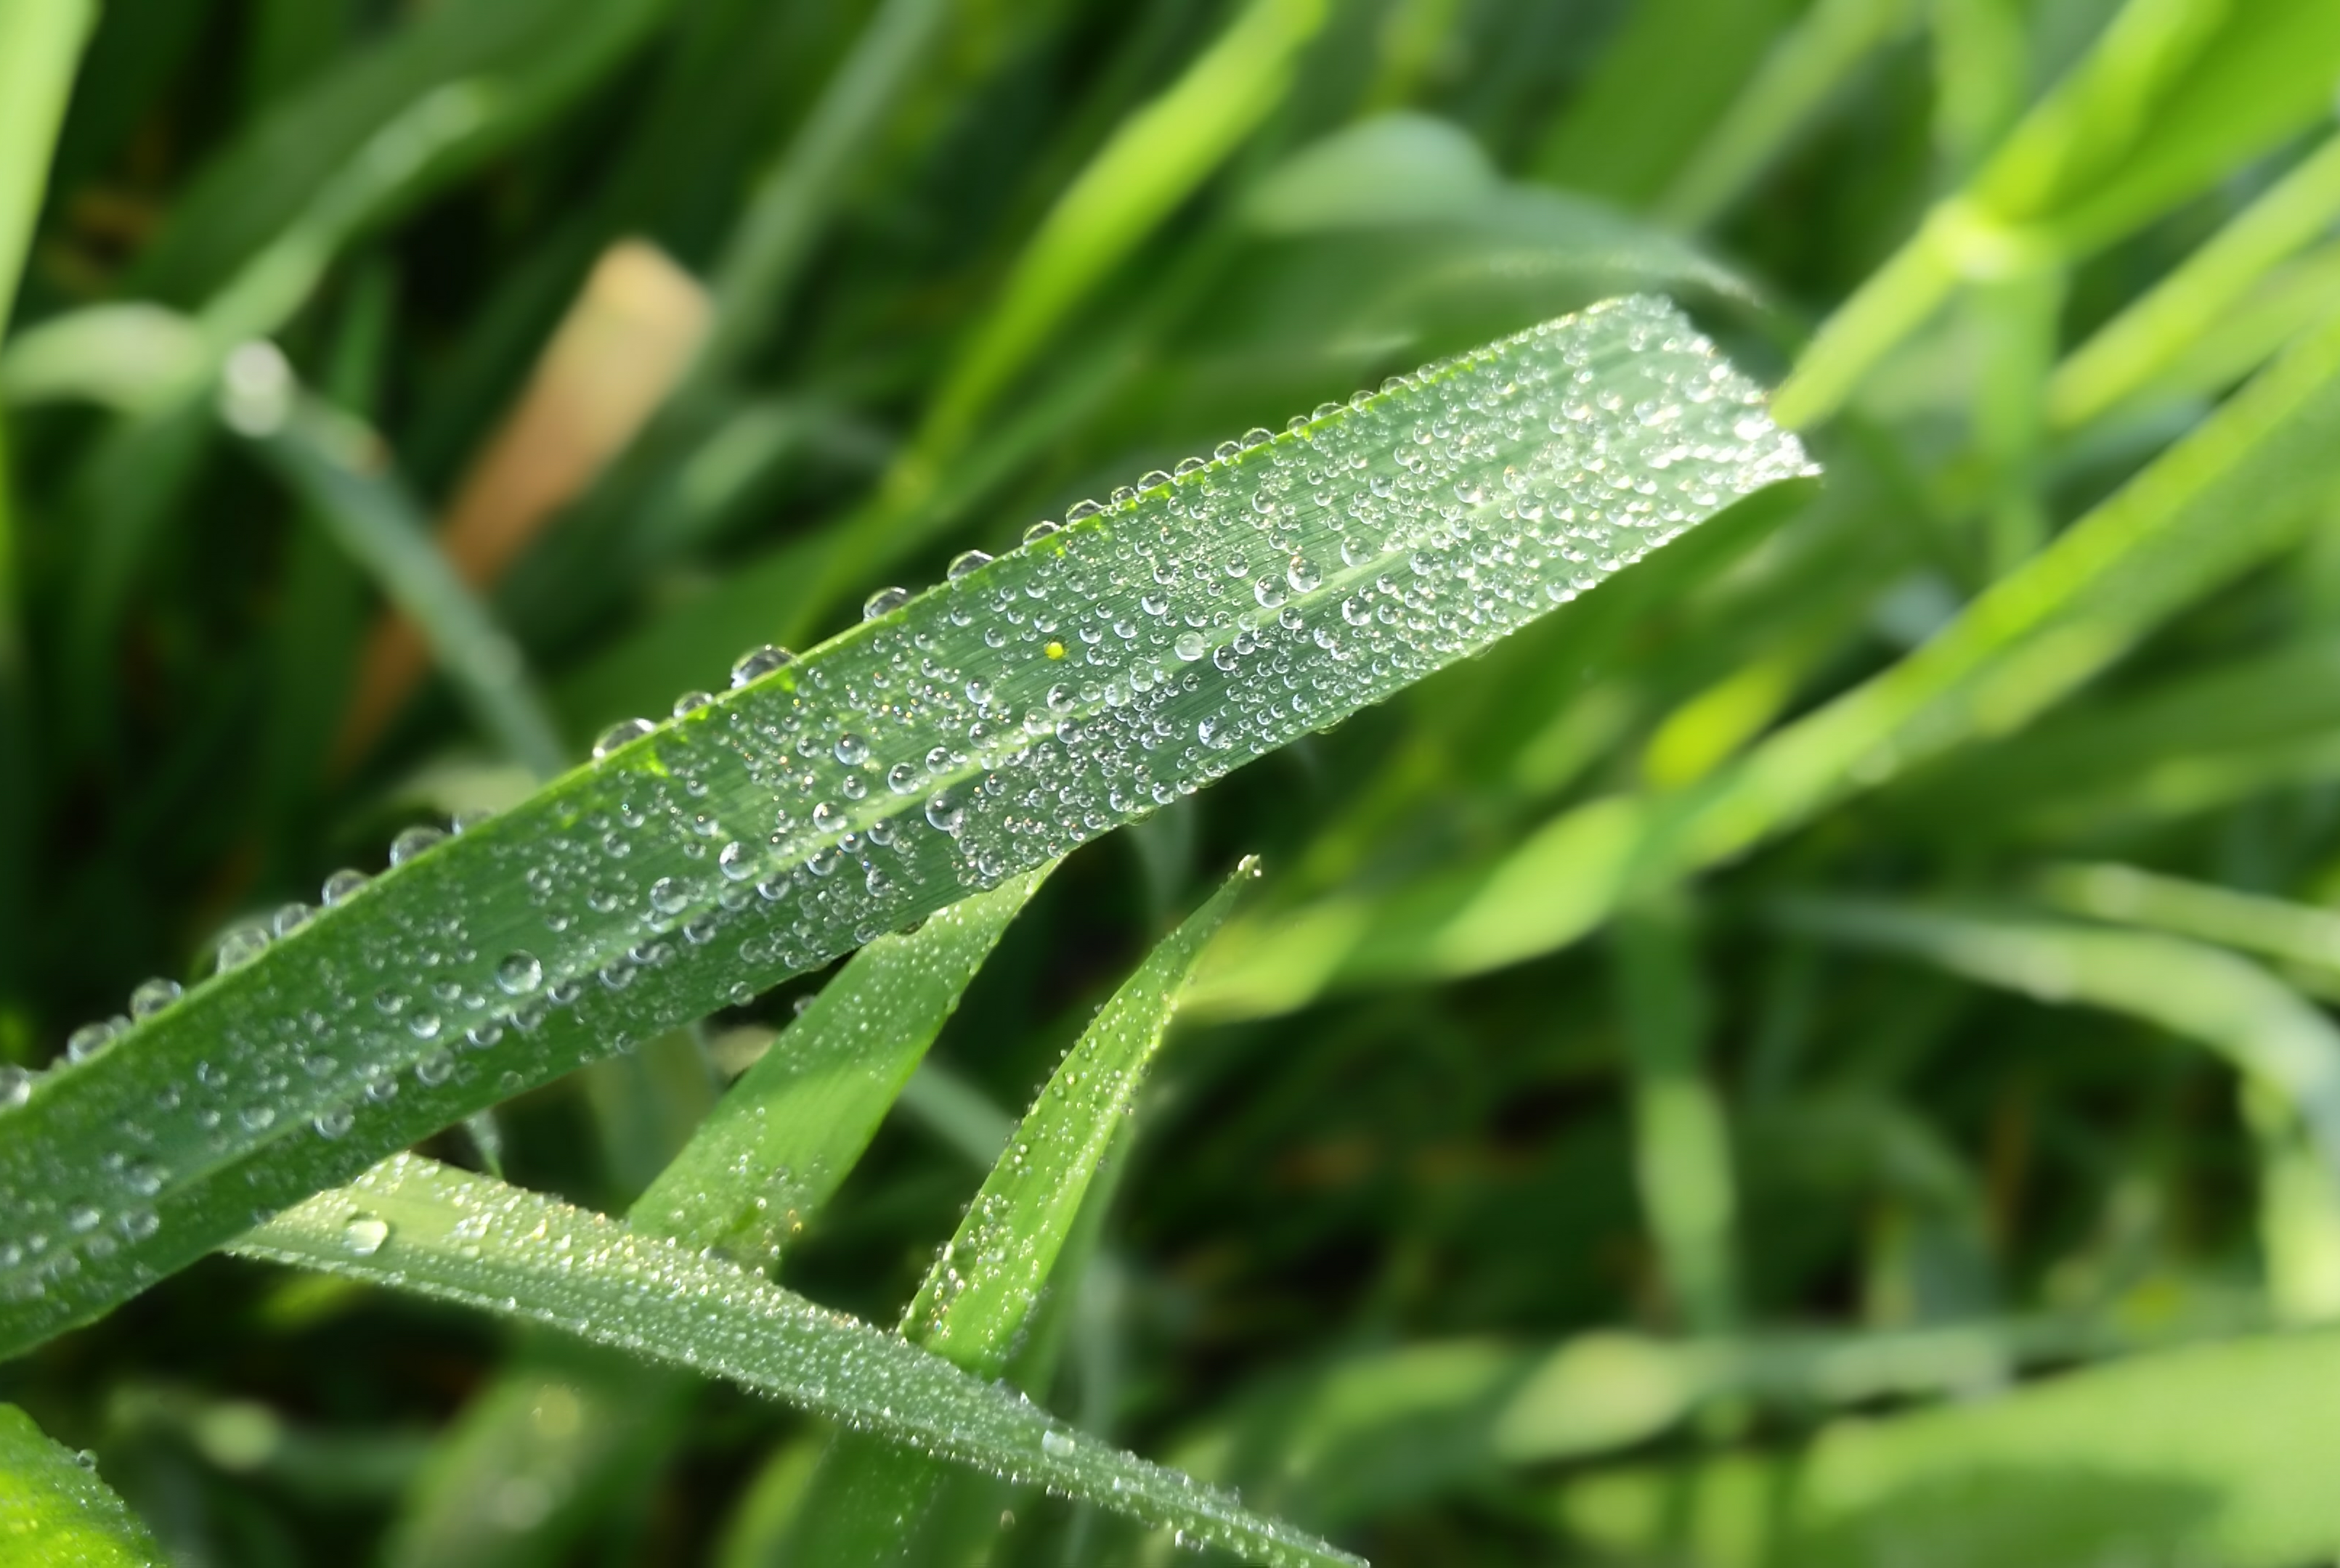
Wheat Rust?
Diseased Leaf
Healthy Leaf

Slide 6
One Crop! 3 Types of Rust
Leaf Rust
Also called Brown Rust
Stripe Rust
Also called Yellow Rust
Stem Rust
Also called Black Rust
My classifier focuses on healthy leaves, brown rust and yellow rust.

Slide 7
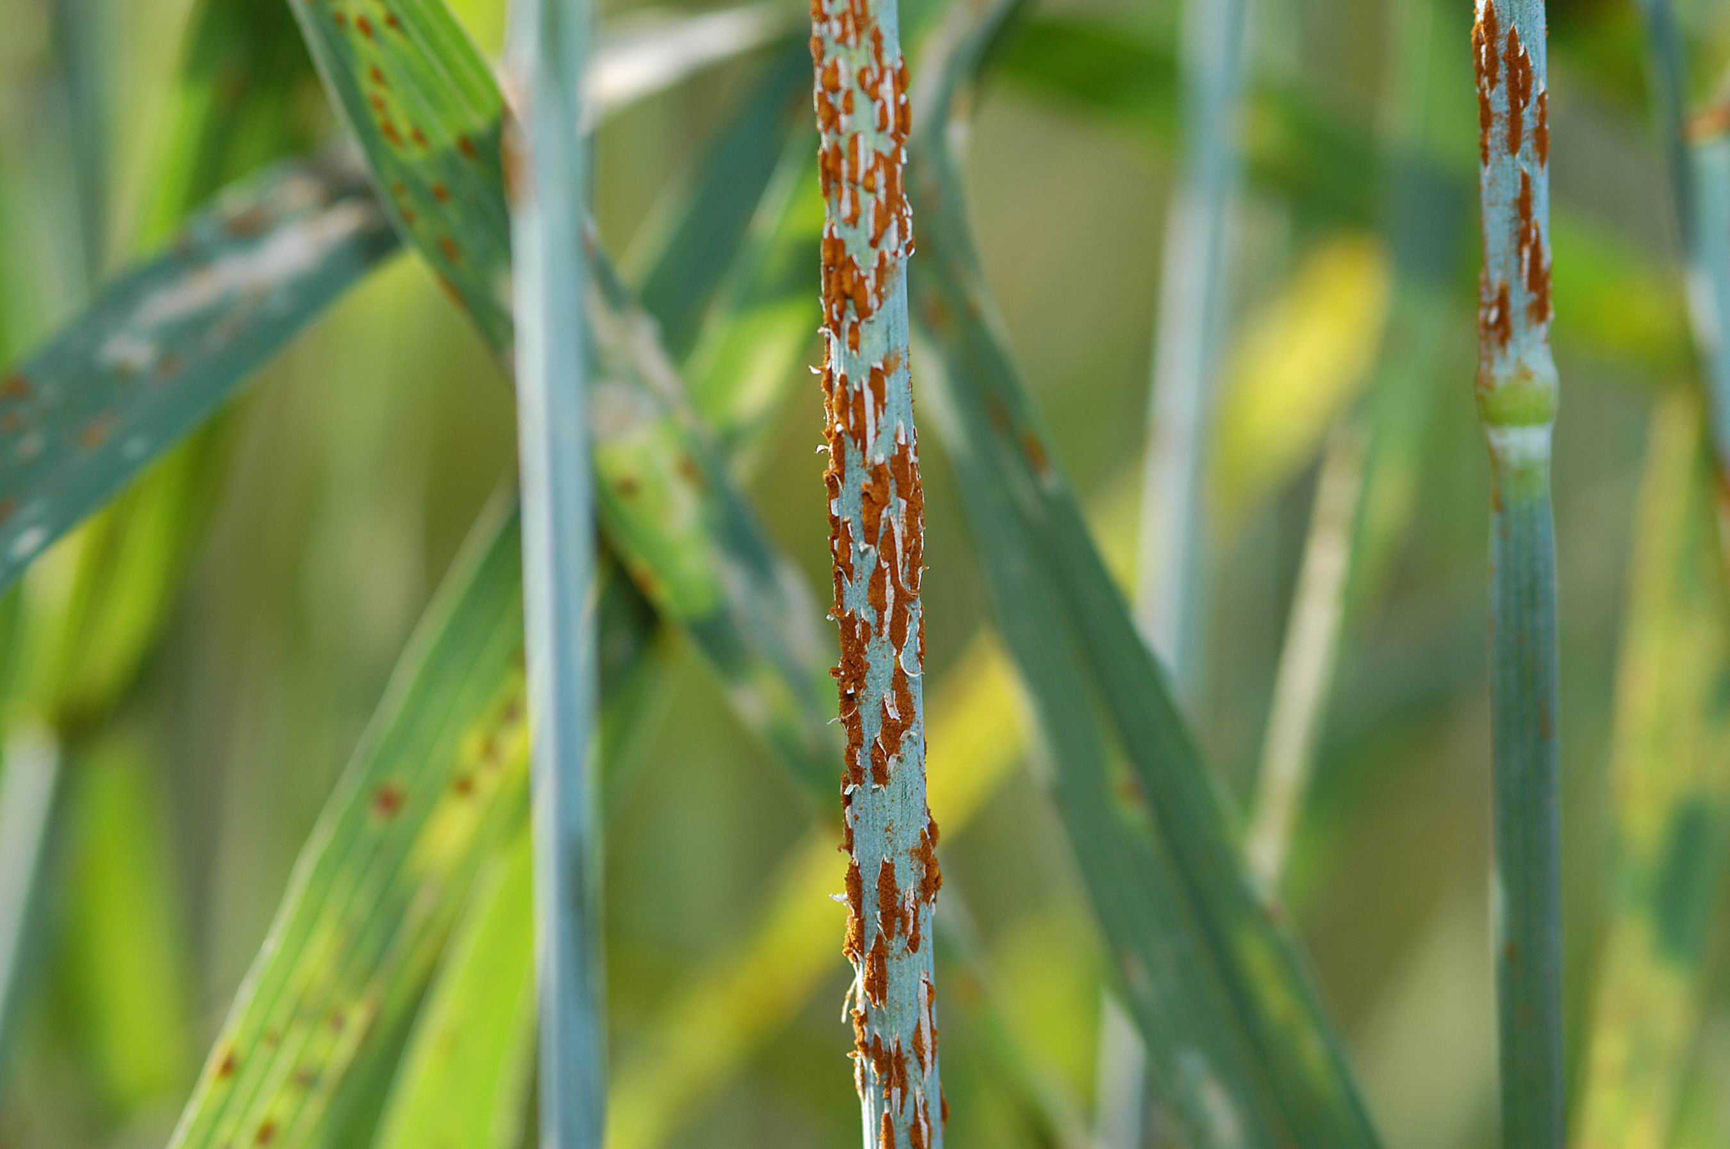
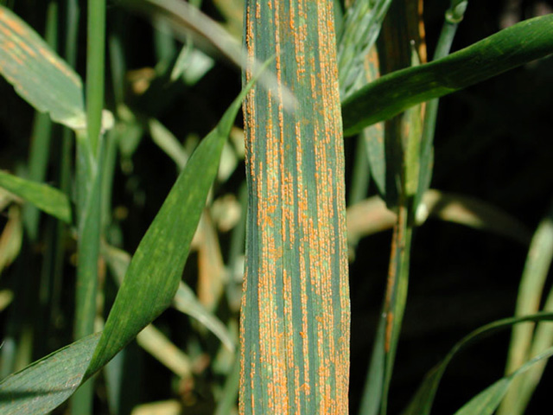
One Crop! 3 Types of Rust
Brown Rust
Black / Stem Rust
Yellow Rust

Slide 8
Can you spot the Odd one out?
🍏 🍏 🍏 🍏 🍎 🍏
Anomaly detection means identifying something that differ from pattern we expect

Slide 9
Why did I Show this?
My Wheat Rust Project
The model learned from healthy leaf images only.
Instead of asking "Is it Yellow/Brown Rust" for each new image, it asked: “Does this leaf look different?”
But lighting, backgrounds and cameras can also cause differences.
Looking Different ≠ Diseased

Slide 10
My Msc Starting Point: Exploring Anomaly Detection
During Masters Project, I explored:
  Isolation Forest
  Autoencoders
My Question:
Could unusual image patterns help identify wheat rust?
The Challenge
Would the model detect disease—or simply differences in appearance?

Slide 11
Why I revisited the evaluation
How the Evaluation Metrics have been calculated?
Some original metric outputs used example labels rather than actual model predictions.
I needed a clearer connection between each image, its true label and the model’s prediction.
This became a priority in my later independent research

Slide 12
Why I revisited the project
Making the connection between actual image and predicted image become priority:
Which Image was evaluated?
What was its correct label?
What prediction the model produced?

Slide 13
Three questions guided my investigation
Evaluation: Were predictions compared with the correct labels?
Generalisation: Would the model work on a different dataset?
Explanations: Which image regions influenced its predictions?

Slide 14
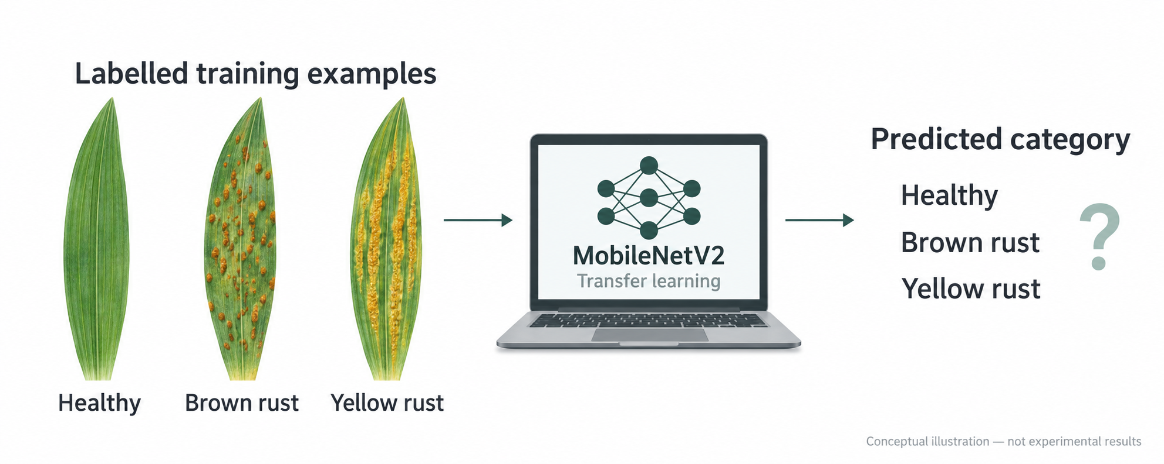
Teaching the model with labelled examples
Each training image had a label:
Healthy · Brown rust · Yellow rust
I used MobileNetV2 with transfer learning to build a classifier for these three categories.
Instead of asking “Is this unusual?”,
the classifier asks
“Which category does this image belong to?”

Slide 15
What is transfer learning?
Start with a pretrained model, then adapt it to a new task.
Pretrained visual features
↓
Training on labelled wheat-leaf images
↓
Three-class prediction
Question: How well the adapted model performs on new images?

Slide 16
Putting the classifier to the test
Internal validation: 737 images
External evaluation: 489 images
Which classes did it confuse?
Evaluation Image
Predicted Label
Compare with dataset label

Slide 17
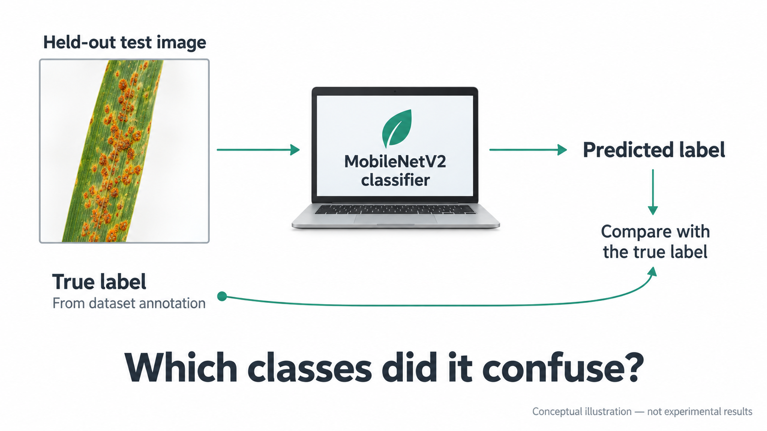
Putting the classifier to the test

Slide 18
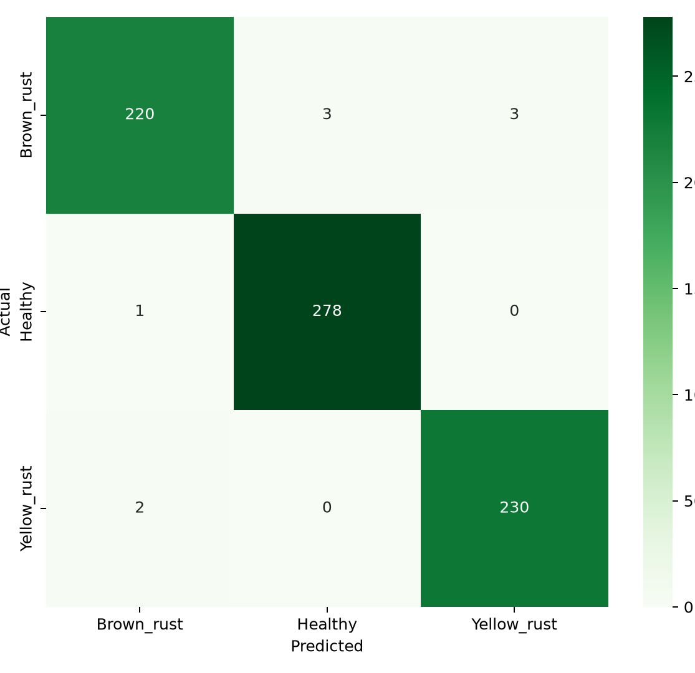
A promising result—but on which data?
98.78%
Internal validation accuracy
728 / 737 images classified correctly
9 misclassifications
Would this performance hold on images from another source?

Slide 19
Which classes did it confuse?
Actual ↓ / Predicted → | Brown rust | Healthy | Yellow rust
Brown rust | 220 | 3 | 3
Healthy | 1 | 278 | 0
Yellow rust | 2 | 0 | 230

Slide 20
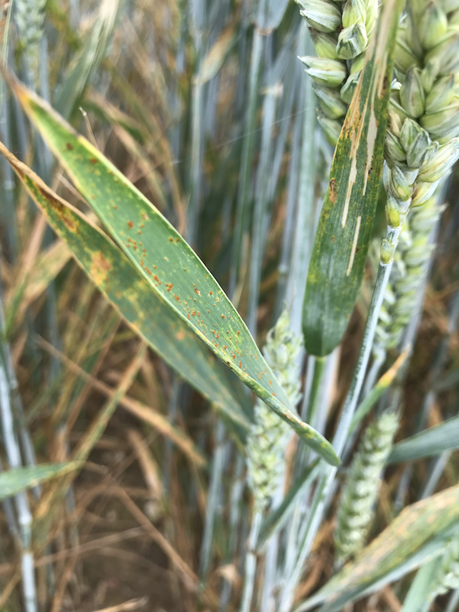
Same disease label. Different photographs.
Both labelled brown rust. Would the model recognize both
Org Validation Dataset
External Dataset

Slide 21
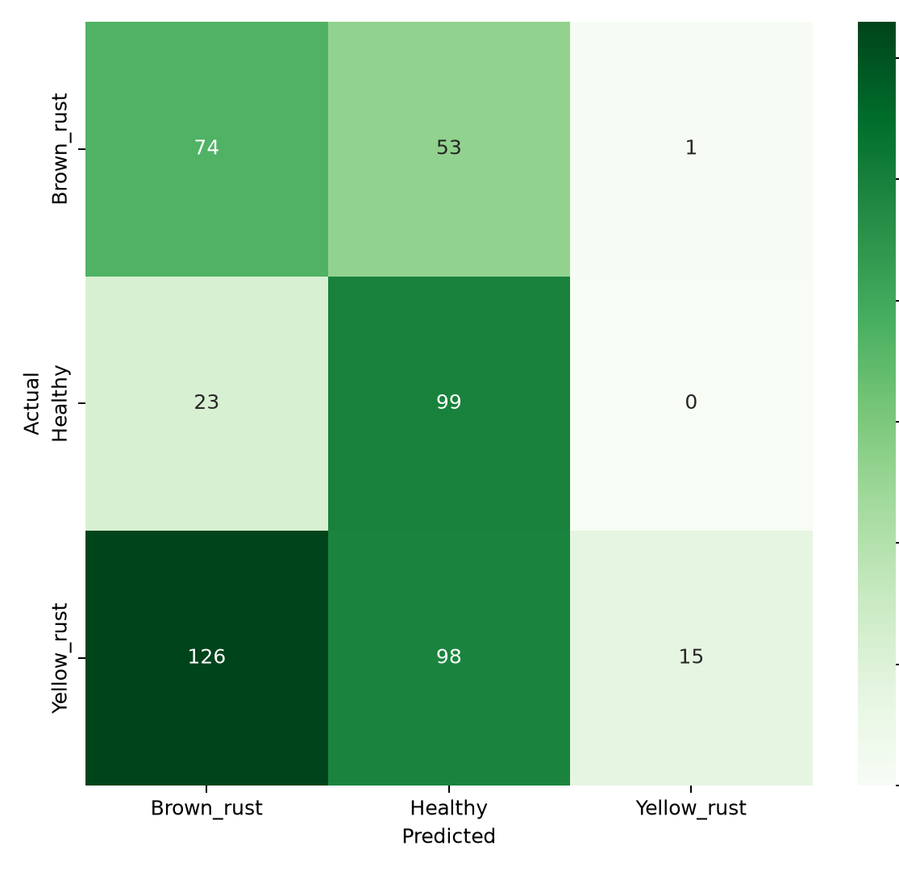
The accuracy did not travel
98.78% - Internal validation
· 737 images
38.45% - External evaluation · 489 images
Only 15 of 239 yellow-rust images were classified correctly.

Slide 22
What changed between the datasets?
Possible differences include:
Lighting and background.
Camera distance and framing.
Disease appearance.
Class proportions and labelling practices.
This comparison shows a performance gap; it does not isolate one cause.

Slide 23
My next question
Does changing the dataset gives me a solution?
I compared models trained with different source mixtures.
Could including images from another source improve performance on that source—and would that improvement transfer elsewhere?

Slide 24
Which sources did I compare?
Original dataset
Healthy, brown rust and yellow rust.
IARI WheatLeafRust
Healthy and brown rust images selected for this study.
Ethiopia subset
Healthy and yellow rust images selected for this study.

Slide 25
How I compared the source mixtures
Include one additional source. Exclude the other.
Condition A: Include IARI; exclude Ethiopia.
Condition B: Include Ethiopia; exclude IARI.
Test both models on separate holdout images from both sources.
Holdout images are images kept aside from training.
Repeat with three random seeds: 42, 43 and 44.

Slide 26
What did I want to find out?
Did adding a source help on new images from that same source?
Did it also help on images from the source excluded from training?
Example: Adding IARI
Improvement on IARI only → suggests a source-specific benefit.
Improvement on IARI and Ethiopia → suggests wider transfer.
Compare improvements against the model trained without the added source.

Slide 27
Source inclusion changed the results
Training Conditions | IARI Evaluation | Ethiopia Evalution
Added IARI; excluded Ethiopia | 75.2–96.1% | 4.9–11.5%
Added Ethiopia; excluded IARI | 2.3–54.3% | 85.2–90.2%
Accuracy ranges across seeds 42, 43 and 44.
Performance was stronger on the included source. Transfer to the excluded source remained weak or variable.

Slide 28
What do these results tell us?
Stronger performance on included sources
Models performed better on sources represented in training.
Limited transfer to excluded sources
Performance remained weak or varied between runs.
Reliable generalization is still unresolved
Adapting to an included source did not establish reliability elsewhere.
Limitation: The selected sources contained different class combinations, so photographic differences alone cannot explain the results.

Slide 29
A confident prediction can still be wrong
Confidence and Correctness are different.
Dataset label: Brown rust
Prediction: Healthy
Model confidence: 99.99%
High confidence does not guarantee a correct prediction.

Slide 30
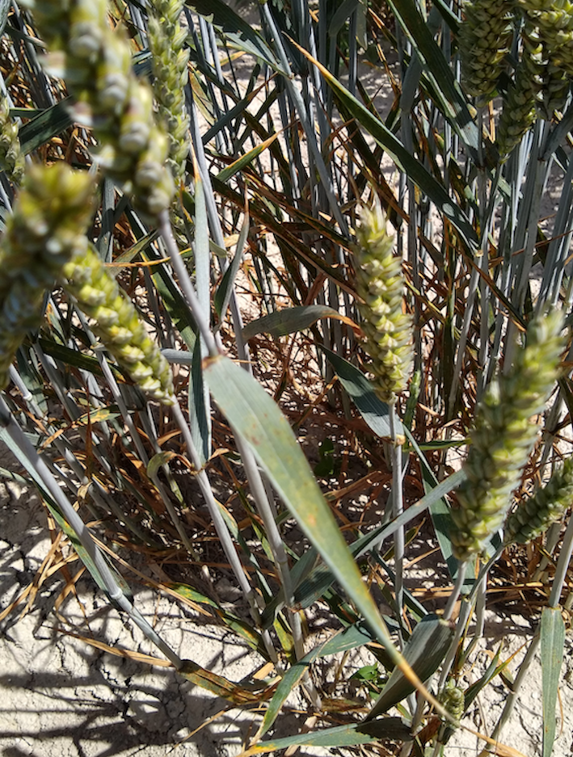
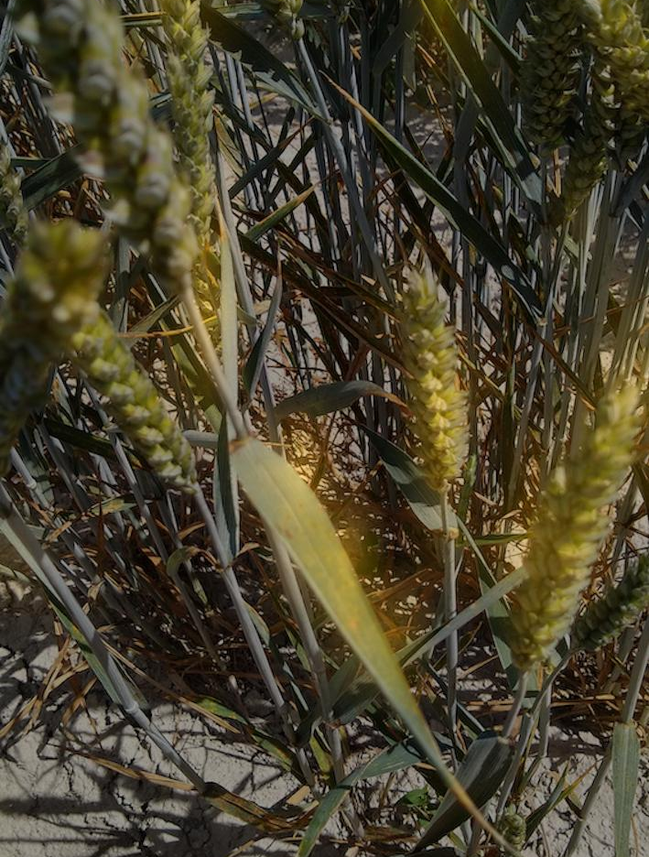
What did the model focus on?
Dataset label: Brown rust
Model prediction: Healthy
Grad-CAM highlights regions associated with a selected class score.
A heatmap can help investigate a prediction. It cannot prove the prediction is correct.
Org Image
GRAD-CAM Overlay

Slide 31
A heatmap is a clue
A highlighted region does not establish that the model learned disease-specific features.
Stronger checks include:
Comparing highlighted regions with expert annotations.
Testing whether masking them changes predictions.
Comparing those changes with random masking.
Explanation also needs evaluation.

Slide 32
Let’s try the research demo
Upload → Predict → Inspect
Would you trust the prediction?
What evidence would you need?
Try the demo:
devanandha-wheat-rust-ai.streamlit.app

Slide 33
What this project taught me
Ask where the score came from
Strong internal validation performance may not carry over to another dataset.
Inspect the failures
Overall accuracy can hide serious weaknesses in individual classes.
Question the explanation
A convincing heatmap does not prove the prediction is correct.
Evaluate beyond the data used for development.

Slide 34
My contribution—and where I’m taking it next
Built
A wheat-rust classifier and interactive research demo.
Investigated
Cross-dataset performance, training-source composition and visual explanations.
Documented
Code, experimental results and failure cases for others to inspect.
Next research priority
More reliable generalization, supported by broader independent evaluation and stronger explanation checks.

Slide 35
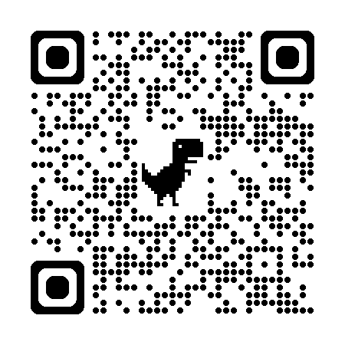
Explore the Research in GitHub
GitHub

Slide 36
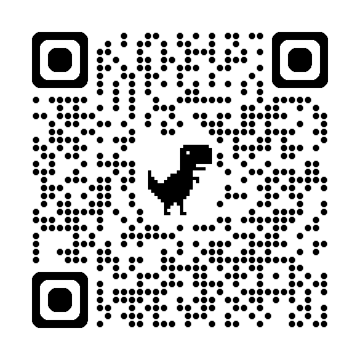
Connect With Me on LinkedIn

Slide 37
Would you trust this model?
98.78% internal validation accuracy
38.45% external evaluation accuracy
What would you investigate first?
A — The data and labels
B — The model
C — The evaluation setup
Questions, challenges and ideas welcome

