Slide 1
Wheat Based Ai Crop Disease Monitoring And Detection
Devanandha Vellaramkuzhiyil Shaji
B00913644
Vellaramkuzhiyil_Shaji-D@ulster.ac.uk

Slide 2
Agenda
Introduction
Background and related work
Aims and Objectives
Methods used and Results
Conclusion and Future works

Slide 3
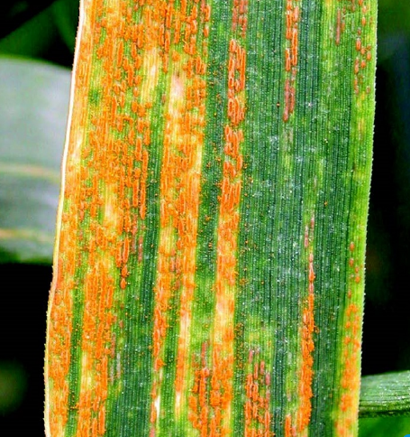
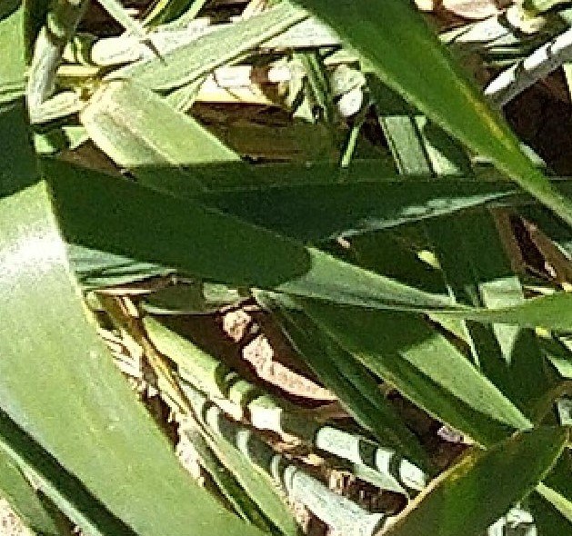
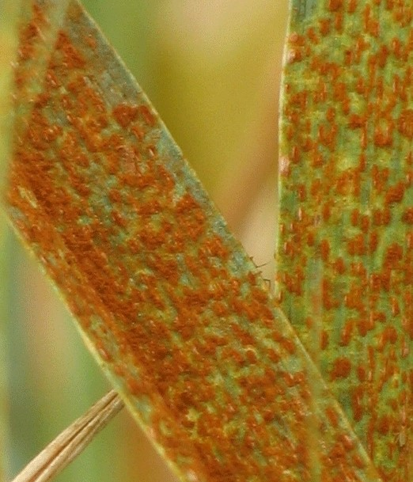
Introduction
What is Wheat Rust?
What are the types of Wheat Rust?
How do we identify them?
fig1
fig2
fig3
Notes:
Notes to presenter:
Description of what you learned in your own words on one side.
Include information about the topic
Details about the topic will also be helpful here.
Tell the story of your learning experience. Just like a story there should always be a beginning, middle and an end.
On the other side, you can add a graphic that provides evidence of what you learned.
Feel free to use more than one slide to reflect upon your process. It also helps to add some video of your process.

Slide 4
Background and related work
Authors | Summary
Antig Guo, Yun Geng, 2021 | Using UAV hyperspectral imagery, wheat yellow rust was observed at field level. Various characteristics such as TFs, Vis and combining them to create PLSR monitoring models for wheat yellow rust during advance, mid and final phases of infection
Shivani sood, Harjeet Singh, 2020 | Two transfer learning strategies have been studied in the development and evaluation of deep learning models for wheat rust identification. ResNet50, VGG16 were used. Vgg16 produced better results than ResNet50 with an accuracy of 99.07% obtained with 50 epochs with adam optimiser, 32 batch size
Guo et al., ‘Wheat yellow rust detection using UAV-based hyperspectral technology’, Remote Sens. (Basel), vol. 13, no. 1, p. 123, 2021
S. Sood and H. Singh, ‘An implementation and analysis of deep learning models for the detection of wheat rust disease’, in 2020 3rd International Conference on Intelligent Sustainable Systems (ICISS), 2020, pp. 341–347.

Slide 5
Aims and Objectives
To find unusual patterns or deviations from normal condition of crop by anomaly detection algorithm.
Examine crop photos for anomalies that deviate from conventional disease indicators like pustules, lesions or discolouration as these could be signs of an infection.
Identify and classify wheat rust infection cases precisely and accurately using crop photos.
Bounding boxes representing the many varieties of wheat rust illness should be places around areas of interest.

Slide 6
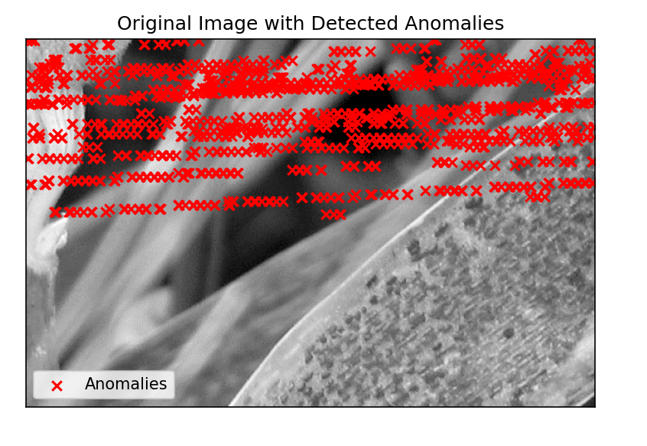
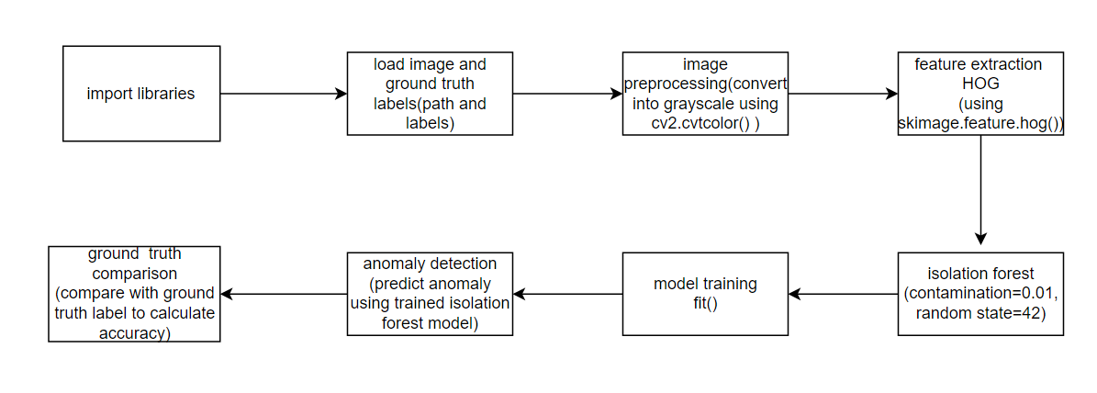
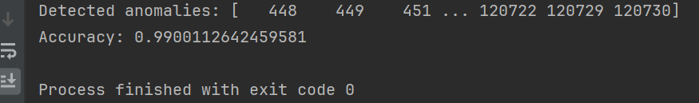
Methods Used And Results
To find unusual patterns or deviations from normal condition of crop by anomaly detection algorithm

Slide 7
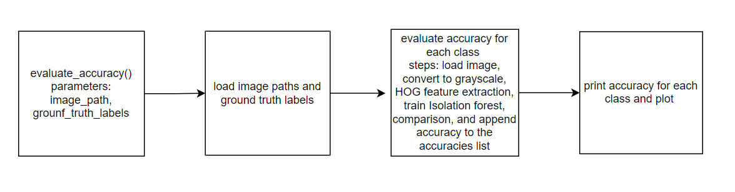
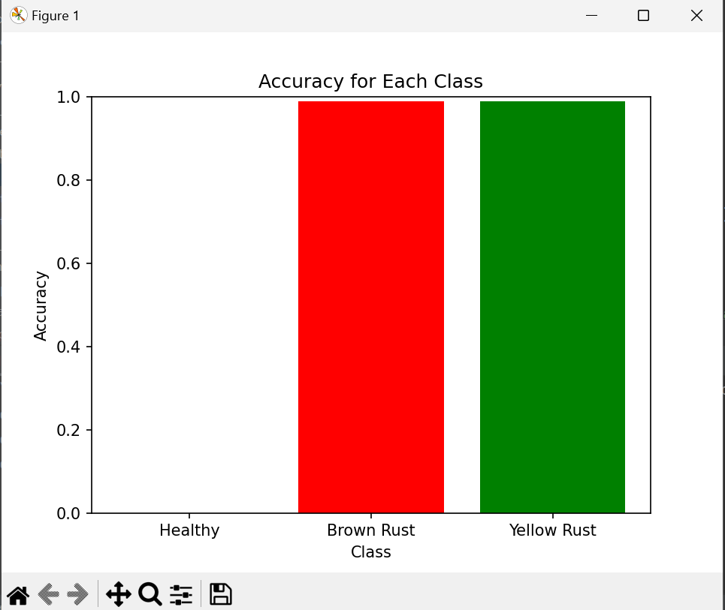
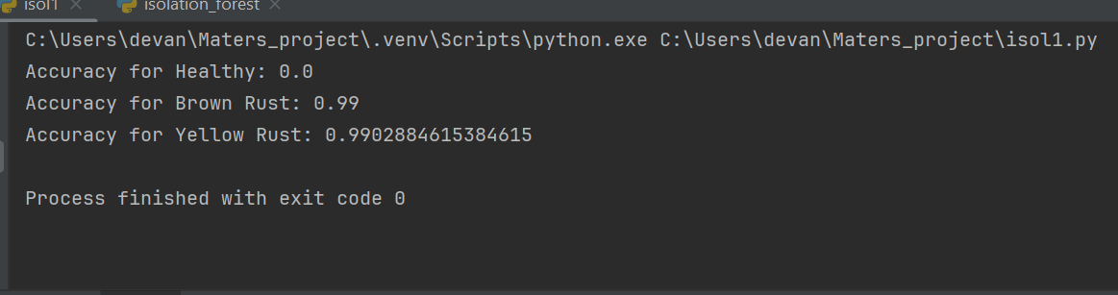
Methods used And Results

Slide 8
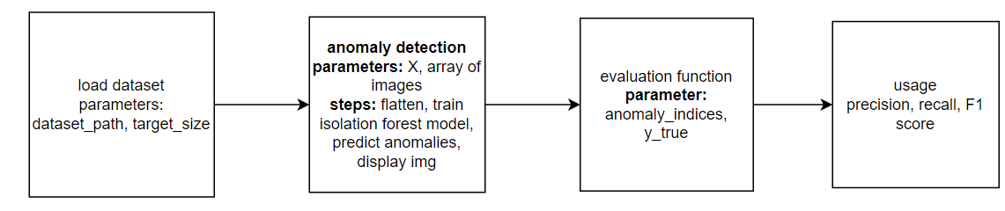
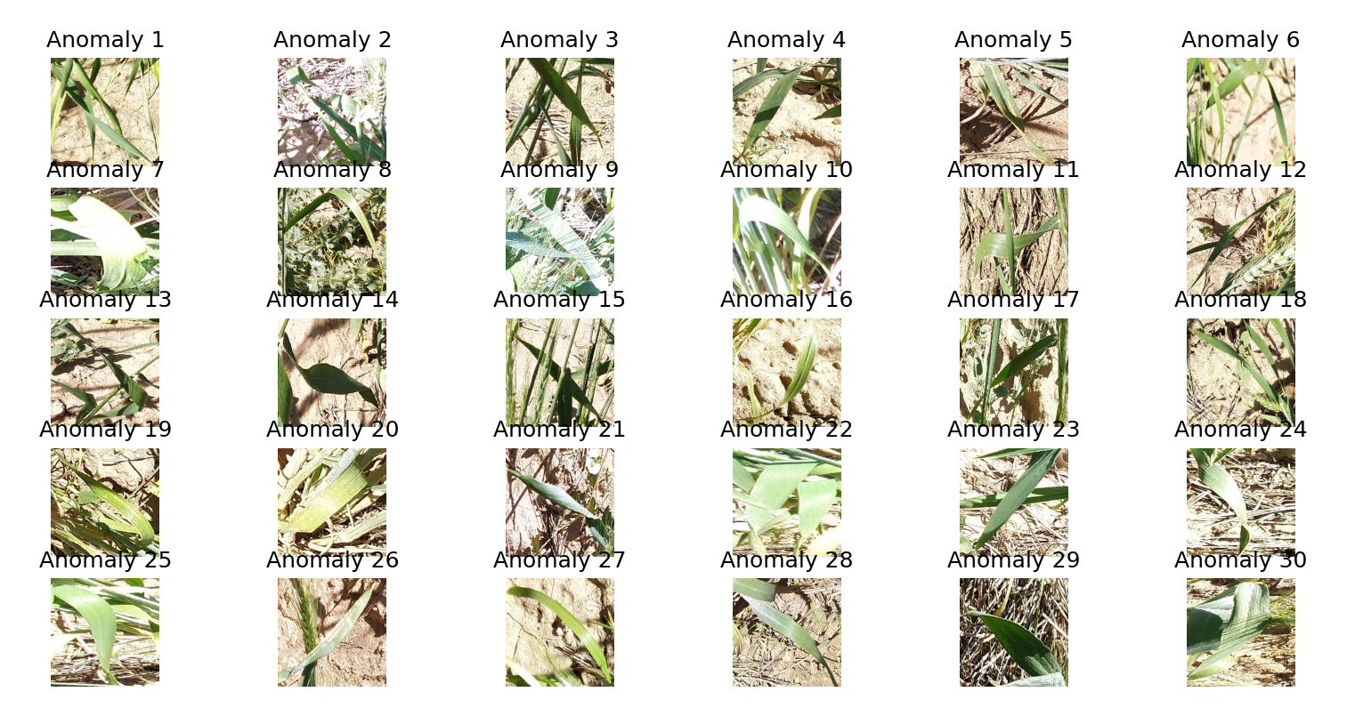
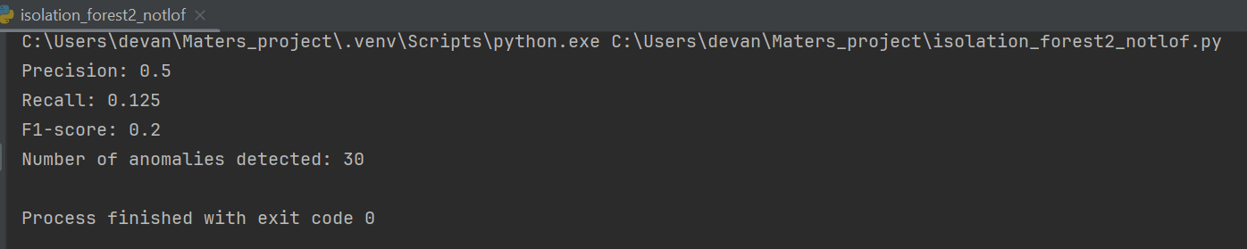
Methods Used And Results
Examine crop photos for anomalies that deviate from conventional disease indicators like pustules, lesions or discolouration as these could be signs of an infection.

Slide 9
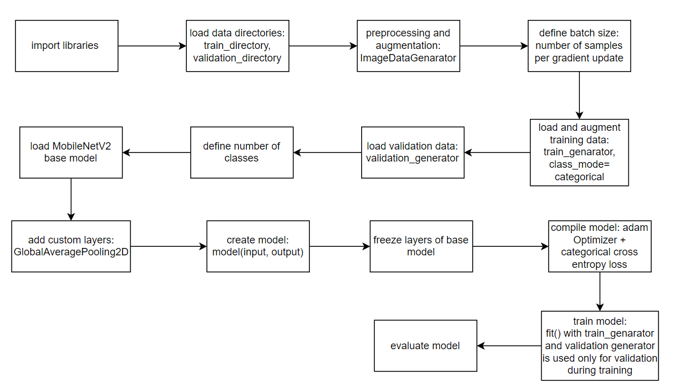
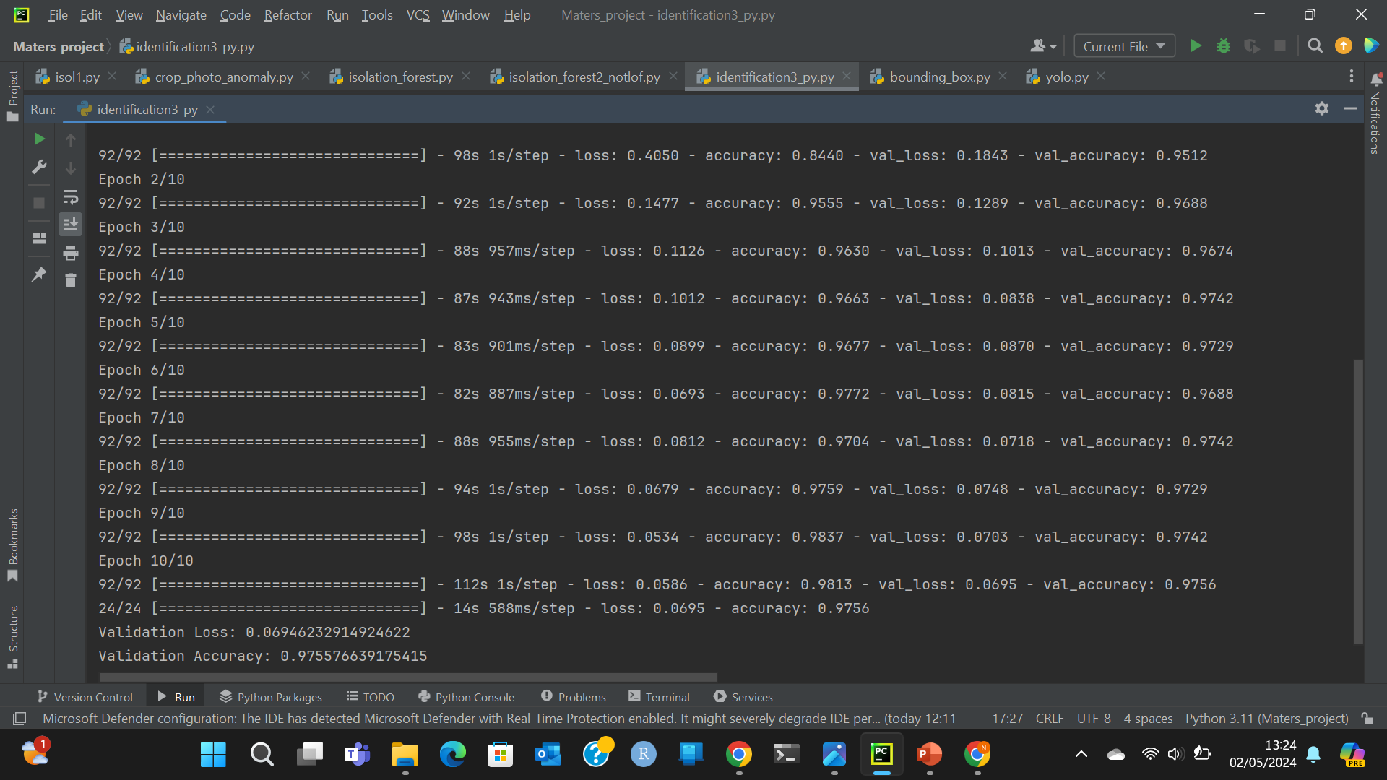
Methods Used And Results
Identify and classify wheat rust infection cases precisely and accurately using crop photos.

Slide 10
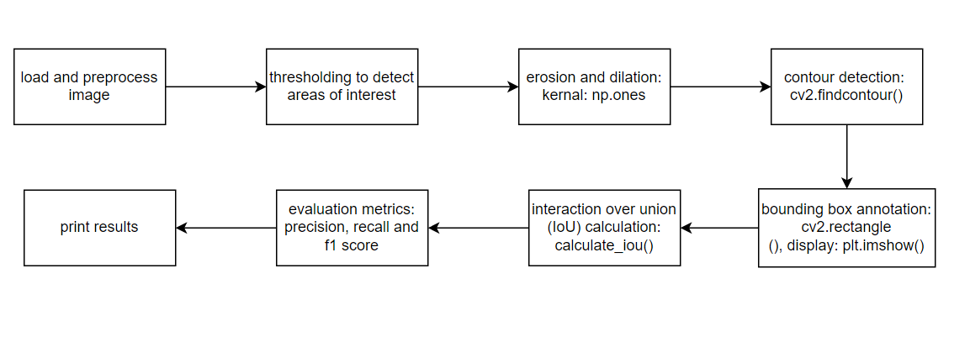
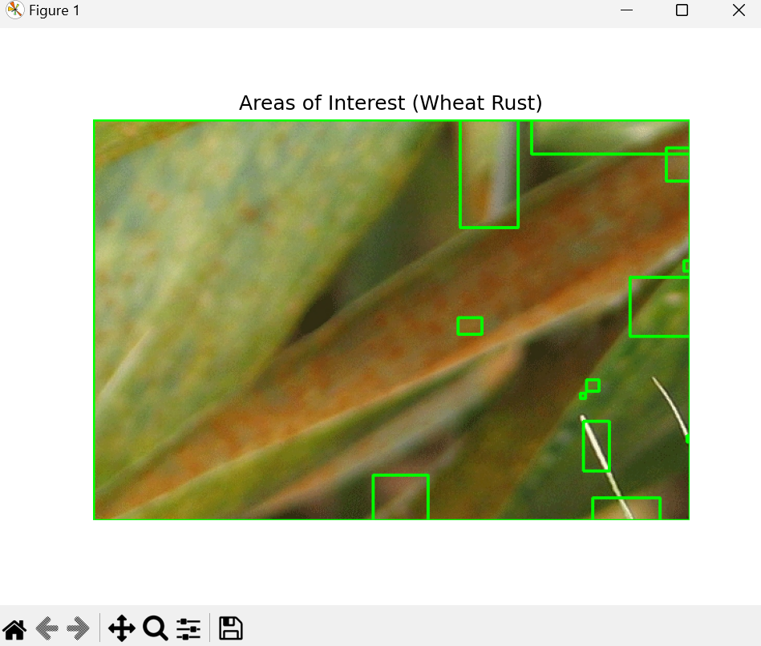
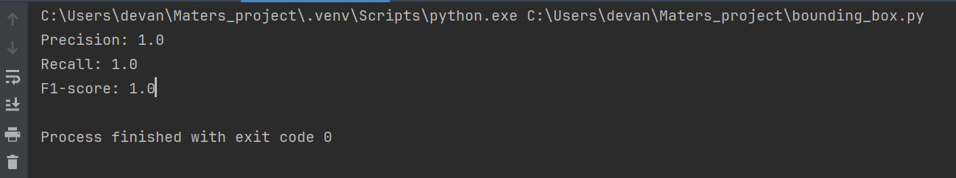
Methods used And Results
Bounding boxes representing the many varieties of wheat rust illness should be places around areas of interest.

Slide 11
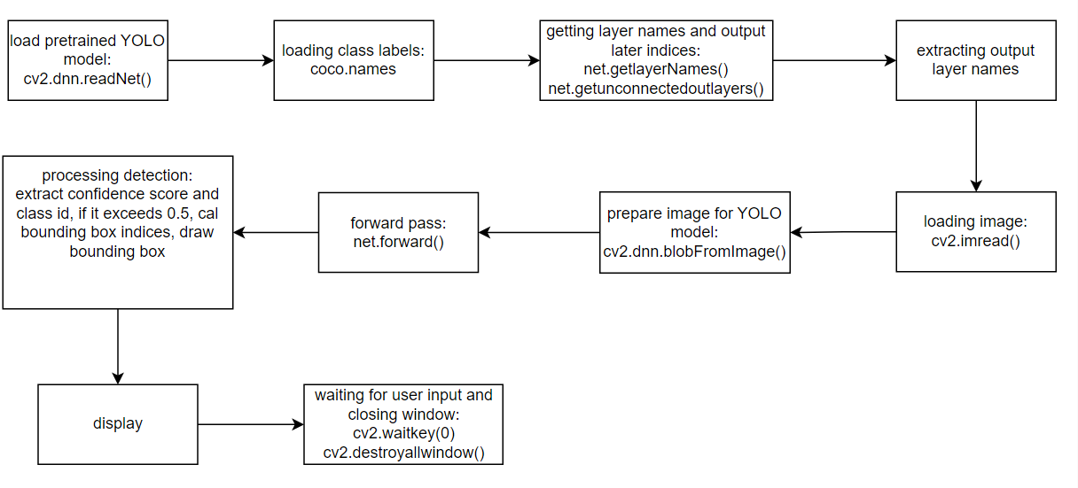
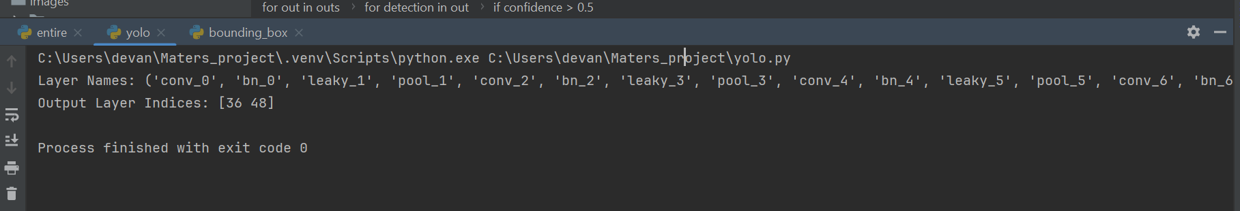
Methods used And Results
Implementing yolov3 on the above code:
Yolov3.weights
Yolov3_tiny.cfg
Coco.names

Slide 12
Conclusion and future work
In conclusion,
the development of methods for monitoring and detecting wheat rust disease is crucial for agricultural management and food security. Early detection and monitoring are essential for timely intervention and mitigation of crop losses.
Use of computer vision techniques, ML algorithms and deep learning has been very significant In this field.
Challenges remain in accurately detecting and monitoring wheat rust disease. Change in climatic conditions, disease manifestation and image quality can affect the performance of automated detection system. The availability of labelled data for model training and validation is often limited.
Future works:
Enhanced models : exploring advanced deep learning architecture, transfer learning
Data collection: diverse and representative dataset with different wheat varieties, growth stages and much more.
Integration with decision support system: it helps in actionable recommendations for disease management , crop protection strategies.

Slide 13
Questions?

