Slide 1
COVID-19 Data Analysis
Python, Pandas, Matplotlib Project

Slide 2
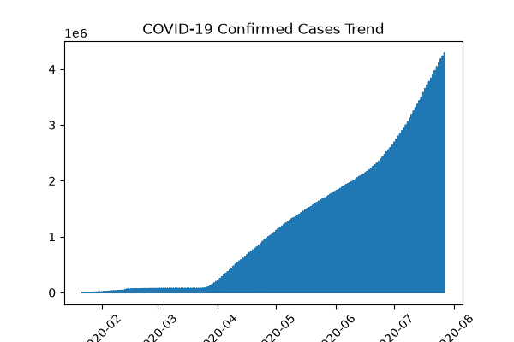
Confirmed Cases Trend

Slide 3
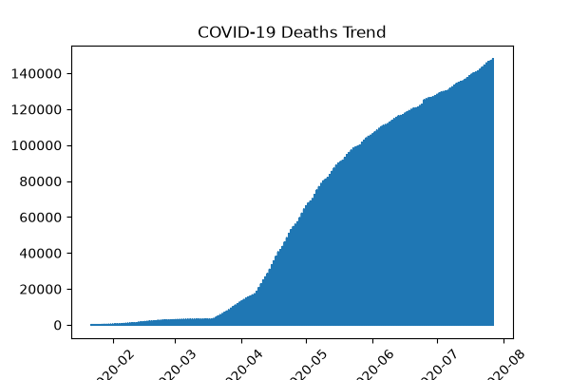
Deaths Trend

Slide 4
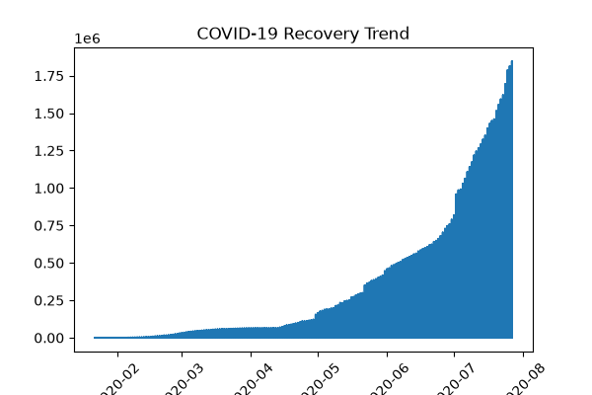
Recovery Trend

Slide 5
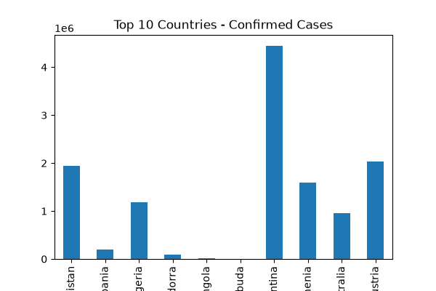
Country Comparison

