Slide 1
Source_Code
# Program to find the Minimum and Maximum values in a list
# Corrected version of the given code
def min_max(arr):
# Check if the list is empty
if len(arr) == 0:
return None
# Initialize minimum and maximum with the first element
mn = arr[0]
mx = arr[0]
# Traverse the remaining elements
for x in arr[1:]:
# Update minimum if a smaller element is found
if x < mn:
mn = x
# Update maximum if a larger element is found
if x > mx:
mx = x
minimum, maximum = min_max(arr)

Slide 2
Time Complexity
Best Case: O(n)
Average Case: O(n)
Worst Case: O(n)
The algorithm scans the array only once, making it a brute-force linear scan.
Space Complexity
O(1) (Constant extra space)
Conclusion
The corrected program properly tracks both the minimum and maximum values by:
Updating the minimum only when a smaller element is encountered.
Updating the maximum only when a larger element is encountered.
The solution is efficient, readable, and maintains the original brute-force linear scan approach.

Slide 3
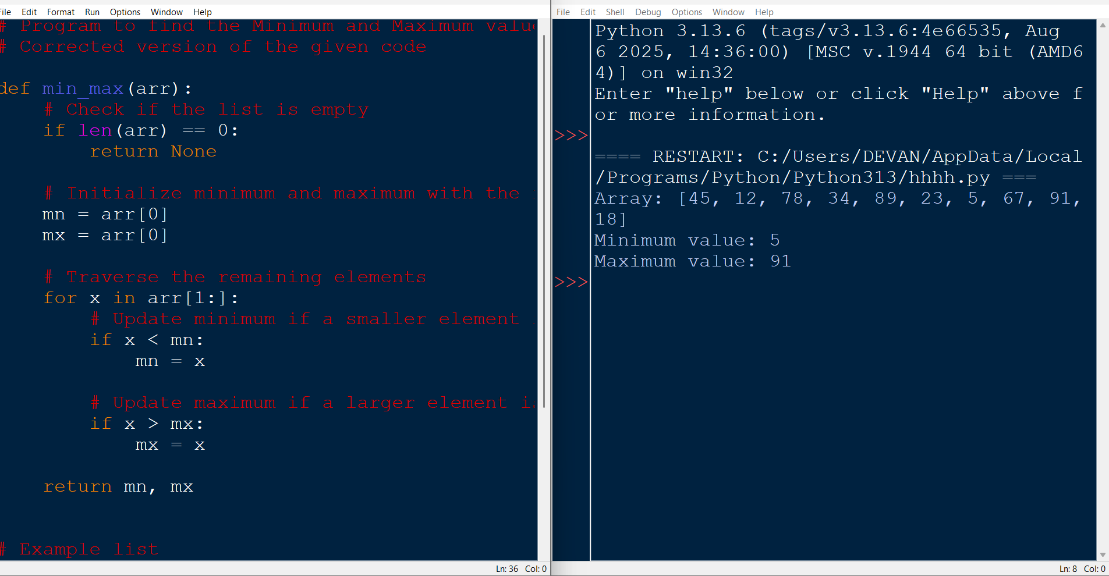
output

