Slide 1
Source_Code
# Binary Search Program
marks = [25, 32, 38, 45, 50, 56, 60, 67, 72, 80, 85, 90, 95]
def binary_search(arr, key):
low = 0
high = len(arr) - 1
while low <= high:
mid = (low + high) // 2
if arr[mid] == key:
return mid
elif arr[mid] < key:
low = mid + 1
else:
high = mid - 1
return -1
key = int(input("Enter the mark to search: "))
result = binary_search(marks, key)
if result != -1:
print(f"Mark {key} found at index {result}.")
else:
print("Mark not found.")
data.")

Slide 2
Title
Binary Search on Student Marks
Aim
To implement Binary Search on a sorted dataset of student marks and analyze its performance.
Problem Statement
A dataset of student marks is stored in sorted order. The system frequently searches for a specific mark using Binary Search. However, new records are inserted randomly, disturbing the sorted order.
Algorithm
Store marks in sorted order.
Read the mark to search.
Calculate the middle index.
Compare the middle element with the search key.
Search the left or right half accordingly.
Repeat until found or search space becomes empty.
Display the result.
Insert a new mark randomly and observe that the list is no longer sorted.

Slide 3
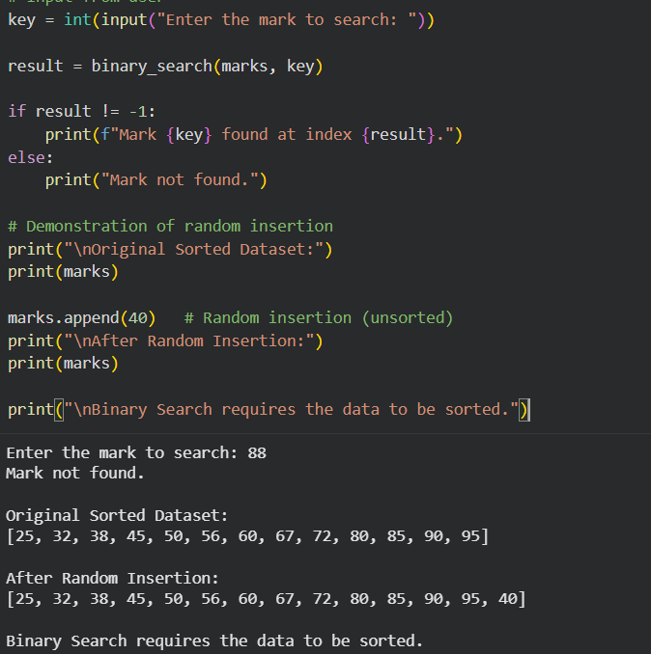
output

