Slide 1
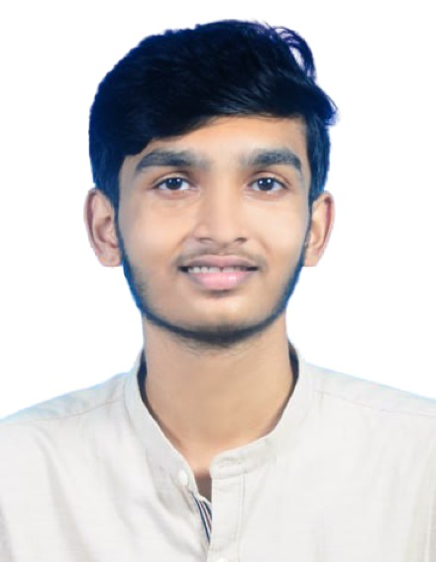
Name: Devanarayanan TM
UST Role: Junior SRE
Location: Trivandrum
Family: Parents and Brother
Total Work Experience: NA
College Project:
1) Faculty Management System
2) Pothole Detection Using Federated Learning
Technology courses attended: NA
Professional Certificates : Azure Administrator Associate
Professional skill set: Git, Jenkins, Ansible, Kubernetes, Terraform, Docker, Shell Scripting, C, Python, SQL
Have your Picture here

Slide 2
Hobbies: Dancing, Kathakali
Interest: Travelling, Solving Problems

