Slide 1
Exploring Explainable AI in Cybersecurity Using the Kairos Dataset
-Tejas Mhadgut
This Project Addresses Enhancing Model Transparency for Improved Intrusion Detection and Attack Investigation
GROUP 3

Slide 2



X
X
Embed Graphs
Create Database
Prepare
Train
Test ?
Evaluation ?
Anomalous Queue ?
Attack Investigation ?
ENVIRONMENT SETUP!

Slide 3
Contributions!
Hierarchical XAI for Kairos
TGNN-Explainer Feature Importance
GROUP 3

Slide 4
X
X
Graph clustering with graph neural networks.[A. Tsitsulin, J. Palowitch, B. Perozzi, and E. Müller]
Unveiling Molecular Moieties through Hierarchical Graph Explainability.[P. Sortino, S. Contino, U. Perricone, and R. Pirrone]
Believe the HiPe: Hierarchical perturbation for fast, robust, and model-agnostic saliency mapping.[J. Cooper, O. Arandjelovic, and D. J. Harrison]
Everybody needs a little help: Explaining graphs via hierarchical concepts.[Under Review]
Explaining Temporal Graph Models through an Explorer-Navigator Framework.[W. Xia, M. Lai, C. Shan, Y. Zhang, X. Dai, X. Li, and D. Li]
Explainability Methods for Graph Convolutional Neural Networks.[P. E. Pope, S. Kolouri, M. Rostami, C. E. Martin, and H. Hoffmann]
LITERATURE REVIEW

Slide 5
PAPER REVIEW: Graph clustering with graph neural networks
OBJECTIVE: Introduction of DMoN (Deep Modularity Networks), a novel GNN-based graph clustering approach.
01
Addresses limitations of existing GNN pooling methods for graph clustering.
04
Incorporates a null model to prevent collapse and ensure meaningful clustering.
02
Directly optimizes modularity, a metric measuring the strength of a graph’s division into clusters.
05
Relevant for Further Research into Hierarchical XAI.
03
Resolves cluster collapse, where all nodes are assigned to one cluster.

Slide 6
PAPER REVIEW: Believe the HiPe – Hierarchical Perturbation for Saliency Mapping
OBJECTIVE: Introduces HiPe, a model-agnostic technique for saliency mapping in AI models.
01
Primarily used to explain predictions in image classification tasks using Perturbations.
04
Captures salient features across scales, from coarse to fine-grained details.
02
Starts with large overlapping regions, observes their effect on model predictions.
05
Offers insights for applying hierarchical methods in understanding model decisions in cybersecurity contexts.
03
Refines by subdividing into smaller regions for detailed analysis.

Slide 7
PAPER REVIEW: Everybody Needs a Little HELP – Explaining Graphs via Hierarchical Concepts
OBJECTIVE: HELP method provides explanations for how graph-based AI models (GNNs) make decisions.
01
Analyzes patterns in node behavior after applying GNN layers.
04
Reveals how simpler components form complex structures step by step..
02
Groups similar nodes into clusters.
05
Enhances understanding of model decision-making at multiple levels.
03
Merges connected nodes in a cluster into “super-nodes”, calculating their properties by averaging.

Slide 8
Challenges for Hierarchical XAI in Cybersec
Limited availability of hierarchical XAI Research Papers, especially for GNNs.
Existing work predominantly focuses on image datasets.
Many relevant papers are still under review, restricting established resources.
GROUP 3

Slide 9
Potential Approach : Adapting HiPe for Hierarchical Perturbation on Kairos
PROPOSED METHOD: Apply hierarchical perturbation to the provenance graph in Kairos..
01
Edge Removal: Simulate absence of specific events by selectively removing edges to evaluate their importance in anomaly detection or model performance.
02
Node Removal: Simulate absence of entities by removing nodes, highlighting their overall contribution.
03
Timestamp Modification: Assess model sensitivity to event timing by altering timestamps.
04
Hierarchical Integration: Group these perturbations into a hierarchical framework to create an explainable hierarchy.

Slide 10
TGNN-Explainer
OBJECTIVE: Explain predictions made by Temporal Graph Neural Networks (TGNNs) in dynamic graphs, focusing on the temporal dependencies of events.
01
Explorer: Uses Monte Carlo Tree Search (MCTS) to identify event combinations contributing to predictions.
02
Navigator:A pre-trained feed-forward network that guides the Explorer by predicting important events, reducing the search space.
03
Navigator Inputs: Node Representations, Edge features, and Temporal Features.
04
Provides Instance level Explanations.
05
Evaluation Metrics is Fidelity and Sparsity.

Slide 11
Research Contribution
OBJECTIVE: Introducing Hierarchical Explainability by performing individual event importance.
01
Select candidate events (based on temporal and spatial proximity, max 25).
02
Use Monte Carlo Tree Search (MCTS) to evaluate event subsets (coalitions).
03
Compute feature importance from high-fidelity coalitions.
04
The final importance score for each candidate event is based on how often it appears in the coalitions with the highest rewards, indicating its significant contribution to the model’s decision-making process.
05
This approach allows for a detailed and nuanced understanding of the factors that most influence the model's predictions, providing a more interpretable explanation.

Slide 12
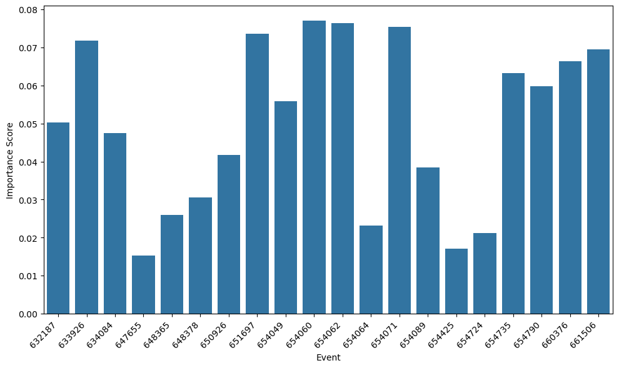
Result
Above figure displays key events influencing a TGN’s edge prediction.
Provides granular insights into the model’s decision-making process.

Slide 13
Significance
01
Debugging models and identifying biases: If the explainer highlights unexpected events as highly influential, it could point to potential biases or issues in the training data or model architecture.
02
Enhancing trust and transparency in predictions: Being able to explain predictions in a clear, visual way can increase trust in the TGN's output, particularly in high-stakes applications.
03
Supporting high-stakes decision-making: By understanding which past events are deemed most important, we gain insights into the patterns and relationships the TGN has learned.

Slide 14
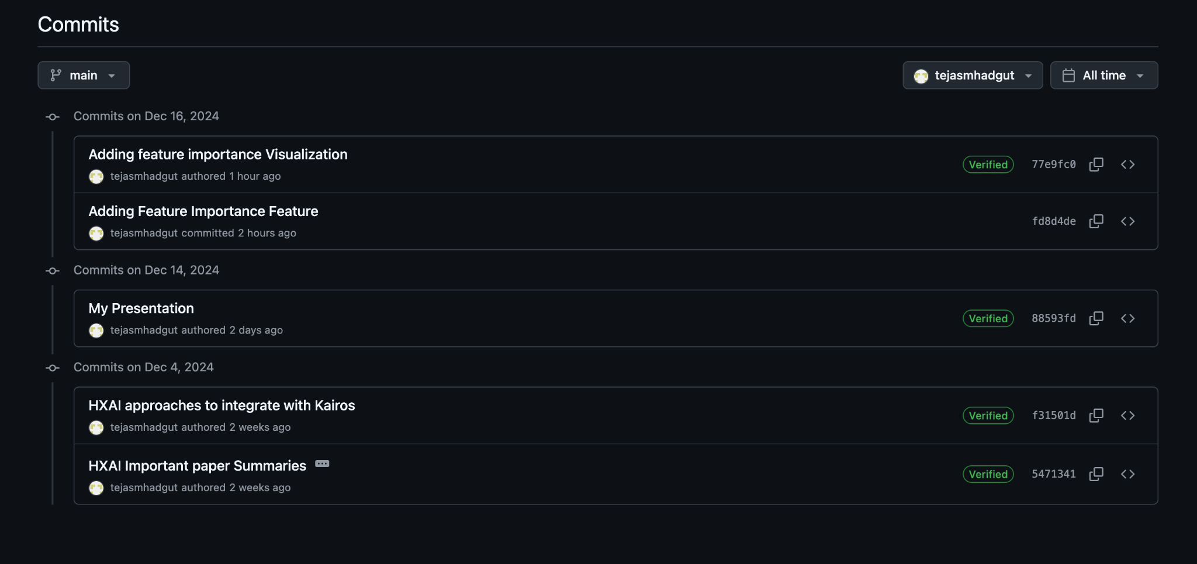
Commits

Slide 15
THANK YOU TEAM!

