Slide 1
Contents
Introduction
Motivation
Problem Statement
Objectives
Scope
Review of Existing Literature
Proposed System
Block diagram of Proposed System

Slide 2
Introduction
Retinopathy, a condition that affects the retina and can lead to vision impairment or blindness, is commonly associated with diseases such as diabetes and hypertension. Early detection is critical to prevent progression and irreversible damage.
In recent years, deep learning has emerged as a powerful tool in medical imaging, offering promising results in automating the detection of retinopathy.
This project explores the application of deep learning techniques, such as convolutional neural networks (CNNs), for the accurate identification and classification of retinopathy from retinal images.
This project focuses on applying CNNs to detect and classify retinopathy from fundus images, aiming to achieve diagnostic accuracy comparable to experts while reducing processing times and healthcare burdens.
By leveraging advanced image processing and classification techniques, the system can support clinical decision-making, enabling deployment in telemedicine, community health centers, and mobile devices.
Ultimately, this technology can improve early detection, reduce the risk of blindness, and enhance patient outcomes through timely interventions.

Slide 3
Introduction
Motivation
Retinopathy, especially diabetic retinopathy, is one of the leading causes of blindness worldwide. According to the World Health Organization, approximately 463 million people suffer from diabetes globally, with over one-third developing some form of diabetic retinopathy.
In India, the prevalence of diabetes is on the rise, with about 77 million people diagnosed in 2020. This has led to an alarming increase in cases of diabetic retinopathy, making early detection critical. However, due to a lack of specialized eye care infrastructure, especially in rural areas, many cases remain undiagnosed or untreated until the condition has progressed.
Deep learning offers an efficient way to detect retinopathy automatically, helping prevent blindness by ensuring early diagnosis and treatment.

Slide 4
Introduction
Problem Statement
Retinopathy, particularly diabetic retinopathy, is a growing concern due to its impact on vision, potentially leading to blindness if not detected early.
Many patients, especially in rural and underserved areas, lack access to timely diagnosis, resulting in late-stage detection when treatment options are limited.
This study aims to develop a deep learning model to accurately detect retinopathy from retinal images, enabling early diagnosis and reducing the risk of blindness.

Slide 5
Introduction
Objectives
To develop a deep learning model for automatic detection of retinopathy from retinal images.
To enhance the accuracy and efficiency of diagnosis compared to traditional manual methods.
To ensure early detection of retinopathy, enabling timely medical intervention and reducing the risk of vision loss.
To provide a solution that can be easily deployed in remote and underserved areas where specialized eye care is limited.

Slide 6
Introduction
Scope
Deep learning has revolutionized many aspects of medical diagnosis, offering faster and more accurate solutions. By leveraging deep learning techniques, this project aims to address the growing issue of retinopathy.
For years, the increasing number of undiagnosed cases of diabetic retinopathy has led to a rise in preventable blindness, primarily due to delayed detection. This project will focus on developing a deep learning model that can automatically analyze retinal images, detect retinopathy at an early stage, and assist healthcare professionals in making quicker, more accurate diagnoses.

Slide 7
Review of Existing Literature
Sr. No. | Author Names | Title of the Project | Technologies Used | Conclusion | Research Gap
1 | Dr. R. Hemalatha, Dr. V. Anjanadevi, J. Naren, Dr. G. Vithya | A Detailed Study on Diagnosis and Prediction of Diabetic Retinopathy Using Current Machine Learning and Deep Learning Techniques | Machine Learning, Deep Learning, CNN, SVM | Evaluated various methods, CNN showed 95% sensitivity, 75% accuracy | Need for cheaper, robust, and error-free tools
2 | Anju Mishra, Dr. Laxman Singh, Dr. Mrinal Pandey | Short Survey on Machine Learning Techniques for Diabetic Retinopathy Detection | Machine Learning, Retinal Fundus Image Processing, SVM, KNN, CNN | Machine learning techniques improve early diagnosis of diabetic retinopathy using fundus images. | Further improvement needed in achieving higher sensitivity and specificity across diverse datasets.
3 | Suwarna Gothane, K. Srujan Raju, Nuthanakanti Bhaskar, G. Divya | Diabetic Retinopathy Detection Using Deep Learning | Deep Learning, ResNet Architecture | Achieved 82% accuracy in classifying fundus images into 5 categories of Diabetic Retinopathy. | Further improvement needed in achieving higher sensitivity and specificity across diverse datasets.
4 | Shyamala Subramanian, Sashikala Mishra, Shruti Patil, Kailash Shaw, Ebrahim Aghajari | Machine Learning Styles for Diabetic Retinopathy Detection: A Review and Bibliometric Analysis | Machine Learning, Deep Learning, CNN, SVM, Random Forest | Machine learning methods, especially CNNs, have shown potential in improving detection accuracy. | Need for better image datasets with more diversity and annotations for effective model training.
5 | Mohamed Chetoui, Moulay A. Akhloufi, Mustapha Kardouchi | Diabetic Retinopathy Detection Using Machine Learning and Texture Features | SVM, LTP, LESH, LBP, MESSIDOR dataset, Gabor Filters | LESH with SVM-RBF was the best-performing technique with 90.4% accuracy and an AUC of 0.931. | Small dataset, lack of exploration into deep learning techniques with small datasets
7

Slide 8
Review of Existing Literature
Sr. No. | Author Names | Title of the Project | Technologies Used | Conclusion | Research Gap
6 | Israa Odeh, Mouhammd Alkasassbeh, Mohammad Alauthman | Diabetic Retinopathy Detection using Ensemble Machine Learning | Ensemble Learning, Random Forest, Neural Networks, SVM, MESSIDOR dataset | The proposed ensemble model achieved higher accuracy (75.1%) compared to single classifiers, especially using InfoGain top 5 features. | Limited dataset, no feature extraction or image analysis performed in this study
7 | Revathy R, Nithya B S, Reshma J J, Ragendhu S S, Sumithra M D | Diabetic Retinopathy Detection using Machine Learning | SVM, KNN, Random Forest, Logistic Regression, Multilayer Perceptron | The hybrid classifier approach achieved 82% accuracy, with precision of 0.8119 and recall of 0.8116. | Lack of comparison with deep learning models for higher accuracy and image feature extraction methods
8 | Kanika Verma, Prakash Deep, A. G. Ramakrishnan | Detection and Classification of Diabetic Retinopathy using Retinal Images | Random Forest, Density Analysis, Bounding Box Techniques, Fundal Camera | The proposed method achieved 90% accuracy for normal cases and 87.5% accuracy for moderate and severe NPDR cases. | Limited exploration of advanced deep learning techniques for improved detection accuracy
9 | Revathy R, Nithya B S, Reshma J J, Ragendhu S S, Sumithra M D | Diabetic Retinopathy Detection using Machine Learning | Hybrid Classifier (SVM, KNN, Random Forest, Logistic Regression, Multilayer Perceptron) | The hybrid classifier approach achieved an accuracy of 82%, precision of 0.8119, recall of 0.8116, and F-measure of 0.8028. | Limited dataset and no exploration of advanced deep learning techniques for improved classification
10 | Dolly Das, Saroj Kr. Biswas, Sivaji Bandyopadhyay | A critical review on diagnosis of diabetic retinopathy using machine learning and deep learning | Machine Learning, Deep Learning, Feature Extraction, Retinal Imaging | Machine learning models struggle with smaller datasets, while deep learning shows promise with larger datasets for DR detection. | Deep learning models need further exploration for small datasets and efficient data processing techniques
8

Slide 9
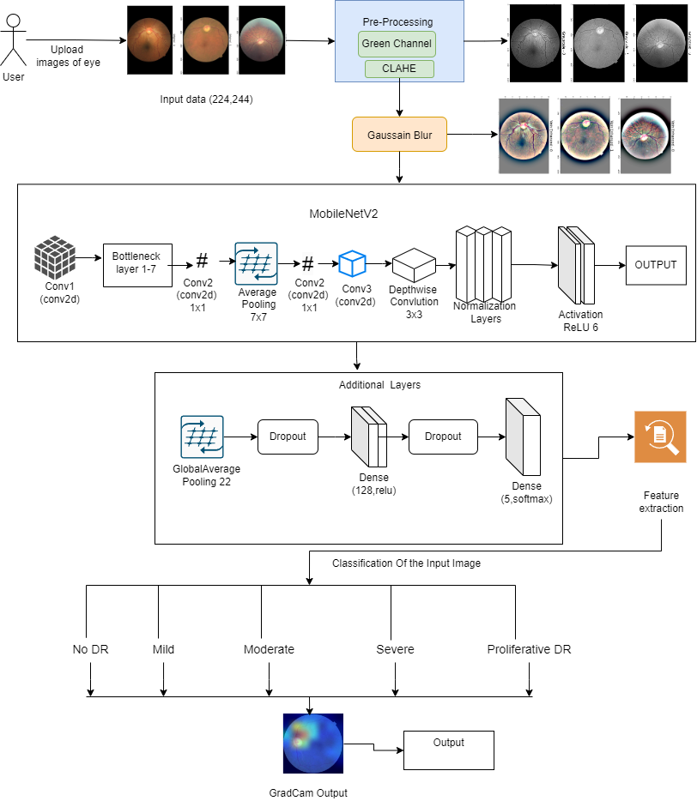
Proposed System
Fig. 1: Block diagram of the proposed system
9

Slide 10
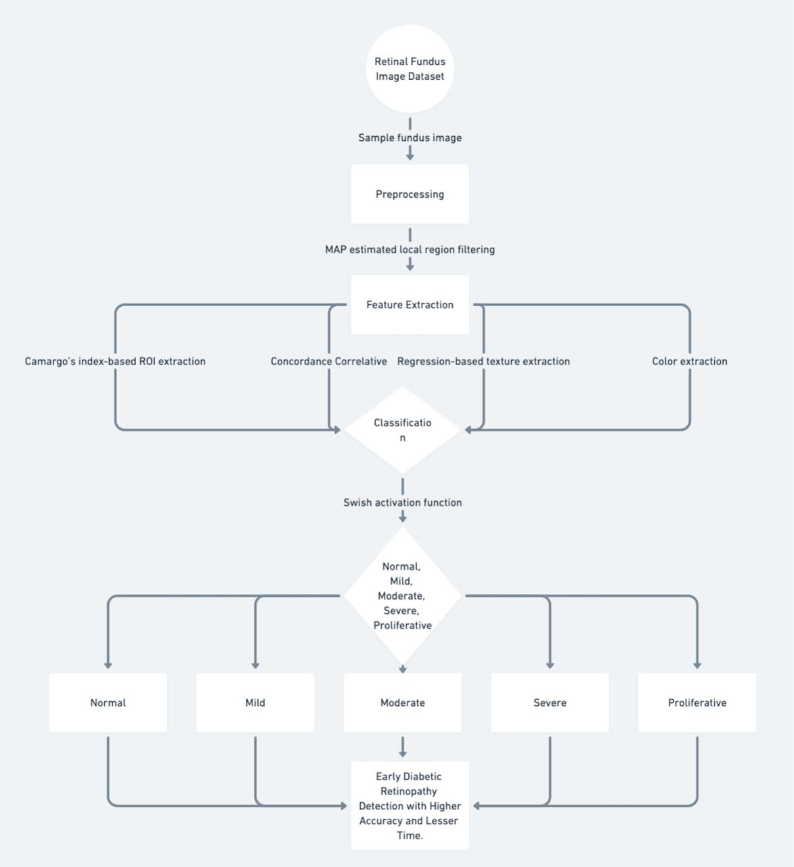
Proposed System
Fig2: Working Flow

Slide 11
References
Hemalatha, R., Anjanadevi, V., Naren, J., and Vithya, G. "A Detailed Study on Diagnosis and Prediction of Diabetic Retinopathy Using Current Machine Learning and Deep Learning Techniques."
Mishra, Anju, Laxman Singh, and Mrinal Pandey. "Short Survey on Machine Learning Techniques for Diabetic Retinopathy Detection .“
Gothane, Suwarna, K. Srujan Raju, Nuthanakanti Bhaskar, and G. Divya. "Diabetic Retinopathy Detection Using Deep Learning ."
Subramanian, Shyamala, Sashikala Mishra, Shruti Patil, Kailash Shaw, and Ebrahim Aghajari. "Machine Learning Styles for Diabetic Retinopathy Detection: A Review and Bibliometric Analysis ."
Chetoui, Mohamed, Moulay A. Akhloufi, and Mustapha Kardouchi. "Diabetic Retinopathy Detection Using Machine Learning and Texture Features."
11

Slide 12
References
Odeh, Israa, Mouhammd Alkasassbeh, and Mohammad Alauthman. "Diabetic Retinopathy Detection using Ensemble Machine Learning ."
Revathy, R., Nithya B. S., Reshma J. J., Ragendhu S. S., and Sumithra M. D. "Diabetic Retinopathy Detection using Machine Learning ."
Verma, Kanika, Prakash Deep, and A. G. Ramakrishnan. "Detection and Classification of Diabetic Retinopathy using Retinal Images ."
Revathy, R., Nithya B. S., Reshma J. J., Ragendhu S. S., and Sumithra M. D. "Diabetic Retinopathy Detection using Machine Learning ."
Das, Dolly, Saroj Kr. Biswas, and Sivaji Bandyopadhyay. "A Critical Review on Diagnosis of Diabetic Retinopathy Using Machine Learning and Deep Learning."
12

Slide 13
Thank You !!!
13

Slide 14
Q & A
14

