Slide 1

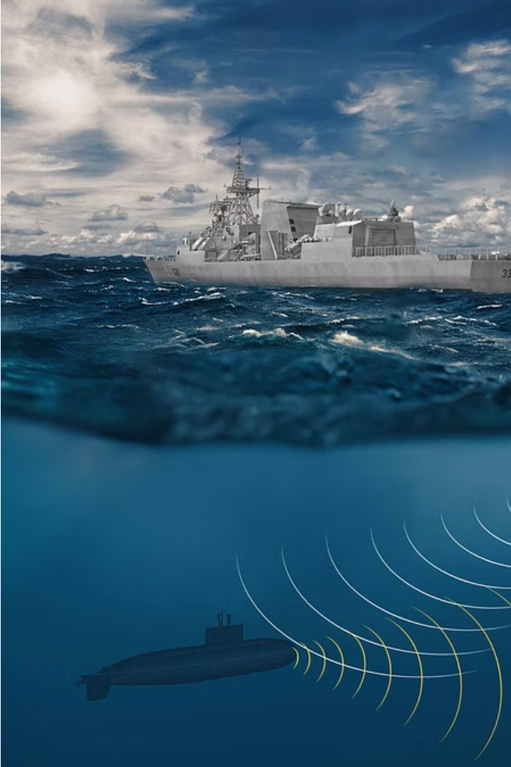
Introduction to Sonar Rock vs. Mine Prediction
This presentation explores the use of logistic regression to predict whether a sonar signal corresponds to a rock or a mine. By analyzing the complex underwater environment, this model can help improve maritime safety and security.
by Devang Chaudhari

Slide 2
Overview of Logistic Regression Model
Logistic Regression
Model Assumptions
Model Interpretation
A supervised machine learning algorithm used to predict binary outcomes, such as rock or mine, based on input features.
Linearity, independence, lack of multicollinearity, and normal distribution of errors.
The model outputs the probability of an instance belonging to one of the two classes (rock or mine).

Slide 3

Data Collection and Preprocessing
Data Acquisition
1
Gather sonar signals from various underwater environments, labeled as either rock or mine.
2
Data Cleaning
Handle missing values, outliers, and inconsistencies in the dataset.
Data Transformation
3
Convert raw sonar data into numerical features suitable for the logistic regression model.

Slide 4
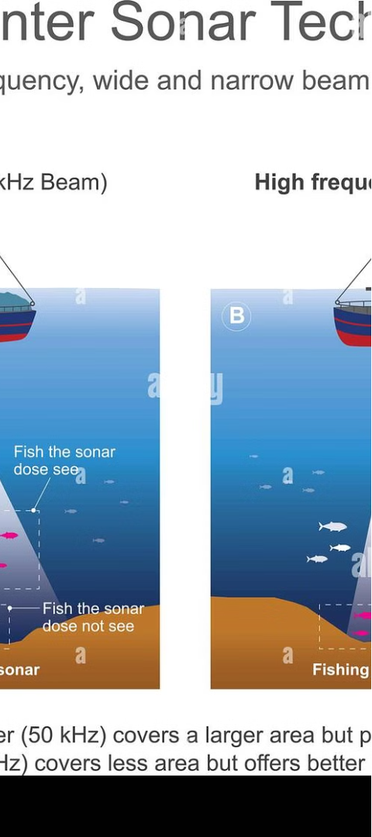
Feature Engineering and Selection
1
Feature Engineering
2
Feature Selection
Extract relevant features from the sonar signals, such as frequency, amplitude, and waveform characteristics.
Identify the most informative features using techniques like correlation analysis and recursive feature elimination.
3
Dimensionality Reduction
Apply techniques like principal component analysis to reduce the number of features without losing significant information.

Slide 5
Model Training and Evaluation
Training the Model
Evaluation Metrics
Cross-Validation
Split the dataset into training and testing sets, and fit the logistic regression model to the training data.
Assess the model's performance using metrics like accuracy, precision, recall, and F1-score.
Employ cross-validation techniques to ensure the model's robustness and generalization ability.

Slide 6
Hyperparameter Tuning and Optimization
Regularization
Learning Rate
Adjust the regularization parameter to control model complexity and prevent overfitting.
Optimize the learning rate to ensure efficient and stable convergence of the model.
Batch Size
Early Stopping
Experiment with different batch sizes to find the optimal balance between training speed and model performance.
Implement early stopping to prevent overfitting and improve the model's generalization ability.

Slide 7
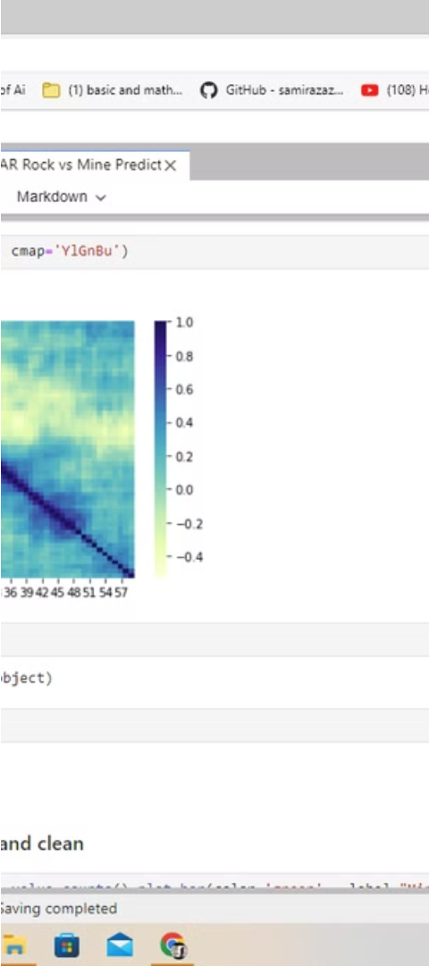



Deployment and Real-World Application
Model Integration
Integrate the trained logistic regression model into a larger system for real-time sonar signal analysis.
Deployment Infrastructure
Establish the necessary infrastructure, such as servers and APIs, to handle the deployment and usage of the model.
Monitoring and Maintenance
Continuously monitor the model's performance and update it as needed to maintain accuracy and reliability.

Slide 8



Conclusion and Future Considerations
Ongoing Research
Interdisciplinary Collaboration
Real-Time Monitoring
Explore advanced techniques like deep learning to further improve the accuracy of sonar rock vs. mine prediction.
Foster collaborations between data scientists, marine biologists, and naval experts to enhance the model's capabilities.
Develop techniques for real-time sonar signal analysis and prediction to enable immediate response to potential threats.

