Slide 1
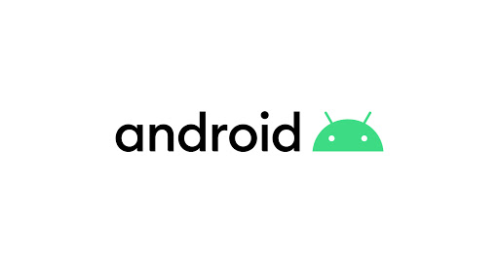
ANDROID
android

Slide 2
What Is Android
Android is a mobile operating system based on a modified version of the Linux kernel and other open source software, designed primarily for touchscreen mobile devices such as smartphones and tablets.

Slide 3
History
Initially, Andy Rubin founded Android Incorporation in Palo Alto, California, United States in October, 2003.
Their goal was to develop a "smarter mobile device that was more aware of its owner's location and preferences.
They operated secretively, admitting only that they were working on software for mobile phones.

Slide 4
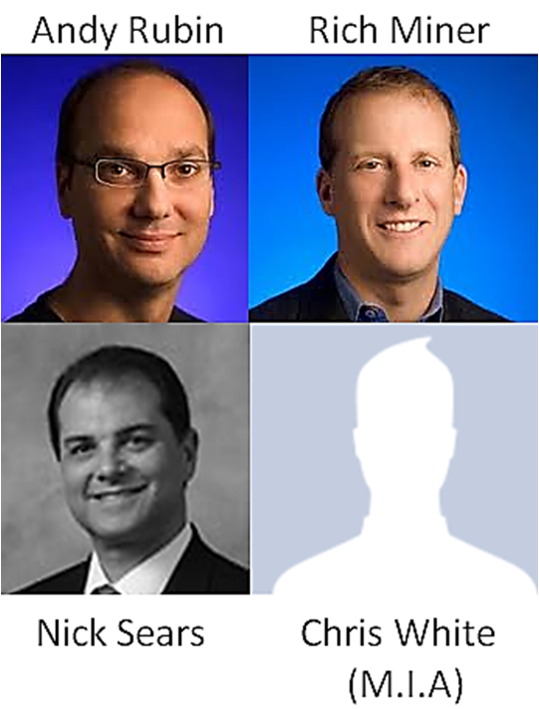

Slide 5
Advantages of Google Android
Android is an open-source platform allowing UI customization. ...
Supports cloud storage enabling sync of devices with G-account. ...
Continual improvement & removal of old features. ...
Supports 3rd party widget & information display on screen…
Supports running multiple apps simultaneously.

Slide 6
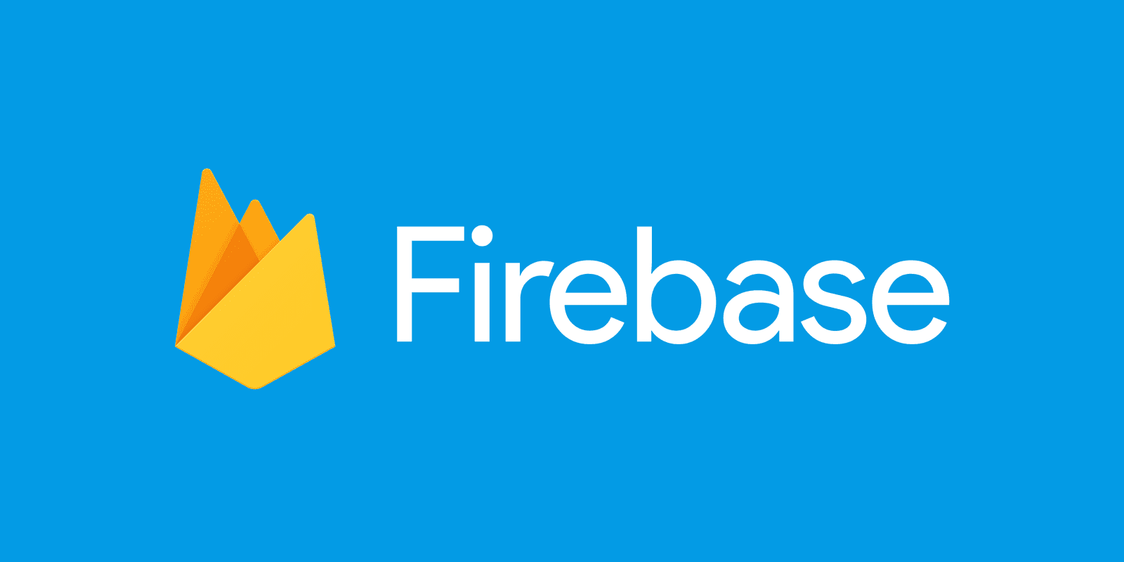
WHat Is Fire-Base

Slide 7
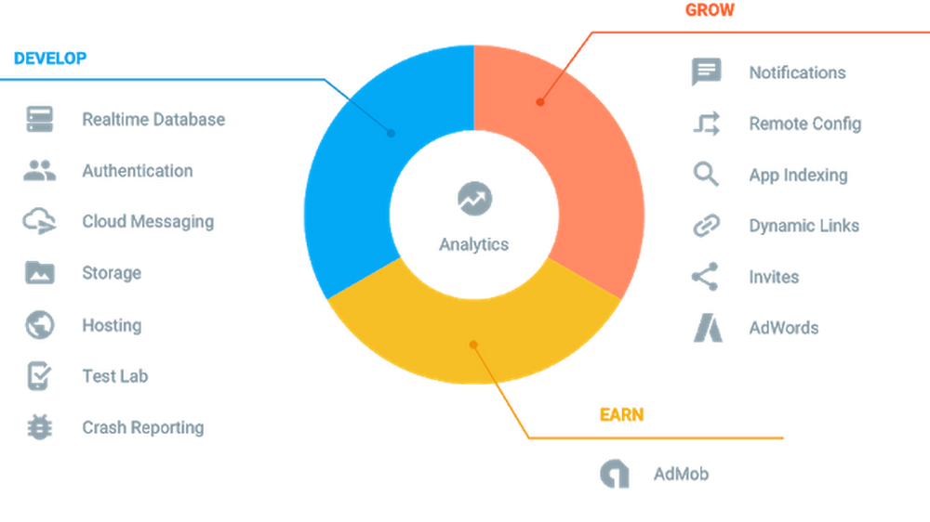

Slide 8
What IS API
An Application Programming Interface (API) is a particular set of rules (‘code’) and specifications that programs can follow to communicate with each other. APIs are growing exponentially every year.
When you use an application on your mobile phone, the application connects to the Internet and sends data to a server.

Slide 9
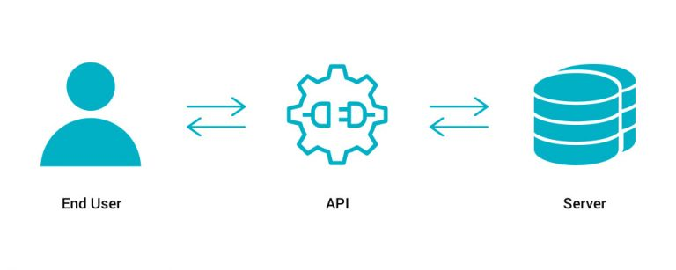

Slide 10
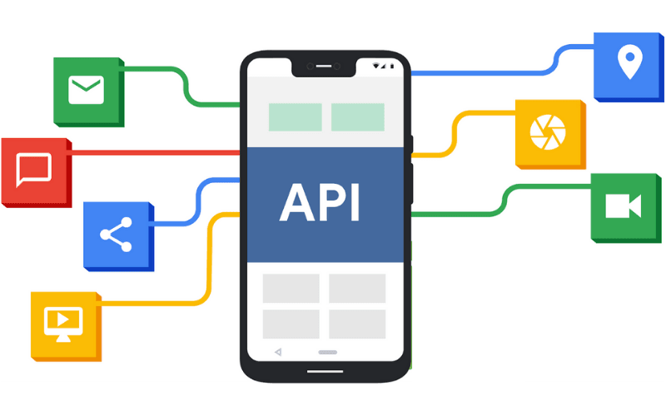

Slide 11

Thank You

