Slide 1

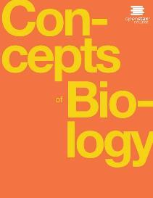
Concepts of Biology
Chapter 18 ANIMAL REPRODUCTION AND DEVELOPMENT
PowerPoint Image Slideshow

Slide 2
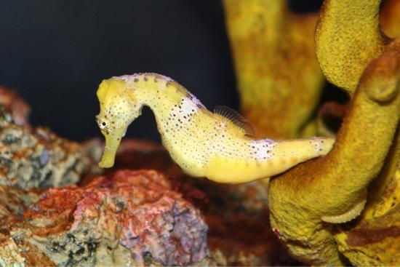
Figure 18.1
Female seahorses produce eggs that are then fertilized by the male. Unlike with almost all other animals, the young then develop in a pouch of the male seahorse until birth.(credit: “cliff1066”/Flickr)
This OpenStax ancillary resource is © Rice University under a CC-BY 4.0 International license; it may be reproduced or modified but must be attributed to OpenStax, Rice University and any changes must be noted. Any images credited to other sources are similarly available for reproduction, but must be attributed to their sources.

Slide 3
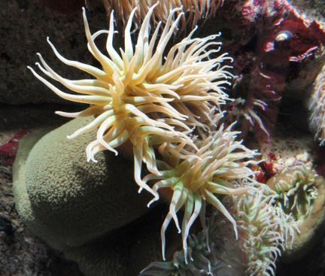
Figure 18.2
The Anthopleura artemisia sea anemone can reproduce through fission.
This OpenStax ancillary resource is © Rice University under a CC-BY 4.0 International license; it may be reproduced or modified but must be attributed to OpenStax, Rice University and any changes must be noted. Any images credited to other sources are similarly available for reproduction, but must be attributed to their sources.

Slide 4
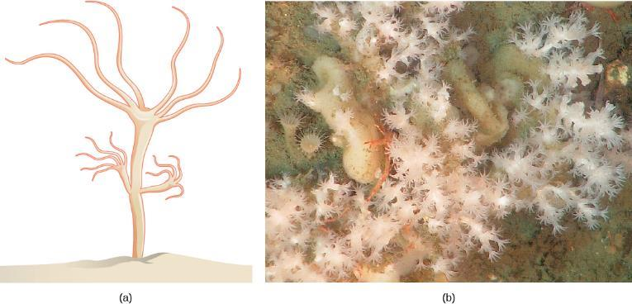
Figure 18.3
Hydra reproduce asexually through budding: a bud forms on the tubular body of an adult hydra, develops a mouth and tentacles, and then detaches from its parent. The new hydra is fully developed and will find its own location for attachment.
Some coral, such as the Lophelia pertusa shown here, can reproduce through budding. (credit b: modification of work by Ed Bowlby, NOAA/Olympic Coast NMS; NOAA/OAR/Office of Ocean Exploration)
This OpenStax ancillary resource is © Rice University under a CC-BY 4.0 International license; it may be reproduced or modified but must be attributed to OpenStax, Rice University and any changes must be noted. Any images credited to other sources are similarly available for reproduction, but must be attributed to their sources.

Slide 5
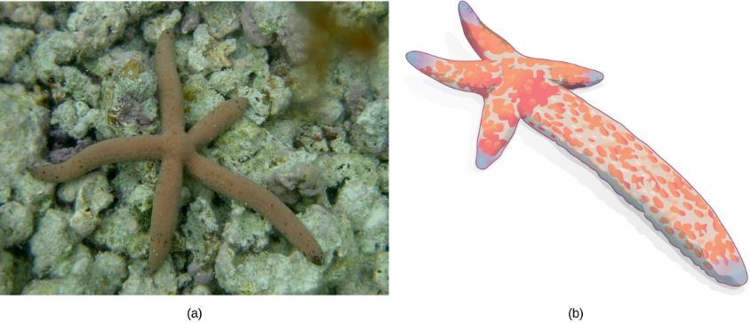
Figure 18.4
(a) Linckia multifora is a species of sea star that can reproduce asexually via fragmentation. In this process, (b) an arm that has been shed grows into a new sea star. (credit a: modifiction of work by Dwayne Meadows, NOAA/NMFS/OPR)
This OpenStax ancillary resource is © Rice University under a CC-BY 4.0 International license; it may be reproduced or modified but must be attributed to OpenStax, Rice University and any changes must be noted. Any images credited to other sources are similarly available for reproduction, but must be attributed to their sources.

Slide 6
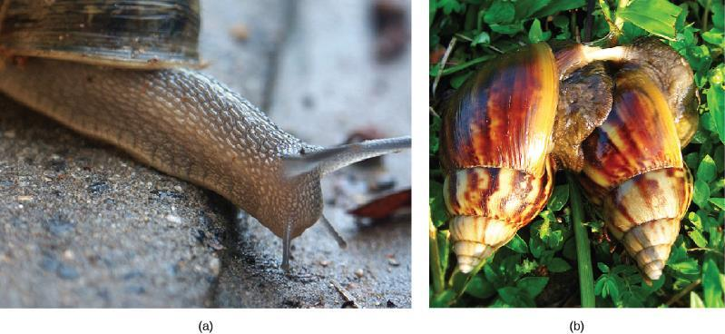
Figure 18.5
Many (a) snails are hermaphrodites. When two individuals (b) mate, they can produce up to 100 eggs each. (credit a: modification of work by Assaf Shtilman; credit b: modification of work by “Schristia”/Flickr)
This OpenStax ancillary resource is © Rice University under a CC-BY 4.0 International license; it may be reproduced or modified but must be attributed to OpenStax, Rice University and any changes must be noted. Any images credited to other sources are similarly available for reproduction, but must be attributed to their sources.

Slide 7
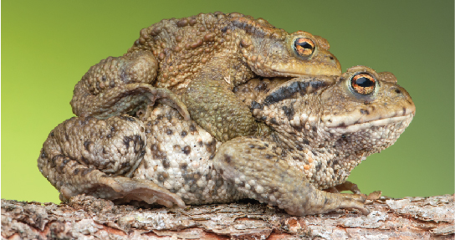
Figure 18.6
During sexual reproduction in toads, the male grasps the female from behind and externally fertilizes the eggs as they are deposited. (credit: Bernie Kohl)
This OpenStax ancillary resource is © Rice University under a CC-BY 4.0 International license; it may be reproduced or modified but must be attributed to OpenStax, Rice University and any changes must be noted. Any images credited to other sources are similarly available for reproduction, but must be attributed to their sources.

Slide 8
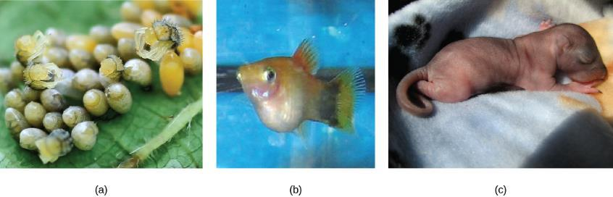
Figure 18.7
In (a) oviparity, young develop in eggs outside the female body, as with these Harmonia axydridis beetles hatching. Some aquatic animals, like this (b) pregnant Xiphophorus maculatus are ovoviparous, with the egg developing inside the female and nutrition supplied primarily from the yolk. In mammals, nutrition is supported by the placenta, as was the case with this (c) newborn squirrel. (credit b: modification of work by Gourami Watcher; credit c: modification of work by “audreyjm529”/Flickr)
This OpenStax ancillary resource is © Rice University under a CC-BY 4.0 International license; it may be reproduced or modified but must be attributed to OpenStax, Rice University and any changes must be noted. Any images credited to other sources are similarly available for reproduction, but must be attributed to their sources.

Slide 9
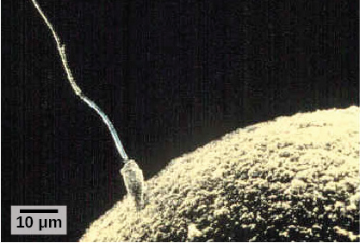
Figure 18.8
Fertilization is the process in which sperm and egg fuse to form a zygote. (credit: scalebar data from Matt Russell)
This OpenStax ancillary resource is © Rice University under a CC-BY 4.0 International license; it may be reproduced or modified but must be attributed to OpenStax, Rice University and any changes must be noted. Any images credited to other sources are similarly available for reproduction, but must be attributed to their sources.

Slide 10
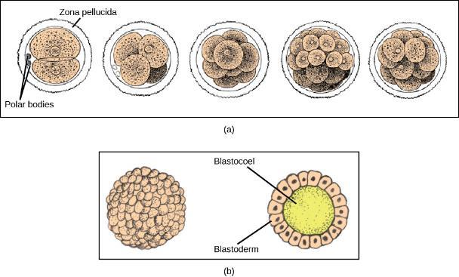
Figure 18.9
During cleavage, the zygote rapidly divides into multiple cells.
The cells rearrange themselves to form a hollow ball called the blastula. (credit a: modification of work by Gray’s Anatomy; credit b: modification of work by Pearson Scott Foresman; donated to the Wikimedia Foundation)
This OpenStax ancillary resource is © Rice University under a CC-BY 4.0 International license; it may be reproduced or modified but must be attributed to OpenStax, Rice University and any changes must be noted. Any images credited to other sources are similarly available for reproduction, but must be attributed to their sources.

Slide 11
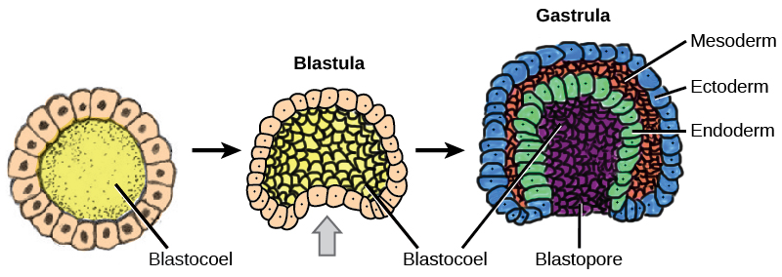
Figure 18.10
Gastrulation is the process wherein the cells in the blastula rearrange themselves to form the germ layers. (credit: modification of work by Abigail Pyne)
This OpenStax ancillary resource is © Rice University under a CC-BY 4.0 International license; it may be reproduced or modified but must be attributed to OpenStax, Rice University and any changes must be noted. Any images credited to other sources are similarly available for reproduction, but must be attributed to their sources.

Slide 12
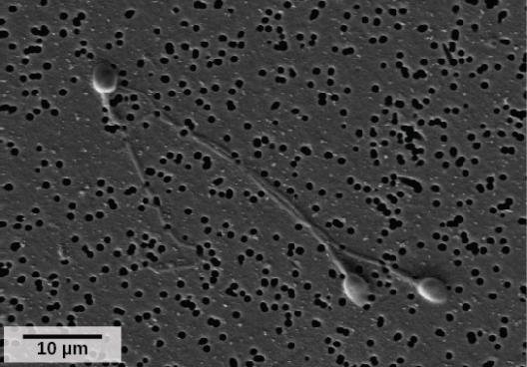
Figure 18.11
As seen in this scanning electron micrograph, human sperm has a flagellum, neck, and head. (credit: scale-bar data from Matt Russell)
This OpenStax ancillary resource is © Rice University under a CC-BY 4.0 International license; it may be reproduced or modified but must be attributed to OpenStax, Rice University and any changes must be noted. Any images credited to other sources are similarly available for reproduction, but must be attributed to their sources.

Slide 13
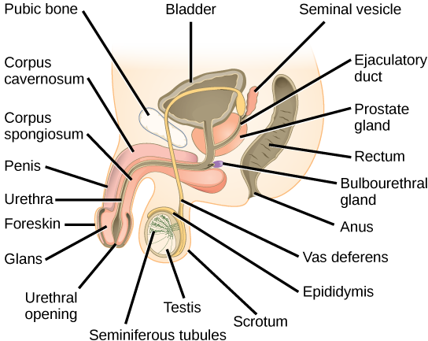
Figure 18.12
The reproductive structures of the human male are shown.
This OpenStax ancillary resource is © Rice University under a CC-BY 4.0 International license; it may be reproduced or modified but must be attributed to OpenStax, Rice University and any changes must be noted. Any images credited to other sources are similarly available for reproduction, but must be attributed to their sources.

Slide 14
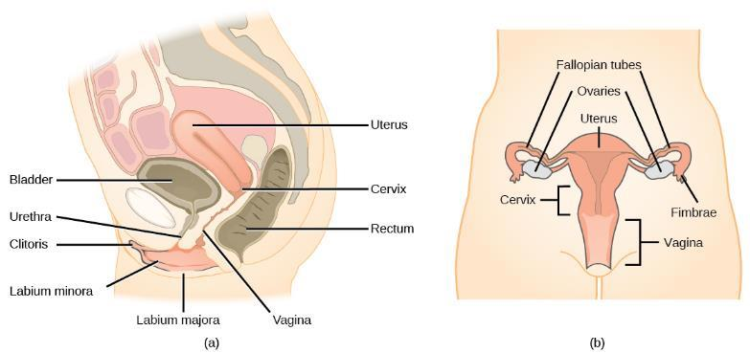
Figure 18.13
The reproductive structures of the human female are shown. (credit a: modification of work by Gray’s Anatomy; credit b: modification of work by CDC)
This OpenStax ancillary resource is © Rice University under a CC-BY 4.0 International license; it may be reproduced or modified but must be attributed to OpenStax, Rice University and any changes must be noted. Any images credited to other sources are similarly available for reproduction, but must be attributed to their sources.

Slide 15
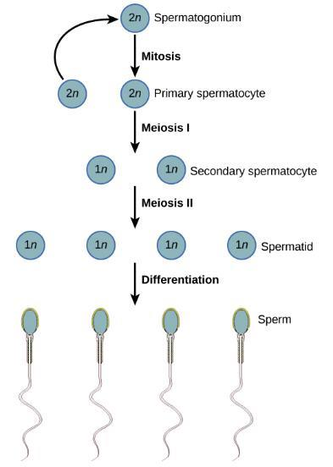
Figure 18.14
During spermatogenesis, four sperm result from each primary spermatocyte. The process also maps onto the physical structure of the wall of the seminiferous tubule, with the spermatogonia on the outer side of the tubule, and the sperm with their developing tails extended into the lumen of the tubule.
This OpenStax ancillary resource is © Rice University under a CC-BY 4.0 International license; it may be reproduced or modified but must be attributed to OpenStax, Rice University and any changes must be noted. Any images credited to other sources are similarly available for reproduction, but must be attributed to their sources.

Slide 16
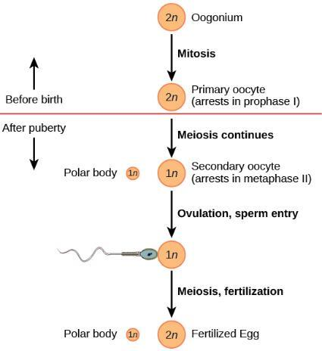
Figure 18.15
The process of oogenesis occurs in the ovary’s outermost layer.
This OpenStax ancillary resource is © Rice University under a CC-BY 4.0 International license; it may be reproduced or modified but must be attributed to OpenStax, Rice University and any changes must be noted. Any images credited to other sources are similarly available for reproduction, but must be attributed to their sources.

Slide 17
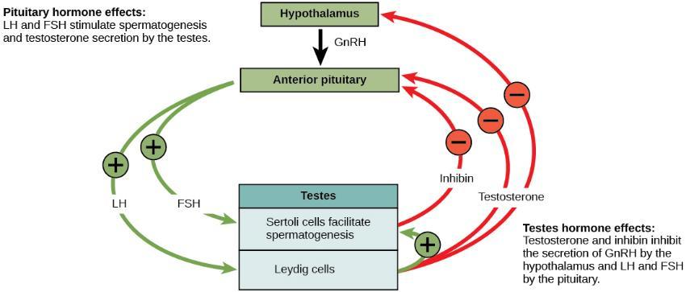
Figure 18.16
Hormones control sperm production in a negative feedback system.
This OpenStax ancillary resource is © Rice University under a CC-BY 4.0 International license; it may be reproduced or modified but must be attributed to OpenStax, Rice University and any changes must be noted. Any images credited to other sources are similarly available for reproduction, but must be attributed to their sources.

Slide 18
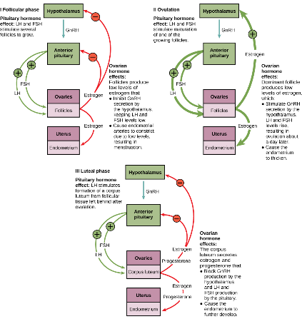
Figure 18.17
The ovarian and menstrual cycles of female reproduction are regulated by hormones produced by the hypothalamus, pituitary, and ovaries.
This OpenStax ancillary resource is © Rice University under a CC-BY 4.0 International license; it may be reproduced or modified but must be attributed to OpenStax, Rice University and any changes must be noted. Any images credited to other sources are similarly available for reproduction, but must be attributed to their sources.

Slide 19
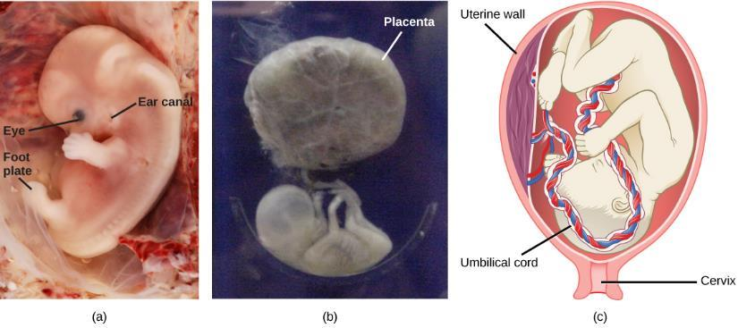
Figure 18.18
Fetal development is shown at nine weeks gestation.
This fetus is just entering the second trimester, when the placenta takes over more of the functions performed as the baby develops.
There is rapid fetal growth during the third trimester. (credit a: modification of work by Ed Uthman; credit b: modification of work by National Museum of Health and Medicine; credit c: modification of work by Gray’s Anatomy)
This OpenStax ancillary resource is © Rice University under a CC-BY 4.0 International license; it may be reproduced or modified but must be attributed to OpenStax, Rice University and any changes must be noted. Any images credited to other sources are similarly available for reproduction, but must be attributed to their sources.

