Slide 1


Concepts of Biology
Chapter 2 CHEMISTRY OF LIFE
PowerPoint Image Slideshow

Slide 2
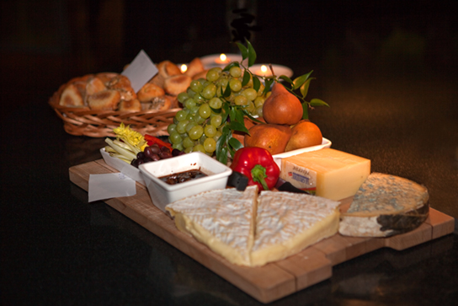
Figure 2.1
Foods such as bread, fruit, and cheese are rich sources of biological macromolecules. (credit: modification of work by Bengt Nyman)
This OpenStax ancillary resource is © Rice University under a CC-BY 4.0 International license; it may be reproduced or modified but must be attributed to OpenStax, Rice University and any changes must be noted. Any images credited to other sources are similarly available for reproduction, but must be attributed to their sources.

Slide 3
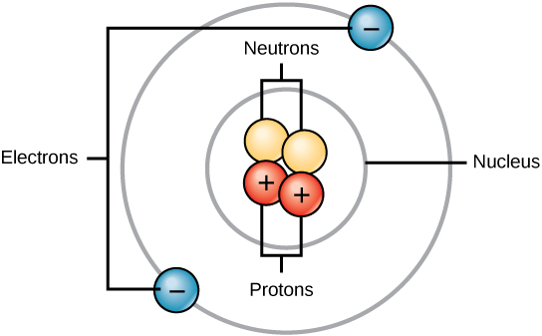
Figure 2.2
Atoms are made up of protons and neutrons located within the nucleus, and electrons surrounding the nucleus.
This OpenStax ancillary resource is © Rice University under a CC-BY 4.0 International license; it may be reproduced or modified but must be attributed to OpenStax, Rice University and any changes must be noted. Any images credited to other sources are similarly available for reproduction, but must be attributed to their sources.

Slide 4
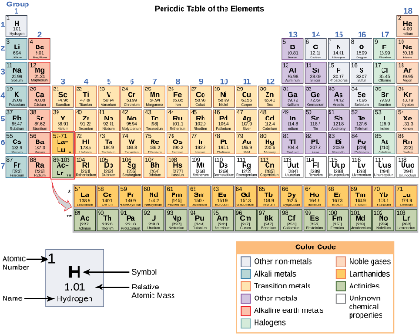
Figure 2.3
Arranged in columns and rows based on the characteristics of the elements, the periodic table provides key information about the elements and how they might interact with each other to form molecules. Most periodic tables provide a key or legend to the information they contain.
This OpenStax ancillary resource is © Rice University under a CC-BY 4.0 International license; it may be reproduced or modified but must be attributed to OpenStax, Rice University and any changes must be noted. Any images credited to other sources are similarly available for reproduction, but must be attributed to their sources.

Slide 5
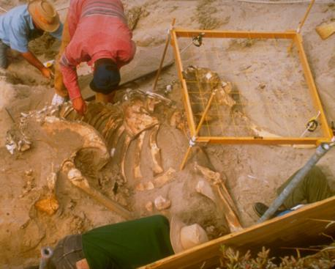
Figure 2.4
The age of remains that contain carbon and are less than about 50,000 years old, such as this pygmy mammoth, can be determined using carbon dating. (credit: Bill Faulkner/ NPS)
This OpenStax ancillary resource is © Rice University under a CC-BY 4.0 International license; it may be reproduced or modified but must be attributed to OpenStax, Rice University and any changes must be noted. Any images credited to other sources are similarly available for reproduction, but must be attributed to their sources.

Slide 6
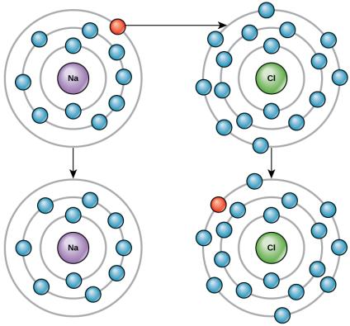
Figure 2.5
Elements tend to fill their outermost shells with electrons. To do this, they can either donate or accept electrons from other elements.
This OpenStax ancillary resource is © Rice University under a CC-BY 4.0 International license; it may be reproduced or modified but must be attributed to OpenStax, Rice University and any changes must be noted. Any images credited to other sources are similarly available for reproduction, but must be attributed to their sources.

Slide 7
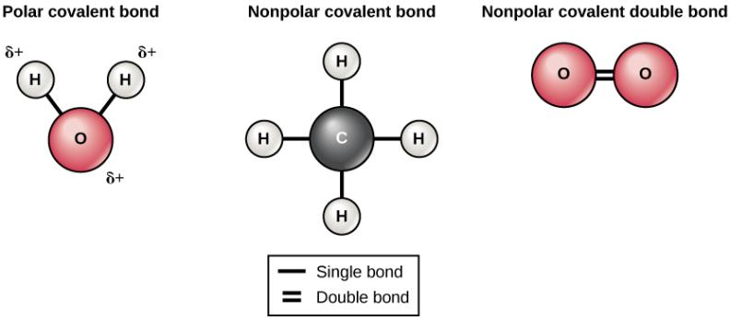
Figure 2.6
The water molecule (left) depicts a polar bond with a slightly positive charge on the hydrogen atoms and a slightly negative charge on the oxygen. Examples of nonpolar bonds include methane (middle) and oxygen (right).
This OpenStax ancillary resource is © Rice University under a CC-BY 4.0 International license; it may be reproduced or modified but must be attributed to OpenStax, Rice University and any changes must be noted. Any images credited to other sources are similarly available for reproduction, but must be attributed to their sources.

Slide 8
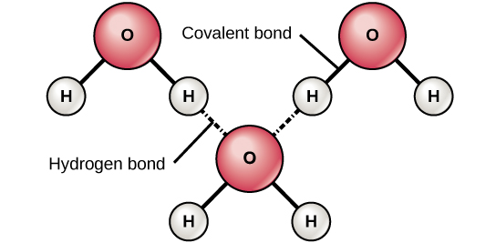
Figure 2.7
Hydrogen bonds form between slightly positive (δ+) and slightly negative (δ–) charges of polar covalent molecules, such as water.
This OpenStax ancillary resource is © Rice University under a CC-BY 4.0 International license; it may be reproduced or modified but must be attributed to OpenStax, Rice University and any changes must be noted. Any images credited to other sources are similarly available for reproduction, but must be attributed to their sources.

Slide 9
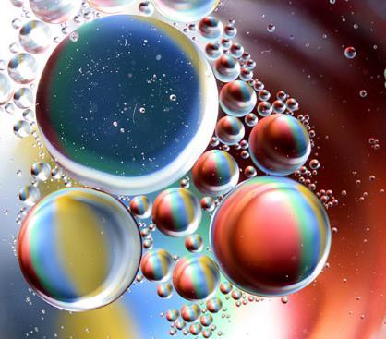
Figure 2.8
As this macroscopic image of oil and water show, oil is a nonpolar compound and, hence, will not dissolve in water. Oil and water do not mix. (credit: Gautam Dogra)
This OpenStax ancillary resource is © Rice University under a CC-BY 4.0 International license; it may be reproduced or modified but must be attributed to OpenStax, Rice University and any changes must be noted. Any images credited to other sources are similarly available for reproduction, but must be attributed to their sources.

Slide 10
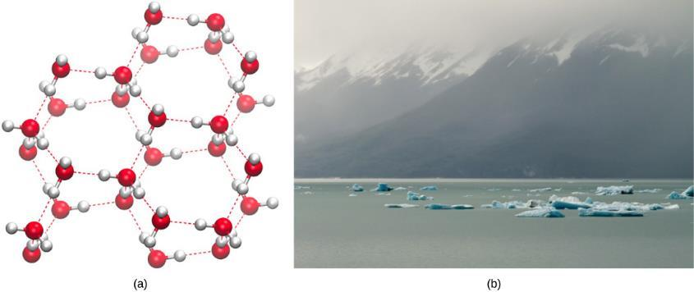
Figure 2.9
(a) The lattice structure of ice makes it less dense than the freely flowing molecules of liquid water. Ice’s lower density enables it to (b) float on water. (credit a: modification of work by Jane Whitney; credit b: modification of work by Carlos Ponte)
This OpenStax ancillary resource is © Rice University under a CC-BY 4.0 International license; it may be reproduced or modified but must be attributed to OpenStax, Rice University and any changes must be noted. Any images credited to other sources are similarly available for reproduction, but must be attributed to their sources.

Slide 11
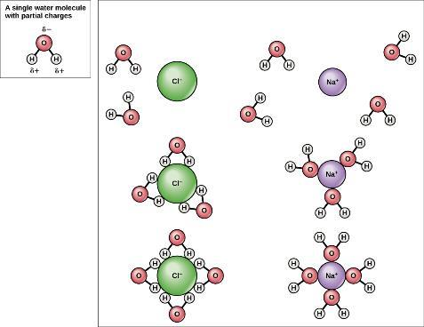
Figure 2.10
When table salt (NaCl) is mixed in water, spheres of hydration form around the ions.
This OpenStax ancillary resource is © Rice University under a CC-BY 4.0 International license; it may be reproduced or modified but must be attributed to OpenStax, Rice University and any changes must be noted. Any images credited to other sources are similarly available for reproduction, but must be attributed to their sources.

Slide 12
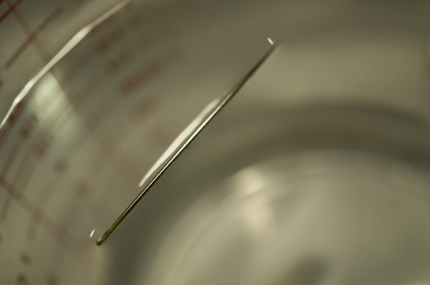
Figure 2.11
The weight of a needle on top of water pulls the surface tension downward; at the same time, the surface tension of the water is pulling it up, suspending the needle on the surface of the water and keeping it from sinking. Notice the indentation in the water around the needle. (credit: Cory Zanker)
This OpenStax ancillary resource is © Rice University under a CC-BY 4.0 International license; it may be reproduced or modified but must be attributed to OpenStax, Rice University and any changes must be noted. Any images credited to other sources are similarly available for reproduction, but must be attributed to their sources.

Slide 13
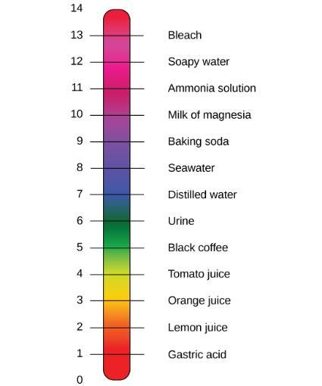
Figure 2.12
The pH scale measures the amount of hydrogen ions (H⁺) in a substance. (credit: modification of work by Edward Stevens)
This OpenStax ancillary resource is © Rice University under a CC-BY 4.0 International license; it may be reproduced or modified but must be attributed to OpenStax, Rice University and any changes must be noted. Any images credited to other sources are similarly available for reproduction, but must be attributed to their sources.

Slide 14
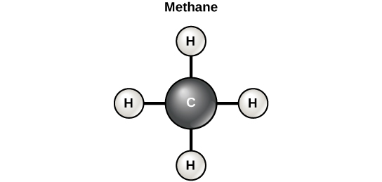
Figure 2.13
Carbon can form four covalent bonds to create an organic molecule. The simplest carbon molecule is methane (CH₄), depicted here.
This OpenStax ancillary resource is © Rice University under a CC-BY 4.0 International license; it may be reproduced or modified but must be attributed to OpenStax, Rice University and any changes must be noted. Any images credited to other sources are similarly available for reproduction, but must be attributed to their sources.

Slide 15
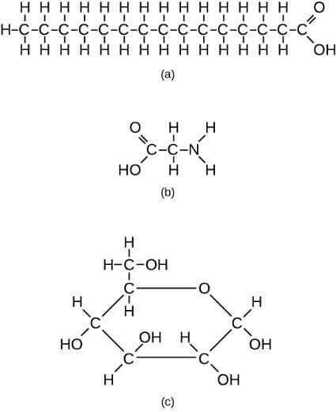
Figure 2.14
These examples show three molecules (found in living organisms) that contain carbon atoms bonded in various ways to other carbon atoms and the atoms of other elements.
This molecule of stearic acid has a long chain of carbon atoms.
Glycine, a component of proteins, contains carbon, nitrogen, oxygen, and hydrogen atoms.
Glucose, a sugar, has a ring of carbon atoms and one oxygen atom.
This OpenStax ancillary resource is © Rice University under a CC-BY 4.0 International license; it may be reproduced or modified but must be attributed to OpenStax, Rice University and any changes must be noted. Any images credited to other sources are similarly available for reproduction, but must be attributed to their sources.

Slide 16
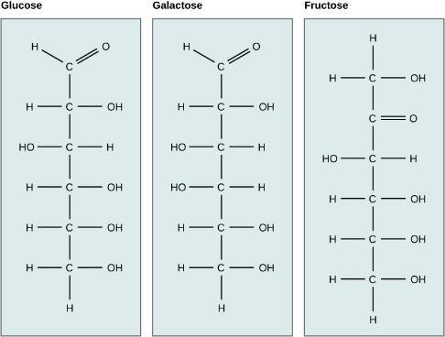
Figure 2.15
Glucose, galactose, and fructose are isomeric monosaccharides, meaning that they have the same chemical formula but slightly different structures.
This OpenStax ancillary resource is © Rice University under a CC-BY 4.0 International license; it may be reproduced or modified but must be attributed to OpenStax, Rice University and any changes must be noted. Any images credited to other sources are similarly available for reproduction, but must be attributed to their sources.

Slide 17
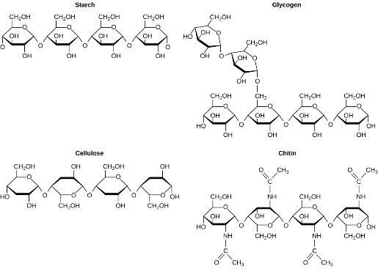
Figure 2.16
Although their structures and functions differ, all polysaccharide carbohydrates are made up of monosaccharides and have the chemical formula (CH₂O)n.
This OpenStax ancillary resource is © Rice University under a CC-BY 4.0 International license; it may be reproduced or modified but must be attributed to OpenStax, Rice University and any changes must be noted. Any images credited to other sources are similarly available for reproduction, but must be attributed to their sources.

Slide 18
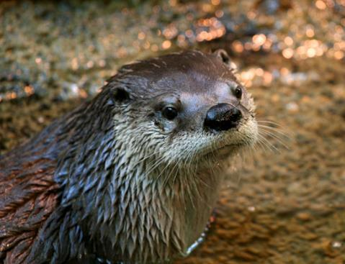
Figure 2.17
Hydrophobic lipids in the fur of aquatic mammals, such as this river otter, protect them from the elements. (credit: Ken Bosma)
This OpenStax ancillary resource is © Rice University under a CC-BY 4.0 International license; it may be reproduced or modified but must be attributed to OpenStax, Rice University and any changes must be noted. Any images credited to other sources are similarly available for reproduction, but must be attributed to their sources.

Slide 19
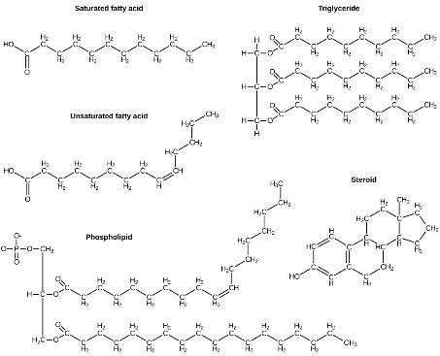
Figure 2.18
Lipids include fats, such as triglycerides, which are made up of fatty acids and glycerol, phospholipids, and steroids.
This OpenStax ancillary resource is © Rice University under a CC-BY 4.0 International license; it may be reproduced or modified but must be attributed to OpenStax, Rice University and any changes must be noted. Any images credited to other sources are similarly available for reproduction, but must be attributed to their sources.

Slide 20
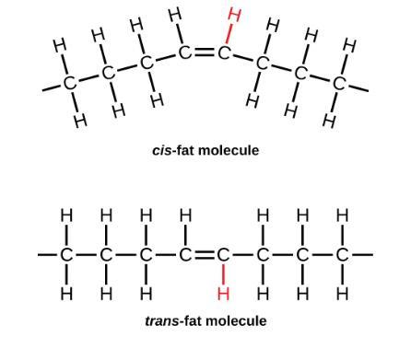
Figure 2.19
During the hydrogenation process, the orientation around the double bonds is changed, making a trans-fat from a cis-fat. This changes the chemical properties of the molecule.
This OpenStax ancillary resource is © Rice University under a CC-BY 4.0 International license; it may be reproduced or modified but must be attributed to OpenStax, Rice University and any changes must be noted. Any images credited to other sources are similarly available for reproduction, but must be attributed to their sources.

Slide 21
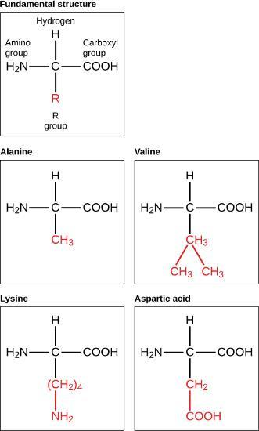
Figure 2.20
Amino acids are made up of a central carbon bonded to an amino group (–NH₂), a carboxyl group (–COOH), and a hydrogen atom. The central carbon’s fourth bond varies among the different amino acids, as seen in these examples of alanine, valine, lysine, and aspartic acid.
This OpenStax ancillary resource is © Rice University under a CC-BY 4.0 International license; it may be reproduced or modified but must be attributed to OpenStax, Rice University and any changes must be noted. Any images credited to other sources are similarly available for reproduction, but must be attributed to their sources.

Slide 22
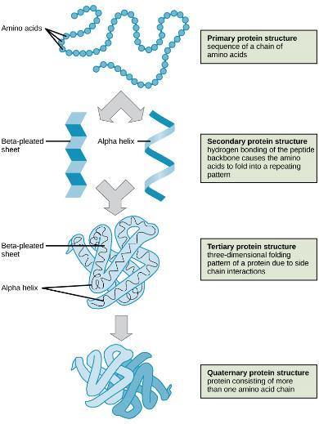
Figure 2.21
The four levels of protein structure can be observed in these illustrations. (credit: modification of work by National Human Genome Research Institute)
This OpenStax ancillary resource is © Rice University under a CC-BY 4.0 International license; it may be reproduced or modified but must be attributed to OpenStax, Rice University and any changes must be noted. Any images credited to other sources are similarly available for reproduction, but must be attributed to their sources.

Slide 23
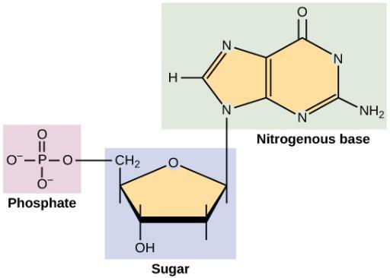
Figure 2.22
A nucleotide is made up of three components: a nitrogenous base, a pentose sugar, and a phosphate group.
This OpenStax ancillary resource is © Rice University under a CC-BY 4.0 International license; it may be reproduced or modified but must be attributed to OpenStax, Rice University and any changes must be noted. Any images credited to other sources are similarly available for reproduction, but must be attributed to their sources.

Slide 24
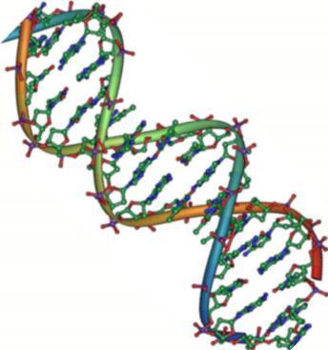
Figure 2.23
The double-helix model shows DNA as two parallel strands of intertwining molecules. (credit: Jerome Walker, Dennis Myts)
This OpenStax ancillary resource is © Rice University under a CC-BY 4.0 International license; it may be reproduced or modified but must be attributed to OpenStax, Rice University and any changes must be noted. Any images credited to other sources are similarly available for reproduction, but must be attributed to their sources.

