Slide 1

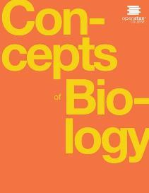
Concepts of Biology
Chapter 4 HOW CELLS OBTAIN ENERGY
PowerPoint Image Slideshow

Slide 2
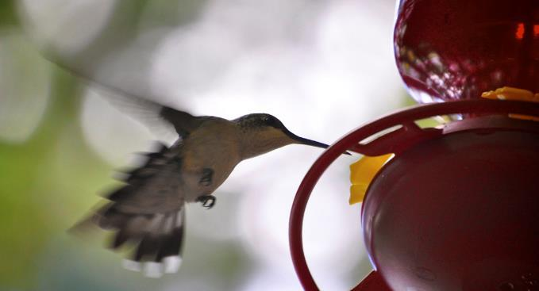
Figure 4.1
A hummingbird needs energy to maintain prolonged flight. The bird obtains its energy from taking in food and transforming the energy contained in food molecules into forms of energy to power its flight through a series of biochemical reactions. (credit: modification of work by Cory Zanker)
This OpenStax ancillary resource is © Rice University under a CC-BY 4.0 International license; it may be reproduced or modified but must be attributed to OpenStax, Rice University and any changes must be noted. Any images credited to other sources are similarly available for reproduction, but must be attributed to their sources.

Slide 3
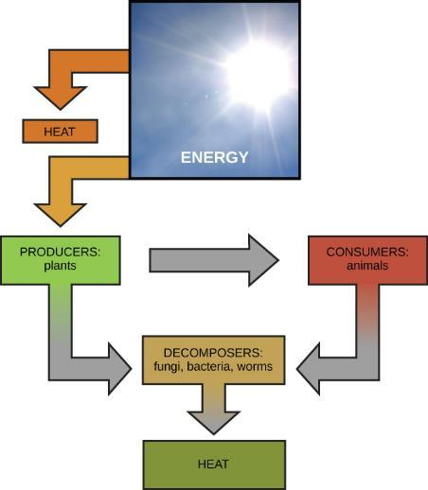
Figure 4.2
Ultimately, most life forms get their energy from the sun. Plants use photosynthesis to capture sunlight, and herbivores eat the plants to obtain energy. Carnivores eat the herbivores, and eventual decomposition of plant and animal material contributes to the nutrient pool.
This OpenStax ancillary resource is © Rice University under a CC-BY 4.0 International license; it may be reproduced or modified but must be attributed to OpenStax, Rice University and any changes must be noted. Any images credited to other sources are similarly available for reproduction, but must be attributed to their sources.

Slide 4
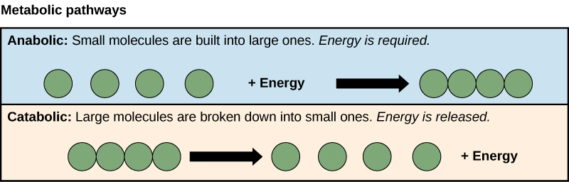
Figure 4.3
Catabolic pathways are those that generate energy by breaking down larger molecules. Anabolic pathways are those that require energy to synthesize larger molecules. Both types of pathways are required for maintaining the cell’s energy balance.
This OpenStax ancillary resource is © Rice University under a CC-BY 4.0 International license; it may be reproduced or modified but must be attributed to OpenStax, Rice University and any changes must be noted. Any images credited to other sources are similarly available for reproduction, but must be attributed to their sources.

Slide 5
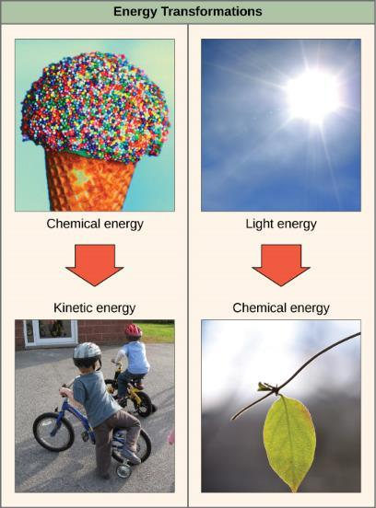
Figure 4.4
Shown are some examples of energy transferred and transformed from one system to another and from one form to another. The food we consume provides our cells with the energy required to carry out bodily functions, just as light energy provides plants with the means to create the chemical energy they need. (credit “ice cream”: modification of work by D. Sharon Pruitt; credit “kids”: modification of work by Max from Providence; credit “leaf”: modification of work by Cory Zanker)
This OpenStax ancillary resource is © Rice University under a CC-BY 4.0 International license; it may be reproduced or modified but must be attributed to OpenStax, Rice University and any changes must be noted. Any images credited to other sources are similarly available for reproduction, but must be attributed to their sources.

Slide 6
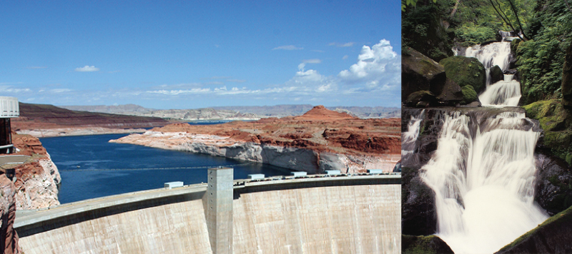
Figure 4.5
Still water has potential energy; moving water, such as in a waterfall or a rapidly flowing river, has kinetic energy. (credit “dam”: modification of work by “Pascal”/Flickr; credit “waterfall”: modification of work by Frank Gualtieri)
This OpenStax ancillary resource is © Rice University under a CC-BY 4.0 International license; it may be reproduced or modified but must be attributed to OpenStax, Rice University and any changes must be noted. Any images credited to other sources are similarly available for reproduction, but must be attributed to their sources.

Slide 7
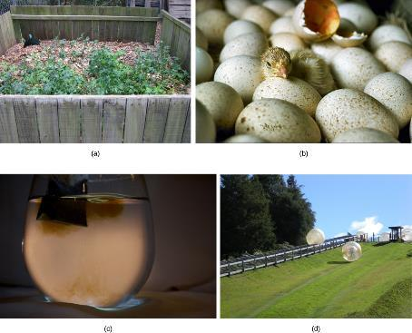
Figure 4.6
Shown are some examples of endergonic processes (ones that require energy) and exergonic processes (ones that release energy). (credit a: modification of work by Natalie Maynor; credit b: modification of work by USDA; credit c: modification of work by Cory Zanker; credit d: modification of work by Harry Malsch)
This OpenStax ancillary resource is © Rice University under a CC-BY 4.0 International license; it may be reproduced or modified but must be attributed to OpenStax, Rice University and any changes must be noted. Any images credited to other sources are similarly available for reproduction, but must be attributed to their sources.

Slide 8
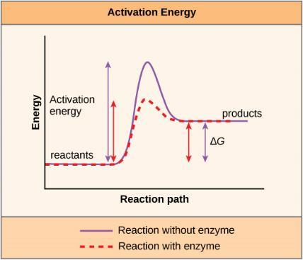
Figure 4.7
Enzymes lower the activation energy of the reaction but do not change the free energy of the reaction.
This OpenStax ancillary resource is © Rice University under a CC-BY 4.0 International license; it may be reproduced or modified but must be attributed to OpenStax, Rice University and any changes must be noted. Any images credited to other sources are similarly available for reproduction, but must be attributed to their sources.

Slide 9
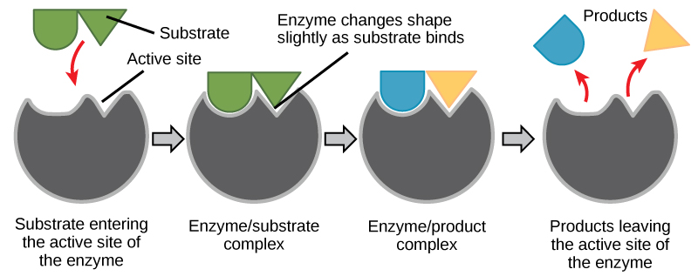
Figure 4.8
The induced-fit model is an adjustment to the lock-and-key model and explains how enzymes and substrates undergo dynamic modifications during the transition state to increase the affinity of the substrate for the active site.
This OpenStax ancillary resource is © Rice University under a CC-BY 4.0 International license; it may be reproduced or modified but must be attributed to OpenStax, Rice University and any changes must be noted. Any images credited to other sources are similarly available for reproduction, but must be attributed to their sources.

Slide 10
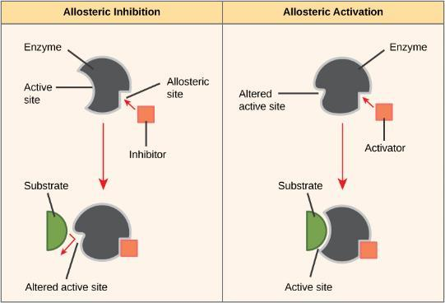
Figure 4.9
Allosteric inhibition works by indirectly inducing a conformational change to the active site such that the substrate no longer fits. In contrast, in allosteric activation, the activator molecule modifies the shape of the active site to allow a better fit of the substrate.
This OpenStax ancillary resource is © Rice University under a CC-BY 4.0 International license; it may be reproduced or modified but must be attributed to OpenStax, Rice University and any changes must be noted. Any images credited to other sources are similarly available for reproduction, but must be attributed to their sources.

Slide 11
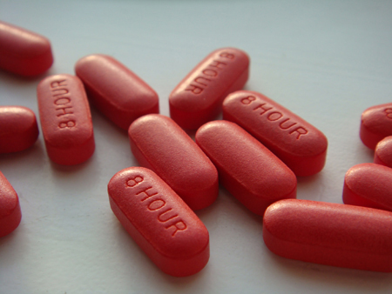
Figure 4.10
Have you ever wondered how pharmaceutical drugs are developed? (credit: Deborah Austin)
This OpenStax ancillary resource is © Rice University under a CC-BY 4.0 International license; it may be reproduced or modified but must be attributed to OpenStax, Rice University and any changes must be noted. Any images credited to other sources are similarly available for reproduction, but must be attributed to their sources.

Slide 12
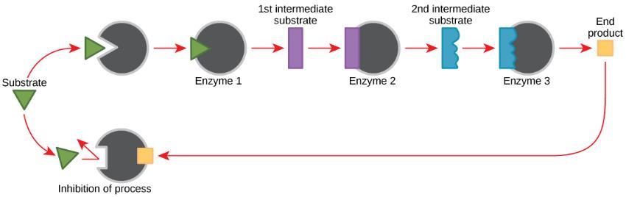
Figure 4.11
Metabolic pathways are a series of reactions catalyzed by multiple enzymes. Feedback inhibition, where the end product of the pathway inhibits an upstream process, is an important regulatory mechanism in cells.
This OpenStax ancillary resource is © Rice University under a CC-BY 4.0 International license; it may be reproduced or modified but must be attributed to OpenStax, Rice University and any changes must be noted. Any images credited to other sources are similarly available for reproduction, but must be attributed to their sources.

Slide 13
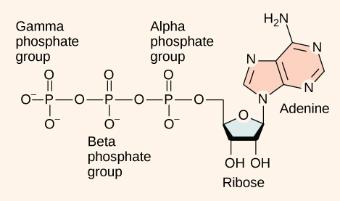
Figure 4.12
The structure of ATP shows the basic components of a two-ring adenine, five-carbon ribose, and three phosphate groups.
This OpenStax ancillary resource is © Rice University under a CC-BY 4.0 International license; it may be reproduced or modified but must be attributed to OpenStax, Rice University and any changes must be noted. Any images credited to other sources are similarly available for reproduction, but must be attributed to their sources.

Slide 14
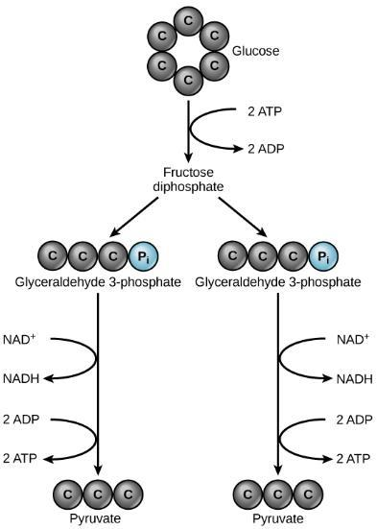
Figure 4.13
In glycolysis, a glucose molecule is converted into two pyruvate molecules.
This OpenStax ancillary resource is © Rice University under a CC-BY 4.0 International license; it may be reproduced or modified but must be attributed to OpenStax, Rice University and any changes must be noted. Any images credited to other sources are similarly available for reproduction, but must be attributed to their sources.

Slide 15
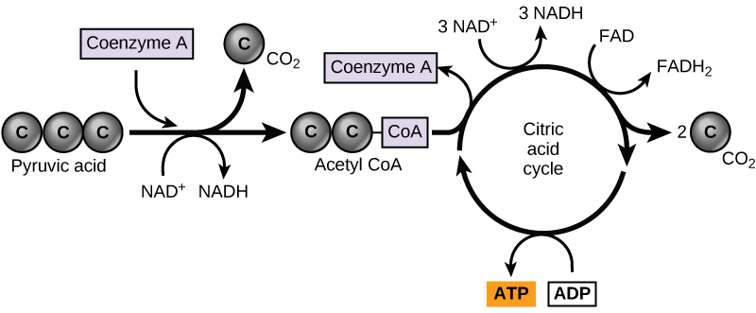
Figure 4.14
Pyruvate is converted into acetyl-CoA before entering the citric acid cycle.
This OpenStax ancillary resource is © Rice University under a CC-BY 4.0 International license; it may be reproduced or modified but must be attributed to OpenStax, Rice University and any changes must be noted. Any images credited to other sources are similarly available for reproduction, but must be attributed to their sources.

Slide 16
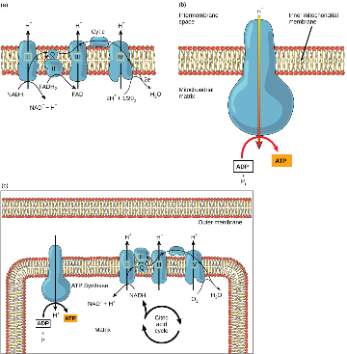
Figure 4.15
The electron transport chain is a set of molecules that supports a series of oxidation-reduction reactions.
ATP synthase is a complex, molecular machine that uses an H⁺ gradient to regenerate ATP from ADP.
Chemiosmosis relies on the potential energy provided by the H⁺ gradient across the membrane.
This OpenStax ancillary resource is © Rice University under a CC-BY 4.0 International license; it may be reproduced or modified but must be attributed to OpenStax, Rice University and any changes must be noted. Any images credited to other sources are similarly available for reproduction, but must be attributed to their sources.

Slide 17
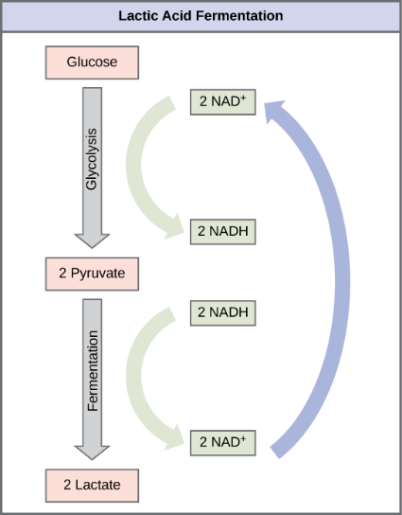
Figure 4.16
Lactic acid fermentation is common in muscles that have become exhausted by use.
This OpenStax ancillary resource is © Rice University under a CC-BY 4.0 International license; it may be reproduced or modified but must be attributed to OpenStax, Rice University and any changes must be noted. Any images credited to other sources are similarly available for reproduction, but must be attributed to their sources.

Slide 18
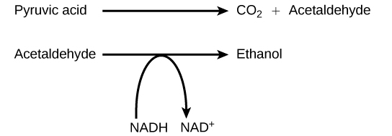
Figure 4.17
The reaction resulting in alcohol fermentation is shown.
This OpenStax ancillary resource is © Rice University under a CC-BY 4.0 International license; it may be reproduced or modified but must be attributed to OpenStax, Rice University and any changes must be noted. Any images credited to other sources are similarly available for reproduction, but must be attributed to their sources.

Slide 19
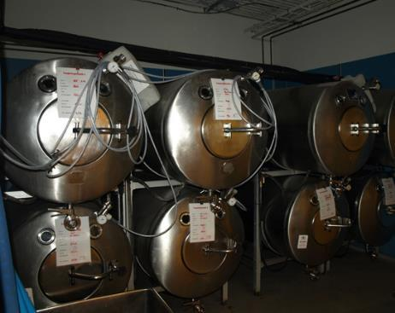
Figure 4.18
Fermentation of grape juice to make wine produces CO₂ as a byproduct. Fermentation tanks have valves so that pressure inside the tanks can be released.
This OpenStax ancillary resource is © Rice University under a CC-BY 4.0 International license; it may be reproduced or modified but must be attributed to OpenStax, Rice University and any changes must be noted. Any images credited to other sources are similarly available for reproduction, but must be attributed to their sources.

Slide 20
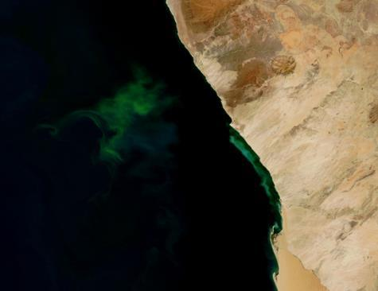
Figure 4.19
The green color seen in these coastal waters is from an eruption of hydrogen sulfide. Anaerobic, sulfate-reducing bacteria release hydrogen sulfide gas as they decompose algae in the water. (credit: NASA image courtesy Jeff Schmaltz, MODIS Land Rapid Response Team at NASA GSFC)
This OpenStax ancillary resource is © Rice University under a CC-BY 4.0 International license; it may be reproduced or modified but must be attributed to OpenStax, Rice University and any changes must be noted. Any images credited to other sources are similarly available for reproduction, but must be attributed to their sources.

Slide 21
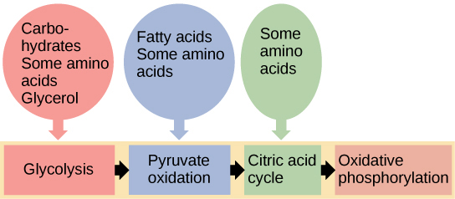
Figure 4.20
Glycogen from the liver and muscles, together with fats, can feed into the catabolic pathways for carbohydrates.
This OpenStax ancillary resource is © Rice University under a CC-BY 4.0 International license; it may be reproduced or modified but must be attributed to OpenStax, Rice University and any changes must be noted. Any images credited to other sources are similarly available for reproduction, but must be attributed to their sources.

