Slide 1

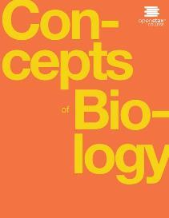
Concepts of Biology
Chapter 5 PHOTOSYNTHESIS
PowerPoint Image Slideshow

Slide 2
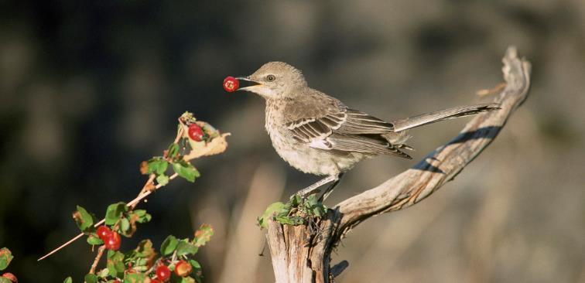
Figure 5.1
This sage thrasher’s diet, like that of almost all organisms, depends on photosynthesis. (credit: modification of work by Dave Menke, U.S. Fish and Wildlife Service)
This OpenStax ancillary resource is © Rice University under a CC-BY 4.0 International license; it may be reproduced or modified but must be attributed to OpenStax, Rice University and any changes must be noted. Any images credited to other sources are similarly available for reproduction, but must be attributed to their sources.

Slide 3
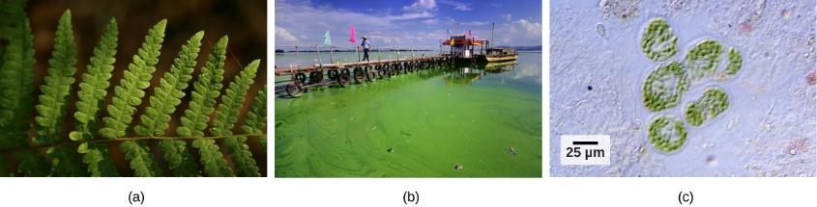
Figure 5.2
(a) Plants, (b) algae, and (c) certain bacteria, called cyanobacteria, are photoautotrophs that can carry out photosynthesis. Algae can grow over enormous areas in water, at times completely covering the surface. (credit a: Steve Hillebrand, U.S. Fish and Wildlife Service; credit b: “eutrophication&hypoxia”/Flickr; credit c: NASA; scale-bar data from Matt Russell)
This OpenStax ancillary resource is © Rice University under a CC-BY 4.0 International license; it may be reproduced or modified but must be attributed to OpenStax, Rice University and any changes must be noted. Any images credited to other sources are similarly available for reproduction, but must be attributed to their sources.

Slide 4
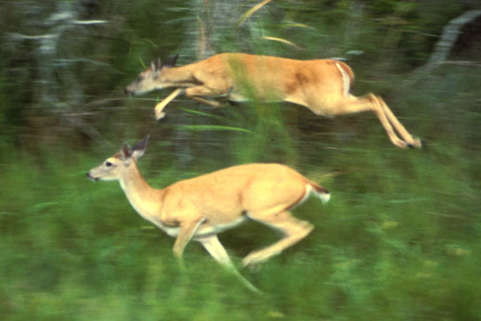
Figure 5.3
The energy stored in carbohydrate molecules from photosynthesis passes through the food chain. The predator that eats these deer is getting energy that originated in the photosynthetic vegetation that the deer consumed. (credit: Steve VanRiper, U.S. Fish and Wildlife Service)
This OpenStax ancillary resource is © Rice University under a CC-BY 4.0 International license; it may be reproduced or modified but must be attributed to OpenStax, Rice University and any changes must be noted. Any images credited to other sources are similarly available for reproduction, but must be attributed to their sources.

Slide 5
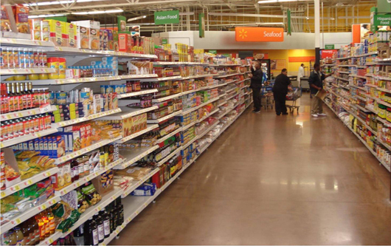
Figure 5.4
Photosynthesis is the origin of the products that comprise the main elements of the human diet. (credit: Associação Brasileira de Supermercados)
This OpenStax ancillary resource is © Rice University under a CC-BY 4.0 International license; it may be reproduced or modified but must be attributed to OpenStax, Rice University and any changes must be noted. Any images credited to other sources are similarly available for reproduction, but must be attributed to their sources.

Slide 6
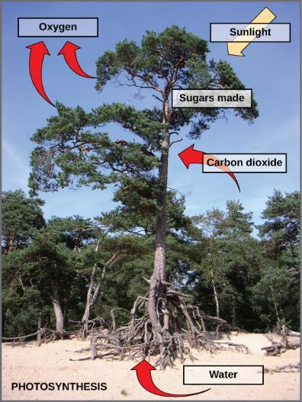
Figure 5.5
Photosynthesis uses solar energy, carbon dioxide, and water to release oxygen and to produce energy-storing sugar molecules.
This OpenStax ancillary resource is © Rice University under a CC-BY 4.0 International license; it may be reproduced or modified but must be attributed to OpenStax, Rice University and any changes must be noted. Any images credited to other sources are similarly available for reproduction, but must be attributed to their sources.

Slide 7
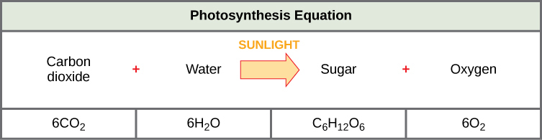
Figure 5.6
The process of photosynthesis can be represented by an equation, wherein carbon dioxide and water produce sugar and oxygen using energy from sunlight.
This OpenStax ancillary resource is © Rice University under a CC-BY 4.0 International license; it may be reproduced or modified but must be attributed to OpenStax, Rice University and any changes must be noted. Any images credited to other sources are similarly available for reproduction, but must be attributed to their sources.

Slide 8
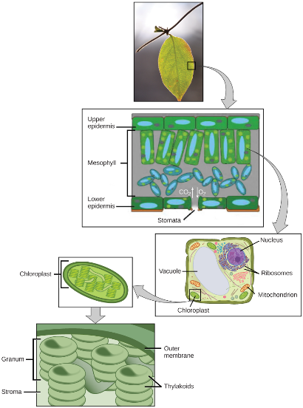
Figure 5.7
Not all cells of a leaf carry out photosynthesis. Cells within the middle layer of a leaf have chloroplasts, which contain the photosynthetic apparatus. (credit “leaf”: modification of work by Cory Zanker)
This OpenStax ancillary resource is © Rice University under a CC-BY 4.0 International license; it may be reproduced or modified but must be attributed to OpenStax, Rice University and any changes must be noted. Any images credited to other sources are similarly available for reproduction, but must be attributed to their sources.

Slide 9
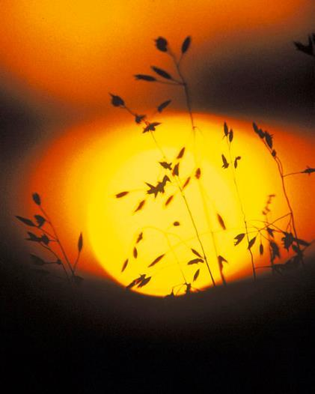
Figure 5.8
Autotrophs can capture light energy from the sun, converting it into chemical energy used to build food molecules. (credit: modification of work by Gerry Atwell, U.S. Fish and Wildlife Service)
This OpenStax ancillary resource is © Rice University under a CC-BY 4.0 International license; it may be reproduced or modified but must be attributed to OpenStax, Rice University and any changes must be noted. Any images credited to other sources are similarly available for reproduction, but must be attributed to their sources.

Slide 10
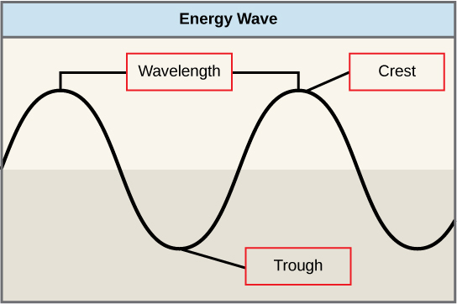
Figure 5.9
The wavelength of a single wave is the distance between two consecutive points along the wave.
This OpenStax ancillary resource is © Rice University under a CC-BY 4.0 International license; it may be reproduced or modified but must be attributed to OpenStax, Rice University and any changes must be noted. Any images credited to other sources are similarly available for reproduction, but must be attributed to their sources.

Slide 11
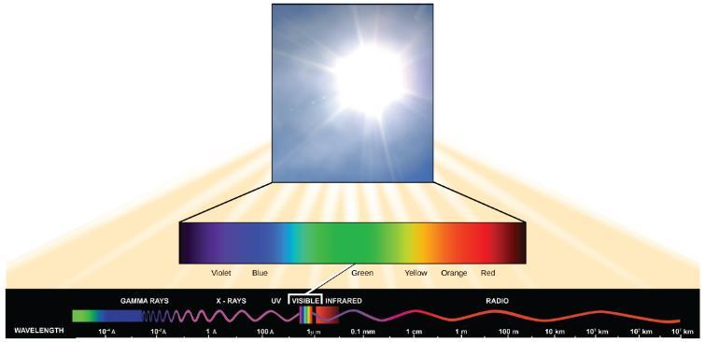
Figure 5.10
The sun emits energy in the form of electromagnetic radiation. This radiation exists in different wavelengths, each of which has its own characteristic energy. Visible light is one type of energy emitted from the sun.
This OpenStax ancillary resource is © Rice University under a CC-BY 4.0 International license; it may be reproduced or modified but must be attributed to OpenStax, Rice University and any changes must be noted. Any images credited to other sources are similarly available for reproduction, but must be attributed to their sources.

Slide 12
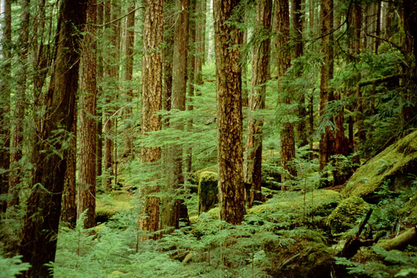
Figure 5.11
Plants that commonly grow in the shade benefit from having a variety of light-absorbing pigments. Each pigment can absorb different wavelengths of light, which allows the plant to absorb any light that passes through the taller trees. (credit: Jason Hollinger)
This OpenStax ancillary resource is © Rice University under a CC-BY 4.0 International license; it may be reproduced or modified but must be attributed to OpenStax, Rice University and any changes must be noted. Any images credited to other sources are similarly available for reproduction, but must be attributed to their sources.

Slide 13
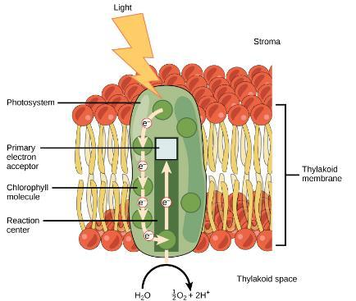
Figure 5.12
Light energy is absorbed by a chlorophyll molecule and is passed along a pathway to other chlorophyll molecules. The energy culminates in a molecule of chlorophyll found in the reaction center. The energy “excites” one of its electrons enough to leave the molecule and be transferred to a nearby primary electron acceptor. A molecule of water splits to release an electron, which is needed to replace the one donated. Oxygen and hydrogen ions are also formed from the splitting of water.
This OpenStax ancillary resource is © Rice University under a CC-BY 4.0 International license; it may be reproduced or modified but must be attributed to OpenStax, Rice University and any changes must be noted. Any images credited to other sources are similarly available for reproduction, but must be attributed to their sources.

Slide 14
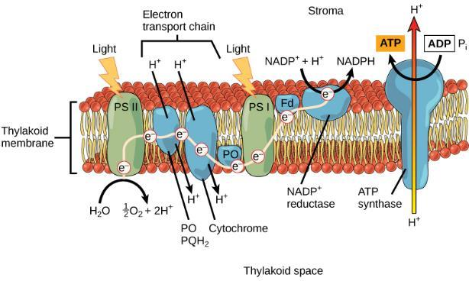
Figure 5.13
From photosystem II, the excited electron travels along a series of proteins. This electron transport system uses the energy from the electron to pump hydrogen ions into the interior of the thylakoid. A pigment molecule in photosystem I accepts the electron.
This OpenStax ancillary resource is © Rice University under a CC-BY 4.0 International license; it may be reproduced or modified but must be attributed to OpenStax, Rice University and any changes must be noted. Any images credited to other sources are similarly available for reproduction, but must be attributed to their sources.

Slide 15
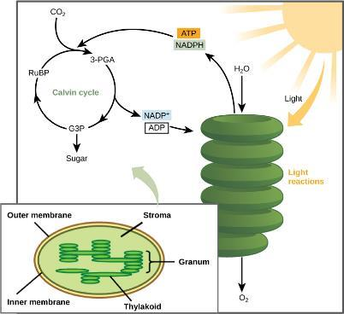
Figure 5.14
Light-dependent reactions harness energy from the sun to produce ATP and NADPH. These energy-carrying molecules travel into the stroma where the Calvin cycle reactions take place.
This OpenStax ancillary resource is © Rice University under a CC-BY 4.0 International license; it may be reproduced or modified but must be attributed to OpenStax, Rice University and any changes must be noted. Any images credited to other sources are similarly available for reproduction, but must be attributed to their sources.

Slide 16
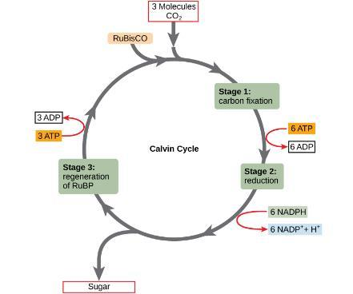
Figure 5.15
The Calvin cycle has three stages. In stage 1, the enzyme RuBisCO incorporates carbon dioxide into an organic molecule. In stage 2, the organic molecule is reduced. In stage 3, RuBP, the molecule that starts the cycle, is regenerated so that the cycle can continue.
This OpenStax ancillary resource is © Rice University under a CC-BY 4.0 International license; it may be reproduced or modified but must be attributed to OpenStax, Rice University and any changes must be noted. Any images credited to other sources are similarly available for reproduction, but must be attributed to their sources.

Slide 17
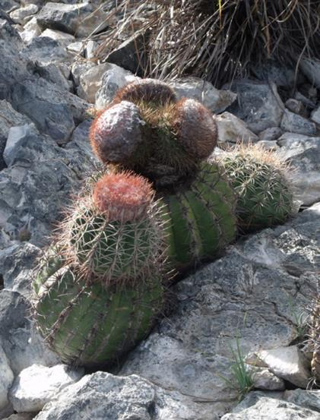
Figure 5.16
Living in the harsh conditions of the desert has led plants like this cactus to evolve variations in reactions outside the Calvin cycle. These variations increase efficiency and help conserve water and energy. (credit: Piotr Wojtkowski)
This OpenStax ancillary resource is © Rice University under a CC-BY 4.0 International license; it may be reproduced or modified but must be attributed to OpenStax, Rice University and any changes must be noted. Any images credited to other sources are similarly available for reproduction, but must be attributed to their sources.

Slide 18
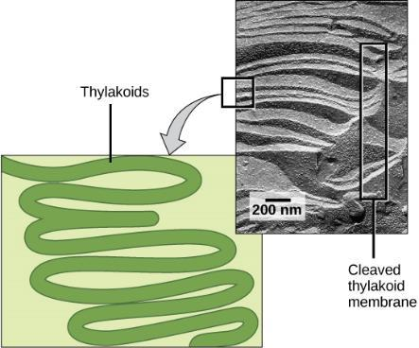
Figure 5.17
A photosynthetic prokaryote has infolded regions of the plasma membrane that function like thylakoids. Although these are not contained in an organelle, such as a chloroplast, all of the necessary components are present to carry out photosynthesis. (credit: scale-bar data from Matt Russell)
This OpenStax ancillary resource is © Rice University under a CC-BY 4.0 International license; it may be reproduced or modified but must be attributed to OpenStax, Rice University and any changes must be noted. Any images credited to other sources are similarly available for reproduction, but must be attributed to their sources.

Slide 19
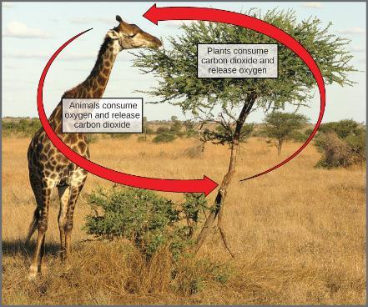
Figure 5.18
In the carbon cycle, the reactions of photosynthesis and cellular respiration share reciprocal reactants and products. (credit: modification of work by Stuart Bassil)
This OpenStax ancillary resource is © Rice University under a CC-BY 4.0 International license; it may be reproduced or modified but must be attributed to OpenStax, Rice University and any changes must be noted. Any images credited to other sources are similarly available for reproduction, but must be attributed to their sources.

