Slide 1

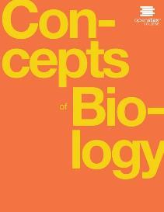
Concepts of Biology
Chapter 7 THE CELLULAR BASIS OF INHERITANCE
PowerPoint Image Slideshow

Slide 2
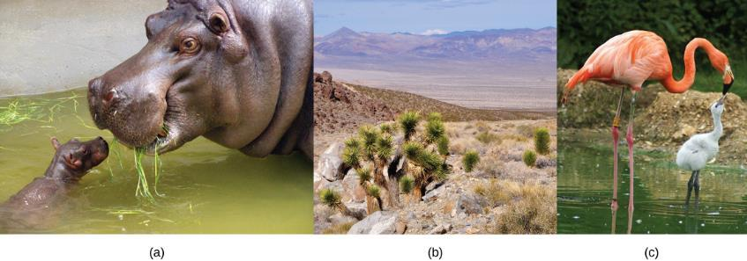
Figure 7.1
Each of us, like these other large multicellular organisms, begins life as a fertilized egg. After trillions of cell divisions, each of us develops into a complex, multicellular organism. (credit a: modification of work by Frank Wouters; credit b: modification of work by Ken Cole, USGS; credit c: modification of work by Martin Pettitt)
This OpenStax ancillary resource is © Rice University under a CC-BY 4.0 International license; it may be reproduced or modified but must be attributed to OpenStax, Rice University and any changes must be noted. Any images credited to other sources are similarly available for reproduction, but must be attributed to their sources.

Slide 3
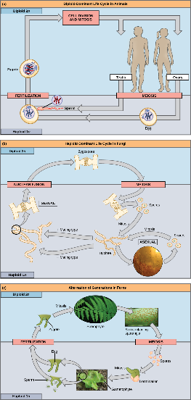
Figure 7.2
In animals, sexually reproducing adults form haploid gametes from diploid germ cells.
Fungi, such as black bread mold (Rhizopus nigricans), have haploid-dominant life cycles.
Plants have a life cycle that alternates between a multicellular haploid organism and a multicellular diploid organism. (credit c “fern”: modification of work by Cory Zanker; credit c “gametophyte”: modification of work by “Vlmastra”/Wikimedia Commons)
This OpenStax ancillary resource is © Rice University under a CC-BY 4.0 International license; it may be reproduced or modified but must be attributed to OpenStax, Rice University and any changes must be noted. Any images credited to other sources are similarly available for reproduction, but must be attributed to their sources.

Slide 4
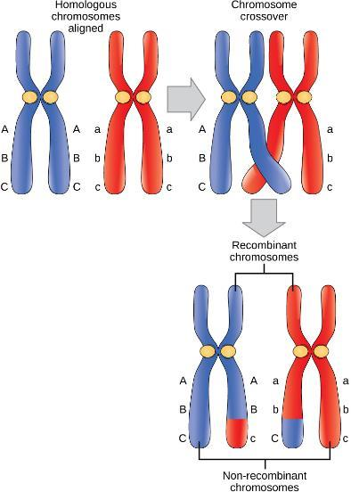
Figure 7.3
In this illustration of the effects of crossing over, the blue chromosome came from the individual’s father and the red chromosome came from the individual’s mother. Crossover occurs between non-sister chromatids of homologous chromosomes. The result is an exchange of genetic material between homologous chromosomes. The chromosomes that have a mixture of maternal and paternal sequence are called recombinant and the chromosomes that are completely paternal or maternal are called non-recombinant.
This OpenStax ancillary resource is © Rice University under a CC-BY 4.0 International license; it may be reproduced or modified but must be attributed to OpenStax, Rice University and any changes must be noted. Any images credited to other sources are similarly available for reproduction, but must be attributed to their sources.

Slide 5
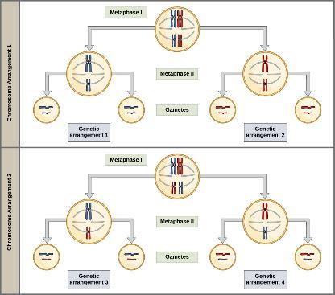
Figure 7.4
To demonstrate random, independent assortment at metaphase I, consider a cell with n = 2. In this case, there are two possible arrangements at the equatorial plane in metaphase I, as shown in the upper cell of each panel. These two possible orientations lead to the production of genetically different gametes. With more chromosomes, the number of possible arrangements increases dramatically.
This OpenStax ancillary resource is © Rice University under a CC-BY 4.0 International license; it may be reproduced or modified but must be attributed to OpenStax, Rice University and any changes must be noted. Any images credited to other sources are similarly available for reproduction, but must be attributed to their sources.

Slide 6
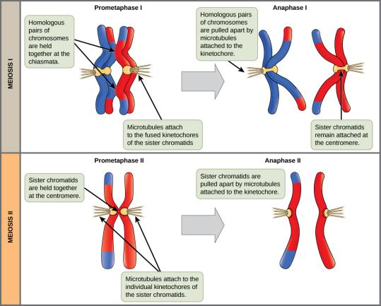
Figure 7.5
In prometaphase I, microtubules attach to the fused kinetochores of homologous chromosomes. In anaphase I, the homologous chromosomes are separated. In prometaphase II, microtubules attach to individual kinetochores of sister chromatids. In anaphase II, the sister chromatids are separated.
This OpenStax ancillary resource is © Rice University under a CC-BY 4.0 International license; it may be reproduced or modified but must be attributed to OpenStax, Rice University and any changes must be noted. Any images credited to other sources are similarly available for reproduction, but must be attributed to their sources.

Slide 7
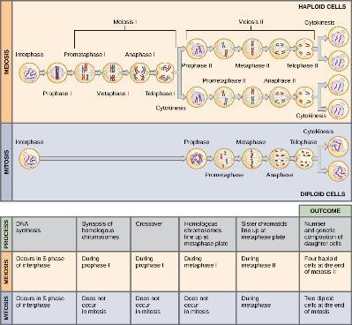
Figure 7.6
Meiosis and mitosis are both preceded by one round of DNA replication; however, meiosis includes two nuclear divisions. The four daughter cells resulting from meiosis are haploid and genetically distinct. The daughter cells resulting from mitosis are diploid and identical to the parent cell.
This OpenStax ancillary resource is © Rice University under a CC-BY 4.0 International license; it may be reproduced or modified but must be attributed to OpenStax, Rice University and any changes must be noted. Any images credited to other sources are similarly available for reproduction, but must be attributed to their sources.

Slide 8
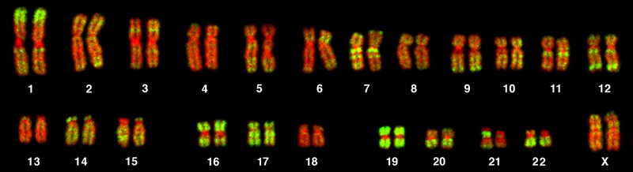
Figure 7.7
This karyogram shows the chromosomes of a female human immune cell during mitosis. (credit: Andreas Bolzer, et al)
This OpenStax ancillary resource is © Rice University under a CC-BY 4.0 International license; it may be reproduced or modified but must be attributed to OpenStax, Rice University and any changes must be noted. Any images credited to other sources are similarly available for reproduction, but must be attributed to their sources.

Slide 9
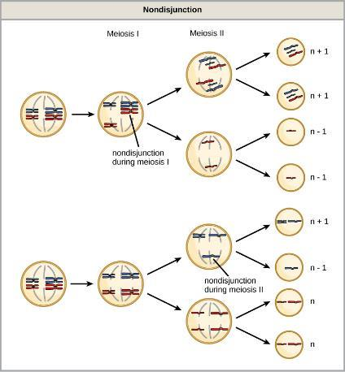
Figure 7.8
Following meiosis, each gamete has one copy of each chromosome. Nondisjunction occurs when homologous chromosomes (meiosis I) or sister chromatids (meiosis II) fail to separate during meiosis.
This OpenStax ancillary resource is © Rice University under a CC-BY 4.0 International license; it may be reproduced or modified but must be attributed to OpenStax, Rice University and any changes must be noted. Any images credited to other sources are similarly available for reproduction, but must be attributed to their sources.

Slide 10
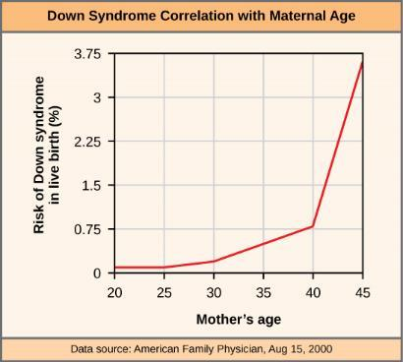
Figure 7.9
The incidence of having a fetus with trisomy 21 increases dramatically with maternal age.
This OpenStax ancillary resource is © Rice University under a CC-BY 4.0 International license; it may be reproduced or modified but must be attributed to OpenStax, Rice University and any changes must be noted. Any images credited to other sources are similarly available for reproduction, but must be attributed to their sources.

Slide 11
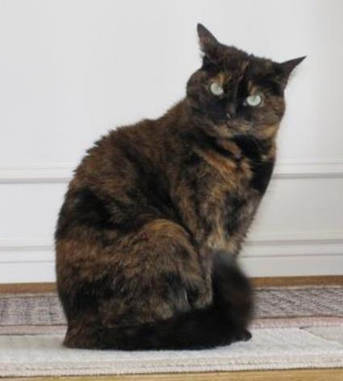
Figure 7.10
Embryonic inactivation of one of two different X chromosomes encoding different coat colors gives rise to the tortoiseshell phenotype in cats. (credit: Michael Bodega)
This OpenStax ancillary resource is © Rice University under a CC-BY 4.0 International license; it may be reproduced or modified but must be attributed to OpenStax, Rice University and any changes must be noted. Any images credited to other sources are similarly available for reproduction, but must be attributed to their sources.

Slide 12
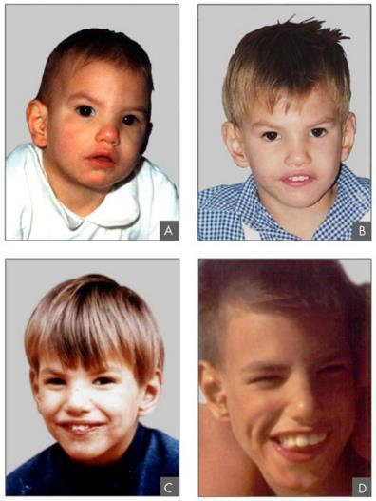
Figure 7.11
This individual with cri-du-chat syndrome is shown at various ages: (A) age two, (B) age four, (C) age nine, and (D) age 12. (credit: Paola Cerruti Mainardi)
This OpenStax ancillary resource is © Rice University under a CC-BY 4.0 International license; it may be reproduced or modified but must be attributed to OpenStax, Rice University and any changes must be noted. Any images credited to other sources are similarly available for reproduction, but must be attributed to their sources.

Slide 13
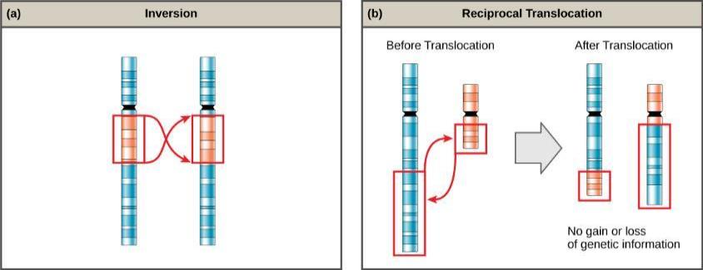
Figure 7.12
An (a) inversion occurs when a chromosome segment breaks from the chromosome, reverses its orientation, and then reattaches in the original position. A (b) reciprocal translocation occurs between two nonhomologous chromosomes and does not cause any genetic information to be lost or duplicated. (credit: modification of work by National Human Genome Research Institute (USA))
This OpenStax ancillary resource is © Rice University under a CC-BY 4.0 International license; it may be reproduced or modified but must be attributed to OpenStax, Rice University and any changes must be noted. Any images credited to other sources are similarly available for reproduction, but must be attributed to their sources.

