Slide 1

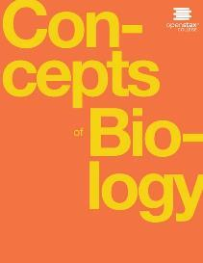
Concepts of Biology
Chapter 8 PATTERNS OF INHERITANCE
PowerPoint Image Slideshow

Slide 2
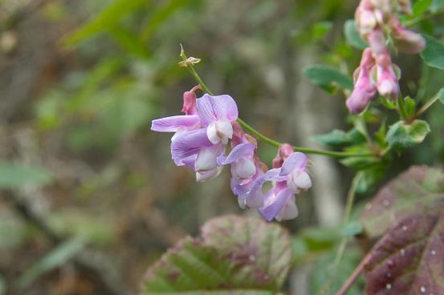
Figure 8.1
Experimenting with thousands of garden peas, Mendel uncovered the fundamentals of genetics. (credit: modification of work by Jerry Kirkhart)
This OpenStax ancillary resource is © Rice University under a CC-BY 4.0 International license; it may be reproduced or modified but must be attributed to OpenStax, Rice University and any changes must be noted. Any images credited to other sources are similarly available for reproduction, but must be attributed to their sources.

Slide 3
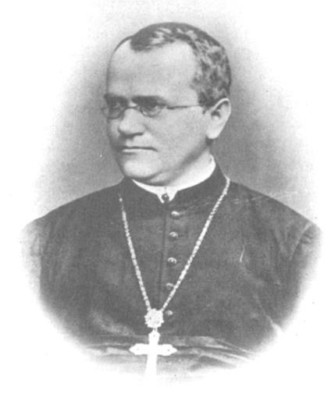
Figure 8.2
Johann Gregor Mendel set the framework for the study of genetics.
This OpenStax ancillary resource is © Rice University under a CC-BY 4.0 International license; it may be reproduced or modified but must be attributed to OpenStax, Rice University and any changes must be noted. Any images credited to other sources are similarly available for reproduction, but must be attributed to their sources.

Slide 4
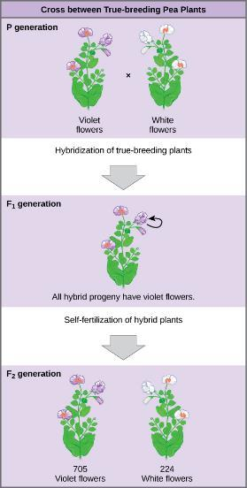
Figure 8.3
Mendel’s process for performing crosses included examining flower color.
This OpenStax ancillary resource is © Rice University under a CC-BY 4.0 International license; it may be reproduced or modified but must be attributed to OpenStax, Rice University and any changes must be noted. Any images credited to other sources are similarly available for reproduction, but must be attributed to their sources.

Slide 5
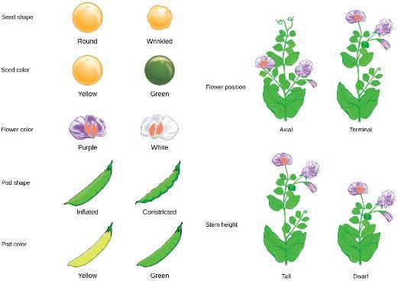
Figure 8.4
Mendel identified seven pea plant characteristics.
This OpenStax ancillary resource is © Rice University under a CC-BY 4.0 International license; it may be reproduced or modified but must be attributed to OpenStax, Rice University and any changes must be noted. Any images credited to other sources are similarly available for reproduction, but must be attributed to their sources.

Slide 6
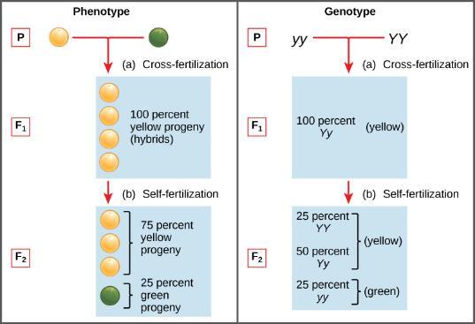
Figure 8.5
Phenotypes are physical expressions of traits that are transmitted by alleles. Capital letters represent dominant alleles and lowercase letters represent recessive alleles. The phenotypic ratios are the ratios of visible characteristics. The genotypic ratios are the ratios of gene combinations in the offspring, and these are not always distinguishable in the phenotypes.
This OpenStax ancillary resource is © Rice University under a CC-BY 4.0 International license; it may be reproduced or modified but must be attributed to OpenStax, Rice University and any changes must be noted. Any images credited to other sources are similarly available for reproduction, but must be attributed to their sources.

Slide 7
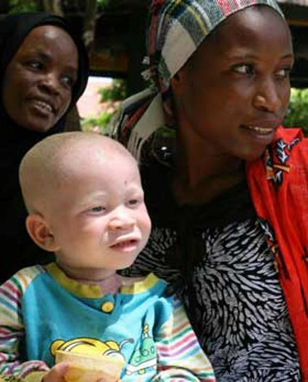
Figure 8.6
The allele for albinism, expressed here in humans, is recessive. Both of this child’s parents carried the recessive allele.
This OpenStax ancillary resource is © Rice University under a CC-BY 4.0 International license; it may be reproduced or modified but must be attributed to OpenStax, Rice University and any changes must be noted. Any images credited to other sources are similarly available for reproduction, but must be attributed to their sources.

Slide 8
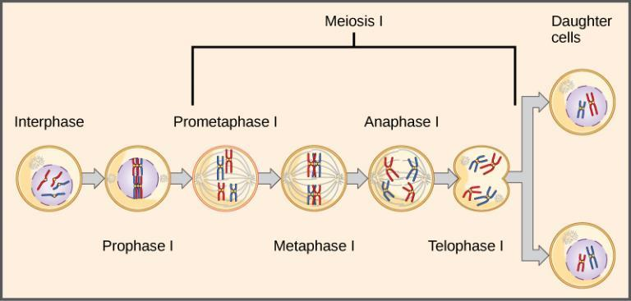
Figure 8.7
The first division in meiosis is shown.
This OpenStax ancillary resource is © Rice University under a CC-BY 4.0 International license; it may be reproduced or modified but must be attributed to OpenStax, Rice University and any changes must be noted. Any images credited to other sources are similarly available for reproduction, but must be attributed to their sources.

Slide 9
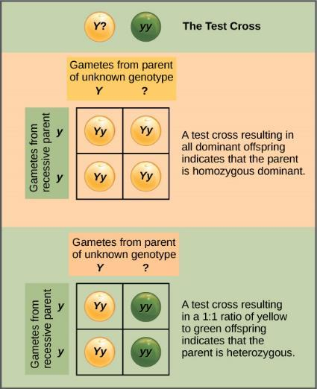
Figure 8.8
A test cross can be performed to determine whether an organism expressing a dominant trait is a homozygote or a heterozygote.
This OpenStax ancillary resource is © Rice University under a CC-BY 4.0 International license; it may be reproduced or modified but must be attributed to OpenStax, Rice University and any changes must be noted. Any images credited to other sources are similarly available for reproduction, but must be attributed to their sources.

Slide 10
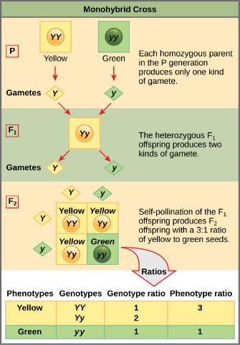
Figure 8.9
This Punnett square shows the cross between plants with yellow seeds and green seeds. The cross between the true-breeding P plants produces F₁ heterozygotes that can be self-fertilized. The self-cross of the F₁ generation can be analyzed with a Punnett square to predict the genotypes of the F₂ generation. Given an inheritance pattern of dominant–recessive, the genotypic and phenotypic ratios can then be determined.
This OpenStax ancillary resource is © Rice University under a CC-BY 4.0 International license; it may be reproduced or modified but must be attributed to OpenStax, Rice University and any changes must be noted. Any images credited to other sources are similarly available for reproduction, but must be attributed to their sources.

Slide 11
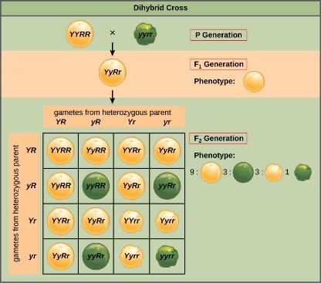
Figure 8.10
A dihybrid cross in pea plants involves the genes for seed color and texture. The P cross produces F₁ offspring that are all heterozygous for both characteristics. The resulting 9:3:3:1 F₂ phenotypic ratio is obtained using a Punnett square.
This OpenStax ancillary resource is © Rice University under a CC-BY 4.0 International license; it may be reproduced or modified but must be attributed to OpenStax, Rice University and any changes must be noted. Any images credited to other sources are similarly available for reproduction, but must be attributed to their sources.

Slide 12
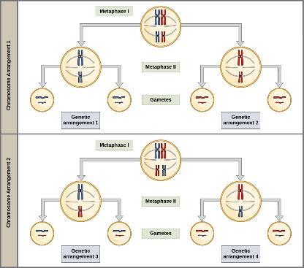
Figure 8.11
The random segregation into daughter nuclei that happens during the first division in meiosis can lead to a variety of possible genetic arrangements.
This OpenStax ancillary resource is © Rice University under a CC-BY 4.0 International license; it may be reproduced or modified but must be attributed to OpenStax, Rice University and any changes must be noted. Any images credited to other sources are similarly available for reproduction, but must be attributed to their sources.

Slide 13
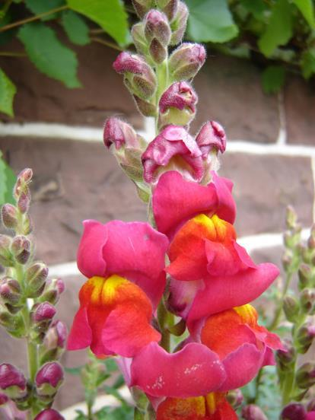
Figure 8.12
These pink flowers of a heterozygote snapdragon result from incomplete dominance. (credit: “storebukkebruse”/Flickr)
This OpenStax ancillary resource is © Rice University under a CC-BY 4.0 International license; it may be reproduced or modified but must be attributed to OpenStax, Rice University and any changes must be noted. Any images credited to other sources are similarly available for reproduction, but must be attributed to their sources.

Slide 14
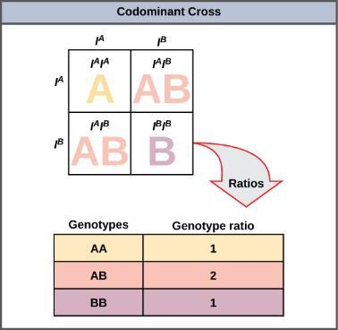
Figure 8.13
This Punnet square shows an AB/AB blood type cross
This OpenStax ancillary resource is © Rice University under a CC-BY 4.0 International license; it may be reproduced or modified but must be attributed to OpenStax, Rice University and any changes must be noted. Any images credited to other sources are similarly available for reproduction, but must be attributed to their sources.

Slide 15
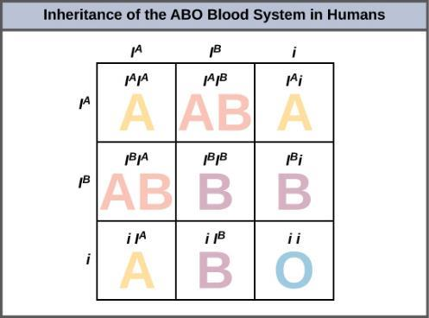
Figure 8.14
Inheritance of the ABO blood system in humans is shown.
This OpenStax ancillary resource is © Rice University under a CC-BY 4.0 International license; it may be reproduced or modified but must be attributed to OpenStax, Rice University and any changes must be noted. Any images credited to other sources are similarly available for reproduction, but must be attributed to their sources.

Slide 16
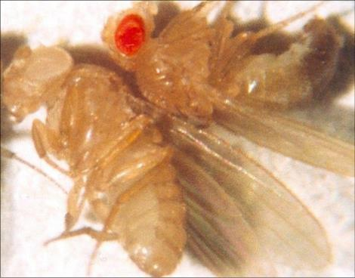
Figure 8.15
In Drosophila, the gene for eye color is located on the X chromosome. Red eye color is wild-type and is dominant to white eye color.
This OpenStax ancillary resource is © Rice University under a CC-BY 4.0 International license; it may be reproduced or modified but must be attributed to OpenStax, Rice University and any changes must be noted. Any images credited to other sources are similarly available for reproduction, but must be attributed to their sources.

Slide 17
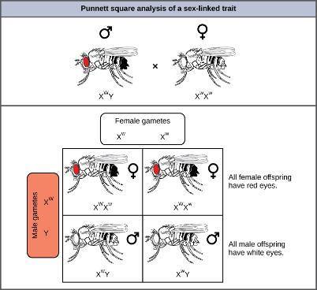
Figure 8.16
Crosses involving sex-linked traits often give rise to different phenotypes for the different sexes of offspring, as is the case for this cross involving red and white eye color in Drosophila. In the diagram, w is the white-eye mutant allele and W is the wild-type, red-eye allele.
This OpenStax ancillary resource is © Rice University under a CC-BY 4.0 International license; it may be reproduced or modified but must be attributed to OpenStax, Rice University and any changes must be noted. Any images credited to other sources are similarly available for reproduction, but must be attributed to their sources.

Slide 18
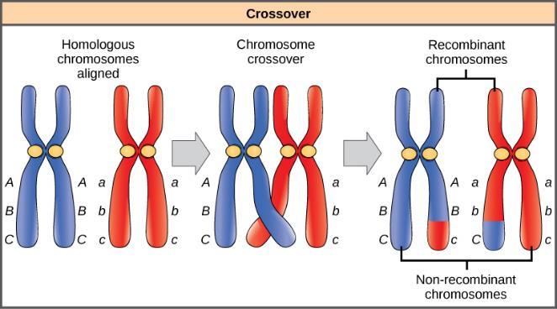
Figure 8.17
The process of crossover, or recombination, occurs when two homologous chromosomes align and exchange a segment of genetic material.
This OpenStax ancillary resource is © Rice University under a CC-BY 4.0 International license; it may be reproduced or modified but must be attributed to OpenStax, Rice University and any changes must be noted. Any images credited to other sources are similarly available for reproduction, but must be attributed to their sources.

Slide 19
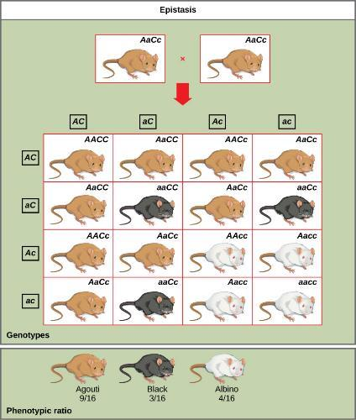
Figure 8.18
In this example of epistasis, one gene (C) masks the expression of another (A) for coat color. When the C allele is present, coat color is expressed; when it is absent (cc), no coat color is expressed. Coat color depends on the A gene, which shows dominance, with the recessive homozygote showing a different phenotype than the heterozygote or dominant homozygote.
This OpenStax ancillary resource is © Rice University under a CC-BY 4.0 International license; it may be reproduced or modified but must be attributed to OpenStax, Rice University and any changes must be noted. Any images credited to other sources are similarly available for reproduction, but must be attributed to their sources.

