Slide 1

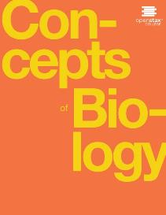
CONCEPTS OF BIOLOGY
Chapter 9 MOLECULAR BIOLOGY
PowerPoint Image Slideshow

Slide 2
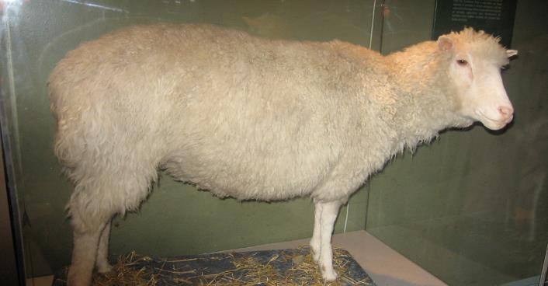
Figure 9.1
Dolly the sheep was the first cloned mammal.
This OpenStax ancillary resource is © Rice University under a CC-BY 4.0 International license; it may be reproduced or modified but must be attributed to OpenStax, Rice University and any changes must be noted. Any images credited to other sources are similarly available for reproduction, but must be attributed to their sources.

Slide 3
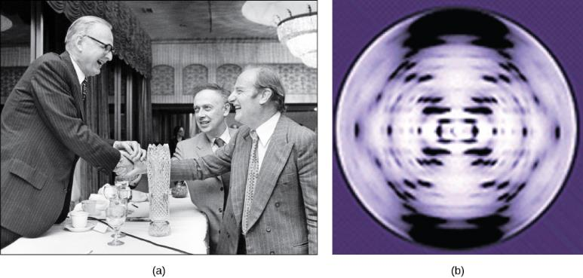
Figure 9.2
Pioneering scientists (a) James Watson and Francis Crick are pictured here with American geneticist Maclyn McCarty. Scientist Rosalind Franklin discovered (b) the X-ray diffraction pattern of DNA, which helped to elucidate its double helix structure. (credit a: modification of work by Marjorie McCarty; b: modification of work by NIH)
This OpenStax ancillary resource is © Rice University under a CC-BY 4.0 International license; it may be reproduced or modified but must be attributed to OpenStax, Rice University and any changes must be noted. Any images credited to other sources are similarly available for reproduction, but must be attributed to their sources.

Slide 4
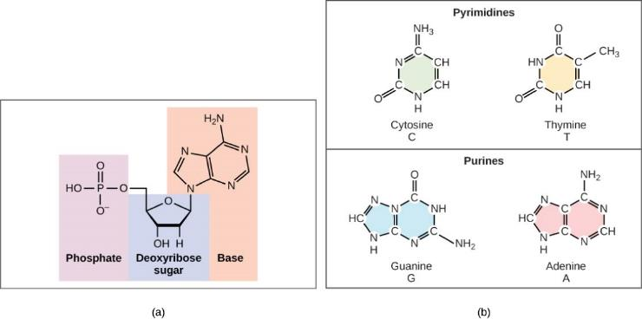
Figure 9.3
(a) Each DNA nucleotide is made up of a sugar, a phosphate group, and a base.
(b) Cytosine and thymine are pyrimidines. Guanine and adenine are purines.
This OpenStax ancillary resource is © Rice University under a CC-BY 4.0 International license; it may be reproduced or modified but must be attributed to OpenStax, Rice University and any changes must be noted. Any images credited to other sources are similarly available for reproduction, but must be attributed to their sources.

Slide 5
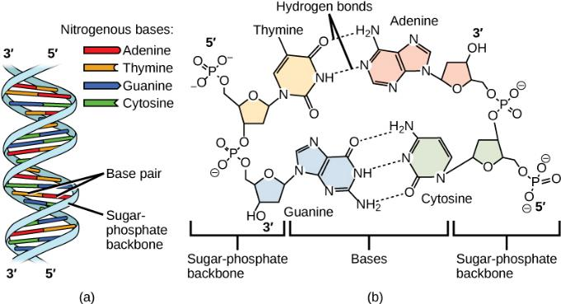
Figure 9.4
DNA (a) forms a double stranded helix, and (b) adenine pairs with thymine and cytosine pairs with guanine. (credit a: modification of work by Jerome Walker, Dennis Myts)
This OpenStax ancillary resource is © Rice University under a CC-BY 4.0 International license; it may be reproduced or modified but must be attributed to OpenStax, Rice University and any changes must be noted. Any images credited to other sources are similarly available for reproduction, but must be attributed to their sources.

Slide 6
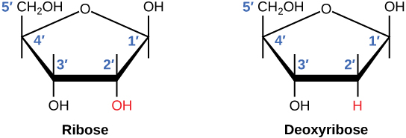
Figure 9.5
The difference between the ribose found in RNA and the deoxyribose found in DNA is that ribose has a hydroxyl group at the 2' carbon.
This OpenStax ancillary resource is © Rice University under a CC-BY 4.0 International license; it may be reproduced or modified but must be attributed to OpenStax, Rice University and any changes must be noted. Any images credited to other sources are similarly available for reproduction, but must be attributed to their sources.

Slide 7
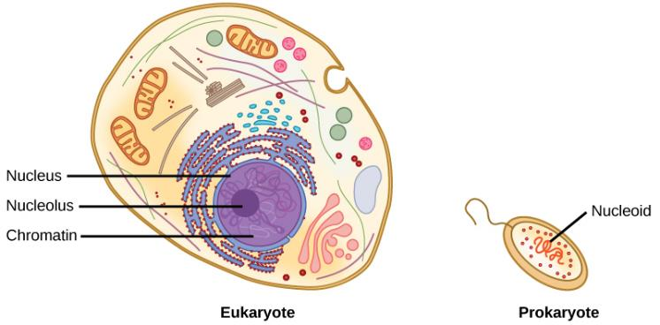
Figure 9.6
A eukaryote contains a well-defined nucleus, whereas in prokaryotes, the chromosome lies in the cytoplasm in an area called the nucleoid.
This OpenStax ancillary resource is © Rice University under a CC-BY 4.0 International license; it may be reproduced or modified but must be attributed to OpenStax, Rice University and any changes must be noted. Any images credited to other sources are similarly available for reproduction, but must be attributed to their sources.

Slide 8
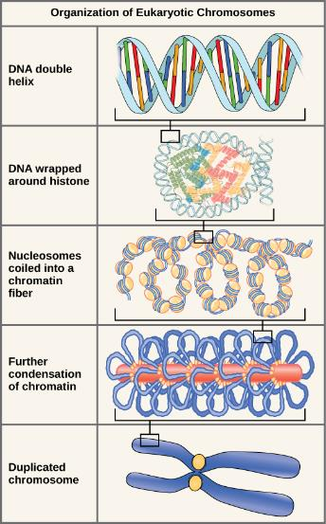
Figure 9.7
These figures illustrate the compaction of the eukaryotic chromosome.
This OpenStax ancillary resource is © Rice University under a CC-BY 4.0 International license; it may be reproduced or modified but must be attributed to OpenStax, Rice University and any changes must be noted. Any images credited to other sources are similarly available for reproduction, but must be attributed to their sources.

Slide 9
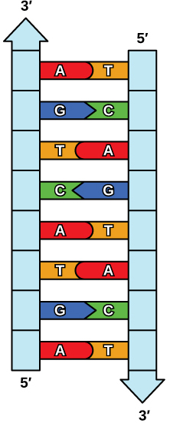
Figure 9.8
The two strands of DNA are complementary, meaning the sequence of bases in one strand can be used to create the correct sequence of bases in the other strand.
This OpenStax ancillary resource is © Rice University under a CC-BY 4.0 International license; it may be reproduced or modified but must be attributed to OpenStax, Rice University and any changes must be noted. Any images credited to other sources are similarly available for reproduction, but must be attributed to their sources.

Slide 10
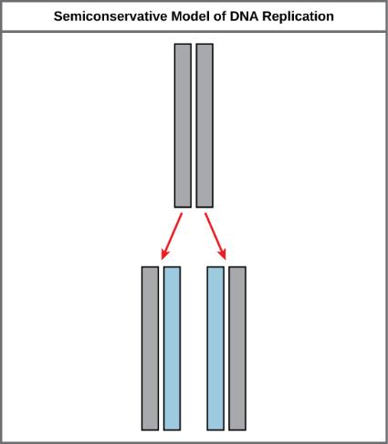
Figure 9.9
The semiconservative model of DNA replication is shown. Gray indicates the original DNA strands, and blue indicates newly synthesized DNA..
This OpenStax ancillary resource is © Rice University under a CC-BY 4.0 International license; it may be reproduced or modified but must be attributed to OpenStax, Rice University and any changes must be noted. Any images credited to other sources are similarly available for reproduction, but must be attributed to their sources.

Slide 11
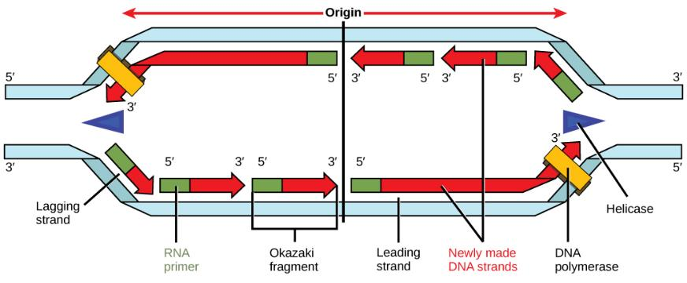
Figure 9.10
A replication fork is formed by the opening of the origin of replication, and helicase separates the DNA strands. An RNA primer is synthesized, and is elongated by the DNA polymerase. On the leading strand, DNA is synthesized continuously, whereas on the lagging strand, DNA is synthesized in short stretches. The DNA fragments are joined by DNA ligase (not shown).
This OpenStax ancillary resource is © Rice University under a CC-BY 4.0 International license; it may be reproduced or modified but must be attributed to OpenStax, Rice University and any changes must be noted. Any images credited to other sources are similarly available for reproduction, but must be attributed to their sources.

Slide 12
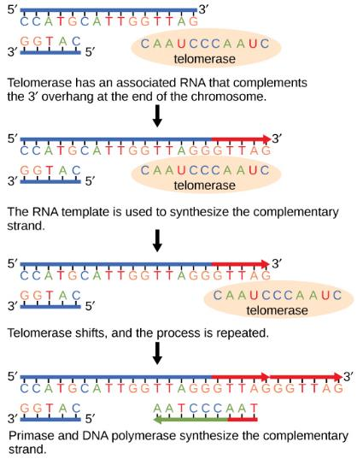
Figure 9.11
The ends of linear chromosomes are maintained by the action of the telomerase enzyme.
This OpenStax ancillary resource is © Rice University under a CC-BY 4.0 International license; it may be reproduced or modified but must be attributed to OpenStax, Rice University and any changes must be noted. Any images credited to other sources are similarly available for reproduction, but must be attributed to their sources.

Slide 13
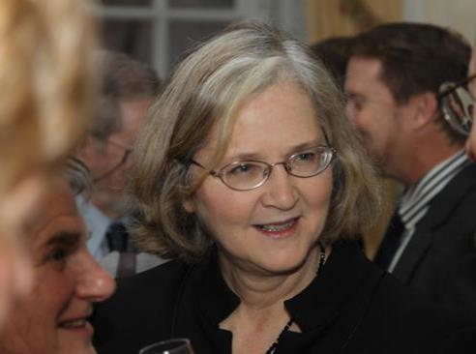
Figure 9.12
Elizabeth Blackburn, 2009 Nobel Laureate, was the scientist who discovered how telomerase works. (credit: U.S. Embassy, Stockholm, Sweden)
This OpenStax ancillary resource is © Rice University under a CC-BY 4.0 International license; it may be reproduced or modified but must be attributed to OpenStax, Rice University and any changes must be noted. Any images credited to other sources are similarly available for reproduction, but must be attributed to their sources.

Slide 14
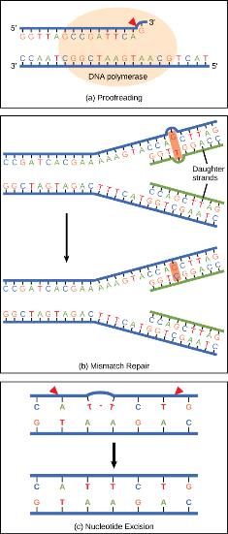
Figure 9.13
Proofreading by DNA polymerase (a) corrects errors during replication. In mismatch repair (b), the incorrectly added base is detected after replication. The mismatch repair proteins detect this base and remove it from the newly synthesized strand by nuclease action. The gap is now filled with the correctly paired base. Nucleotide excision (c) repairs thymine dimers. When exposed to UV, thymines lying adjacent to each other can form thymine dimers. In normal cells, they are excised and replaced.
This OpenStax ancillary resource is © Rice University under a CC-BY 4.0 International license; it may be reproduced or modified but must be attributed to OpenStax, Rice University and any changes must be noted. Any images credited to other sources are similarly available for reproduction, but must be attributed to their sources.

Slide 15
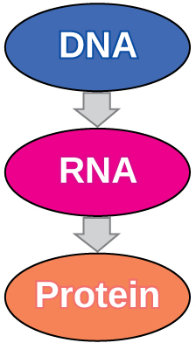
Figure 9.14
The central dogma states that DNA encodes RNA, which in turn encodes protein.
This OpenStax ancillary resource is © Rice University under a CC-BY 4.0 International license; it may be reproduced or modified but must be attributed to OpenStax, Rice University and any changes must be noted. Any images credited to other sources are similarly available for reproduction, but must be attributed to their sources.

Slide 16
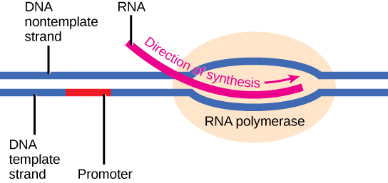
Figure 9.15
The initiation of transcription begins when DNA is unwound, forming a transcription bubble. Enzymes and other proteins involved in transcription bind at the promoter.
This OpenStax ancillary resource is © Rice University under a CC-BY 4.0 International license; it may be reproduced or modified but must be attributed to OpenStax, Rice University and any changes must be noted. Any images credited to other sources are similarly available for reproduction, but must be attributed to their sources.

Slide 17
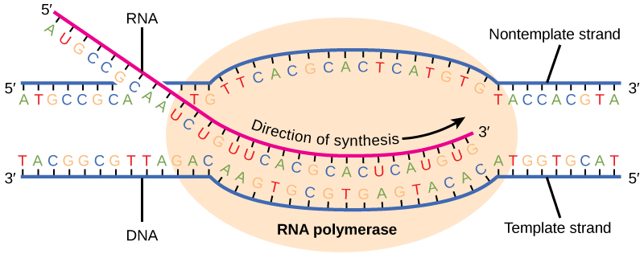
Figure 9.16
During elongation, RNA polymerase tracks along the DNA template, synthesizes mRNA in the 5' to 3' direction, and unwinds then rewinds the DNA as it is read.
This OpenStax ancillary resource is © Rice University under a CC-BY 4.0 International license; it may be reproduced or modified but must be attributed to OpenStax, Rice University and any changes must be noted. Any images credited to other sources are similarly available for reproduction, but must be attributed to their sources.

Slide 18
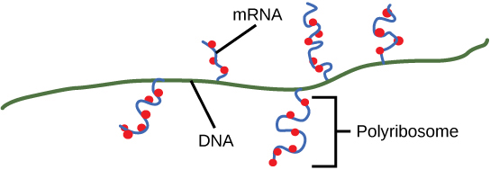
Figure 9.17
Multiple polymerases can transcribe a single bacterial gene while numerous ribosomes concurrently translate the mRNA transcripts into polypeptides. In this way, a specific protein can rapidly reach a high concentration in the bacterial cell.
This OpenStax ancillary resource is © Rice University under a CC-BY 4.0 International license; it may be reproduced or modified but must be attributed to OpenStax, Rice University and any changes must be noted. Any images credited to other sources are similarly available for reproduction, but must be attributed to their sources.

Slide 19
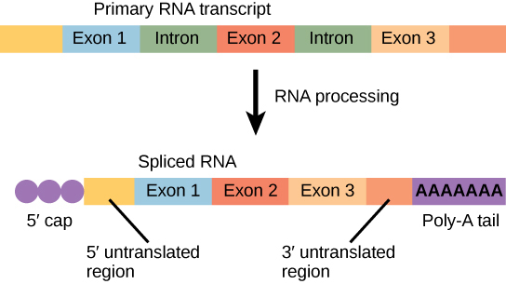
Figure 9.18
Eukaryotic mRNA contains introns that must be spliced out. A 5' cap and 3' tail are also added.
This OpenStax ancillary resource is © Rice University under a CC-BY 4.0 International license; it may be reproduced or modified but must be attributed to OpenStax, Rice University and any changes must be noted. Any images credited to other sources are similarly available for reproduction, but must be attributed to their sources.

Slide 20
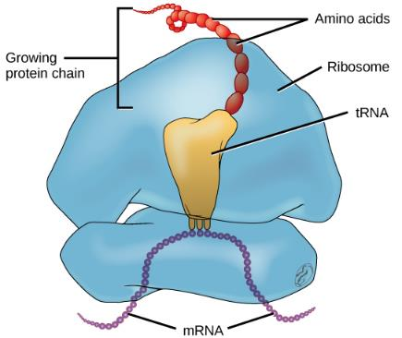
Figure 9.19
The protein synthesis machinery includes the large and small subunits of the ribosome, mRNA, and tRNA. (credit: modification of work by NIGMS, NIH)
This OpenStax ancillary resource is © Rice University under a CC-BY 4.0 International license; it may be reproduced or modified but must be attributed to OpenStax, Rice University and any changes must be noted. Any images credited to other sources are similarly available for reproduction, but must be attributed to their sources.

Slide 21
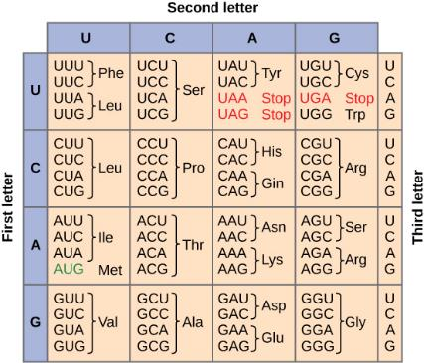
Figure 9.20
This figure shows the genetic code for translating each nucleotide triplet, or codon, in mRNA into an amino acid or a termination signal in a nascent protein. (credit: modification of work by NIH)
This OpenStax ancillary resource is © Rice University under a CC-BY 4.0 International license; it may be reproduced or modified but must be attributed to OpenStax, Rice University and any changes must be noted. Any images credited to other sources are similarly available for reproduction, but must be attributed to their sources.

Slide 22
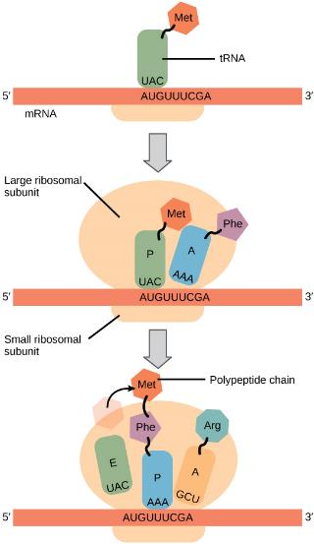
Figure 9.21
Translation begins when a tRNA anticodon recognizes a codon on the mRNA. The large ribosomal subunit joins the small subunit, and a second tRNA is recruited. As the mRNA moves relative to the ribosome, the polypeptide chain is formed. Entry of a release factor into the A site terminates translation and the components dissociate.
This OpenStax ancillary resource is © Rice University under a CC-BY 4.0 International license; it may be reproduced or modified but must be attributed to OpenStax, Rice University and any changes must be noted. Any images credited to other sources are similarly available for reproduction, but must be attributed to their sources.

Slide 23
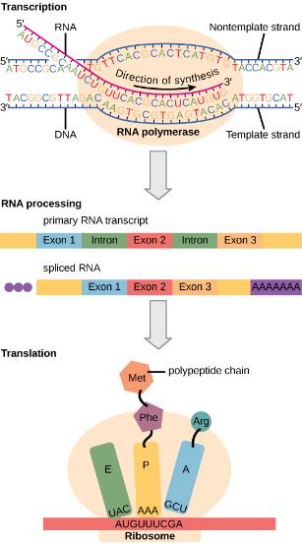
Figure 9.22
Eukaryotic gene expression is regulated during transcription and RNA processing, which take place in the nucleus, as well as during protein translation, which takes place in the cytoplasm. Further regulation may occur through post-translational modifications of proteins.
This OpenStax ancillary resource is © Rice University under a CC-BY 4.0 International license; it may be reproduced or modified but must be attributed to OpenStax, Rice University and any changes must be noted. Any images credited to other sources are similarly available for reproduction, but must be attributed to their sources.

Slide 24
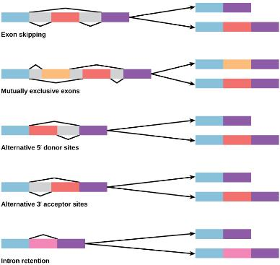
Figure 9.23
There are five basic modes of alternative splicing. Segments of pre-mRNA with exons shown in blue, red, orange, and pink can be spliced to produce a variety of new mature mRNA segments.
This OpenStax ancillary resource is © Rice University under a CC-BY 4.0 International license; it may be reproduced or modified but must be attributed to OpenStax, Rice University and any changes must be noted. Any images credited to other sources are similarly available for reproduction, but must be attributed to their sources.

