Slide 1

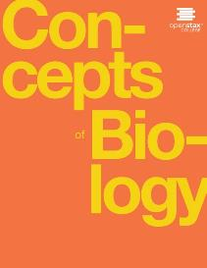
CONCEPTS OF BIOLOGY
Chapter 11 EVOLUTION AND ITS PROCESSES
PowerPoint Image Slideshow

Slide 2
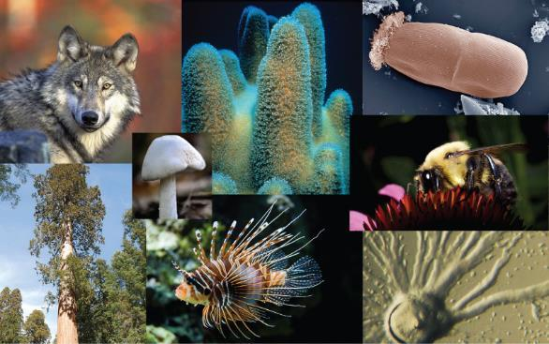
Figure 11.1
The diversity of life on Earth is the result of evolution, a continuous process that is still occurring. (credit “wolf”: modification of work by Gary Kramer, USFWS; credit “coral”: modification of work by William Harrigan, NOAA; credit “river”: modification of work by Vojtěch Dost.l; credit “protozoa”: modification of work by Sharon Franklin, Stephen Ausmus, USDA ARS; credit “fish” modification of work by Christian Mehlführer; credit “mushroom”, “bee”: modification of work by Cory Zanker; credit “tree”: modification of work by Joseph Kranak)
This OpenStax ancillary resource is © Rice University under a CC-BY 4.0 International license; it may be reproduced or modified but must be attributed to OpenStax, Rice University and any changes must be noted. Any images credited to other sources are similarly available for reproduction, but must be attributed to their sources.

Slide 3
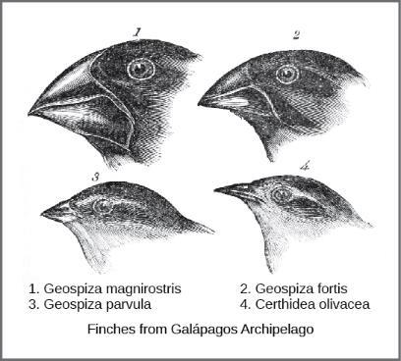
Figure 11.2
Darwin observed that beak shape varies among finch species. He postulated that the beak of an ancestral species had adapted over time to equip the finches to acquire different food sources. This illustration shows the beak shapes for four species of ground finch: 1. Geospiza magnirostris (the large ground finch), 2. G. fortis (the medium ground finch), 3. G. parvula (the small tree finch), and 4. Certhidea olivacea (the green-warbler finch).
This OpenStax ancillary resource is © Rice University under a CC-BY 4.0 International license; it may be reproduced or modified but must be attributed to OpenStax, Rice University and any changes must be noted. Any images credited to other sources are similarly available for reproduction, but must be attributed to their sources.

Slide 4
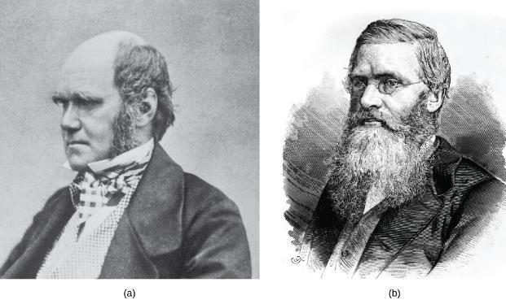
Figure 11.3
(a) Charles Darwin and (b) Alfred Wallace wrote scientific papers on natural selection that were presented together before the Linnean Society in 1858.
This OpenStax ancillary resource is © Rice University under a CC-BY 4.0 International license; it may be reproduced or modified but must be attributed to OpenStax, Rice University and any changes must be noted. Any images credited to other sources are similarly available for reproduction, but must be attributed to their sources.

Slide 5
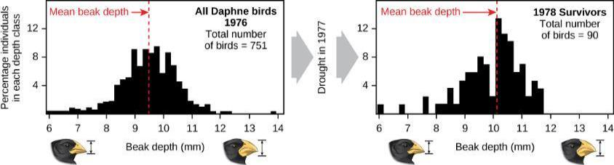
Figure 11.4
A drought on the Galápagos island of Daphne Major in 1977 reduced the number of small seeds available to finches, causing many of the small-beaked finches to die. This caused an increase in the finches’ average beak size between 1976 and 1978.
This OpenStax ancillary resource is © Rice University under a CC-BY 4.0 International license; it may be reproduced or modified but must be attributed to OpenStax, Rice University and any changes must be noted. Any images credited to other sources are similarly available for reproduction, but must be attributed to their sources.

Slide 6
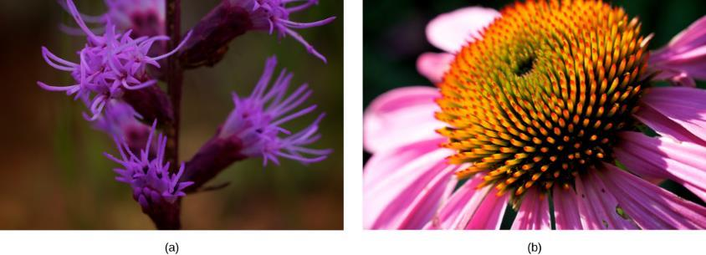
Figure 11.5
Flowering plants evolved from a common ancestor. Notice that the (a) dense blazing star and (b) purple coneflower vary in appearance, yet both share a similar basic morphology. (credit a, b: modification of work by Cory Zanker)
This OpenStax ancillary resource is © Rice University under a CC-BY 4.0 International license; it may be reproduced or modified but must be attributed to OpenStax, Rice University and any changes must be noted. Any images credited to other sources are similarly available for reproduction, but must be attributed to their sources.

Slide 7
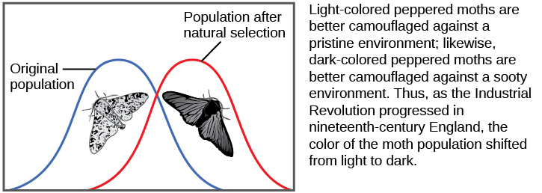
Figure 11.6
As the Industrial Revolution caused trees to darken from soot, darker colored peppered moths were better camouflaged than the lighter colored ones, which caused there to be more of the darker colored moths in the population.
This OpenStax ancillary resource is © Rice University under a CC-BY 4.0 International license; it may be reproduced or modified but must be attributed to OpenStax, Rice University and any changes must be noted. Any images credited to other sources are similarly available for reproduction, but must be attributed to their sources.

Slide 8
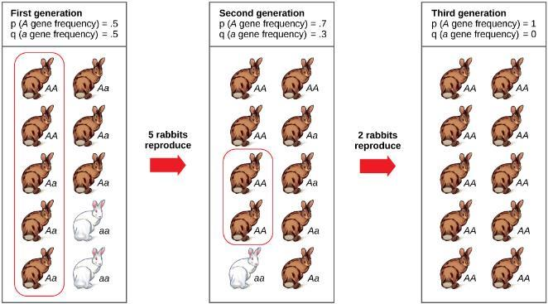
Figure 11.7
Genetic drift in a population can lead to the elimination of an allele from a population by chance. In each generation, a random set of individuals reproduces to produce the next generation. The frequency of alleles in the next generation is equal to the frequency of alleles among the individuals reproducing.
This OpenStax ancillary resource is © Rice University under a CC-BY 4.0 International license; it may be reproduced or modified but must be attributed to OpenStax, Rice University and any changes must be noted. Any images credited to other sources are similarly available for reproduction, but must be attributed to their sources.

Slide 9
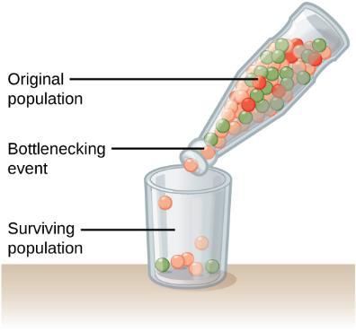
Figure 11.8
A chance event or catastrophe can reduce the genetic variability within a population.
This OpenStax ancillary resource is © Rice University under a CC-BY 4.0 International license; it may be reproduced or modified but must be attributed to OpenStax, Rice University and any changes must be noted. Any images credited to other sources are similarly available for reproduction, but must be attributed to their sources.

Slide 10
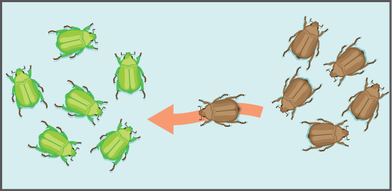
Figure 11.9
Gene flow can occur when an individual travels from one geographic location to another and joins a different population of the species. In the example shown here, the brown allele is introduced into the green population.
This OpenStax ancillary resource is © Rice University under a CC-BY 4.0 International license; it may be reproduced or modified but must be attributed to OpenStax, Rice University and any changes must be noted. Any images credited to other sources are similarly available for reproduction, but must be attributed to their sources.

Slide 11
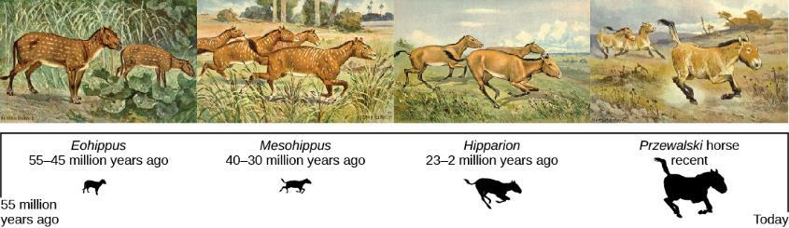
Figure 11.10
This illustration shows an artist’s renderings of these species derived from fossils of the evolutionary history of the horse and its ancestors. The species depicted are only four from a very diverse lineage that contains many branches, dead ends, and adaptive radiations. One of the trends, depicted here is the evolutionary tracking of a drying climate and increase in prairie versus forest habitat reflected in forms that are more adapted to grazing and predator escape through running. Przewalski's horse is one of a few living species of horse.
This OpenStax ancillary resource is © Rice University under a CC-BY 4.0 International license; it may be reproduced or modified but must be attributed to OpenStax, Rice University and any changes must be noted. Any images credited to other sources are similarly available for reproduction, but must be attributed to their sources.

Slide 12
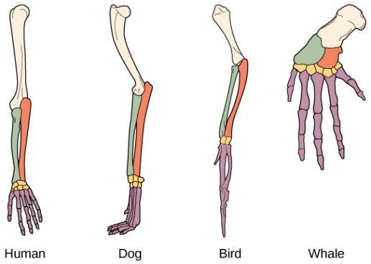
Figure 11.11
The similar construction of these appendages indicates that these organisms share a common ancestor.
This OpenStax ancillary resource is © Rice University under a CC-BY 4.0 International license; it may be reproduced or modified but must be attributed to OpenStax, Rice University and any changes must be noted. Any images credited to other sources are similarly available for reproduction, but must be attributed to their sources.

Slide 13
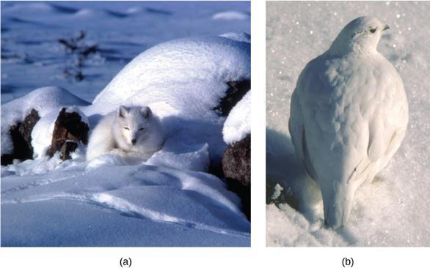
Figure 11.12
The white winter coat of (a) the arctic fox and (b) the ptarmigan’s plumage are adaptations to their environments. (credit a: modification of work by Keith Morehouse)
This OpenStax ancillary resource is © Rice University under a CC-BY 4.0 International license; it may be reproduced or modified but must be attributed to OpenStax, Rice University and any changes must be noted. Any images credited to other sources are similarly available for reproduction, but must be attributed to their sources.

Slide 14
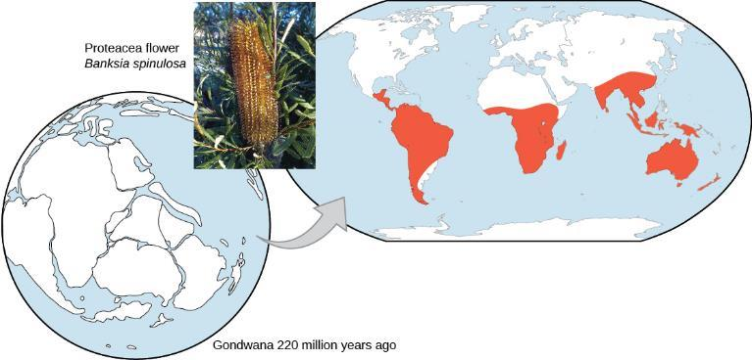
Figure 11.13
The Proteacea family of plants evolved before the supercontinent Gondwana broke up. Today, members of this plant family are found throughout the southern hemisphere (shown in red). (credit “Proteacea flower”: modification of work by “dorofofoto”/Flickr)
This OpenStax ancillary resource is © Rice University under a CC-BY 4.0 International license; it may be reproduced or modified but must be attributed to OpenStax, Rice University and any changes must be noted. Any images credited to other sources are similarly available for reproduction, but must be attributed to their sources.

Slide 15
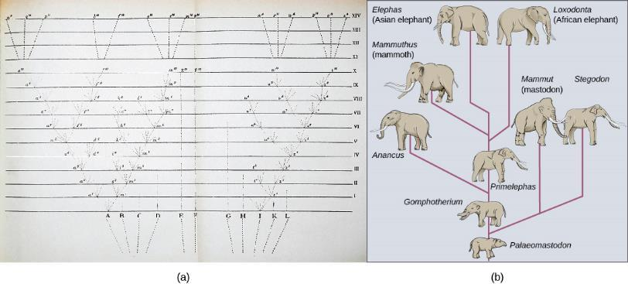
Figure 11.14
The only illustration in Darwin’s On the Origin of Species is (a) a diagram showing speciation events leading to biological diversity. The diagram shows similarities to phylogenetic charts that are drawn today to illustrate the relationships of species. (b) Modern elephants evolved from the Palaeomastodon, a species that lived in Egypt 35–50 million years ago.
This OpenStax ancillary resource is © Rice University under a CC-BY 4.0 International license; it may be reproduced or modified but must be attributed to OpenStax, Rice University and any changes must be noted. Any images credited to other sources are similarly available for reproduction, but must be attributed to their sources.

Slide 16
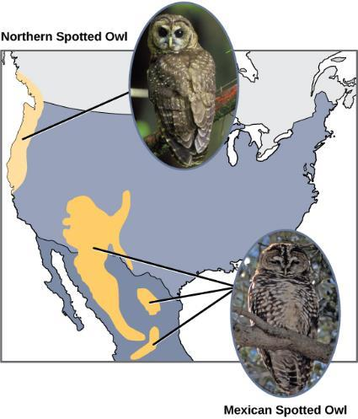
Figure 11.15
The northern spotted owl and the Mexican spotted owl inhabit geographically separate locations with different climates and ecosystems. The owl is an example of incipient speciation. (credit “northern spotted owl”: modification of work by John and Karen Hollingsworth, USFWS; credit “Mexican spotted owl”: modification of work by Bill Radke, USFWS)
This OpenStax ancillary resource is © Rice University under a CC-BY 4.0 International license; it may be reproduced or modified but must be attributed to OpenStax, Rice University and any changes must be noted. Any images credited to other sources are similarly available for reproduction, but must be attributed to their sources.

Slide 17
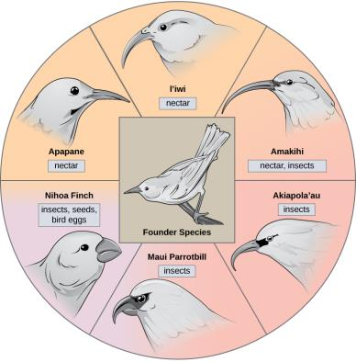
Figure 11.16
The honeycreeper birds illustrate adaptive radiation. From one original species of bird, multiple others evolved, each with its own distinctive characteristics.
This OpenStax ancillary resource is © Rice University under a CC-BY 4.0 International license; it may be reproduced or modified but must be attributed to OpenStax, Rice University and any changes must be noted. Any images credited to other sources are similarly available for reproduction, but must be attributed to their sources.

Slide 18
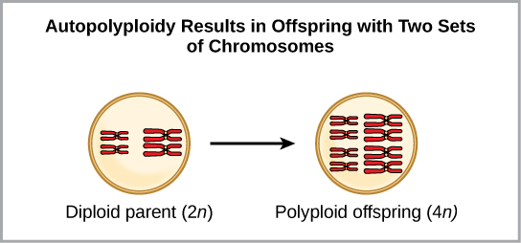
Figure 11.17
Autopolyploidy results when mitosis is not followed by cytokinesis.
This OpenStax ancillary resource is © Rice University under a CC-BY 4.0 International license; it may be reproduced or modified but must be attributed to OpenStax, Rice University and any changes must be noted. Any images credited to other sources are similarly available for reproduction, but must be attributed to their sources.

Slide 19
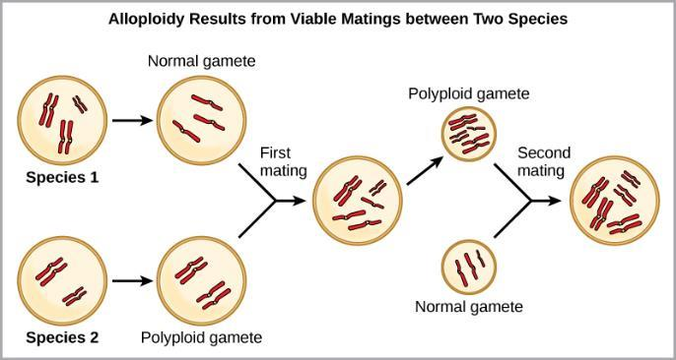
Figure 11.18
Alloploidy results when two species mate to produce viable offspring. In the example shown, a normal gamete from one species fuses with a polyploid gamete from another. Two matings are necessary to produce viable offspring.
This OpenStax ancillary resource is © Rice University under a CC-BY 4.0 International license; it may be reproduced or modified but must be attributed to OpenStax, Rice University and any changes must be noted. Any images credited to other sources are similarly available for reproduction, but must be attributed to their sources.

Slide 20
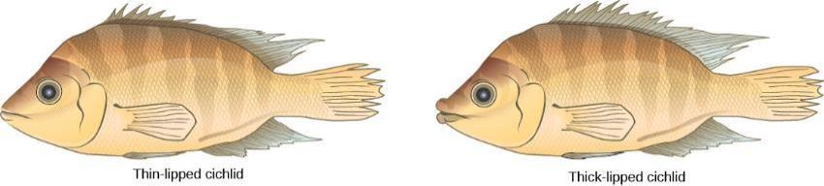
Figure 11.19
Cichlid fish from Lake Apoyeque, Nicaragua, show evidence of sympatric speciation. Lake Apoyeque, a crater lake, is 1800 years old, but genetic evidence indicates that the lake was populated only 100 years ago by a single population of cichlid fish. Nevertheless, two populations with distinct morphologies and diets now exist in the lake, and scientists believe these populations may be in an early stage of speciation.
This OpenStax ancillary resource is © Rice University under a CC-BY 4.0 International license; it may be reproduced or modified but must be attributed to OpenStax, Rice University and any changes must be noted. Any images credited to other sources are similarly available for reproduction, but must be attributed to their sources.

