Slide 1

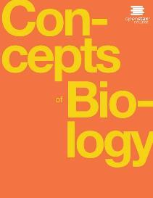
Concepts of Biology
Chapter 12 DIVERSITY OF LIFE
PowerPoint Image Slideshow

Slide 2
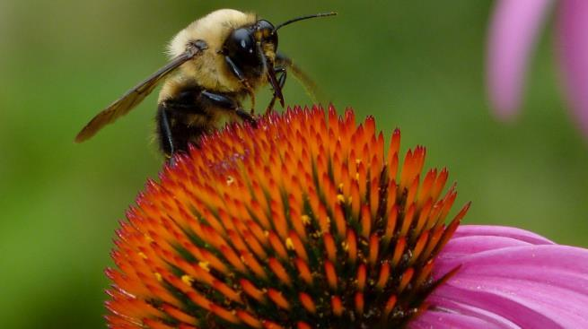
Figure 12.1
Although they look different, this bee and flower are distantly related. (credit: modification of work by John Beetham)
This OpenStax ancillary resource is © Rice University under a CC-BY 4.0 International license; it may be reproduced or modified but must be attributed to OpenStax, Rice University and any changes must be noted. Any images credited to other sources are similarly available for reproduction, but must be attributed to their sources.

Slide 3
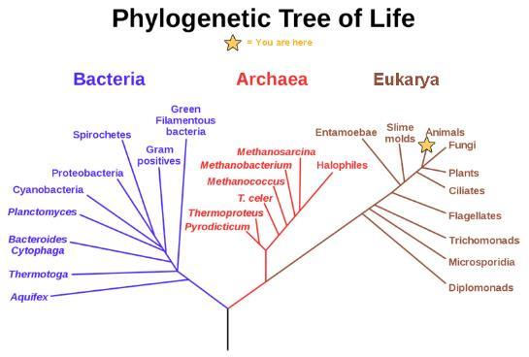
Figure 12.2
In the evolution of life on Earth, the three domains of life—Archaea, Bacteria, and Eukarya—branch from a single point. (credit: modification of work by Eric Gaba)
This OpenStax ancillary resource is © Rice University under a CC-BY 4.0 International license; it may be reproduced or modified but must be attributed to OpenStax, Rice University and any changes must be noted. Any images credited to other sources are similarly available for reproduction, but must be attributed to their sources.

Slide 4
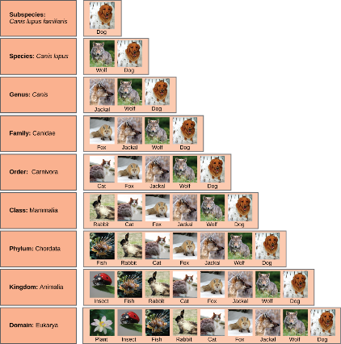
Figure 12.3
At each sublevel in the taxonomic classification system, organisms become more similar. Dogs and wolves are the same species because they can breed and produce viable offspring, but they are different enough to be classified as different subspecies. (credit “plant”: modification of work by "berduchwal"/Flickr; credit “insect”: modification of work by Jon Sullivan; credit “fish”: modification of work by Christian Mehlführer; credit “rabbit”: modification of work by Aidan Wojtas; credit “cat”: modification of work by Jonathan Lidbeck; credit “fox”: modification of work by Kevin Bacher, NPS; credit “jackal”: modification of work by Thomas A. Hermann, NBII, USGS; credit “wolf” modification of work by Robert Dewar; credit “dog”: modification of work by "digital_image_fan"/Flickr)
This OpenStax ancillary resource is © Rice University under a CC-BY 4.0 International license; it may be reproduced or modified but must be attributed to OpenStax, Rice University and any changes must be noted. Any images credited to other sources are similarly available for reproduction, but must be attributed to their sources.

Slide 5
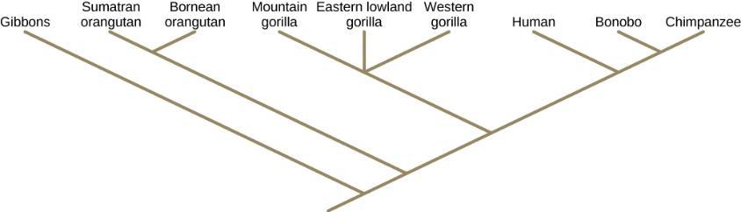
Figure 12.4
A phylogenetic tree is rooted and shows how different organisms, in this case the species and subspecies of living apes, evolved from a common ancestor.
This OpenStax ancillary resource is © Rice University under a CC-BY 4.0 International license; it may be reproduced or modified but must be attributed to OpenStax, Rice University and any changes must be noted. Any images credited to other sources are similarly available for reproduction, but must be attributed to their sources.

Slide 6
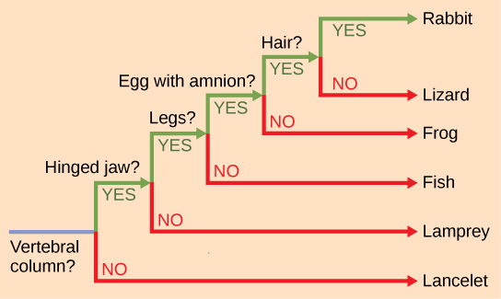
Figure 12.5
This phylogenetic tree is rooted by an organism that lacked a vertebral column. At each branch point, organisms with different characters are placed in different groups.
This OpenStax ancillary resource is © Rice University under a CC-BY 4.0 International license; it may be reproduced or modified but must be attributed to OpenStax, Rice University and any changes must be noted. Any images credited to other sources are similarly available for reproduction, but must be attributed to their sources.

Slide 7
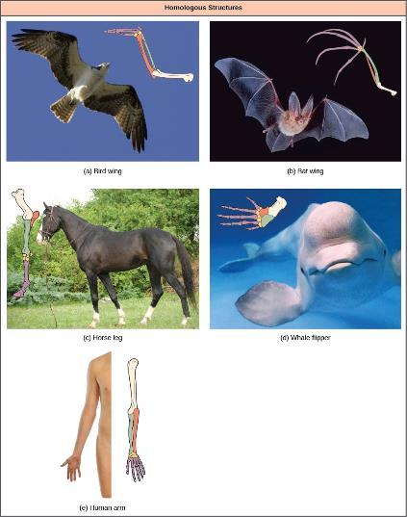
Figure 12.6
Bat and bird wings, the foreleg of a horse, the flipper of a whale, and the arm of a human are homologous structures, indicating that bats, birds, horses, whales, and humans share a common evolutionary past. (credit a photo: modification of work by Steve Hillebrand, USFWS; credit b photo: modification of work by U.S. BLM; credit c photo: modification of work by Virendra Kankariya; credit d photo: modification of work by Russian Gov./Wikimedia Commons)
This OpenStax ancillary resource is © Rice University under a CC-BY 4.0 International license; it may be reproduced or modified but must be attributed to OpenStax, Rice University and any changes must be noted. Any images credited to other sources are similarly available for reproduction, but must be attributed to their sources.

Slide 8
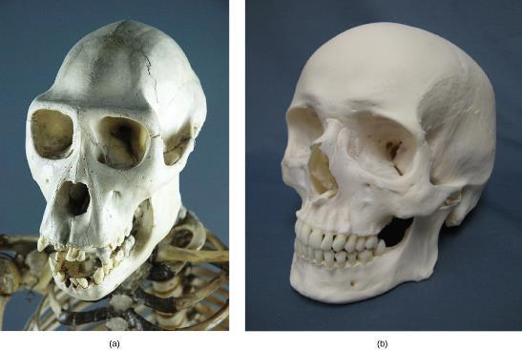
Figure 12.7
(a) The chimpanzee jaw protrudes to a much greater degree than (b) the human jaw.
(credit a: modification of work by "Pastorius"/Wikimedia Commons)
This OpenStax ancillary resource is © Rice University under a CC-BY 4.0 International license; it may be reproduced or modified but must be attributed to OpenStax, Rice University and any changes must be noted. Any images credited to other sources are similarly available for reproduction, but must be attributed to their sources.

Slide 9
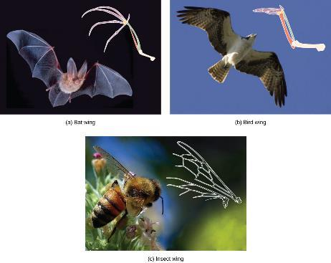
Figure 12.8
The wing of a honey bee is similar in shape to a bird wing and a bat wing and serves the same function (flight). The bird and bat wings are homologous structures. However, the honey bee wing has a different structure (it is made of a chitinous exoskeleton, not a boney endoskeleton) and embryonic origin. The bee and bird or bat wing types illustrate an analogy—similar structures that do not share an evolutionary history. (credit a photo: modification of work by U.S. BLM; credit b: modification of work by Steve Hillebrand, USFWS; credit c: modification of work by Jon Sullivan)
This OpenStax ancillary resource is © Rice University under a CC-BY 4.0 International license; it may be reproduced or modified but must be attributed to OpenStax, Rice University and any changes must be noted. Any images credited to other sources are similarly available for reproduction, but must be attributed to their sources.

Slide 10
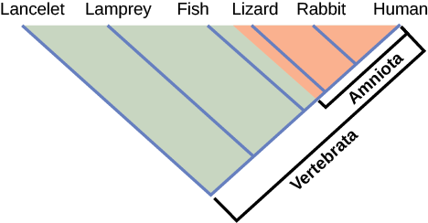
Figure 12.9
Lizards, rabbits, and humans all descend from a common ancestor in which the amniotic egg evolved. Thus, lizards, rabbits, and humans all belong to the clade Amniota. Vertebrata is a larger clade that also includes fish and lamprey.
This OpenStax ancillary resource is © Rice University under a CC-BY 4.0 International license; it may be reproduced or modified but must be attributed to OpenStax, Rice University and any changes must be noted. Any images credited to other sources are similarly available for reproduction, but must be attributed to their sources.

