Slide 1


Concepts of Biology
Chapter 20 ECOSYSTEMS AND THE BIOSPHERE
PowerPoint Image Slideshow

Slide 2
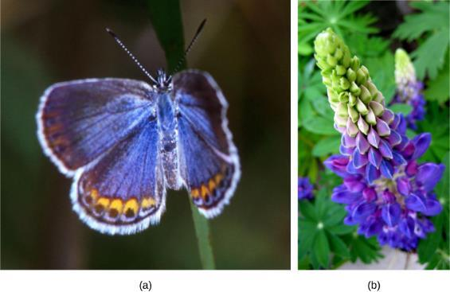
Figure 20.1
The (a) Karner blue butterfly and (b) wild lupine live in oak-pine barren habitats in North America. (credit a: modification of work by John & Karen Hollingsworth, USFWS)
This OpenStax ancillary resource is © Rice University under a CC-BY 4.0 International license; it may be reproduced or modified but must be attributed to OpenStax, Rice University and any changes must be noted. Any images credited to other sources are similarly available for reproduction, but must be attributed to their sources.

Slide 3
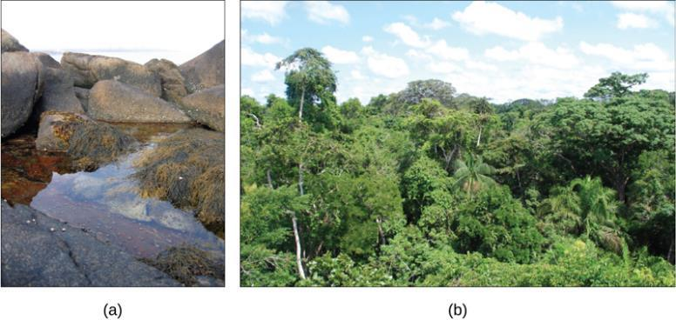
Figure 20.2
A (a) tidal pool ecosystem in Matinicus Island, Maine, is a small ecosystem, while the (b) Amazon rainforest in Brazil is a large ecosystem. (credit a: modification of work by Jim Kuhn; credit b: modification of work by Ivan Mlinaric)
This OpenStax ancillary resource is © Rice University under a CC-BY 4.0 International license; it may be reproduced or modified but must be attributed to OpenStax, Rice University and any changes must be noted. Any images credited to other sources are similarly available for reproduction, but must be attributed to their sources.

Slide 4
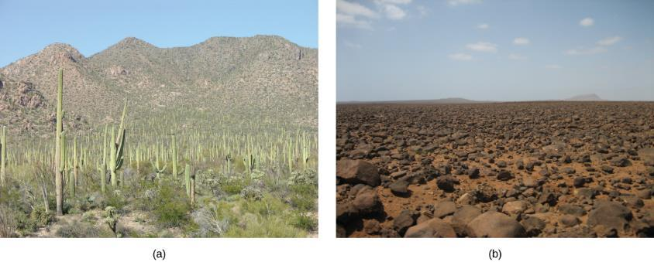
Figure 20.3
Desert ecosystems, like all ecosystems, can vary greatly. The desert in (a) Saguaro National Park, Arizona, has abundant plant life, while the rocky desert of (b) Boa Vista island, Cape Verde, Africa, is devoid of plant life. (credit a: modification of work by Jay Galvin; credit b: modification of work by Ingo Wölbern)
This OpenStax ancillary resource is © Rice University under a CC-BY 4.0 International license; it may be reproduced or modified but must be attributed to OpenStax, Rice University and any changes must be noted. Any images credited to other sources are similarly available for reproduction, but must be attributed to their sources.

Slide 5
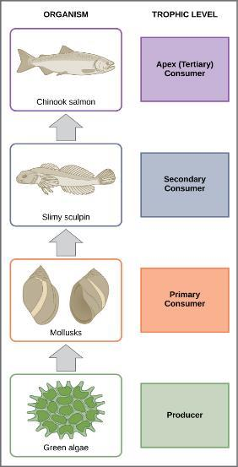
Figure 20.4
These are the trophic levels of a food chain in Lake Ontario at the United States–Canada border. Energy and nutrients flow from photosynthetic green algae at the base to the top of the food chain: the Chinook salmon. (credit: modification of work by National Oceanic and Atmospheric Administration/NOAA)
This OpenStax ancillary resource is © Rice University under a CC-BY 4.0 International license; it may be reproduced or modified but must be attributed to OpenStax, Rice University and any changes must be noted. Any images credited to other sources are similarly available for reproduction, but must be attributed to their sources.

Slide 6
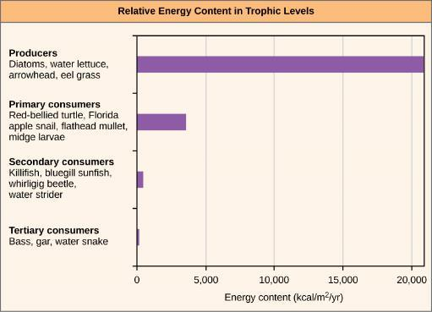
Figure 20.5
The relative energy in trophic levels in a Silver Springs, Florida, ecosystem is shown. Each trophic level has less energy available, and usually, but not always, supports a smaller mass of organisms at the next level.
This OpenStax ancillary resource is © Rice University under a CC-BY 4.0 International license; it may be reproduced or modified but must be attributed to OpenStax, Rice University and any changes must be noted. Any images credited to other sources are similarly available for reproduction, but must be attributed to their sources.

Slide 7
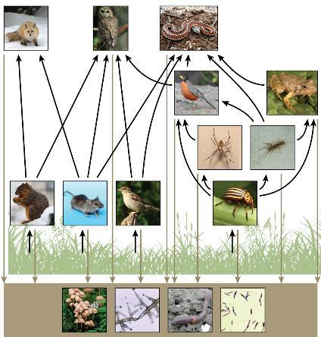
Figure 20.6
This food web shows the interactions between organisms across trophic levels. Arrows point from an organism that is consumed to the organism that consumes it. All the producers and consumers eventually become nourishment for the decomposers (fungi, mold, earthworms, and bacteria in the soil). (credit “fox”: modification of work by Kevin Bacher, NPS; credit “owl”: modification of work by John and Karen Hollingsworth, USFWS; credit “snake”: modification of work by Steve Jurvetson; credit “robin”: modification of work by Alan Vernon; credit “frog”: modification of work by Alessandro Catenazzi; credit “spider”: modification of work by “Sanba38”/Wikimedia Commons; credit “centipede”: modification of work by “Bauerph”/Wikimedia Commons; credit “squirrel”: modification of work by Dawn Huczek; credit “mouse”: modification of work by NIGMS, NIH; credit “sparrow”: modification of work by David Friel; credit “beetle”: modification of work by Scott Bauer, USDA Agricultural Research Service; credit “mushrooms”: modification of work by Chris Wee; credit “mold”: modification of work by Dr. Lucille Georg, CDC; credit “earthworm”: modificationof work by Rob Hille; credit “bacteria”: modification of work by Don Stalons, CDC)
This OpenStax ancillary resource is © Rice University under a CC-BY 4.0 International license; it may be reproduced or modified but must be attributed to OpenStax, Rice University and any changes must be noted. Any images credited to other sources are similarly available for reproduction, but must be attributed to their sources.

Slide 8
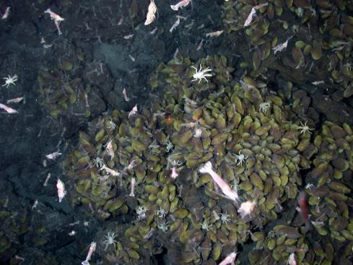
Figure 20.7
Swimming shrimp, a few squat lobsters, and hundreds of vent mussels are seen at a hydrothermal vent at the bottom of the ocean. As no sunlight penetrates to this depth, the ecosystem is supported by chemoautotrophic bacteria and organic material that sinks from the ocean’s surface. This picture was taken in 2006 at the submerged NW Eifuku volcano off the coast of Japan by the National Oceanic and Atmospheric Administration (NOAA). The summit of this highly active volcano lies 1535 m below the surface.
This OpenStax ancillary resource is © Rice University under a CC-BY 4.0 International license; it may be reproduced or modified but must be attributed to OpenStax, Rice University and any changes must be noted. Any images credited to other sources are similarly available for reproduction, but must be attributed to their sources.

Slide 9
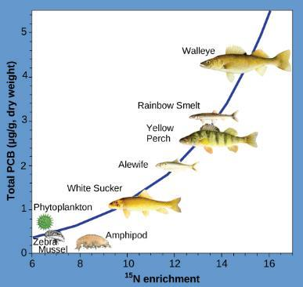
Figure 20.8
This chart shows the PCB concentrations found at the various trophic levels in the Saginaw Bay ecosystem of Lake Huron. Notice that the fish in the higher trophic levels accumulate more PCBs than those in lower trophic levels. (credit: Patricia Van Hoof, NOAA)
This OpenStax ancillary resource is © Rice University under a CC-BY 4.0 International license; it may be reproduced or modified but must be attributed to OpenStax, Rice University and any changes must be noted. Any images credited to other sources are similarly available for reproduction, but must be attributed to their sources.

Slide 10
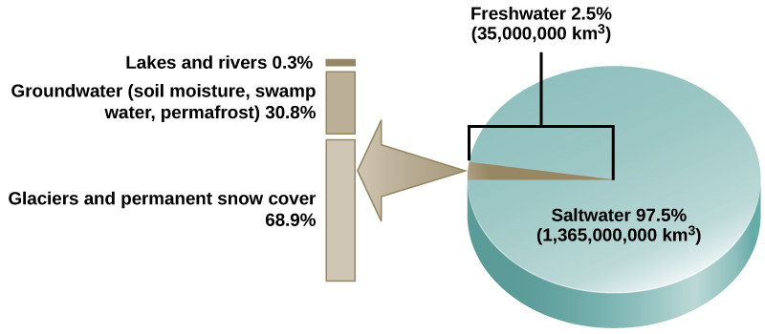
Figure 20.9
Only 2.5 percent of water on Earth is fresh water, and less than 1 percent of fresh water is easily accessible to living things.
This OpenStax ancillary resource is © Rice University under a CC-BY 4.0 International license; it may be reproduced or modified but must be attributed to OpenStax, Rice University and any changes must be noted. Any images credited to other sources are similarly available for reproduction, but must be attributed to their sources.

Slide 11
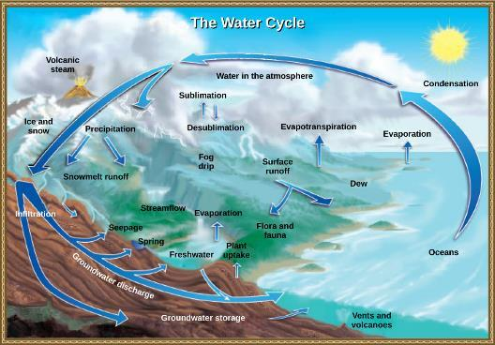
Figure 20.10
Water from the land and oceans enters the atmosphere by evaporation or sublimation, where it condenses into clouds and falls as rain or snow. Precipitated water may enter freshwater bodies or infiltrate the soil. The cycle is complete when surface or groundwater reenters the ocean. (credit: modification of work by John M. Evans and Howard Perlman, USGS)
This OpenStax ancillary resource is © Rice University under a CC-BY 4.0 International license; it may be reproduced or modified but must be attributed to OpenStax, Rice University and any changes must be noted. Any images credited to other sources are similarly available for reproduction, but must be attributed to their sources.

Slide 12
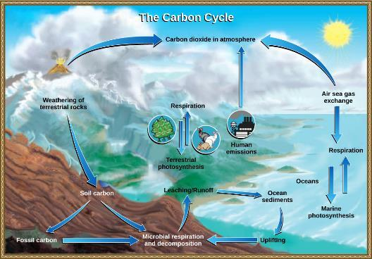
Figure 20.11
Carbon dioxide gas exists in the atmosphere and is dissolved in water. Photosynthesis converts carbon dioxide gas to organic carbon, and respiration cycles the organic carbon back into carbon dioxide gas. Long-term storage of organic carbon occurs when matter from living organisms is buried deep underground and becomes fossilized. Volcanic activity and, more recently, human emissions bring this stored carbon back into the carbon cycle. (credit: modification of work by John M. Evans and Howard Perlman, USGS)
This OpenStax ancillary resource is © Rice University under a CC-BY 4.0 International license; it may be reproduced or modified but must be attributed to OpenStax, Rice University and any changes must be noted. Any images credited to other sources are similarly available for reproduction, but must be attributed to their sources.

Slide 13
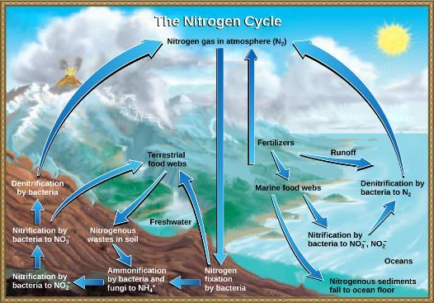
Figure 20.12
Nitrogen enters the living world from the atmosphere through nitrogen-fixing bacteria. This nitrogen and nitrogenous waste from animals is then processed back into gaseous nitrogen by soil bacteria, which also supply terrestrial food webs with the organic nitrogen they need. (credit: modification of work by John M. Evans and Howard Perlman, USGS)
This OpenStax ancillary resource is © Rice University under a CC-BY 4.0 International license; it may be reproduced or modified but must be attributed to OpenStax, Rice University and any changes must be noted. Any images credited to other sources are similarly available for reproduction, but must be attributed to their sources.

Slide 14
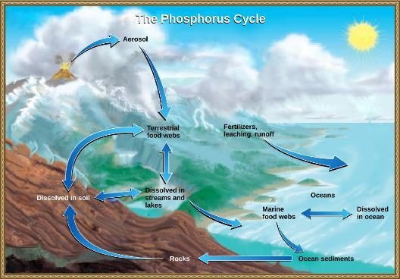
Figure 20.13
In nature, phosphorus exists as the phosphate ion (PO₄³⁻). Weathering of rocks and volcanic activity releases phosphate into the soil, water, and air, where it becomes available to terrestrial food webs. Phosphate enters the oceans in surface runoff, groundwater flow, and river flow. Phosphate dissolved in ocean water cycles into marine food webs. Some phosphate from the marine food webs falls to the ocean floor, where it forms sediment. (credit: modification of work by John M. Evans and Howard Perlman, USGS)
This OpenStax ancillary resource is © Rice University under a CC-BY 4.0 International license; it may be reproduced or modified but must be attributed to OpenStax, Rice University and any changes must be noted. Any images credited to other sources are similarly available for reproduction, but must be attributed to their sources.

Slide 15
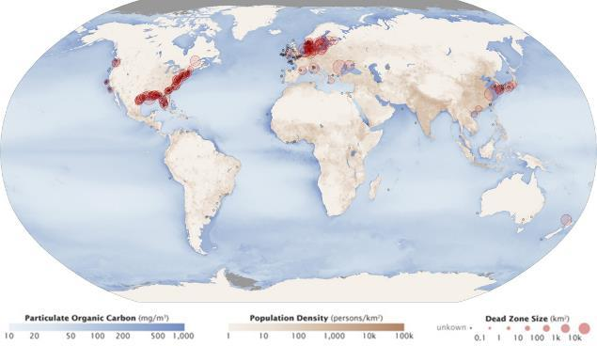
Figure 20.14
Dead zones occur when phosphorus and nitrogen from fertilizers cause excessive growth of microorganisms, which depletes oxygen and kills fauna. Worldwide, large dead zones are found in areas of high population density. (credit: Robert Simmon, Jesse Allen, NASA Earth Observatory)
This OpenStax ancillary resource is © Rice University under a CC-BY 4.0 International license; it may be reproduced or modified but must be attributed to OpenStax, Rice University and any changes must be noted. Any images credited to other sources are similarly available for reproduction, but must be attributed to their sources.

Slide 16
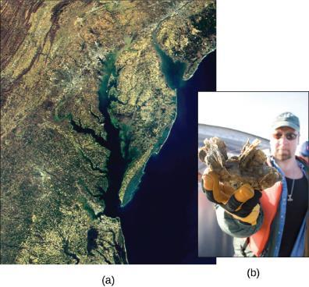
Figure 20.15
This (a) satellite image shows the Chesapeake Bay, an ecosystem affected by phosphate and nitrate runoff. A (b) member of the Army Corps of Engineers holds a clump of oysters being used as a part of the oyster restoration effort in the bay. (credit a: modification of work by NASA/MODIS; credit b: modification of work by U.S. Army)
This OpenStax ancillary resource is © Rice University under a CC-BY 4.0 International license; it may be reproduced or modified but must be attributed to OpenStax, Rice University and any changes must be noted. Any images credited to other sources are similarly available for reproduction, but must be attributed to their sources.

Slide 17
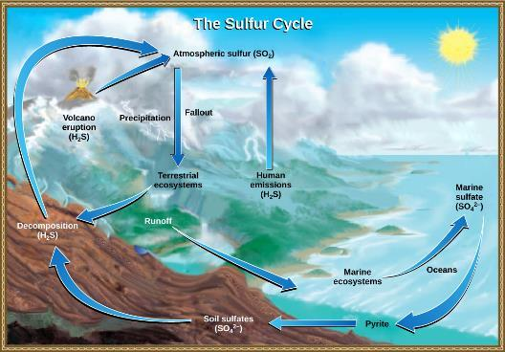
Figure 20.16
Sulfur dioxide from the atmosphere becomes available to terrestrial and marine ecosystems when it is dissolved in precipitation as weak sulfuric acid or when it falls directly to Earth as fallout. Weathering of rocks also makes sulfates available to terrestrial ecosystems. Decomposition of living organisms returns sulfates to the ocean, soil, and atmosphere. (credit: modification of work by John M. Evans and Howard Perlman, USGS)
This OpenStax ancillary resource is © Rice University under a CC-BY 4.0 International license; it may be reproduced or modified but must be attributed to OpenStax, Rice University and any changes must be noted. Any images credited to other sources are similarly available for reproduction, but must be attributed to their sources.

Slide 18
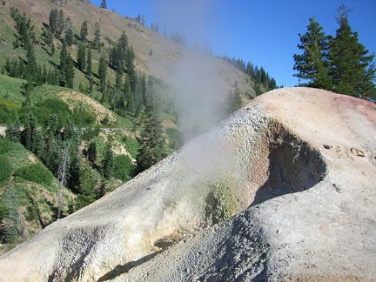
Figure 20.17
At this sulfur vent in Lassen Volcanic National Park in northeastern California, the yellowish sulfur deposits are visible near the mouth of the vent. (credit: “Calbear22”/Wikimedia Commons)
This OpenStax ancillary resource is © Rice University under a CC-BY 4.0 International license; it may be reproduced or modified but must be attributed to OpenStax, Rice University and any changes must be noted. Any images credited to other sources are similarly available for reproduction, but must be attributed to their sources.

Slide 19
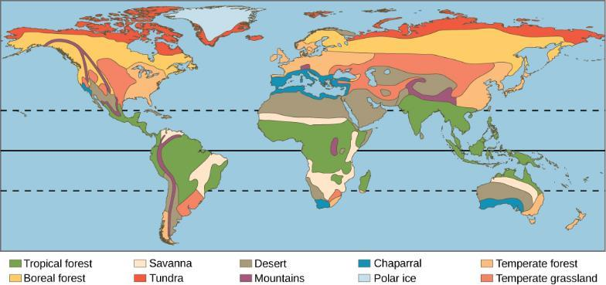
Figure 20.18
Each of the world’s eight major biomes is distinguished by characteristic temperatures and amount of precipitation. Polar ice caps and mountains are also shown.
This OpenStax ancillary resource is © Rice University under a CC-BY 4.0 International license; it may be reproduced or modified but must be attributed to OpenStax, Rice University and any changes must be noted. Any images credited to other sources are similarly available for reproduction, but must be attributed to their sources.

Slide 20
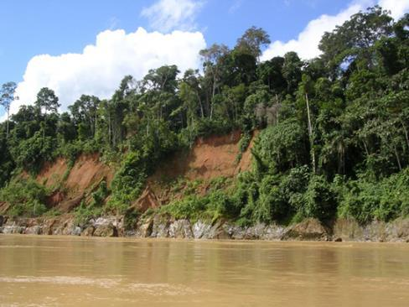
Figure 20.19
Species diversity is very high in tropical wet forests, such as these forests of Madre de Dios, Peru, near the Amazon River. (credit: Roosevelt Garcia)
This OpenStax ancillary resource is © Rice University under a CC-BY 4.0 International license; it may be reproduced or modified but must be attributed to OpenStax, Rice University and any changes must be noted. Any images credited to other sources are similarly available for reproduction, but must be attributed to their sources.

Slide 21
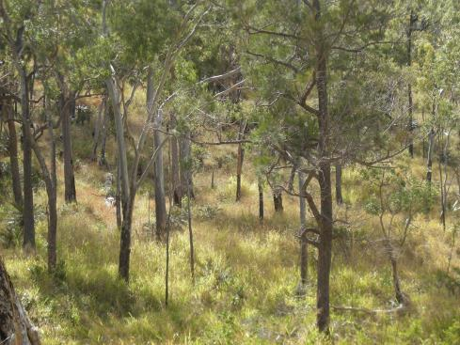
Figure 20.20
Although savannas are dominated by grasses, small woodlands, such as this one in Mount Archer National Park in Queensland, Australia, may dot the landscape. (credit: “Ethel Aardvark”/Wikimedia Commons)
This OpenStax ancillary resource is © Rice University under a CC-BY 4.0 International license; it may be reproduced or modified but must be attributed to OpenStax, Rice University and any changes must be noted. Any images credited to other sources are similarly available for reproduction, but must be attributed to their sources.

Slide 22
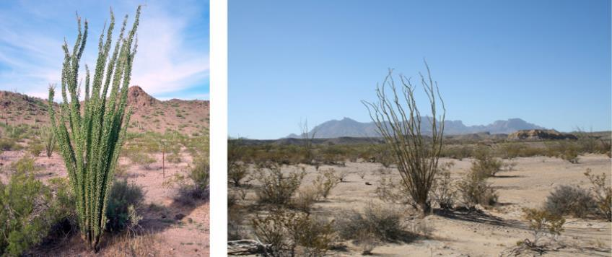
Figure 20.21
Many desert plants have tiny leaves or no leaves at all to reduce water loss. The leaves of ocotillo, shown here in the Chihuahuan Desert in Big Bend National Park, Texas, appear only after rainfall and then are shed. (credit “bare ocotillo”: “Leaflet”/Wikimedia Commons)
This OpenStax ancillary resource is © Rice University under a CC-BY 4.0 International license; it may be reproduced or modified but must be attributed to OpenStax, Rice University and any changes must be noted. Any images credited to other sources are similarly available for reproduction, but must be attributed to their sources.

Slide 23
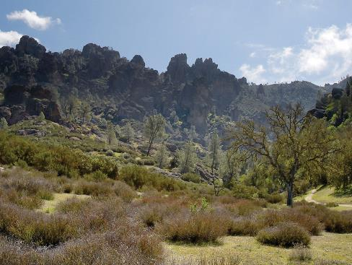
Figure 20.22
The chaparral is dominated by shrubs. (credit: Miguel Vieira)
This OpenStax ancillary resource is © Rice University under a CC-BY 4.0 International license; it may be reproduced or modified but must be attributed to OpenStax, Rice University and any changes must be noted. Any images credited to other sources are similarly available for reproduction, but must be attributed to their sources.

Slide 24
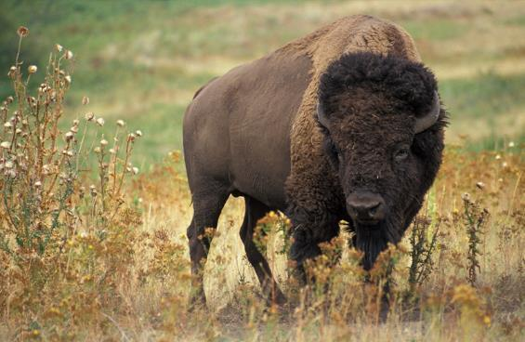
Figure 20.23
The American bison (Bison bison), more commonly called the buffalo, is a grazing mammal that once populated American prairies in huge numbers. (credit: Jack Dykinga, USDA ARS)
This OpenStax ancillary resource is © Rice University under a CC-BY 4.0 International license; it may be reproduced or modified but must be attributed to OpenStax, Rice University and any changes must be noted. Any images credited to other sources are similarly available for reproduction, but must be attributed to their sources.

Slide 25
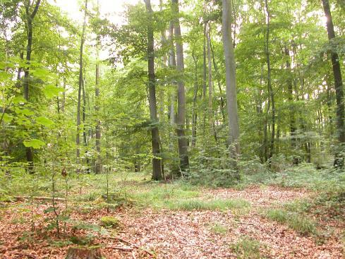
Figure 20.24
Deciduous trees are the dominant plant in the temperate forest. (credit: Oliver Herold)
This OpenStax ancillary resource is © Rice University under a CC-BY 4.0 International license; it may be reproduced or modified but must be attributed to OpenStax, Rice University and any changes must be noted. Any images credited to other sources are similarly available for reproduction, but must be attributed to their sources.

Slide 26
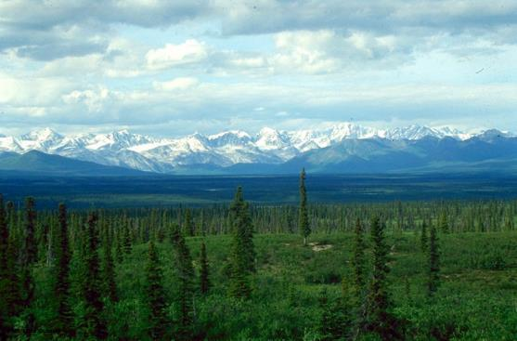
Figure 20.25
The boreal forest (taiga) has low lying plants and conifer trees. (credit: L.B. Brubaker, NOAA)
This OpenStax ancillary resource is © Rice University under a CC-BY 4.0 International license; it may be reproduced or modified but must be attributed to OpenStax, Rice University and any changes must be noted. Any images credited to other sources are similarly available for reproduction, but must be attributed to their sources.

Slide 27
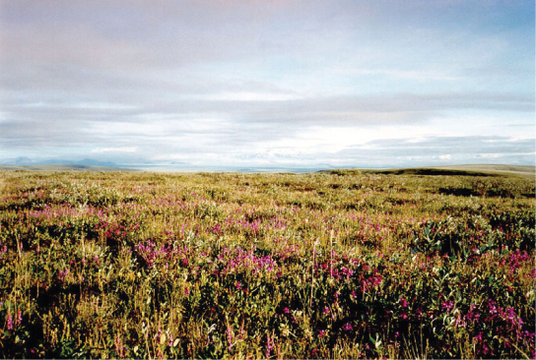
Figure 20.26
Low-growing plants such as shrub willow dominate the tundra landscape during the summer, shown here in the Arctic National Wildlife Refuge. (credit: Arctic National Wildlife Refuge, USFWS)
This OpenStax ancillary resource is © Rice University under a CC-BY 4.0 International license; it may be reproduced or modified but must be attributed to OpenStax, Rice University and any changes must be noted. Any images credited to other sources are similarly available for reproduction, but must be attributed to their sources.

Slide 28
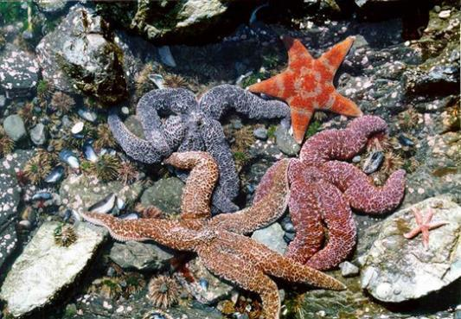
Figure 20.27
Sea stars, sea urchins, and mussel shells are often found in the intertidal zone, shown here in Kachemak Bay, Alaska. (credit: NOAA)
This OpenStax ancillary resource is © Rice University under a CC-BY 4.0 International license; it may be reproduced or modified but must be attributed to OpenStax, Rice University and any changes must be noted. Any images credited to other sources are similarly available for reproduction, but must be attributed to their sources.

Slide 29
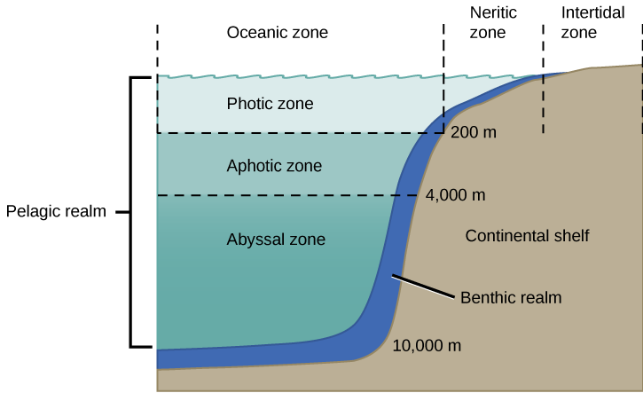
Figure 20.28
The ocean is divided into different zones based on water depth, distance from the shoreline, and light penetration.
This OpenStax ancillary resource is © Rice University under a CC-BY 4.0 International license; it may be reproduced or modified but must be attributed to OpenStax, Rice University and any changes must be noted. Any images credited to other sources are similarly available for reproduction, but must be attributed to their sources.

Slide 30
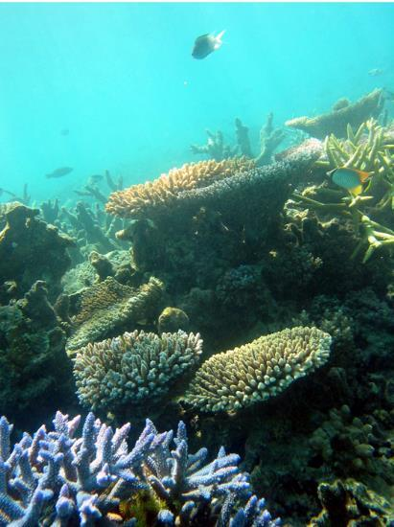
Figure 20.29
Coral reefs are formed by the calcium carbonate skeletons of coral organisms, which are marine invertebrates in the phylum Cnidaria. (credit: Terry Hughes)
This OpenStax ancillary resource is © Rice University under a CC-BY 4.0 International license; it may be reproduced or modified but must be attributed to OpenStax, Rice University and any changes must be noted. Any images credited to other sources are similarly available for reproduction, but must be attributed to their sources.

Slide 31
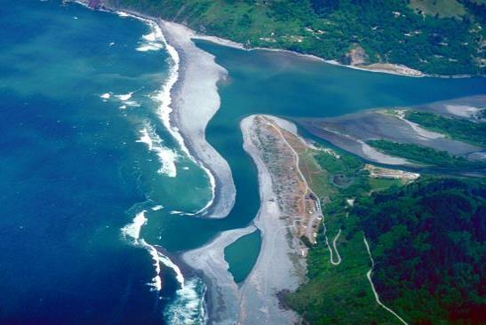
Figure 20.30
As estuary is where fresh water and salt water meet, such as the mouth of the Klamath River in California, shown here. (credit: U.S. Army Corps of Engineers)
This OpenStax ancillary resource is © Rice University under a CC-BY 4.0 International license; it may be reproduced or modified but must be attributed to OpenStax, Rice University and any changes must be noted. Any images credited to other sources are similarly available for reproduction, but must be attributed to their sources.

Slide 32
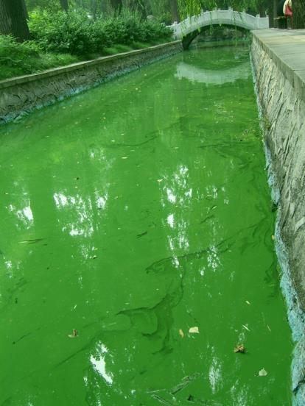
Figure 20.31
The uncontrolled growth of algae in this waterway has resulted in an algal bloom.
This OpenStax ancillary resource is © Rice University under a CC-BY 4.0 International license; it may be reproduced or modified but must be attributed to OpenStax, Rice University and any changes must be noted. Any images credited to other sources are similarly available for reproduction, but must be attributed to their sources.

Slide 33
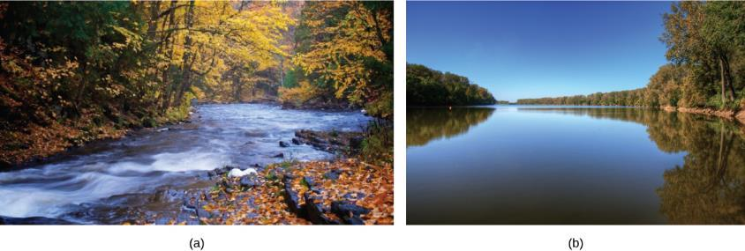
Figure 20.32
Rivers range from (a) narrow and shallow to (b) wide and slow moving. (credit a: modification of work by Cory Zanker; credit b: modification of work by David DeHetre)
This OpenStax ancillary resource is © Rice University under a CC-BY 4.0 International license; it may be reproduced or modified but must be attributed to OpenStax, Rice University and any changes must be noted. Any images credited to other sources are similarly available for reproduction, but must be attributed to their sources.

Slide 34
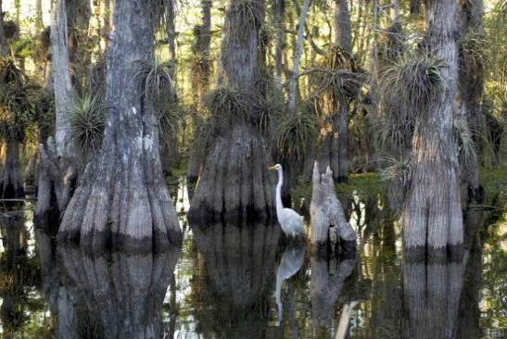
Figure 20.33
Located in southern Florida, Everglades National Park is vast array of wetland environments, including sawgrass marshes, cypress swamps, and estuarine mangrove forests. Here, a great egret walks among cypress trees. (credit: NPS)
This OpenStax ancillary resource is © Rice University under a CC-BY 4.0 International license; it may be reproduced or modified but must be attributed to OpenStax, Rice University and any changes must be noted. Any images credited to other sources are similarly available for reproduction, but must be attributed to their sources.

