Slide 1

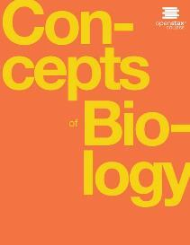
Concepts of Biology
Chapter 21 CONSERVATION AND BIODIVERSITY
PowerPoint Image Slideshow

Slide 2
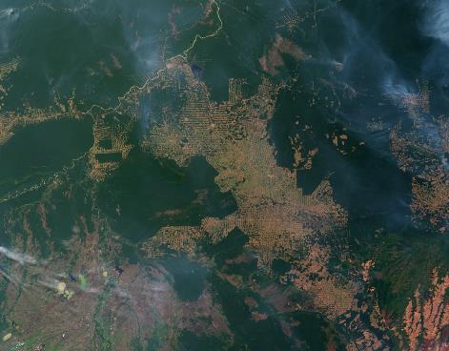
Figure 21.1
Habitat destruction through deforestation, especially of tropical rainforests as seen in this satellite view of Amazon rainforests in Brazil, is a major cause of the current decline in biodiversity. (credit: modification of work by Jesse Allen and Robert Simmon, NASA Earth Observatory)
This OpenStax ancillary resource is © Rice University under a CC-BY 4.0 International license; it may be reproduced or modified but must be attributed to OpenStax, Rice University and any changes must be noted. Any images credited to other sources are similarly available for reproduction, but must be attributed to their sources.

Slide 3
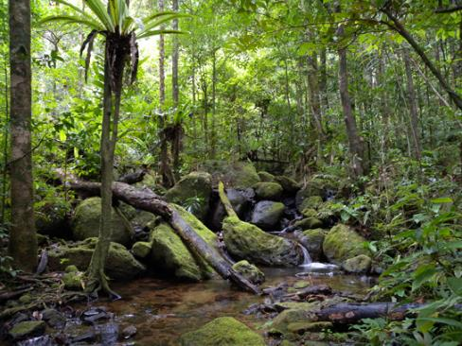
Figure 21.2
This tropical lowland rainforest in Madagascar is an example of a high biodiversity habitat. This particular location is protected within a national forest, yet only 10 percent of the original coastal lowland forest remains, and research suggests half the original biodiversity has been lost. (credit: Frank Vassen)
This OpenStax ancillary resource is © Rice University under a CC-BY 4.0 International license; it may be reproduced or modified but must be attributed to OpenStax, Rice University and any changes must be noted. Any images credited to other sources are similarly available for reproduction, but must be attributed to their sources.

Slide 4
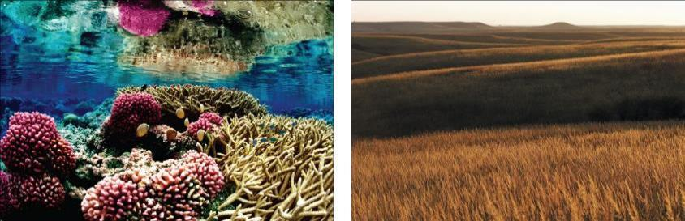
Figure 21.3
The variety of ecosystems on Earth—from coral reef to prairie—enables a great diversity of species to exist. (credit “coral reef”: modification of work by Jim Maragos, USFWS; credit: “prairie”: modification of work by Jim Minnerath, USFWS)
This OpenStax ancillary resource is © Rice University under a CC-BY 4.0 International license; it may be reproduced or modified but must be attributed to OpenStax, Rice University and any changes must be noted. Any images credited to other sources are similarly available for reproduction, but must be attributed to their sources.

Slide 5
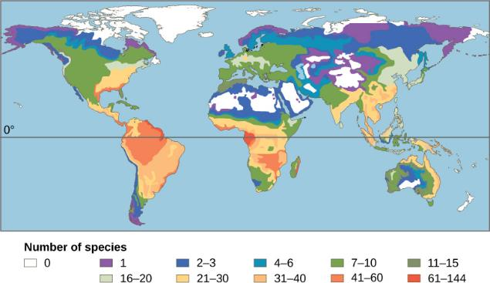
Figure 21.4
This map illustrates the number of amphibian species across the globe and shows the trend toward higher biodiversity at lower latitudes. A similar pattern is observed for most taxonomic groups.
This OpenStax ancillary resource is © Rice University under a CC-BY 4.0 International license; it may be reproduced or modified but must be attributed to OpenStax, Rice University and any changes must be noted. Any images credited to other sources are similarly available for reproduction, but must be attributed to their sources.

Slide 6
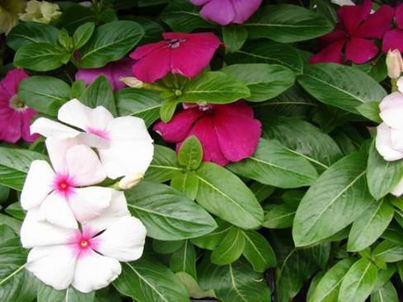
Figure 21.5
Catharanthus roseus, the Madagascar periwinkle, has various medicinal properties. Among other uses, it is a source of vincristine, a drug used in the treatment of lymphomas. (credit: Forest and Kim Starr)
This OpenStax ancillary resource is © Rice University under a CC-BY 4.0 International license; it may be reproduced or modified but must be attributed to OpenStax, Rice University and any changes must be noted. Any images credited to other sources are similarly available for reproduction, but must be attributed to their sources.

Slide 7
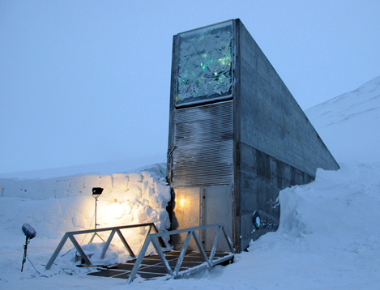
Figure 21.6
The Svalbard Global Seed Vault is a storage facility for seeds of Earth’s diverse crops. (credit: Mari Tefre, Svalbard Global Seed Vault)
This OpenStax ancillary resource is © Rice University under a CC-BY 4.0 International license; it may be reproduced or modified but must be attributed to OpenStax, Rice University and any changes must be noted. Any images credited to other sources are similarly available for reproduction, but must be attributed to their sources.

Slide 8
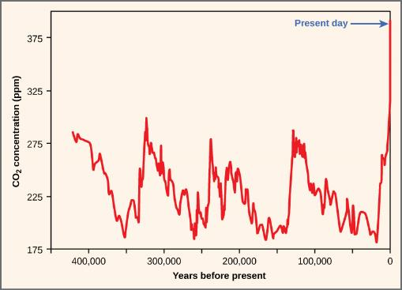
Figure 21.7
Atmospheric carbon dioxide levels fluctuate in a cyclical manner. However, the burning of fossil fuels in recent history has caused a dramatic increase in the levels of carbon dioxide in the Earth’s atmosphere, which have now reached levels never before seen on Earth. Scientists predict that the addition of this “greenhouse gas” to the atmosphere is resulting in climate change that will significantly impact biodiversity in the coming century.
This OpenStax ancillary resource is © Rice University under a CC-BY 4.0 International license; it may be reproduced or modified but must be attributed to OpenStax, Rice University and any changes must be noted. Any images credited to other sources are similarly available for reproduction, but must be attributed to their sources.

Slide 9
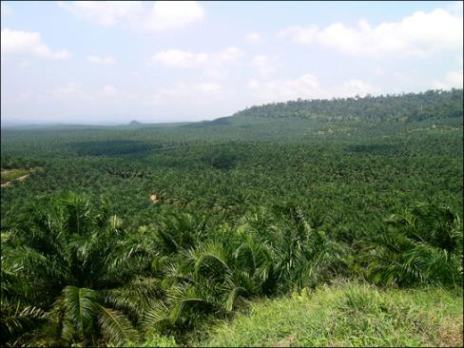
Figure 21.8
An oil palm plantation in Sabah province Borneo, Malaysia, replaces native forest habitat that a variety of species depended on to live. (credit: Lian Pin Koh)
This OpenStax ancillary resource is © Rice University under a CC-BY 4.0 International license; it may be reproduced or modified but must be attributed to OpenStax, Rice University and any changes must be noted. Any images credited to other sources are similarly available for reproduction, but must be attributed to their sources.

Slide 10
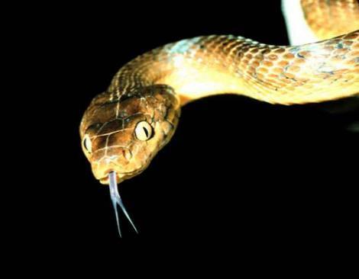
Figure 21.9
The brown tree snake, Boiga irregularis, is an exotic species that has caused numerous extinctions on the island of Guam since its accidental introduction in 1950. (credit: NPS)
This OpenStax ancillary resource is © Rice University under a CC-BY 4.0 International license; it may be reproduced or modified but must be attributed to OpenStax, Rice University and any changes must be noted. Any images credited to other sources are similarly available for reproduction, but must be attributed to their sources.

Slide 11
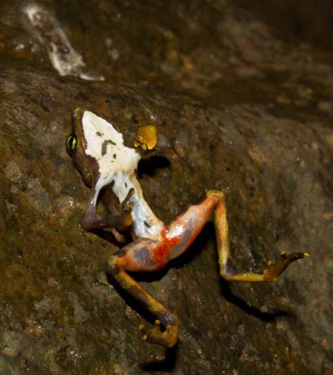
Figure 21.10
This Limosa harlequin frog (Atelopus limosus), an endangered species from Panama, died from a fungal disease called chytridiomycosis. The red lesions are symptomatic of the disease. (credit: Brian Gratwicke)
This OpenStax ancillary resource is © Rice University under a CC-BY 4.0 International license; it may be reproduced or modified but must be attributed to OpenStax, Rice University and any changes must be noted. Any images credited to other sources are similarly available for reproduction, but must be attributed to their sources.

Slide 12
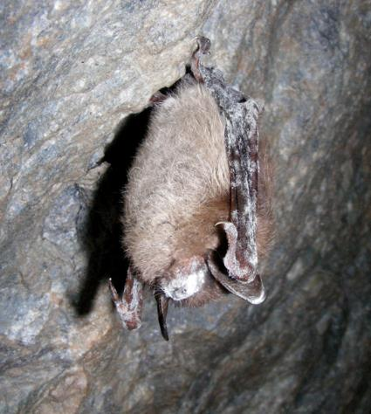
Figure 21.11
This little brown bat in Greeley Mine, Vermont, March 26, 2009, was found to have white-nose syndrome. (credit: modification of work by Marvin Moriarty, USFWS)
This OpenStax ancillary resource is © Rice University under a CC-BY 4.0 International license; it may be reproduced or modified but must be attributed to OpenStax, Rice University and any changes must be noted. Any images credited to other sources are similarly available for reproduction, but must be attributed to their sources.

Slide 13
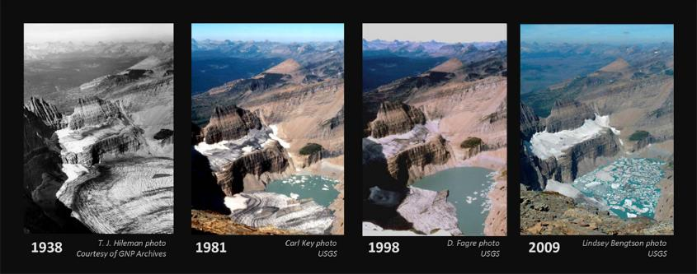
Figure 21.12
The effect of global warming can be seen in the continuing retreat of Grinnell Glacier. The mean annual temperature in Glacier National Park has increased 1.33°C since 1900. The loss of a glacier results in the loss of summer meltwaters, sharply reducing seasonal water supplies and severely affecting local ecosystems. (credit: USGS, GNP Archives)
This OpenStax ancillary resource is © Rice University under a CC-BY 4.0 International license; it may be reproduced or modified but must be attributed to OpenStax, Rice University and any changes must be noted. Any images credited to other sources are similarly available for reproduction, but must be attributed to their sources.

Slide 14
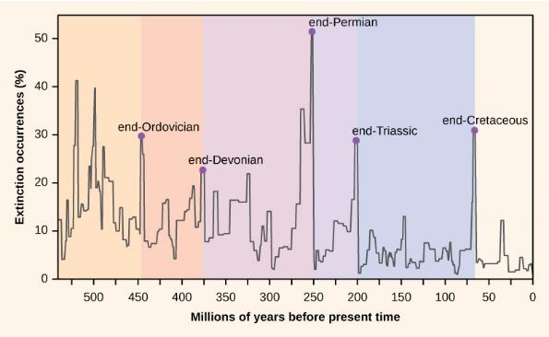
Figure 21.13
Extinction intensity as reflected in the fossil record has fluctuated throughout Earth’s history. Sudden and dramatic losses of biodiversity, called mass extinctions, have occurred five times.
This OpenStax ancillary resource is © Rice University under a CC-BY 4.0 International license; it may be reproduced or modified but must be attributed to OpenStax, Rice University and any changes must be noted. Any images credited to other sources are similarly available for reproduction, but must be attributed to their sources.

Slide 15
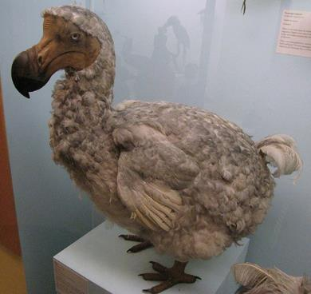
Figure 21.14
The dodo bird was hunted to extinction around 1662. (credit: Ed Uthman, taken in Natural History Museum, London, England)
This OpenStax ancillary resource is © Rice University under a CC-BY 4.0 International license; it may be reproduced or modified but must be attributed to OpenStax, Rice University and any changes must be noted. Any images credited to other sources are similarly available for reproduction, but must be attributed to their sources.

Slide 16
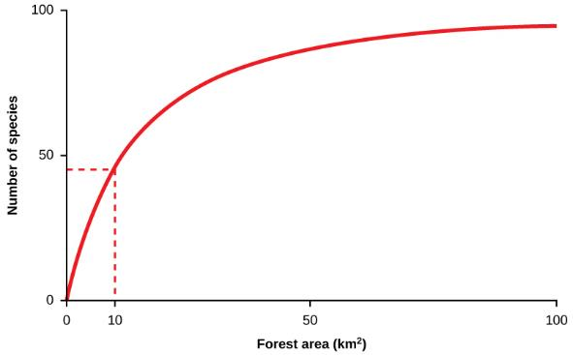
Figure 21.15
A typical species-area curve shows the cumulative number of species found as more and more area is sampled. The curve has also been interpreted to show the effect on species numbers of destroying habitat; a reduction in habitat of 90 percent from 100 km² to 10 km² reduces the number of species supported by about 50 percent.
This OpenStax ancillary resource is © Rice University under a CC-BY 4.0 International license; it may be reproduced or modified but must be attributed to OpenStax, Rice University and any changes must be noted. Any images credited to other sources are similarly available for reproduction, but must be attributed to their sources.

Slide 17
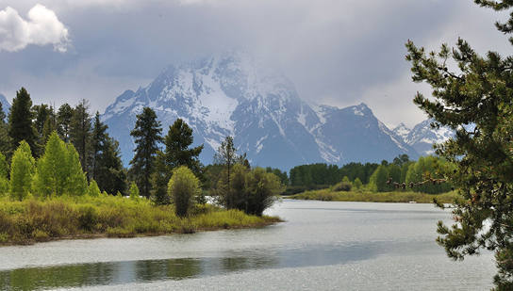
Figure 21.16
National parks, such as Grand Teton National Park in Wyoming, help conserve biodiversity. (credit: Don DeBold)
This OpenStax ancillary resource is © Rice University under a CC-BY 4.0 International license; it may be reproduced or modified but must be attributed to OpenStax, Rice University and any changes must be noted. Any images credited to other sources are similarly available for reproduction, but must be attributed to their sources.

Slide 18
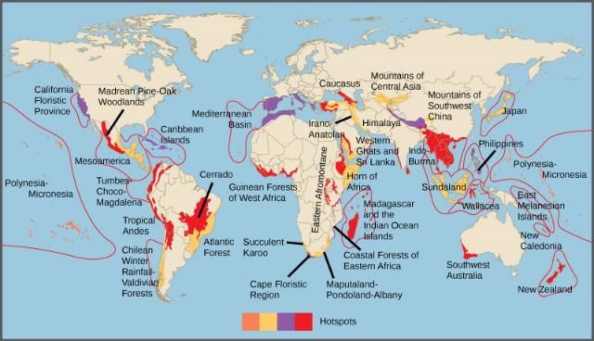
Figure 21.17
Conservation International has identified 34 biodiversity hotspots. Although these cover only 2.3 percent of the Earth’s surface, 42 percent of the terrestrial vertebrate species and 50 percent of the world’s plants are endemic to those hotspots.
This OpenStax ancillary resource is © Rice University under a CC-BY 4.0 International license; it may be reproduced or modified but must be attributed to OpenStax, Rice University and any changes must be noted. Any images credited to other sources are similarly available for reproduction, but must be attributed to their sources.

Slide 19
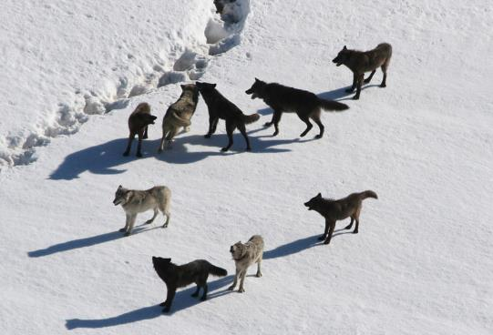
Figure 21.18
This photograph shows the Gibbon wolf pack in Yellowstone National Park, March 1, 2007. Wolves have been identified as a keystone species. (credit: Doug Smith, NPS)
This OpenStax ancillary resource is © Rice University under a CC-BY 4.0 International license; it may be reproduced or modified but must be attributed to OpenStax, Rice University and any changes must be noted. Any images credited to other sources are similarly available for reproduction, but must be attributed to their sources.

Slide 20
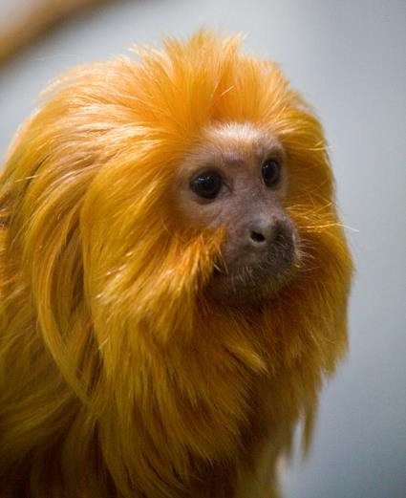
Figure 21.19
Zoos and captive breeding programs help preserve many endangered species, such as this golden lion tamarin. (credit: Garrett Ziegler)
This OpenStax ancillary resource is © Rice University under a CC-BY 4.0 International license; it may be reproduced or modified but must be attributed to OpenStax, Rice University and any changes must be noted. Any images credited to other sources are similarly available for reproduction, but must be attributed to their sources.

