Slide 1

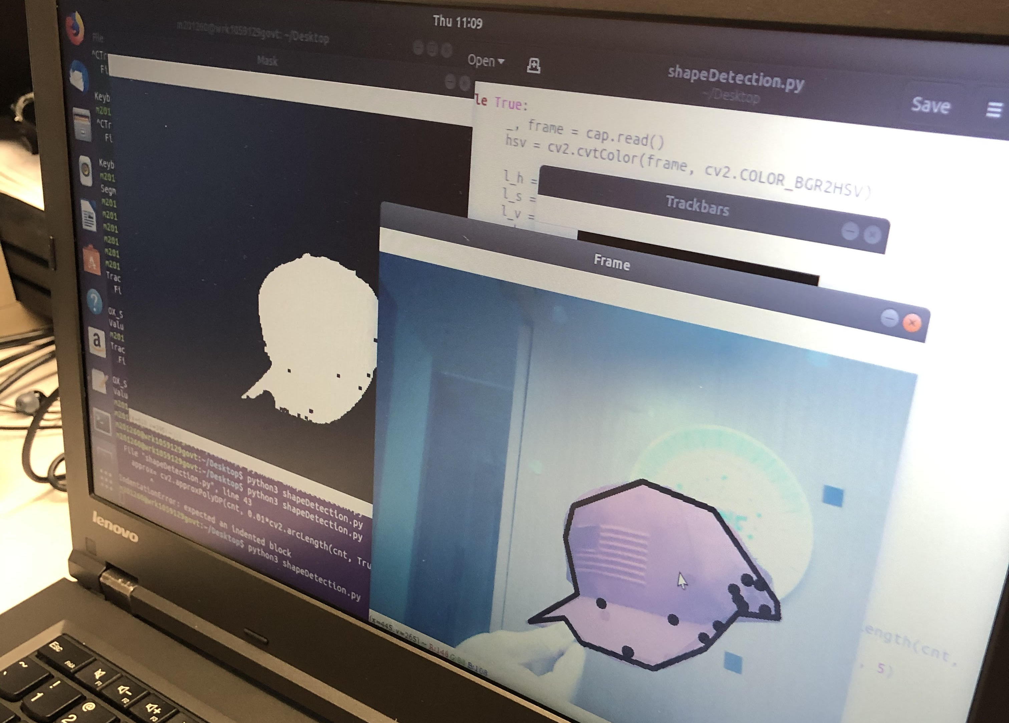
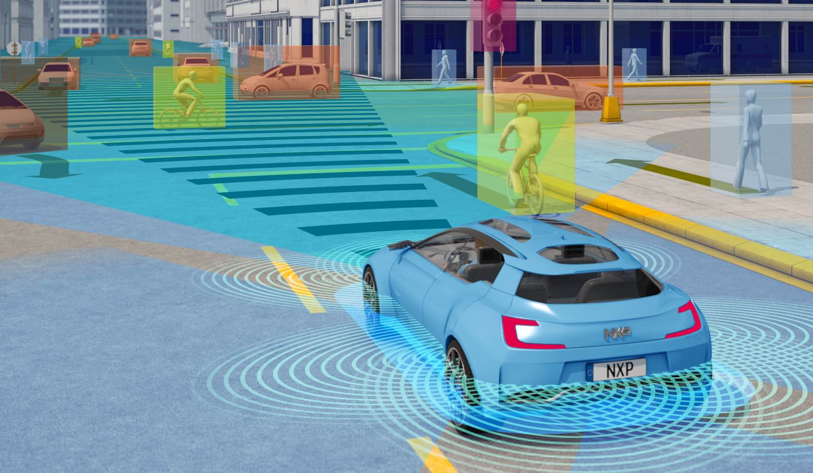
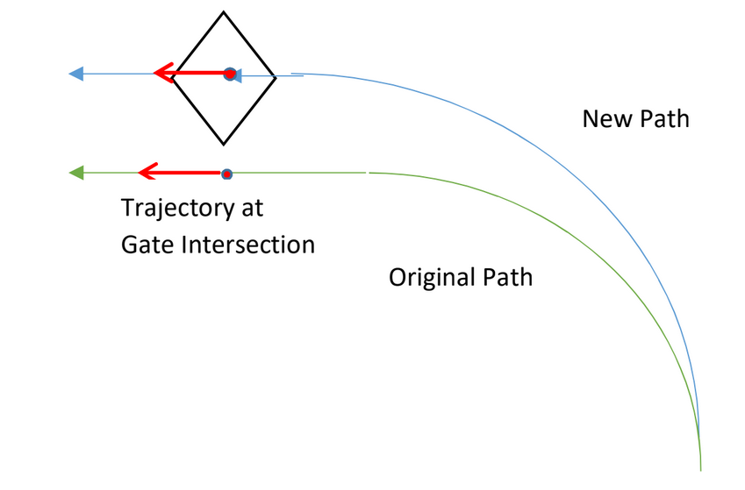
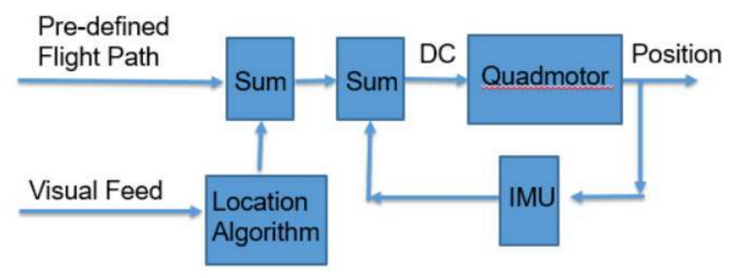
Autonomous Drone Racing
Midn 1/C Austin Credle and Prof. Dennis Evangelista
Motivation
Methods
Results
Autonomous vehicles of the future must be able to navigate based on both an assumed path and a relative location in order to efficiently and safely navigate dynamic environments. Navigation by global positioning must be coupled with relative maneuvering to ensure continuous transportation when physical hazards cannot be predicted.
Individual testing will isolate each of the “identify, locate, and modify” processes and analyze their performances.
Initial steps in this research focused on the flight controls of the selected drone (DJI Tello), video connectivity between the drone and the computer, and the gate identification process.
First, a protocol was written to connect the Tello drone to the Linux system. The drone was then pilot using test commands from the user through the Linux system.
Identification
For the identify process, a rectangular gate, will be inserted into the environment. The drone will also be placed in the environment approximately 5 to 20 feet away from the gate at 0 to 150 degree angles from the orthogonal vector of the gates plane. The processor will be tasked with identify the gate.
Location
Photo of Computer controlled flight
Color thresholding with edge recognition on a random object
For the location process, the processor will be tasked with estimating the approximate location of the gates target point in reference to the drone. The target point will be one of five points at which the drone intends to cross the gates plane, be it at the center of the gate or one of the corners. The processor, knowing the dimensions of the gate and the target point, will be able to calculate the angle offset from the orthogonal, and the distance from the target point.
These three protocols and scripts will be combined to have the drone identify a racegate and fly through it. Path modification will then be developed to finalize the drone’s flight control.
Source: electronicsweekly.com
An autonomous vehicle sensing dynamic hazards.
Problem Statement
A separate protocol was written to connect the Tello drone’s camera to the Linux system. The resulting Video Feed is shown below.
Conclusion
Given a three-dimensional flight path, drone accelerometer readings, and the image of a drone-racing gate in a three dimensional environment, this research intends to begin the process of developing autonomous drone flight through a drone-racing course. Given a three-dimensional path that does not fly through the gate, we will find and test the feasibility of a guidance system that creates a similar path that does.
This research will create a process for a drone to modify its flight path based on the visual recognition of racing gates. This is the first steps in the process to create a fully autonomous racing drone. Future steps will include path optimization and processing optimization.
Modification
The processor will take the original path (which does not fly through the target point) and calculate the trajectory of the drone on the original path as it would pass through the target point. Then, the processor will create a new path with the same trajectory at the target point and the smallest deviations in trajectories along the rest of the path.
Photo of computer video feed
References
[1] W.-K. Chen, Linear Networks and Systems. Belmont, CA: Wadsworth, 1993, pp. 123–135. (book example, omit page numbers if needed)
See https://libguides.usna.edu/citing/ieee for format style
For the gate identification process, a python program was developed that color thresholds a camera and identifies edges of an object. An example of the program running to identify a random object is shown below.
Related Work
Short mention of other work by Kumar and others
Drone and controller block diagram
Depiction of flight path correction
Notes:
Do not change: page size, background color, font size or font type
You may change: the name of the section headings as appropriate (e.g. Method might be Algorithm, Design Approach or Analysis); You may also remove a section if it doesn’t apply (e.g. Acknowledgements)
Tips:
Graphics should be hi res (will be printed large), captioned, and source listed in caption or on graphic if not self generated. Use white outline. Png is a good file format for matlab plots. Jpg preferred for photos
Plots: make sure fonts for axis labels are readable. Consider adding axis labels or annotations in power point rather than generating software.

