Slide 1
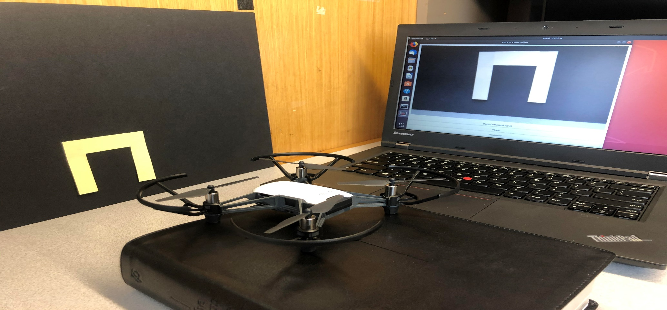
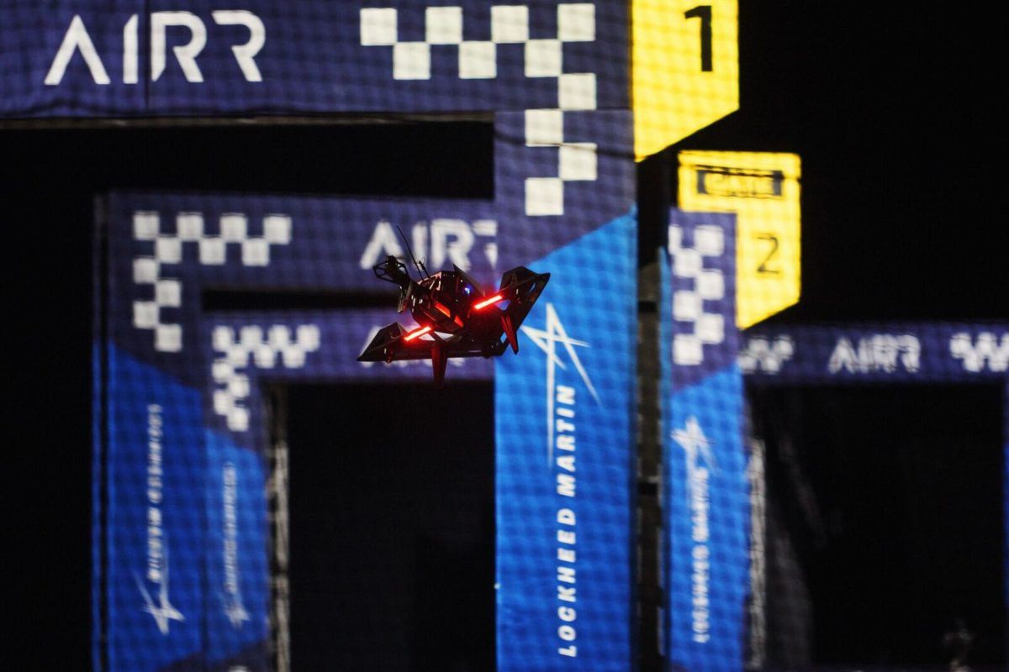
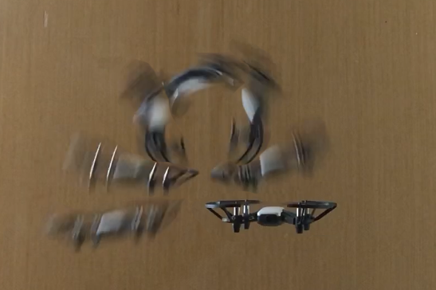
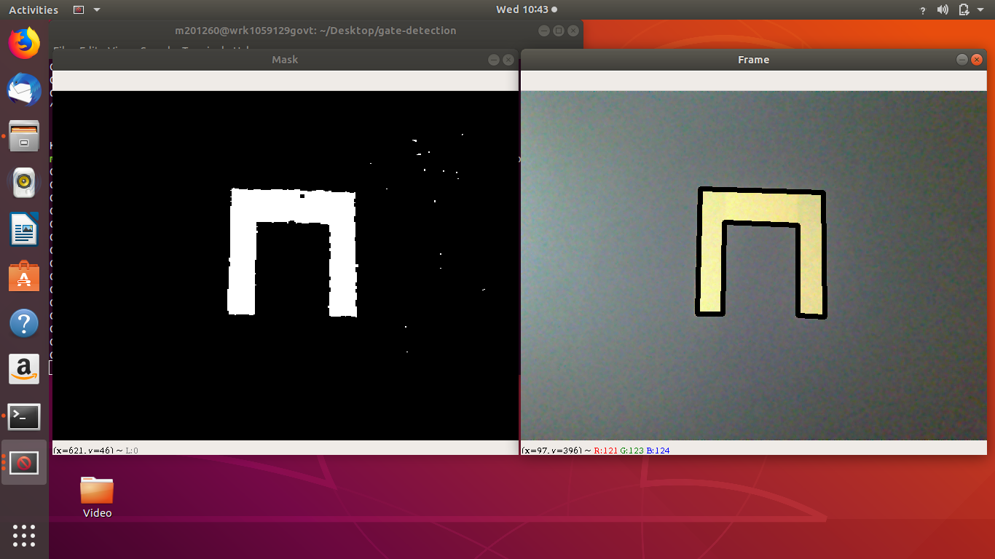
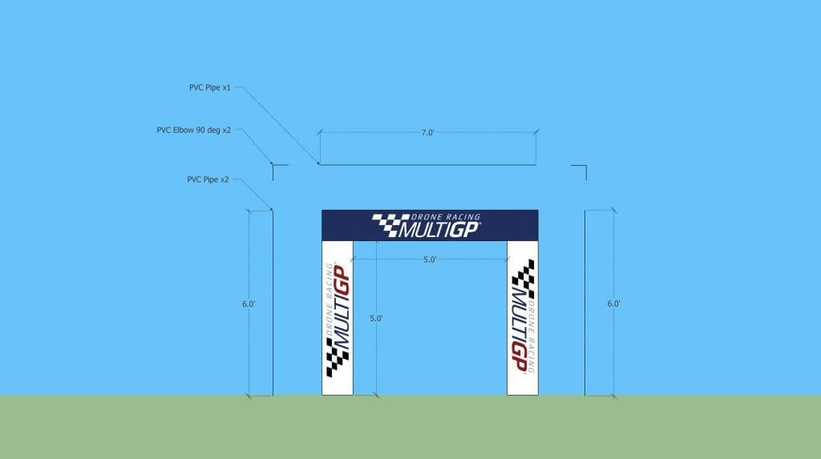
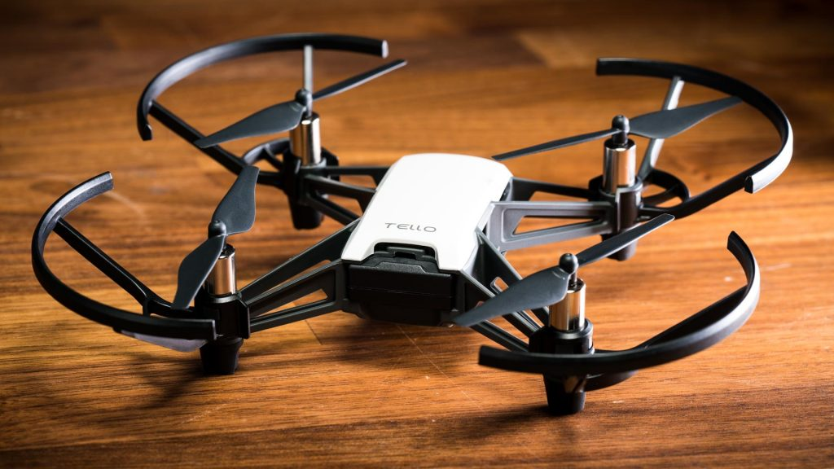
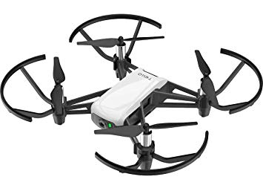
Autonomous Drone Flight
MIDN 1/C A Credle and Asst Prof D Evangelista
Department of Weapons, Robotics, and Control Engineering, United States Naval Academy
Abstract: Autonomous racing drones are not only beneficial to the drone racing sport, but also to autonomous vehicles and to military drones flying through windows, chimneys, etc. We will create a process for a drone to modify its given flight path based on the visual recognition of a gate in order to fly through the gate. The processor will identify the gate, locate it in relation to the drone’s current path, and modify the path to fly through the gate. If successful, this will be the first step in creating an autonomous racing drone at USNA.
Methods and Materials
Drone Platform: DJI Tello
The Tello platform was selected for its price range, its built-in camera, and its pre-programmed flight controller. The low level flight controller is advantageous to maintain stable flight.
Race Gate: 5’x5’ Gold Race Gate
A large, gold race gate was selected to allow easy gate recognition and ample space for drone navigation. This is the standard size for drone race gates.
Major Steps:
Tello Flight by Remote Controller
Tello Flight by Computer
Tello Video Stream to Computer
Computer Gate Recognition
Integration of previous steps
Results: Tello Flight by Computer
Communication from the Tello drone to the Linux computer system was hosted through a python socket over the Tello’s Wi-Fi. The Tello requires an initial command message of “command” to finalize connection to the computer terminal. The drone can then receive pre-programmed text commands to take off, land, or perform translational/ rotational movements.
Figure 5: Video streaming from Tello drone to Linux system through python socket.
Figure 6(a,b): Gate recognition program segmenting for gate color and projecting edges on gate in non-segmented image.
Figure 1: An autonomous drone attempting to recognize a race gate at the Lockheed Martin Alpha Pilot Challenge [source: Technical.ly].
Figure 4: Tello drone flight under computer control, performing a flip.
Future Development
Major steps 1 through 4 have been completed. Each of these pieces must now be connected to achieve visual servoing capabilities. Following, a path-correction controller will be designed and tested for the feasibility to pass through a physical gate.
Tello drone flight by computer, video streaming, and gate recognition are integral pieces to autonomous drone racing. Combining these features will allow for successful drone flight and path correction capabilities.
Can visual servoing be used for terminal phase of autonomous race-gate-clearing?
Given a 3D flight path, drone IMU readings, and FPV video feed, a suitable controller will be developed to automatically adjust the flight path to ensure the gate is cleared. Attempts will be made in proof of concept demonstration. These will demonstrate the cohesion of race gate identification, relative location identification, and path modification to adjust the drones path through the gate. Success of this system is based on the accuracy of the adjusted path compared to the center of the gate.
Results: Tello Video Stream and Gate Recognition
Communication between the Tello drone and Linux computer system for the video stream worked over a python socket, similar to the flight controls. The video is streamed through the Wi-Fi, and the running python program utilizes an h256 decoder.
A separate python program was also developed to recognize a race gate. The program segments video feed to isolate a specific color. The program then recognizes clusters of the color, and identifies the cluster’s size and number of edges. This will allow for a gate (a known shape) to be recognized and oriented in relation to the drone.
Figure 2: Standard Race Gate Design (6’x7’ outer dimensions, 5’x5’ inner dimensions).
Acknowledgement
We would like to thank the KEF Robotics team competing in the Lockheed Martin Alpha Pilot Challenge for their expertise and guidance.
Figure 3: DJI Tello Drone [source: Newegg.com].
Acknowledgements: We thank Prof C Clark (UCR), Prof B Cheng (PSU), Prof J Dawkins, Prof G Piper, 2Lt B Canlas, and MIDN 1/C Guinan.

