Slide 1

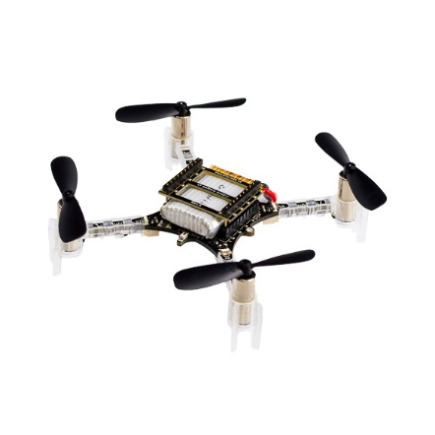
Acoustic Localization of UAVs
MIDN 1/C Carly Donner
Asst. Prof. Dennis Evangelista
Prof. Murray Korman

Slide 2
Problem Statement
Assume that some acoustic characteristics of the UAVs are known, that echoes are not present or small, and that only human auditory frequencies ranges (20 Hz-20 kHz) are taken into account. The goal of this project is to design and implement a microphone array to answer the following questions.
What are the acoustic signatures of several different UAVs and of different UAV operating environments and can filters be used to distinguish the UAVs from background noise?
Can the system differentiate between different types of UAVs as well as similar sounding noises?
Can the system track a UAV, providing direction and altitude?
How much recording time and at what distances from the UAV is the array able to provide an initial tracking solution?

Slide 3
Acoustic Signature Identification
Signature frequencies
Number of characteristic frequencies

Slide 4
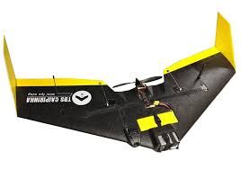
Acoustic Classification: How do we determine which drone is which?

Slide 5
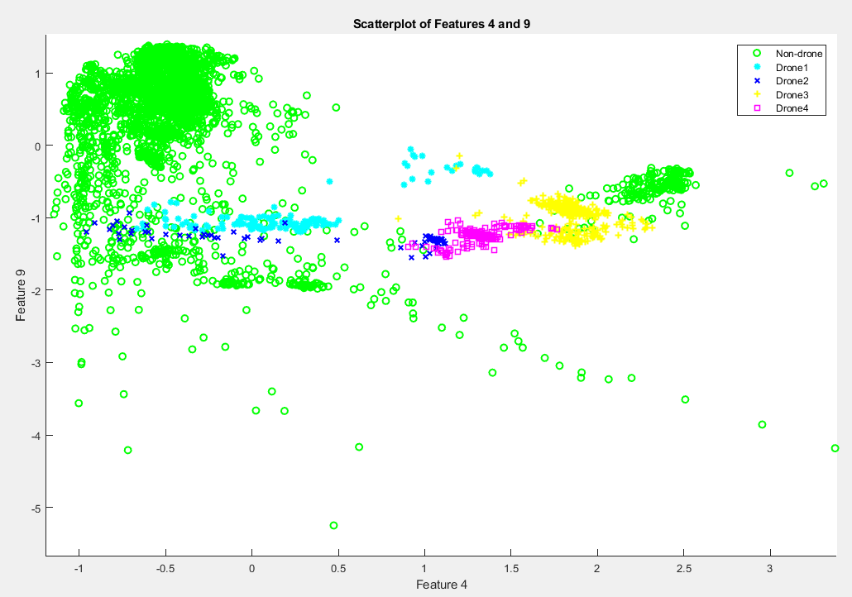
Acoustic Classification

Slide 6
Proof of Concept Experiment

