Slide 1
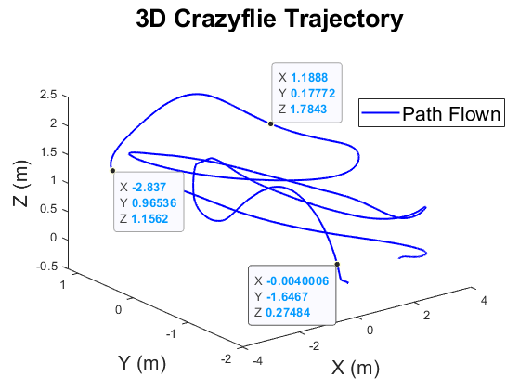
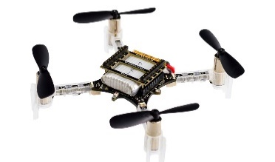
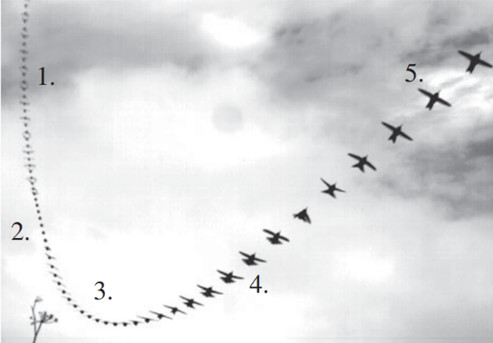
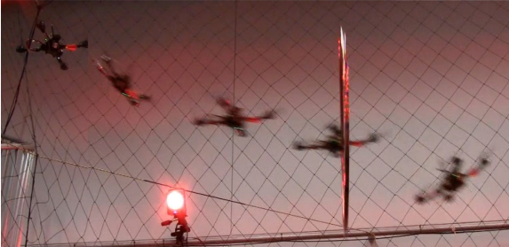
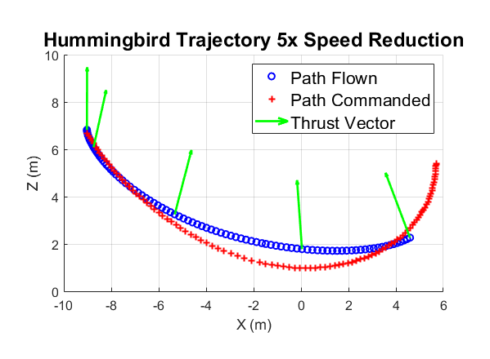
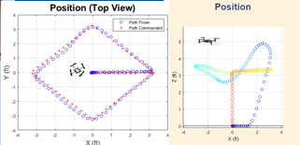



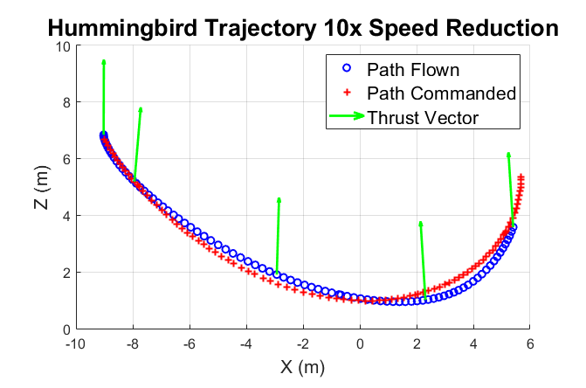

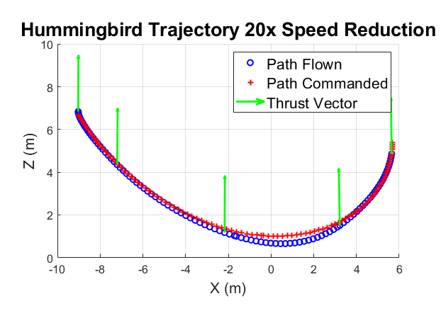
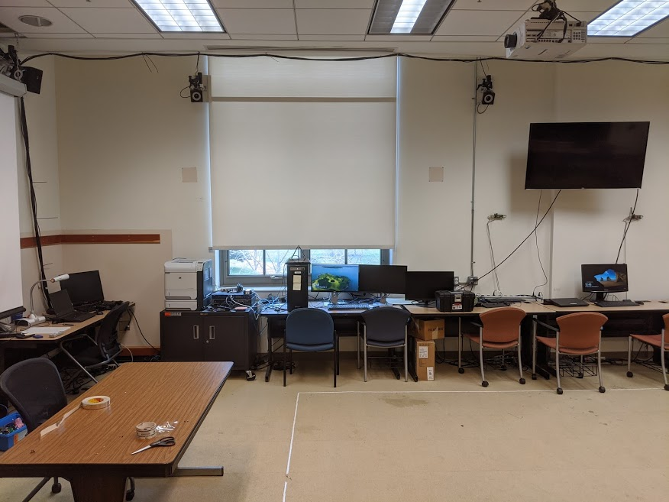

Autonomous trajectory planning to control a small UAS performing
extreme maneuvers modeled on hummingbird display dives
MIDN 1/C E Marcello and Asst Prof D Evangelista
Department of Weapons, Robotics, and Control Engineering, United States Naval Academy
Abstract: Animals moving in complex environments are an excellent source of inspiration for improving robots. This project is inspired by the extreme maneuverability of the male Anna’s Hummingbird (Calypte anna). I hope to make use of the study of their phenomenal dive maneuvers to test the limits of quadrotor control at high speeds and torques. Successful research will enhance our high-speed control ability of quadrotor drones to increase their usefulness and application in the public and private sectors.
Methods and materials
Simulation (MATLAB Simulink):
Rigid Body Model:
Body Properties: Crazyflie modeled from bitcraze website given parameters and distance measurements taken by calipers.
The hover condition is assumed for control, with pitch and roll angles linearized about an operating point of zero degrees. Attitude angle command saturation limits capped at +/-12 degrees.
Controller: Position Controller with PID control.
Results: Simulation of quadrotor flying C anna trajectory
Three trials were run at varying speed reductions using the same PID controller used to fly the diamond pattern in Figure 2. The attitude angle command saturation limits were increased to +/-25 degrees. The simulated quadrotor was able to follow the one twentieth speed reduction the closest, and had the smallest RMSE, while the trial at one fifth the speed was incredibly slow.
Results: Successful marker-based automatic tracking of UAS
Figure 5: 3D position data of a manually-controlled flight with the Crazyflie, captured with OptiTrack, and plotted in MATLAB.
Figure 1: (a) The five stages of an Anna’s Hummingbird dive maneuver, from [1]. (b) A quadrotor using an aggressive path planning algorithm to fly through a thrown hoop, from [2].
Hardware testing for the autonomous Crazyflie flight was successful in obtaining 3D position data from the Crazyflie. The next step is to obtain data from an autonomous flight using a basic position controller as in the simulation. Additionally, the trajectory controller will undergo basic tuning, consider saturation limits and incorporate additional linearization regions of control for different stages of the dive.
To what extent can an extreme maneuver be accomplished with path planning and position control versus more direct dynamic control of rates and accelerations?
Given a representative C. anna trajectory, a quadrotor MATLAB Simulink simulation, a Bitcraze Crazyflie 2.1, and an optical motion tracking system (OptiTrack), a suitable controller will be developed to fly a quadrotor autonomously to mimic a scaled-down representative hummingbird dive trajectory. Attempts will first be made in simulation, and then in proof of concept demonstration. Successful trials will demonstrate a root mean square error (RMSE) between the desired trajectory and the actual trajectory of less than 10cm with a 5cm standard deviation over the entire dataset. These errors will be calculated between the x,y,z position data for each pair of data points with the same time stamp.
Figure 2: (a, b) Simulated quadrotor flying a commanded “Diamond” trajectory in the X-Y plane, while attempting to maintain a 1m hover.
Proof-of-concept demonstration
ROS on linux machine sends commands to Crazyflie and obtains sensor data from Crazyflie, and x,y,z position data from the OptiTrack
OptiTrack Motion Tracking System accurate to +/- 0.5mm
Feasibility of mimicking C. anna dives:
The work displayed has shown that slowed-down trajectory flight similar to C. anna display dives is possible with a quadrotor. Adjusting PID gains, or implementing a more direct control that commands angle rates or accelerations rather than high-level positions would likely increase drone performance. Due to constraints on lab size, geometrically similar but shorter trajectories will also be explored.
OptiTrack Cameras
References
[1]C. Clark, "Courtship dives of Anna's hummingbird offer insights into flight performance limits", Proceedings of the Royal Society B: Biological Sciences, vol. 276, no. 1670, pp. 3047-3052, 2009 [Online]. Available: https://royalsocietypublishing.org/doi/pdf/10.1098/rspb.2009.0508. [Accessed: 19- Feb- 2019]
[2]D. Mellinger and V. Kumar, "Minimum snap trajectory generation and control for quadrotors," 2011 IEEE International Conference on Robotics and Automation, Shanghai, 2011, pp. 2520-2525 [Online]. Available: http://ieeexplore.ieee.org/stamp/stamp.jsp?tp=&arnumber=5980809&isnumber=5979525. [Accessed: 19- Feb- 2019]
<<<Pic here of drone flying w/ OptiTrack in background>>> Also point to important stuff using art/arrows
OptiTrack Workstation
Figure 4(a,b,c): Simulated Crazyflie flying the true hummingbird trajectory at one fifth, one tenth, and one twentieth the actual Hummingbird’s speed.
Figure 3: Maury 201 OptiTrack lab setup.
Acknowledgements: We thank Prof C Clark (UCR), Prof B Cheng (PSU), Prof J Dawkins, Prof G Piper, 2Lt B Canlas, and MIDN 1/C Guinan.

