Slide 1

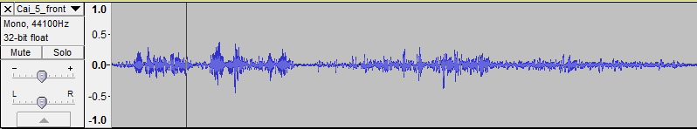
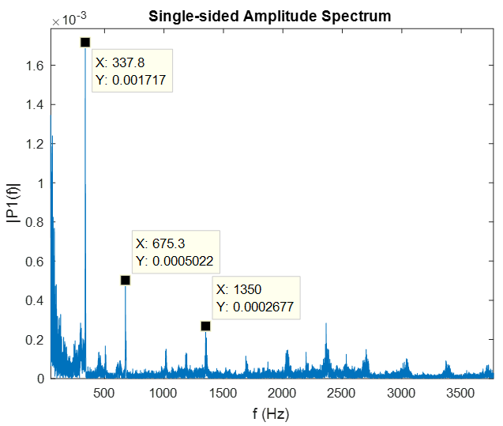
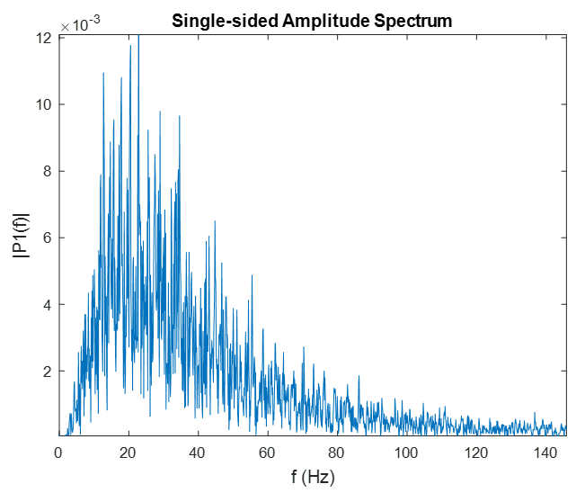
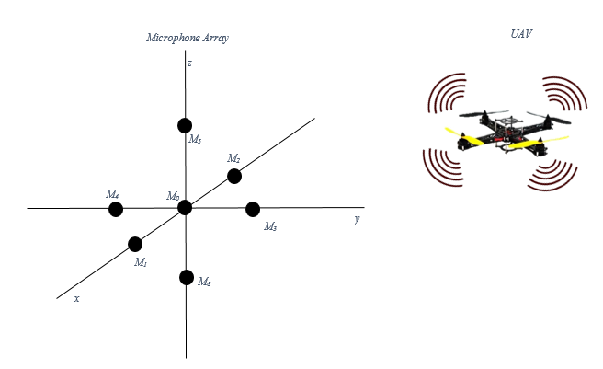
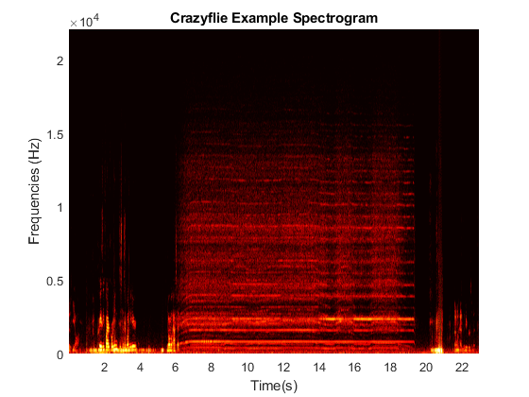
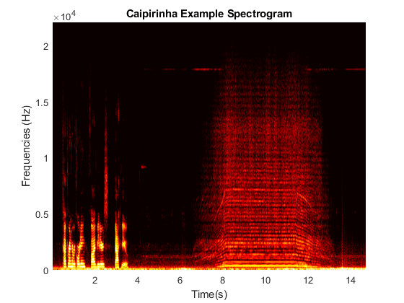
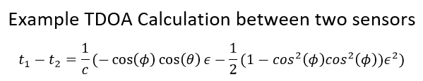
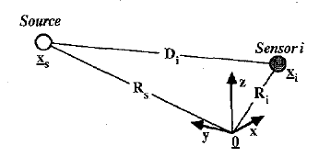
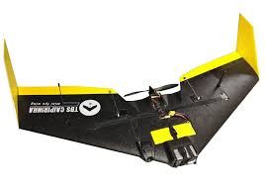

Localization of UAVs Using an Acoustic Microphone Array
MIDN 1/C Carly Donner, Asst. Prof. Dennis Evangelista
Systems Engineering Department
United States Naval Academy
Abstract
Acoustic characterization of typical UAV and environmental sources
Proof of Concept Demonstration
Unmanned Aerial Vehicle (UAV) tracking and detection is becoming an important field of interest. However, none of the methods in the past have used acoustics. Acoustic localization of UAVs is passive and has the potential to be portable and less noticeable compared with other localization methods, making it ideal for military purposes. This research project outlines the process to design and implement a microphone array to acoustically localize UAVs at a near real-time speed . To demonstrate these concepts, first the signature acoustics of various UAVs will be characterized using recordings so that the system can distinguish between the UAV and background noise. Next, a simulation will be done to test the localization algorithms and determine good placement of the microphones to increase localization resolution. The final experiment will be to use the previous results to design, build and test the array.
Fixed wing and quadrotor UAVs have unique sound signatures compared to each other and the environment.
Construct a microphone array and demonstrate that it can locate a UAV’s position
Test data recorded for fixed wing (Caipirinha and Zephyr II) and quadrotor (Craziefly and Flamewheel F450) at 44.1 kHz 12 bit mono, outdoors with ambient noise.
The final demonstration will have a UAV be flown or moved around in a room. It will be recorded by the microphone array and also tracked visually using high-speed cameras as a secondary method of localization to verify the acoustic localization. The microphone array will be connected to a Labjack T7, which has the capability to read in the recordings of each microphone as analog inputs. The Labjack will be connected to a PC computer which will contain the necessary Matlab programs to correlate the sound signals and determine the localization solutions.
Fast Fourier Transform (FFT) and Spectrogram Analysis in Matlab (number of points and window size?) reveals distinctive sound signatures for each type.
Matlab simulation of microphone arrays using delays
Add cartoons of each in corner of plot
Add arrows to point to interesting parts
Simulations of microphone arrays as a tool for determining the required number, arrangement, and performance specifications for the system.
Simulate several sensors and a source making noise
Materials
8+ ADMP401 MEMS Microphones
Labjack T7
Caipirinha Drone
Crazyflie Drone
High-speed cameras
For forward simulation, Implement in time domain using upsampling and delays
Tonal frequencies help identify propeller blade passing frequency, motor electrical and switching noise, and presence of one or multiple rotors.
Acknowledgements
Classification and Identification underway in Matlab, using feature extraction from time and frequency domain audio analysis and (TYPE) machine learning.
For inverse localization, minimize the sum of the calculated time differences
Prof. Murray Korman, Physics Professor, USNA.
F. Gustafsson and F. Gunnarsson, "Position using time-difference of arrival measurements," IEEE International Conference on Acoustics, Speech, and Signal Processing, vol. 6, no. VI, pp. 553-556, 2003.
J. O. Smith and J. S. Abel, "Closed-Form Least-Squares Source Location Estimation from Range-Difference Measurements," IEEE Transactions on Acoustics, Speech, and Signal Processing, vol. 35, no. 12, pp. 1661-1669, 1987.
Add Crazyflie too?

