Slide 1

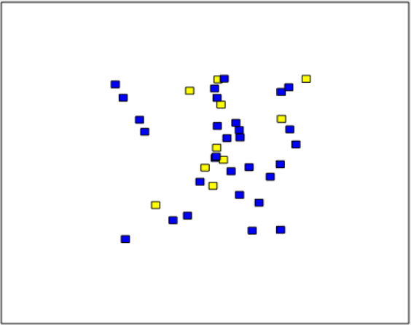
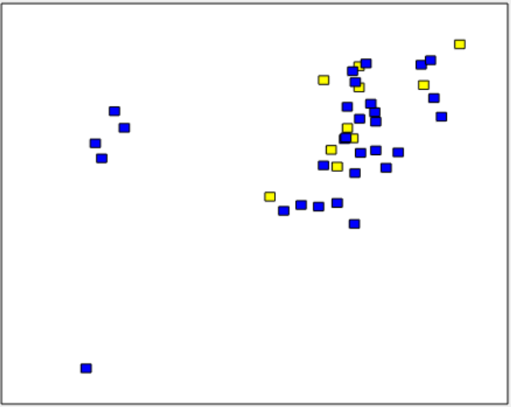
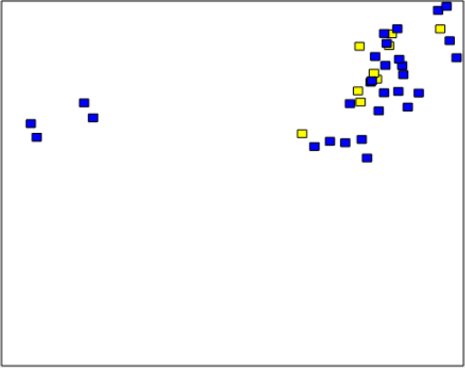
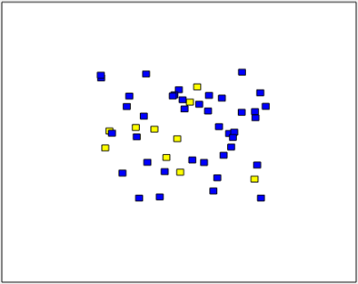
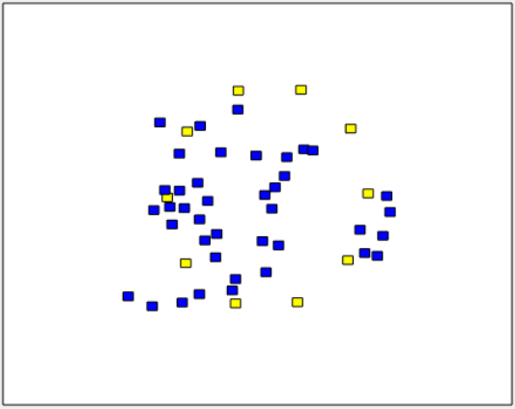
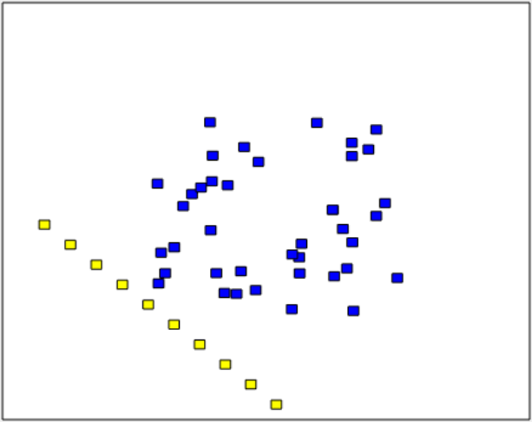
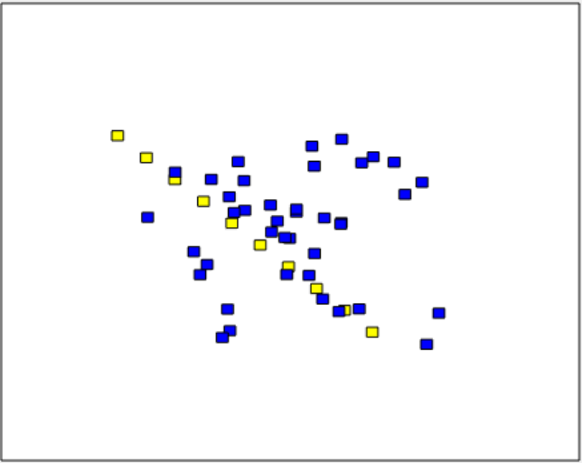
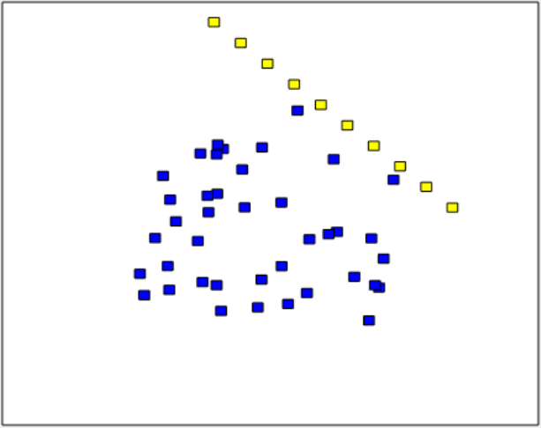
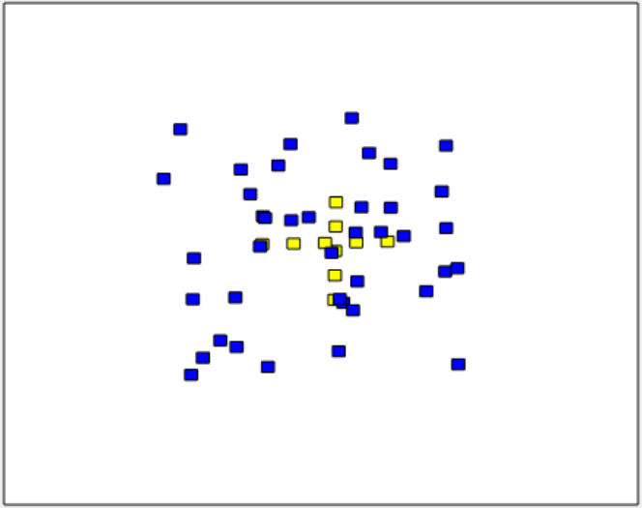
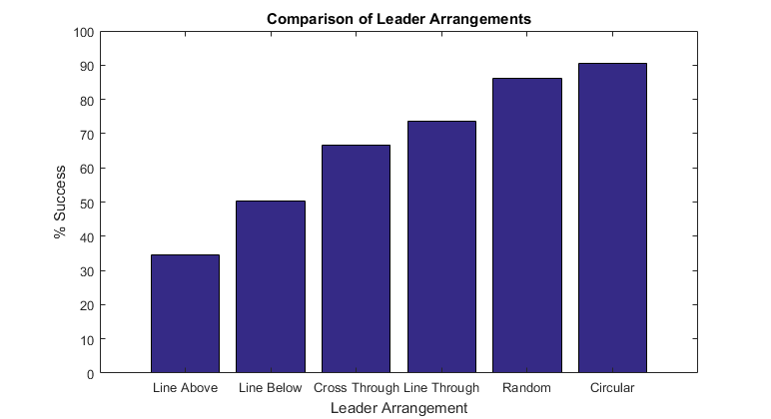
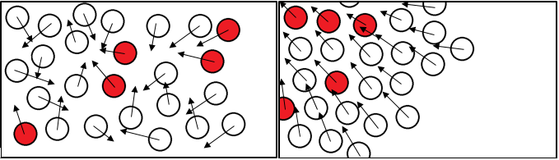
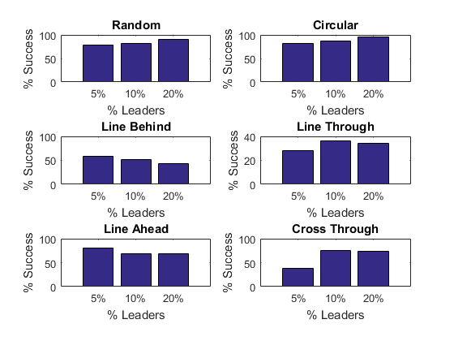
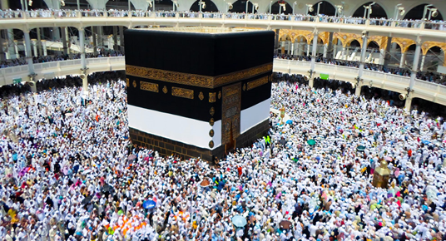

Can we redirect a crowd by seeding it with informed leaders?
MIDN 1/C A Toth and Asst Prof D Evangelista (evangeli@usna.edu)
Abstract
Simulating Swarms in MATLAB
When considering the collective behavior of large groups, such as human crowds in physical or cyber spaces, schools of fish, large flocks of birds, etc., a natural question to consider is what it would take to change the direction of motion of the group. We will discuss simulations and initial experiments with Naval Academy midshipmen to test whether "informed" leaders, seeded within the group with an unannounced but coordinated agenda, can adequately alter the motions of the group. We will consider both the number and physical location of the informed leaders (spread throughout, or at the periphery) within the crowd. Testing with live midshipmen is, by necessity, limited to small numbers, so we will also use crowd simulations to explore the scaling effect of crowd size as well as the effect of a calm versus agitated state. We will also consider the relevance of such results to public safety, civil applications, and cases where it is desired to alter or redirect a swarm or flock.
MATLAB is the principal simulation software used. A crowd dynamics algorithm was written based on [1].
To produce results, % of leaders in the group was changed and starting position was changed.
A successful “run” of the simulation was counted when a majority of the followers arrived inside of the target space.
FOLLOWER
LEADER
BEGINNING
MIDDLE
END
In a visualization of a simulation iteration, beginning, middle, and end phases of the leaders’ influence on the group are shown in sequence. Blue boxes represent followers and yellow boxes represent leaders. The space is scalable to about a 85ft x 60ft room for human beings. The radius each individual is influenced inside of is roughly scalable to 8.5 ft.Leaders here are randomly placed around the crowd. As the simulation progresses, it is visible that the moves in a group to the top right corner with the leaders.
leader velocities = toward target coordinate
for each member
if member1 is close to member2
member1’s velocity = average of 1’s & 2’s
member2’s velocity = average of 2’s & 1’s
member’s position = old position + velocity*time
end
end
if a majority of members end up in target area
run = “success”
end
RANDOM
CIRCULAR
LINE BEHIND
LINE
THROUGH
CROSS
THROUGH
LINE AHEAD
Visualizations of the six tested leader arrangements are shown above.
Introduction
Pseudo code explaining the crowd simulation is shown above.
On the left is a crowd with informed leaders placed throughout, shown in red. These leaders’ motion, without any active communication, can cause the movement of the rest of the crowd, as shown on the right. As shown by the arrows, the velocity vectors of the crowd become more homogenous as the actions of the informed leaders progress.
Questions this study hopes to answer are:
1. How does leader placement affect crowd/swarm reaction? How can leaders be placed among crowd members to elicit the most effective change in behavior, specifically crowd motion in a pre-specified target direction?
2. How does the required density of leaders needed to influence crowd behavior change with different leader placements?
Yes, we CAN redirect a crowd...
Acknowledgements
Thank you to Professors B.E. Bishop, J.S. Donnal, and J.A. Piepmeier, whose code was referenced as an example when building this original simulation.
[1] Z. Liu, "The proportion of leaders needed in the consensus decision-making," in Proceedings of the 51st IEEE Conference on Decision and Control, Maui, Hawaii, USA, 2012.
[2] J. R. Dyer, A. Johansson, D. Helbing, I. D. Couzin and J. Krause, "Leadership, consensus decision making and collective behaviour in humans," Philosophical Transactions of the Royal Society B: Biological Sciences, vol. 364, no. 1518, pp. 781-789, 12 December 2008.
[3] S. Guler, Artist, MECCA. [Art]. 2015
[4] The Pack, Artist, Flock. [Art]. 2007.
Seeding swarms with leaders redirects the crowd according to simulation. [2] has shown that this is also true in real human groups, but did not test varying formations. The arrangement and number of leaders affects the level of successful redirection. Simulation data shows that a circular formation around the target crowd is the most effective solution to move them to a target area because leaders influence all members around the edge of the group and those members in turn influence members further inside. Interestingly, the next most successful formation was random placement of the leaders throughout the group. The least effective solution was the line of leaders ahead of the group; not surprisingly, they tend to move away without a high degree of influence because of lower amounts of interaction. In addition, though higher ratios of leaders to followers is in the group will always lead to an increase in likelihood of success, only about 10% were needed to make a significant difference in the crowd. 5% will move the crowd in many cases, but significantly slower and with less total individuals reaching the goal area. Roughly the same number of individuals reached the goal area when 20% of the group were leaders in many leader arrangements, though it was completed faster.
Image credit to [4] and [3] from left to right.
Notes:
Do not change: page size, background color, font size or font type
You may change: the name of the section headings as appropriate (e.g. Method might be Algorithm, Design Approach or Analysis); You may also remove a section if it doesn’t apply (e.g. Acknowledgements)
Tips:
Graphics should be hi res (will be printed large), captioned, and source listed in caption or on graphic if not self generated. Use white outline. Png is a good file format for matlab plots. Jpg preferred for photos
Plots: make sure fonts for axis labels are readable. Consider adding axis labels or annotations in power point rather than generating software.

