Slide 1
Company Analysis

Slide 2
businessoverview
Amazon's business overview has seen significant changes over time, evolving from a books-only retailer in 1996 with $15 million in revenue to a global giant selling almost every physical and digital retail item imaginable with a vibrant third-party seller ecosystem. By 2022, Amazon's international consumer segment drove $118 billion of revenue, showcasing a 30% compound annual growth rate in the UK, 26% in Germany, and 21% in Japan from 2019 to 2021. Amazon's business expansion includes the introduction of Amazon Web Services (AWS) in 2006, which has grown into an $85 billion annual revenue business. In recent years, Amazon ventured into new market segments like grocery, healthcare, and advertising. Their grocery business, nearly 20 years in the making, focuses on larger pack sizes and offerings via Whole Foods Market and Amazon Fresh. Amazon Business, launched in 2015, now drives $35 billion in annualized gross sales. Additionally, their advertising segment grew by 25% YoY in 2022, reaching $31 billion in revenue. This broad diversification reflects Amazon's dynamic strategy to leverage market opportunities and innovations developed over time.

Slide 3
revenue
Amazon's revenue has shown significant growth over the past few years. In 2020, the company reported net sales of $386.064 billion, which increased to $469.822 billion in 2021, representing a 22% year-over-year growth. In 2022, net sales reached $513.983 billion, marking a 9% increase from 2021. The growth in revenue can be attributed to various segments. North America saw sales increase from $279.833 billion in 2021 to $315.880 billion in 2022, a 13% growth. AWS (Amazon Web Services) also contributed significantly with sales growing from $62.202 billion in 2021 to $80.096 billion in 2022, a 29% increase. However, the International segment experienced a decline in sales from $127.787 billion in 2021 to $118.007 billion in 2022, an 8% decrease, negatively impacted by changes in foreign currency exchange rates.

Slide 4
operatingincome
Amazon's operating income has displayed volatility over the recent years. In 2020, the company reported an operating income of $22.9 billion. It increased slightly in 2021 to $24.9 billion. However, in 2022, the operating income dropped significantly to $12.2 billion, primarily due to increased operating expenses related to fulfillment, shipping, technology, and content costs across its various segments. The North America segment, which had an operating income of $7.3 billion in 2021, reported a loss of $2.8 billion in 2022. The International segment continued to struggle, increasing its operating loss from $0.9 billion in 2021 to $7.7 billion in 2022. Contrarily, AWS's operating income rose from $18.5 billion in 2021 to $22.8 billion in 2022, boosted by sales growth and cost structure productivity. Overall, the downturn in 2022 illustrates pressures from rising costs offsetting gains in specific segments.

Slide 5
cashflow
Amazon's cash flow over the past few years shows significant fluctuations and priorities in investments and financing activities. In 2020, the net cash provided by operating activities was $66.1 billion, reduced to $46.3 billion in 2021 and slightly increased to $46.8 billion in 2022. This reduction after 2020 was driven by changes in net income, including increased depreciation, amortization, and stock-based compensation, offset by significant increases and changes in accounts receivable and payable. Cash used in investing activities varied significantly. In 2020, net cash used was $59.6 billion, which slightly decreased to $58.2 billion in 2021 and then significantly decreased to $37.6 billion in 2022. These were primarily driven by purchases of property and equipment, sales, and maturities of marketable securities. Net cash provided by financing activities fluctuated as well. In 2020, it was -$1.1 billion, jumping to $6.3 billion in 2021 and further increasing to $9.7 billion in 2022, driven by proceeds and repayments from debt and lease obligations. Overall, while operating cash flow has stabilized post-2020, the company has significantly adjusted its investment and financing strategies, reflecting changes in market conditions and strategic priorities.

Slide 6
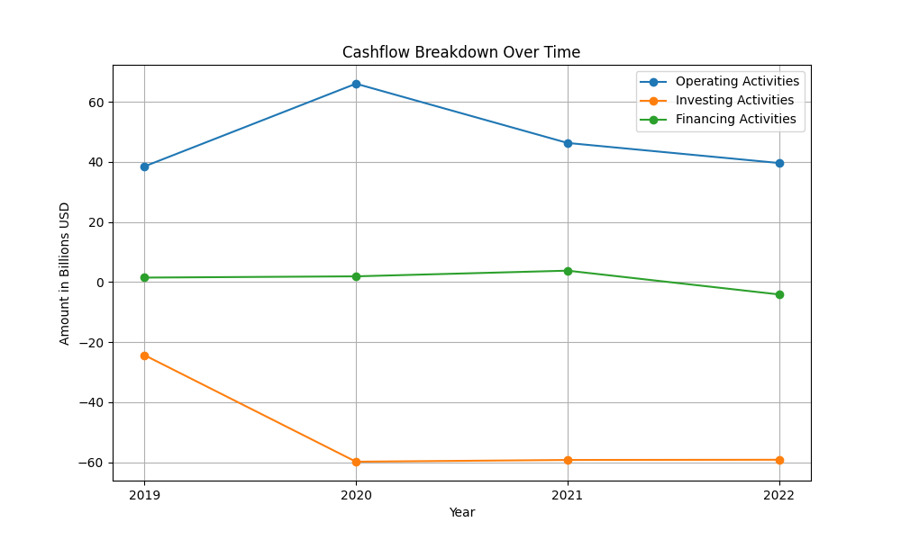
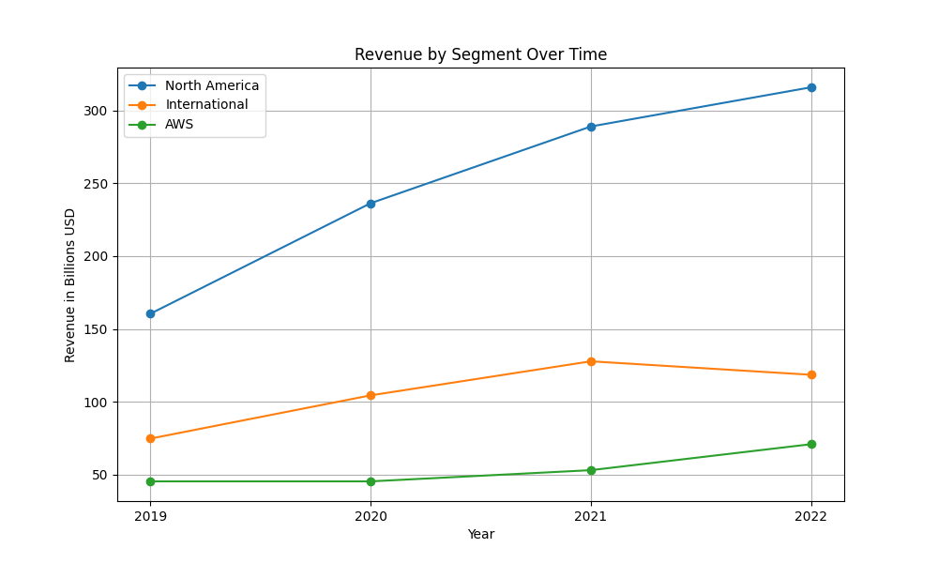
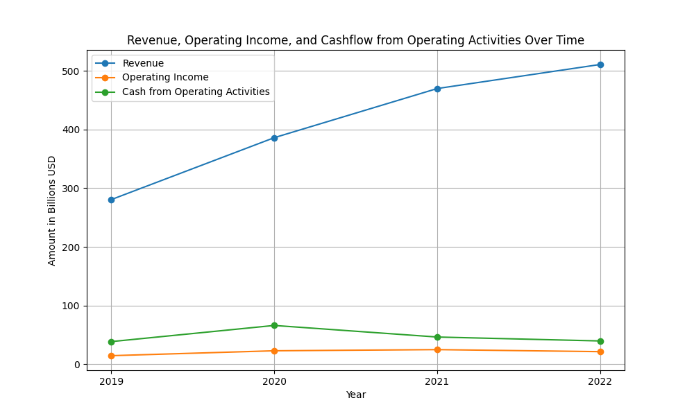
businessoverview figures

Slide 7
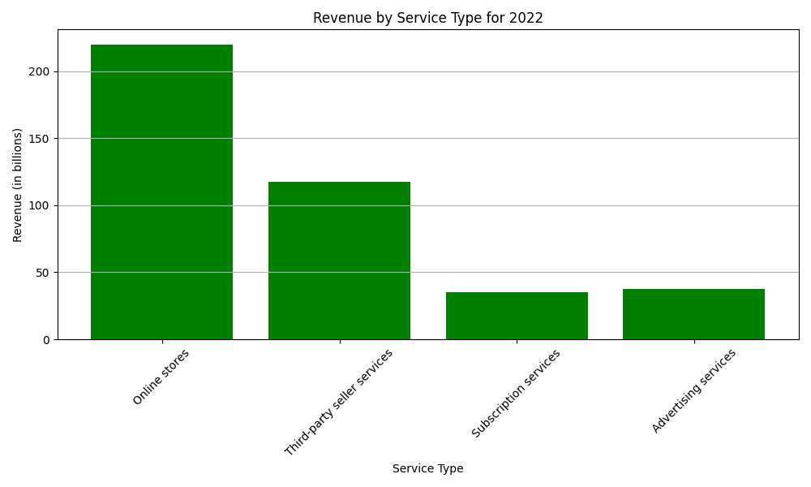
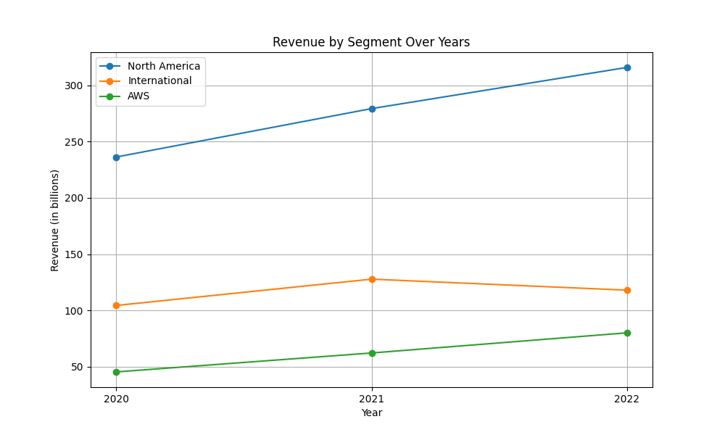
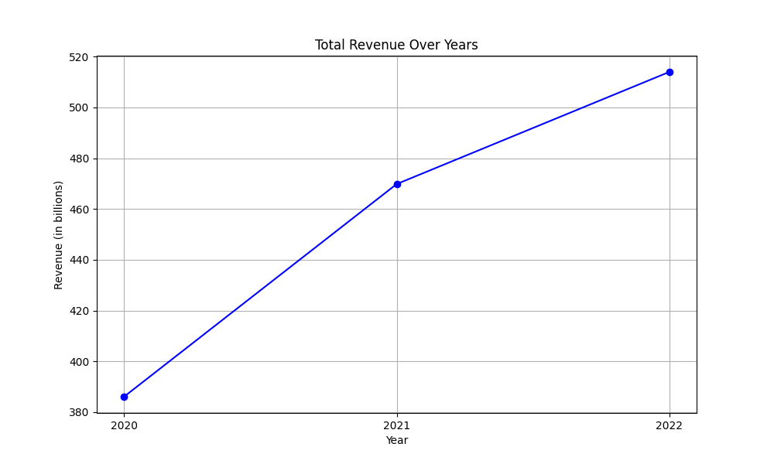
revenue figures

Slide 8
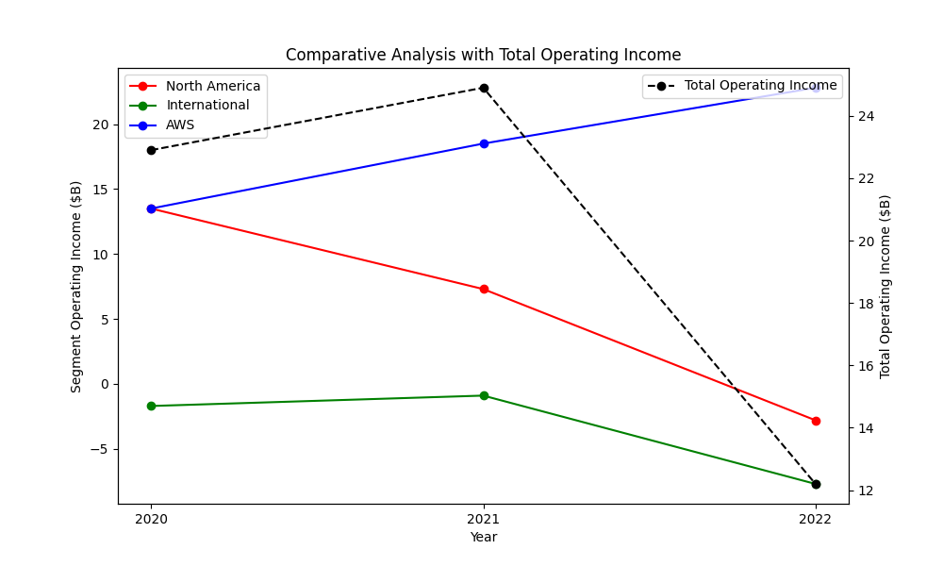
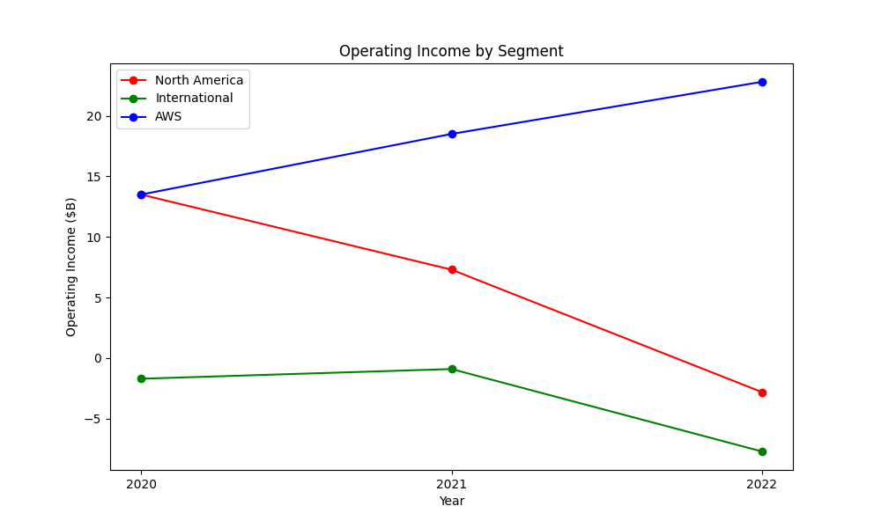
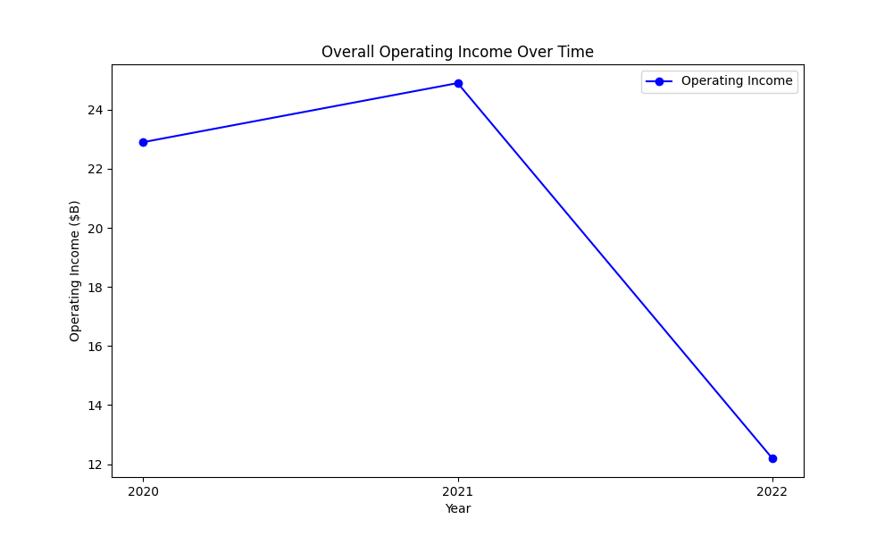
operatingincome figures

Slide 9
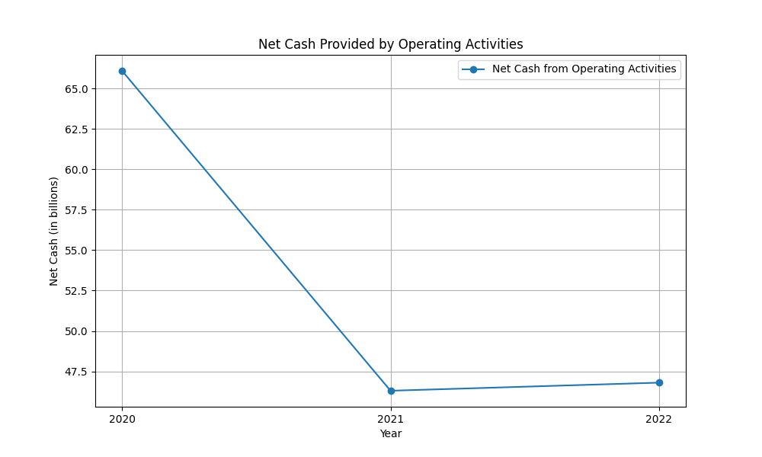
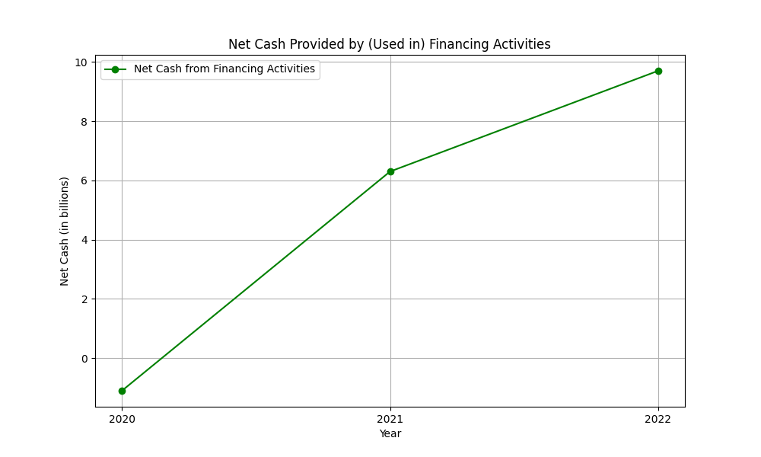
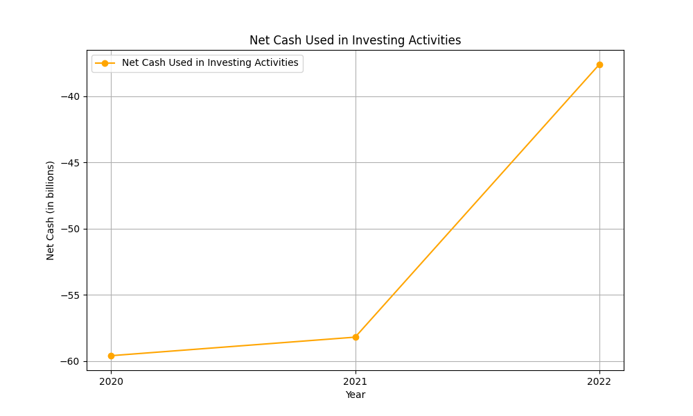
cashflow figures

