Slide 1
Company Analysis

Slide 2
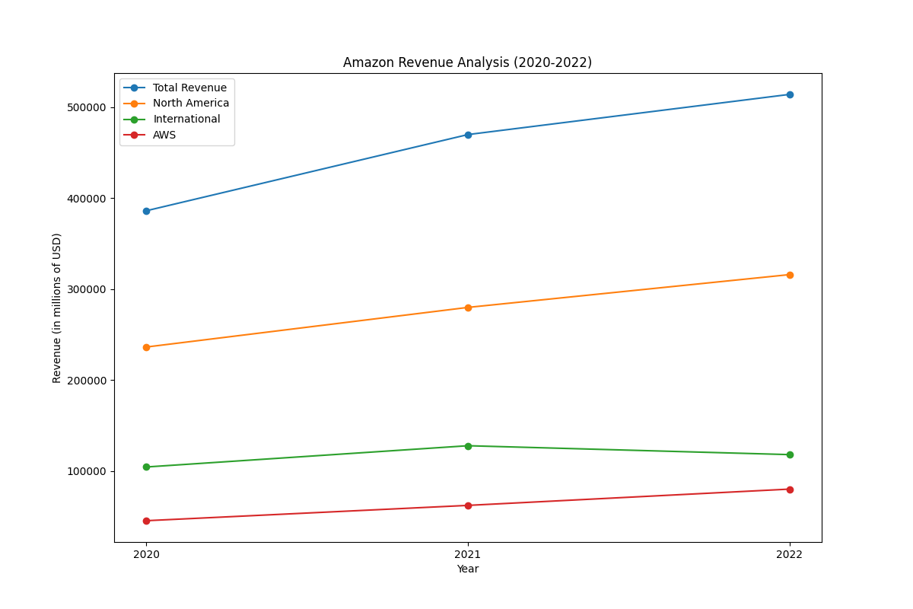
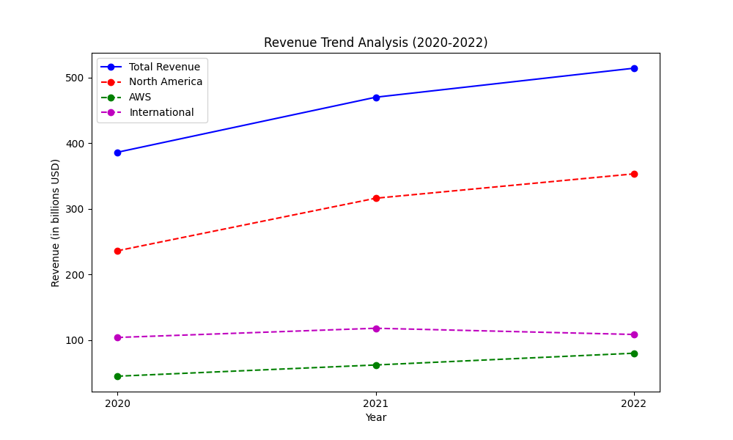
Revenue Analysis
Amazon's revenue has consistently grown over the past few years. Here’s an analysis of the company's revenue and profit trends: 1. Revenue Growth: - 2020: $386.06 billion - 2021: $469.82 billion (22% increase from 2020) - 2022: $513.98 billion (9% increase from 2021) AWS has been the significant growth driver, with revenue increasing from $45.37 billion in 2020 to $80.10 billion in 2022, showing a 77% increase over two years. In 2022, AWS’ growth was 29% compared to the previous year. 2. Segment Analysis: - North America: Revenue grew from $279.83 billion in 2021 to $315.88 billion in 2022 (13% increase). - International: Revenue declined from $127.79 billion in 2021 to $118.01 billion in 2022 (8% decrease) due to foreign exchange rates impacts. - AWS: Steady growth from $62.20 billion in 2021 to $80.10 billion in 2022 (29% increase). 3. Net Income: - 2020: $21.33 billion - 2021: $33.36 billion - 2022: Net loss of $2.72 billion due to higher operating expenses and other non-operating expenses. 4. Operating Income: - Decreased from $24.88 billion in 2021 to $12.25 billion in 2022, significantly impacted by higher operating expenses, inventory management, and business optimizations. 5. Revenue by Product/Service: - Online Stores: $220.00 billion in 2022, a slight decrease from $222.08 billion in 2021. - Third-party Seller Services: Increased to $117.72 billion in 2022 from $103.37 billion in 2021. - AWS: Largest growth segment. Amazon has effectively diversified its revenue streams, with significant contributions from AWS, third-party seller services, and subscription/advertising services. Despite the challenges in 2022, particularly in the international segment, Amazon’s robust growth in AWS and third-party services has sustained its overall revenue growth. The net loss in 2022 indicates the rising costs impacting operating income, requiring continuous operational efficiency efforts.

Slide 3
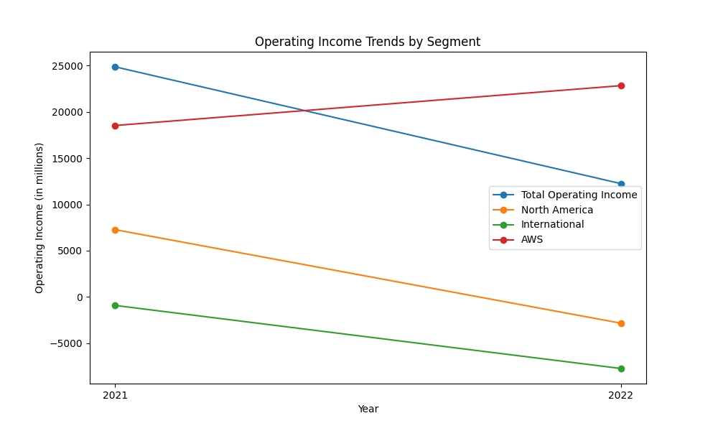
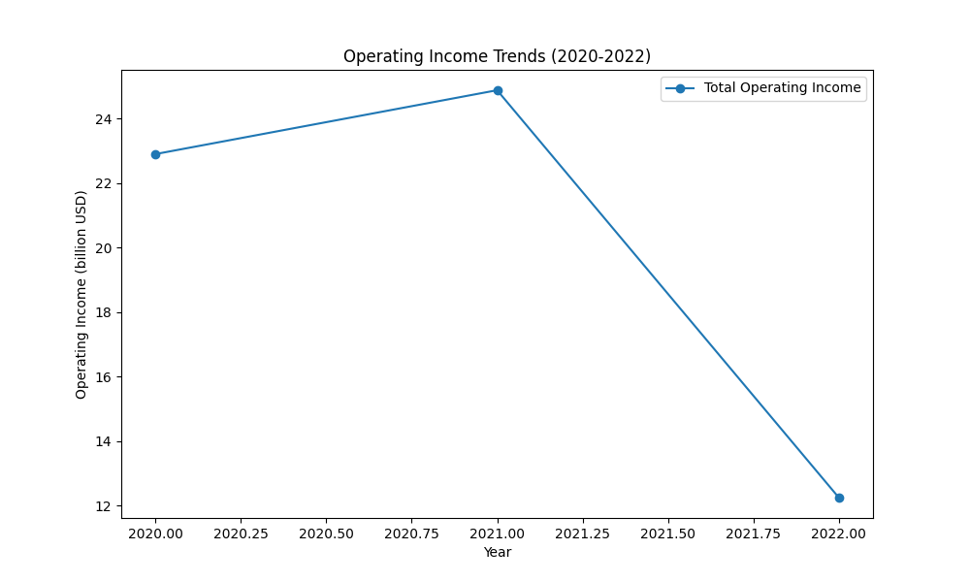
Operating Income Analysis
Operating income for Amazon has shown significant fluctuations over recent years. In 2020, the operating income was $22.9 billion, which increased to $24.9 billion in 2021. However, in 2022, operating income dropped to $12.2 billion. Breaking down by segments: 1. North America: Operating income decreased from $7.3 billion in 2021 to a loss of $2.8 billion in 2022. This decline was attributed to higher fulfillment and shipping costs, investments in the fulfillment network, and increased technology and content costs. 2. International: Operating loss expanded from $924 million in 2021 to $7.7 billion in 2022. This was mainly due to higher fulfillment costs, wage rates, and technology expenses, despite increased advertising sales. 3. AWS: Contrasting with the other segments, AWS operating income rose from $18.5 billion in 2021 to $22.8 billion in 2022. Growth in this segment was driven by increased sales and improved cost structure productivity. Overall, while AWS has been a consistent performer with increasing operating income, the North America and International segments faced substantial challenges in 2022 resulting in reduced operating incomes.

Slide 4
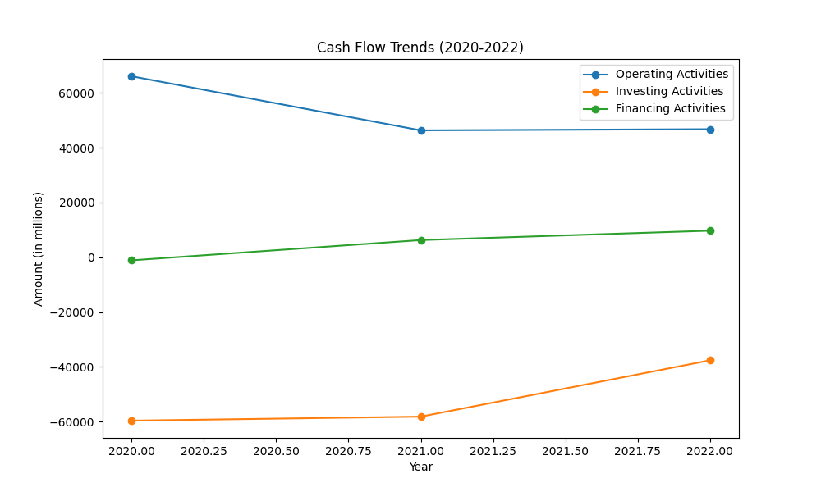
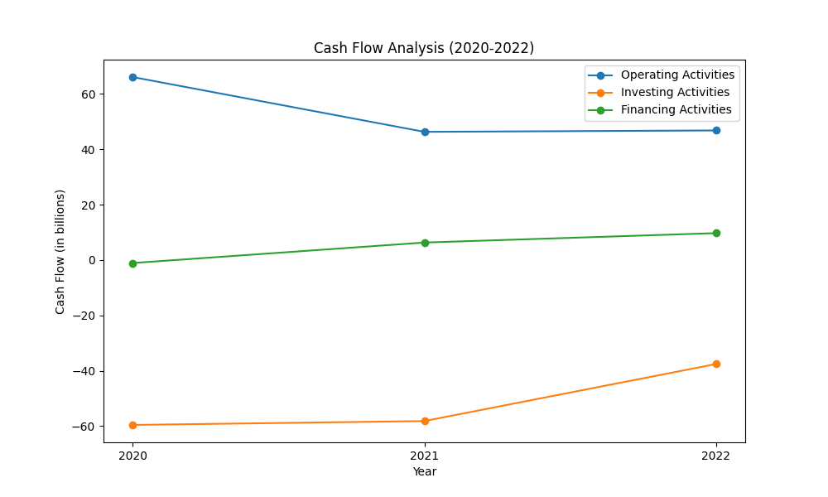
Cash Flow Analysis
Amazon's cash flow has experienced significant changes from 2020 to 2022. In 2020, the net cash provided by operating activities was $66.1 billion, decreasing to $46.3 billion in 2021 and slightly increasing to $46.8 billion in 2022. The cash used in investing activities had fluctuations, with $(59.6) billion in 2020, $(58.2) billion in 2021, and decreasing significantly to $(37.6) billion in 2022. The cash provided by financing activities also varied, with $(1.1) billion in 2020, increasing to $6.3 billion in 2021, and further rising to $9.7 billion in 2022. Amazon’s free cash flow, defined as net cash provided by operating activities less purchases of property and equipment, was $(9.1) billion in 2021 and further decreased to $(11.6) billion in 2022. Additionally, when accounting for finance leases and finance obligations, free cash flow was $(20.4) billion in 2021 and $(19.8) billion in 2022. Overall, while Amazon maintained a robust operating cash flow, substantial investments and financing cash flows experienced notable variability during this period.

Slide 5
Other KPIs
1. PBT Margin: - 2021: Operating income of $24,879 million with net sales of $469,822 million gives PBT margin of 5.3% - 2022: Operating income of $12,248 million with net sales of $513,983 million gives PBT margin of 2.4% 2. Cost of Risk: - 2022: Approximately $1.1 billion recorded as impairments of property and equipment and operating leases 3. Return on Tangible Equity: - Shareholders' equity reduced from $138,245 million in 2021 to $146,043 million in 2022 - Net loss of $2,722 million in 2022; therefore, return on tangible equity is negative 4. Net Interest Margin: - Interest expenses: $1,561 million - Total liabilities and equity of $462,675 million in 2022. Analysis: - PBT Margin decreased significantly from 2021 to 2022 due to increased expenses. - Cost of Risk increased mainly due to impairments. - Return on Tangible Equity negative in 2022, illustrating a setback in equity performance. - Net Interest Margin indicates a higher liability context.

Slide 6
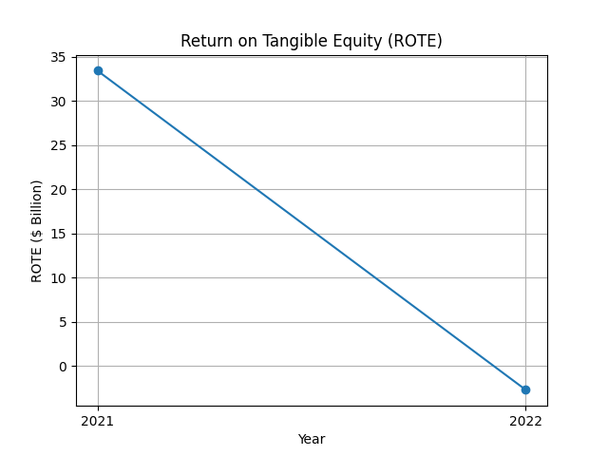
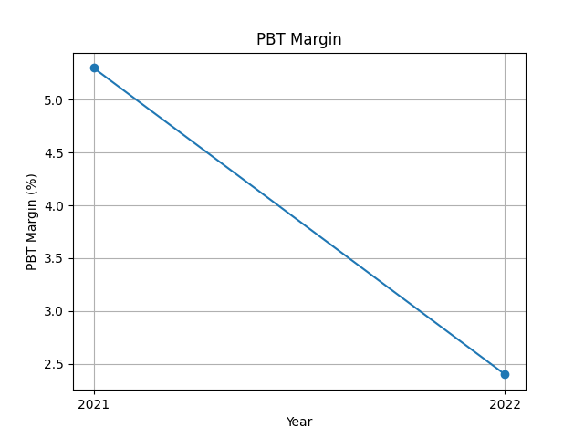
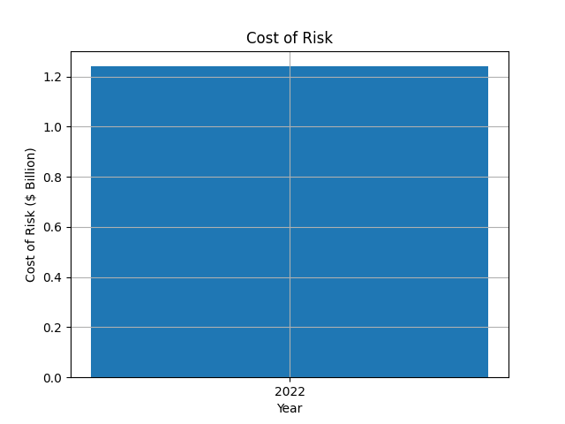
KPI Plots

