Slide 1
Amazon.Com, Inc. Analysis

Slide 2
Business Overview
Amazon's business overview has evolved significantly over time. Initially, Amazon started as an online bookstore that rapidly expanded its selection to include a wide range of products. By 1997, it had generated $147.8 million in sales, a significant increase from $15.7 million in 1996. In recent years, Amazon has further diversified its offerings into various sectors. Amazon Business, launched in 2015, allowed the company to leverage its logistics capabilities for bulk procurement, achieving roughly $35 billion in annualized gross sales by 2022. The grocery segment, which Amazon entered in the early 2000s and later expanded through acquisitions like Whole Foods in 2017, also remains a focus. Amazon Web Services (AWS), introduced in 2006, has grown to be a substantial part of the business, generating $80 billion in 2022, up from $62.2 billion in 2021, although its growth rate has slightly declined. The company has also ventured into healthcare with Amazon Pharmacy, launched in 2020, which aims to provide a full-service online pharmacy experience. Overall, Amazon's business model has shifted from a singular e-commerce focus to a diversified portfolio encompassing various high-growth industries.

Slide 3
Revenue
Amazon's revenue has consistently grown over the past three years but recently faced some challenges. In 2020, Amazon reported total net sales of $386.1 billion. This figure increased by 22% to $469.8 billion in 2021 and further by 9% to $514.0 billion in 2022. The growth in net sales has been driven by various segments, with Amazon Web Services (AWS) showing significant increases. Specifically, AWS sales escalated from $45.4 billion in 2020 to $62.2 billion in 2021, and finally to $80.1 billion in 2022. Conversely, the International segment saw a decline in 2022 with net sales decreasing from $127.8 billion in 2021 to $118.0 billion in 2022, primarily due to foreign exchange rate impacts. On a regional basis, North America remains the largest contributor, with net sales growing from $279.8 billion in 2021 to $315.9 billion in 2022. However, operating expenses for this region also increased, impacting overall profitability. Overall, despite the challenges, particularly in the International segment due to currency fluctuations and rising operational costs, Amazon continues its revenue growth trajectory albeit at a slower pace in the latest year.

Slide 4
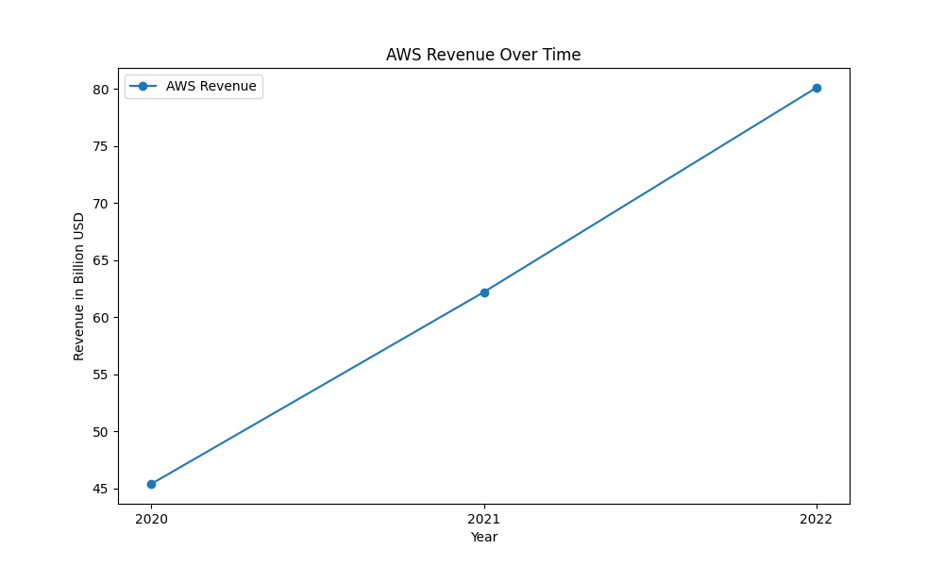
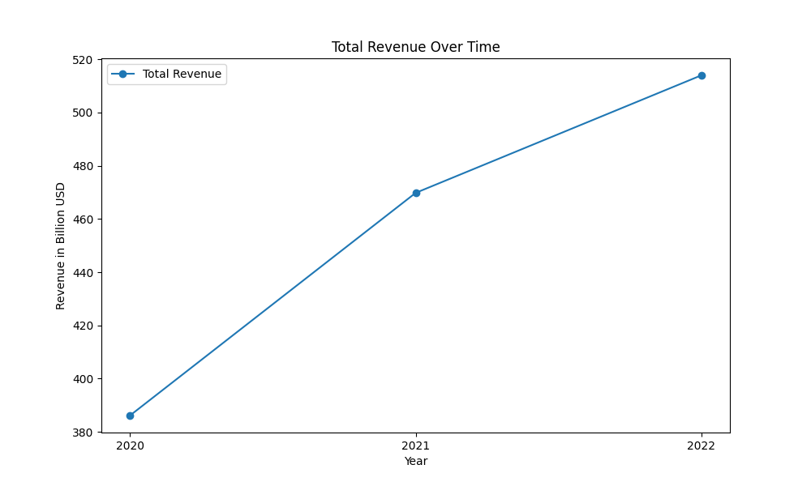
revenue figures

Slide 5
Operating Income
Amazon's operating income has shown both growth and decline over the reported years. In 2020, the company recorded an operating income of $22.9 billion. This figure increased to $24.9 billion in 2021, highlighting a period of profitability and expansion. However, in 2022, Amazon's operating income significantly dropped to $12.2 billion. This decline in 2022 can be primarily attributed to increased costs, including fulfillment and shipping expenses, investments in the fulfillment network, transportation costs, wage rates, and incentive growth. Additionally, the increase in AWS operating income due to sales and cost efficiencies was offset by the aforementioned costs and increased spending on technology infrastructure. By segment in 2022, North America saw an operating loss of $2.8 billion compared to a $7.3 billion income the previous year; the international segment also recorded a loss of $7.7 billion compared to a $924 million loss in 2021. Conversely, AWS saw an operating income increase from $18.5 billion in 2021 to $22.8 billion in 2022.

Slide 6
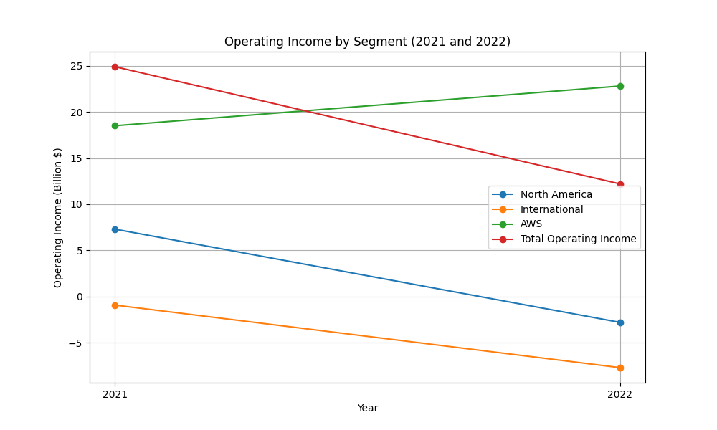
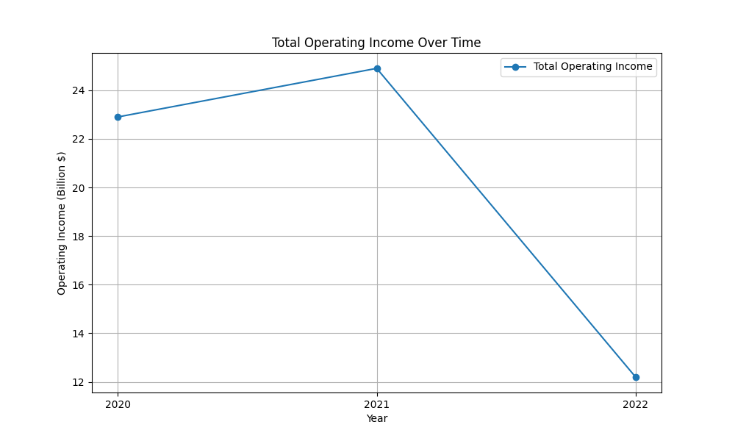
operatingincome figures

Slide 7
Cash Flow
Amazon's cash flow has notably fluctuated over the three-year period from 2020 to 2022. In 2020, net cash from operating activities was $66.1 billion. This declined to $46.3 billion in 2021 and stayed relatively stable at $46.8 billion in 2022. The decrease in 2021 was due to changes in working capital, although operating cash flow steadied in 2022. Net cash used in investing activities showcased significant outflow, recording $(59.6) billion in 2020, $(58.2) billion in 2021, and $(37.6) billion in 2022. These outflows primarily stemmed from cash capital expenditures, especially investments in technology infrastructure for AWS and additional capacity for their fulfillment network. Financing activities displayed mixed results. The cash inflow from financing surged from $(1.1) billion in 2020 to $6.3 billion in 2021, then further increased to $9.7 billion in 2022. This was facilitated by proceeds from long-term debt issuances and increased short-term debt borrowings. Overall, total cash and cash equivalents, including restricted cash, increased from $36.5 billion at the end of 2020 to $54.3 billion by the end of 2022, indicating considerably enhanced liquidity.

Slide 8
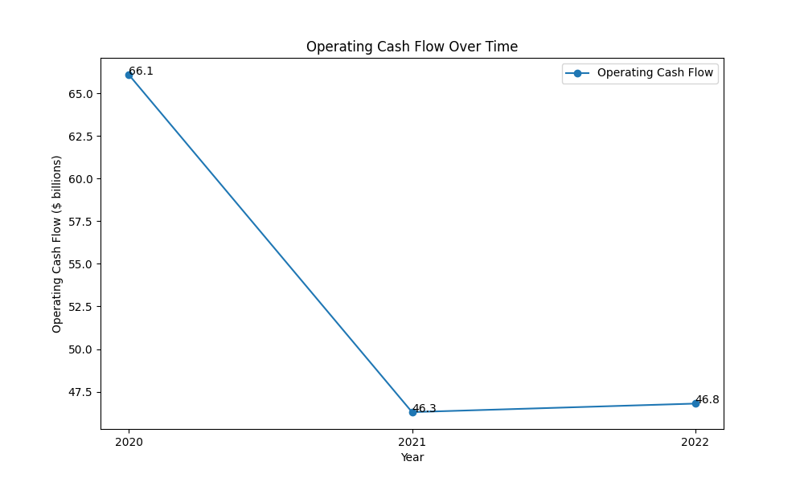
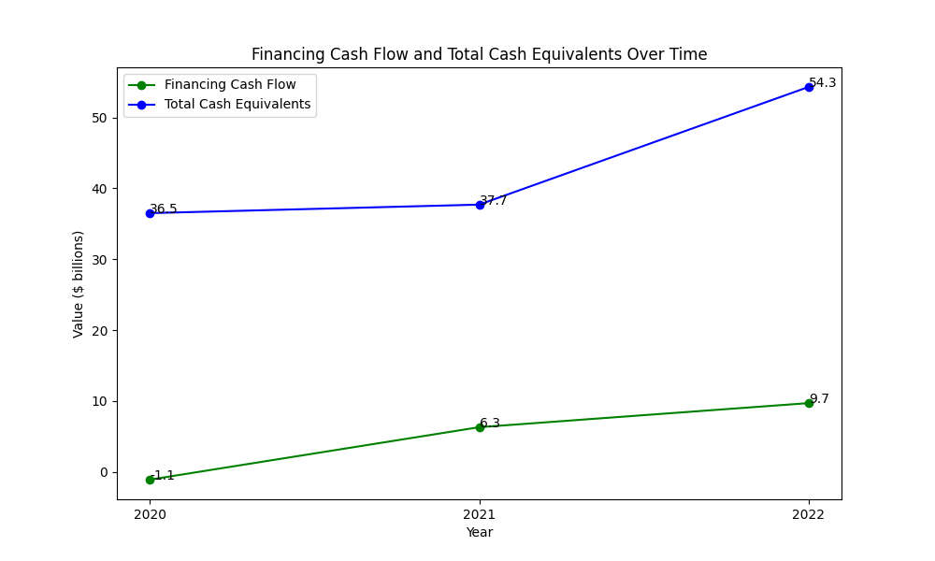
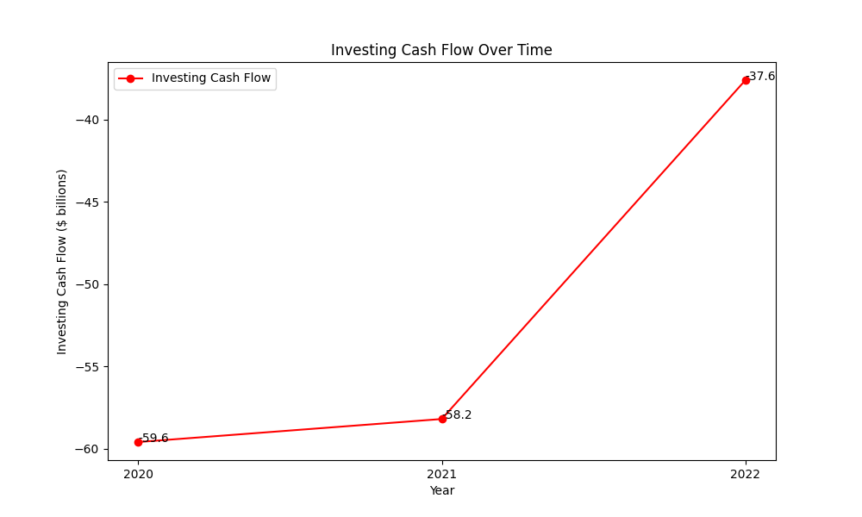
cashflow figures

