Slide 1
Company Analysis

Slide 2
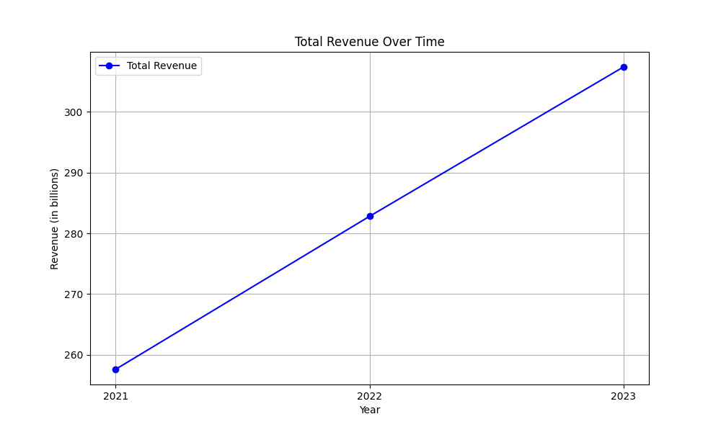
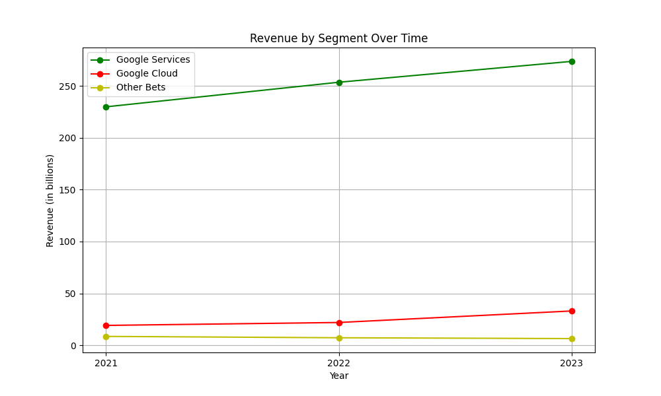
Revenue Analysis
The company's revenue and general profit and loss have exhibited consistent growth over the years 2021 to 2023. Here is a synthesized analysis with the key financial metrics and derived trends: 1. Revenue Growth: - Total revenues grew from $257.6 billion in 2021 to $282.8 billion in 2022, and further to $307.4 billion in 2023. This indicates a Compound Annual Growth Rate (CAGR) of approximately 9%. 2. Revenue Distribution: - Google Services, comprising Google Search, YouTube ads, and others, continues to dominate, accounting for roughly 89% of 2023 revenues. - Google Cloud saw significant growth, increasing from $19.2 billion in 2021 to $33.1 billion in 2023, showcasing the importance of cloud services in the revenue mix. 3. Geographical Distribution: - The U.S. remains the largest market, contributing 46-48% of total revenues from 2021 to 2023. EMEA and APAC are also significant, composing nearly 46% in 2023. 4. Cost and Expenses: - Costs and expenses increased from $178.9 billion in 2021 to $223.1 billion in 2023. Major cost contributors include the cost of revenues (e.g., content acquisition, infrastructure), research and development, and sales and marketing expenses. 5. Profitability: - Operating income fluctuated from $78.7 billion in 2021 to $74.8 billion in 2022, then rose to $84.3 billion in 2023. This improvement in 2023 is attributed to increased efficiency and the extended useful life of servers and network equipment, reducing depreciation expenses by about $3.9 billion. 6. Net Income: - The net income showed variability, dropping from $76.0 billion in 2021 to $60.0 billion in 2022, then rising to $73.8 billion in 2023, highlighting the impact of marketable security fluctuations and operational efficiencies. Derived Trends: - The revenue growth, especially in Google Cloud, indicates a strategic pivot towards diversified services. - The significant R&D spending increase suggests a strong focus on innovation and securing future revenue streams. - The geographical revenue distribution underscores the importance of global operations and the need to manage currency risks. In summary, Alphabet Inc.'s robust revenue growth, strategic investments in cloud services, and operational efficiencies ensure sustained profitability, despite fluctuations in other income and expenses.

Slide 3
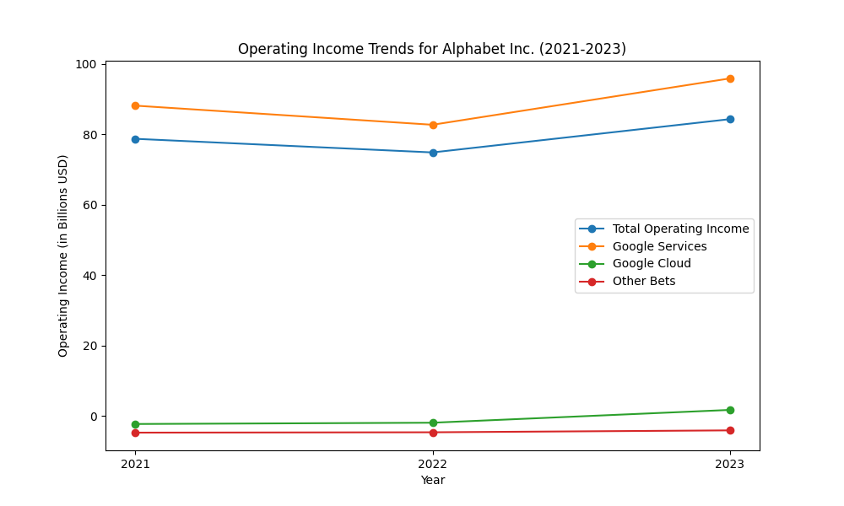
Operating Income Analysis
Operating income for Alphabet Inc. experienced notable changes from 2021 to 2023. In 2021, the total operating income was $78.714 billion, which slightly decreased to $74.842 billion in 2022 but rebounded to $84.293 billion in 2023. In terms of segment performance, Google Services consistently contributed the highest operating income: $88.132 billion in 2021, $82.699 billion in 2022, and increased to $95.858 billion in 2023. Google Cloud showed significant improvement, moving from a loss of $2.282 billion in 2021 to a smaller loss of $1.922 billion in 2022, and then turned profitable with an income of $1.716 billion in 2023. The 'Other Bets' segment, however, showed persistent losses, recording a loss of $4.636 billion in 2022 which slightly improved to a loss of $4.095 billion in 2023. These changes are influenced primarily by increases in revenues and strategic expense management across the different segments.

Slide 4
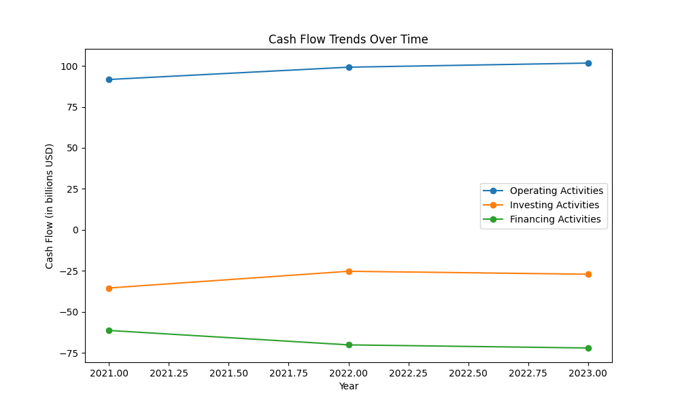
Cash Flow Analysis
Alphabet's cash flow has shown notable changes over time: From 2021 to 2023, net cash provided by operating activities increased from $91.7 billion in 2021 to $101.7 billion in 2023. The increase in operating cash flow was primarily driven by higher cash received from customers, despite increases in cash paid for cost of revenues and operating expenses. Investing activities reflected an increasing use of cash, with net cash used in investing activities widening from $35.5 billion in 2021 to $27.1 billion in 2023. This was mainly due to increased purchases of property and equipment, though offset by reduced maturities and sales of marketable securities and payment for acquisitions. With regard to financing activities, net cash used grew from $61.4 billion in 2021 to $72.1 billion in 2023, primarily due to increased stock repurchases. Overall, Alphabet has maintained a robust cash flow, emphasizing its strong operational efficiency and strategic investments for long-term growth.

Slide 5
Other KPIs
PBT Margin: - 2022: Operating Income = $74,842M, Revenues = $282,836M PBT Margin = (Operating Income / Revenues) * 100 PBT Margin for 2022 = (74,842 / 282,836) * 100 ≈ 26.46% - 2023: Operating Income = $84,293M, Revenues = $307,394M PBT Margin for 2023 = (84,293 / 307,394) * 100 ≈ 27.43% The PBT margin increased from approximately 26.46% in 2022 to 27.43% in 2023. Return on Tangible Equity (ROTE): - 2022: Net Income = $59,972M, Tangible Equity (Total Stockholders' Equity - Goodwill) = $256,104M - $28,960M = $227,144M ROTE = (Net Income / Tangible Equity) * 100 ROTE for 2022 = (59,972 / 227,144) * 100 ≈ 26.4% - 2023: Net Income = $73,795M, Tangible Equity (Total Stockholders' Equity - Goodwill) = $282,379M - $29,198M = $253,181M ROTE for 2023 = (73,795 / 253,181) * 100 ≈ 29.15% The ROTE improved from approximately 26.4% in 2022 to 29.15% in 2023. Net Interest Margin (NIM): - 2022: Interest Income = $2,174M, Interest Expense = $357M, Average Earning Assets = $91,883M (Cash, cash equivalents, and marketable securities) NIM = ((Interest Income - Interest Expense) / Average Earning Assets) * 100 NIM for 2022 = ((2,174 - 357) / 91,883) * 100 ≈ 1.98% - 2023: Interest Income = $3,865M, Interest Expense = $308M, Average Earning Assets = $86,868M (Cash, cash equivalents, and marketable securities) NIM for 2023 = ((3,865 - 308) / 86,868) * 100 ≈ 4.10% The NIM increased significantly from approximately 1.98% in 2022 to 4.10% in 2023. These KPIs indicate an overall enhancement in profitability and interest management effectiveness from 2022 to 2023.

Slide 6
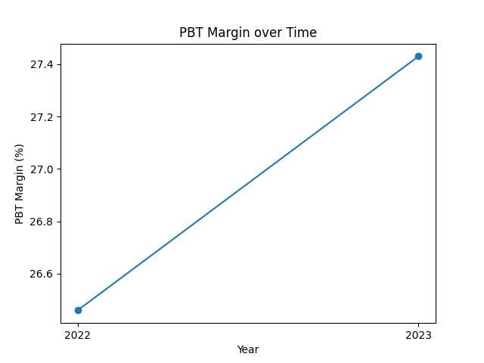
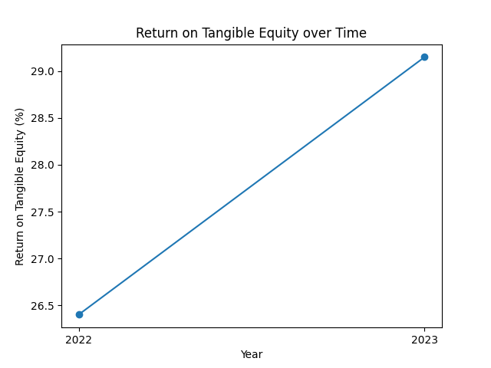
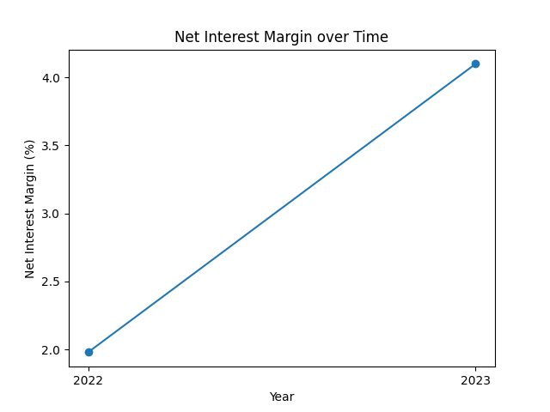
KPI Plots

