Slide 1
Amazon.com, Inc. Analysis

Slide 2
Business Overview
Amazon's business overview has evolved significantly over the years. Initially, the primary revenue source was the sale of products through online stores. They recognized revenue from items sold from inventory and from third-party seller services. In recent years, Amazon expanded its customer offerings across large, unique market segments such as grocery and business procurement. The grocery segment includes investments in Whole Foods Markets and experimenting with Amazon Fresh. Amazon Business, launched in 2015, caters to the procurement needs of organizations and now drives roughly $35 billion in annual gross sales. Amazon has also diversified into various service offerings like web services through AWS, digital content subscriptions, advertising services, and enterprise services. AWS remains a vital segment, showing consistent growth from $62.2 billion in 2021 to $80.1 billion in 2022and $90.8 billion in 2023. Geographically, the company has shown robust growth, expanding its North American sales from $279.8 billion in 2021 to $352.8 billion in 2023, while international sales also fluctuated. These expansions are strategically focused on leveraging Amazon's infrastructure and logistics capabilities to meet diverse customer needs, ultimately aiming for sustainable long-term growth in free cash flow.

Slide 3
Cash Flow
Amazon's cash flow has shown significant fluctuations over the past few years. In 2021, the net cash provided by operating activities was $46.33 billion, which slightly increased to $46.75 billion in 2022. However, in 2023 there was a substantial increase, with net cash provided by operating activities soaring to $84.95 billion. Investing activities saw a consistent outflow of cash, though the amounts varied. In 2021, the net cash used in investing activities was $58.15 billion, which decreased to $37.60 billion in 2022, followed by an increase to $49.83 billion in 2023. This variation is primarily attributed to fluctuations in property and equipment purchases and sales of marketable securities. Financing activities exhibited substantial changes. In 2021, financing activities provided $6.29 billion, which increased to $9.72 billion in 2022, but shifted to a significant outflow of $15.88 billion in 2023 as the company reduced its short-term and long-term debt. Overall, Amazon's net cash position showcased a dynamic evolution, reflecting its strategic investments and financial management practices aimed at supporting its expansive growth and infrastructure.

Slide 4
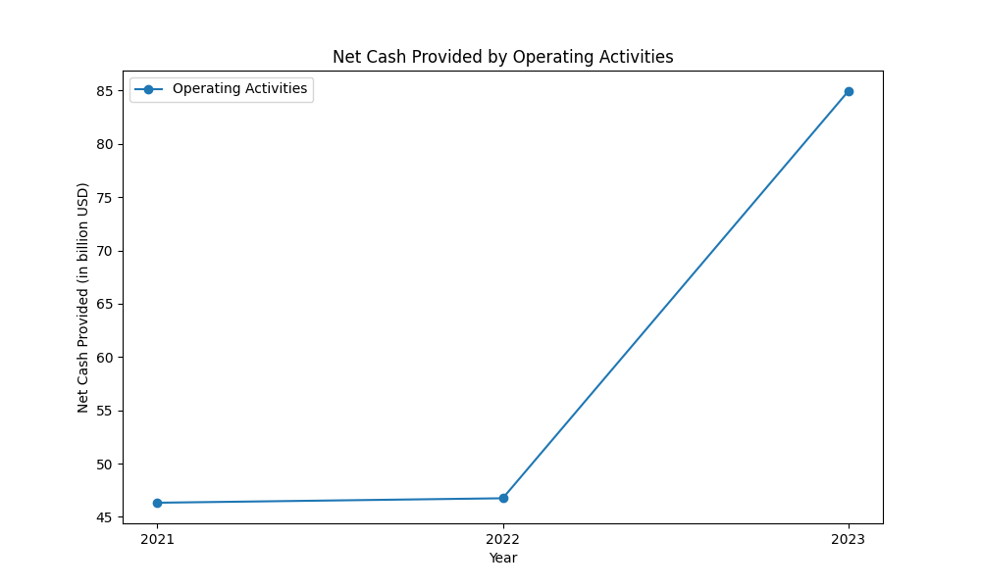
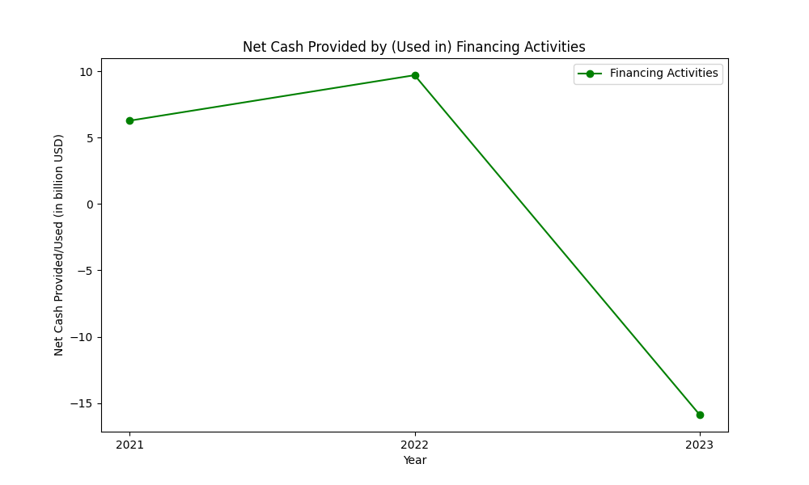
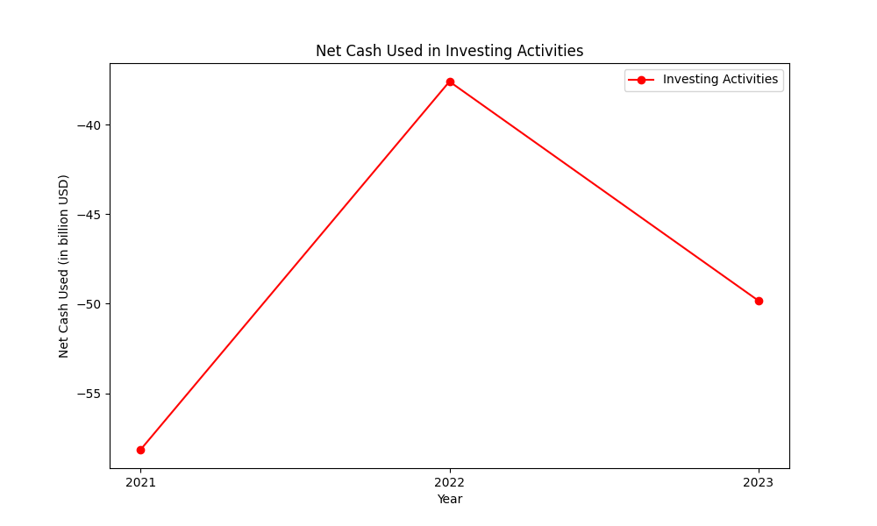
cashflow figures

Slide 5
Net Interest Margin
The Net Interest Margin (NIM) of Amazon has varied over the recent years due to fluctuations in both interest income and interest expense. In 2021, Amazon's interest income was $448 million with an interest expense of $1.8 billion. In 2022, the interest income increased to $989 million while interest expense rose to $2.4 billion. This trend continued in 2023, where interest income further rose significantly to $2.9 billion due to an increase in prevailing rates, while the interest expense increased to $3.2 billion primarily related to debt and finance leases. Overall, Amazon's interest income showed a significant increasing trend from 2021 to 2023, primarily due to rising prevailing rates and higher average balances of invested funds. Conversely, the company's interest expense also increased consistently over these years, mainly due to rising debt levels and finance leases costs. This impacted Amazon's NIM, reflecting the balancing act between rising income from investments and growing costs from debts. For detailed values and additional context, refer to the financial data and analysis from the provided reports.

Slide 6
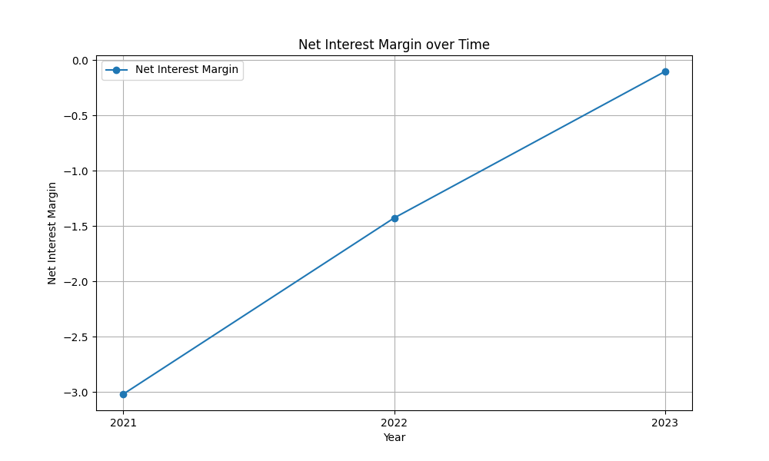
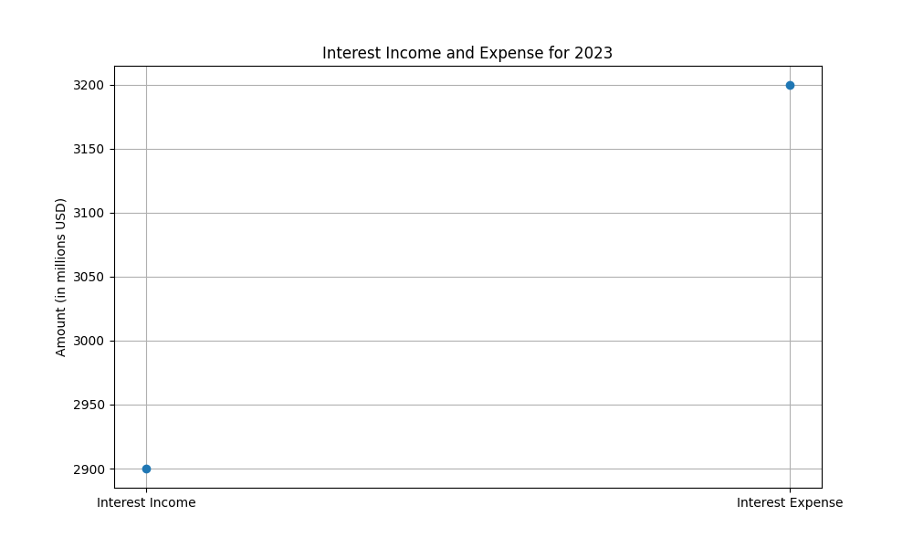
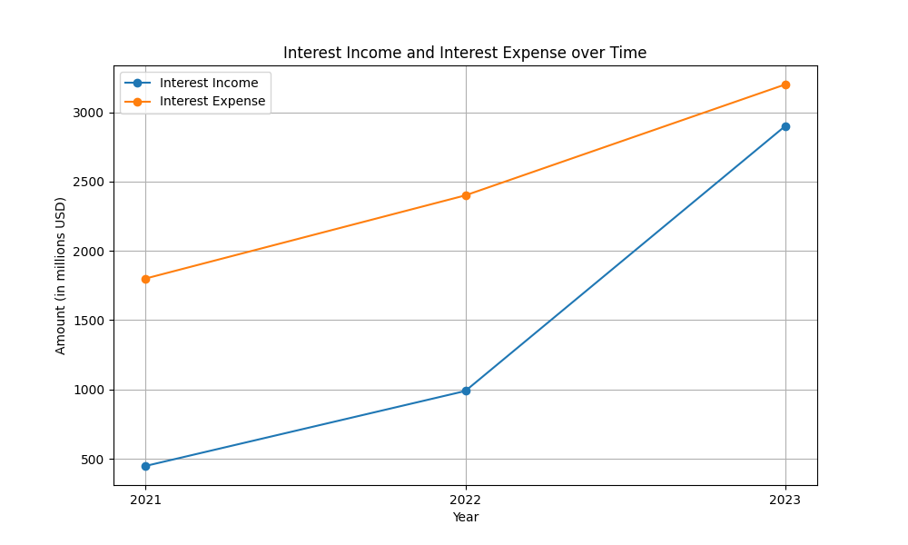
netinterestmargin figures

