Slide 1
Amazon.Com, Inc. 【4:0†source】【4:1†source】. Analysis

Slide 2
Business Overview
Amazon has consistently evolved its business model and strategic focus over time. Initially, the company started as an online book retailer, emphasizing vast selection, customer convenience, and competitive pricing. By 1997, sales had grown significantly, and Amazon expanded its product offerings. In recent years, Amazon has diversified into various sectors beyond traditional e-commerce. For example, Amazon Business was launched in 2015 and has grown to deliver approximately $35 billion in annualized gross sales. The company has also ventured into the grocery sector, particularly with Amazon Fresh and the acquisition of Whole Foods Market, indicating a strategic shift to address more of the customer’s grocery needs through both online and physical stores. Moreover, the introduction of Buy with Prime aims to enhance third-party merchants' sales by leveraging Amazon's logistics and Prime membership benefits. Another significant change in Amazon's business is its investment in the healthcare industry, marked by the launch of Amazon Pharmacy in 2020, which offers online pharmacy services. Additionally, Amazon continues to strengthen its cloud computing arm, AWS, serving a broad array of customers from startups to large enterprises. Overall, Amazon has transformed from a niche online retailer to a diversified global conglomerate, expanding into new markets and leveraging its core competencies to innovate and grow in various sectors.

Slide 3
Revenue
Amazon's revenue has shown significant growth over the years, with some fluctuations specific to business segments and global economic conditions. Consolidated net sales increased from $386.064 billion in 2020 to $469.822 billion in 2021, and further to $513.983 billion in 2022. This represents an increase of approximately 21.68% in 2021 and a moderate increase of 9.4% in 2022. A detailed breakdown reveals a mixed performance across geographic segments and business units. North America sales rose from $236.282 billion in 2020 to $279.833 billion in 2021, and to $315.880 billion in 2022. On the other hand, international sales grew from $104.412 billion in 2020 to $127.787 billion in 2021 but decreased to $118.007 billion in 2022 due in part to foreign currency impacts. AWS (Amazon Web Services) showed robust growth, ascending from $45.370 billion in 2020 to $62.202 billion in 2021, and $80.096 billion in 2022. Overall, while Amazon experienced strong revenue growth from 2020 to 2021, the growth rate decelerated in 2022 primarily due to macroeconomic pressures and foreign exchange rate impacts, particularly on international sales.

Slide 4
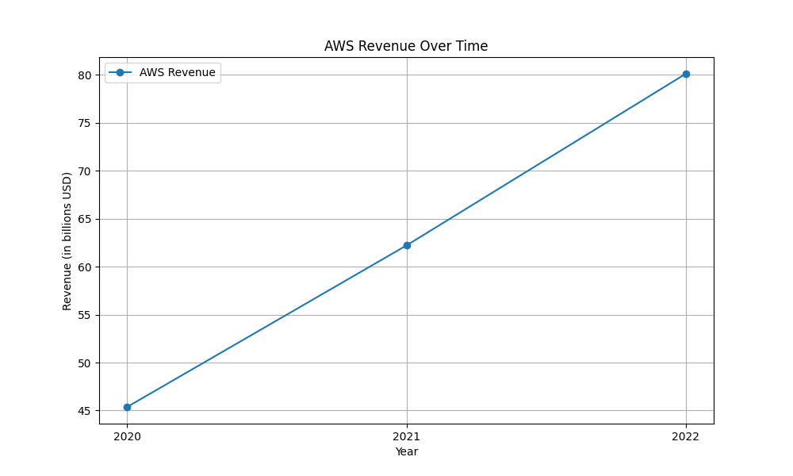
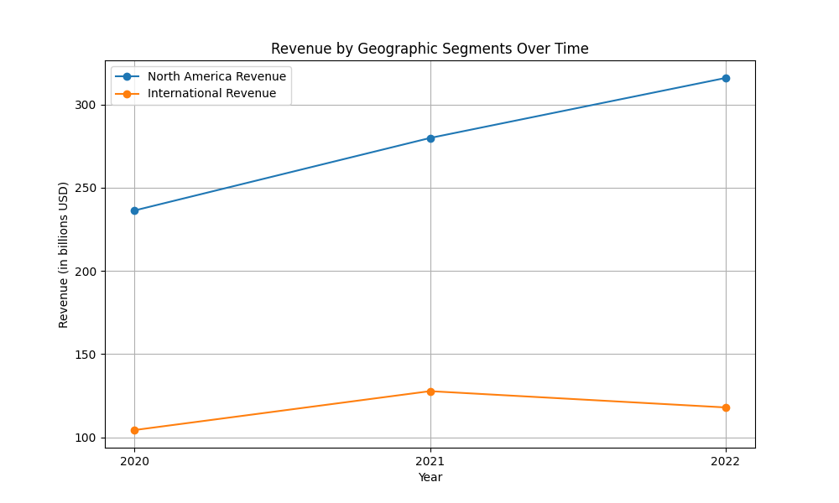
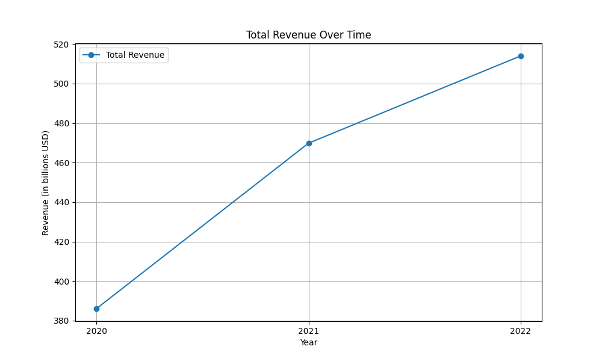
Revenue figures

Slide 5
Operating Income
The operating income of Amazon shows significant variation over the period from 2020 to 2022. In 2020, the company's consolidated operating income was $22.899 billion. This amount saw an increase in 2021 to $24.879 billion. However, in 2022, there was a sharp decline to $12.248 billion. Breaking it down by segment: - North America: The operating income was $8.651 billion in 2020, decreased to $7.271 billion in 2021, and turned into an operating loss of $2.847 billion in 2022. This decline was primarily due to increased fulfillment and shipping costs, and investments in the fulfillment network. - International: Operating income was $717 million in 2020, turned into an operating loss of $924 million in 2021, and further worsened to a loss of $7.746 billion in 2022 due to increased fulfillment and shipping costs, and adverse foreign currency exchange effects. - AWS (Amazon Web Services): Operating income increased steadily from $13.531 billion in 2020 to $18.532 billion in 2021, and then further to $22.841 billion in 2022. This increase was driven by higher sales and improved cost structure productivity. Overall, the sharp decline in consolidated operating income in 2022 was influenced by the substantial losses in the North America and International segments, despite the continued growth in AWS operating income.

Slide 6
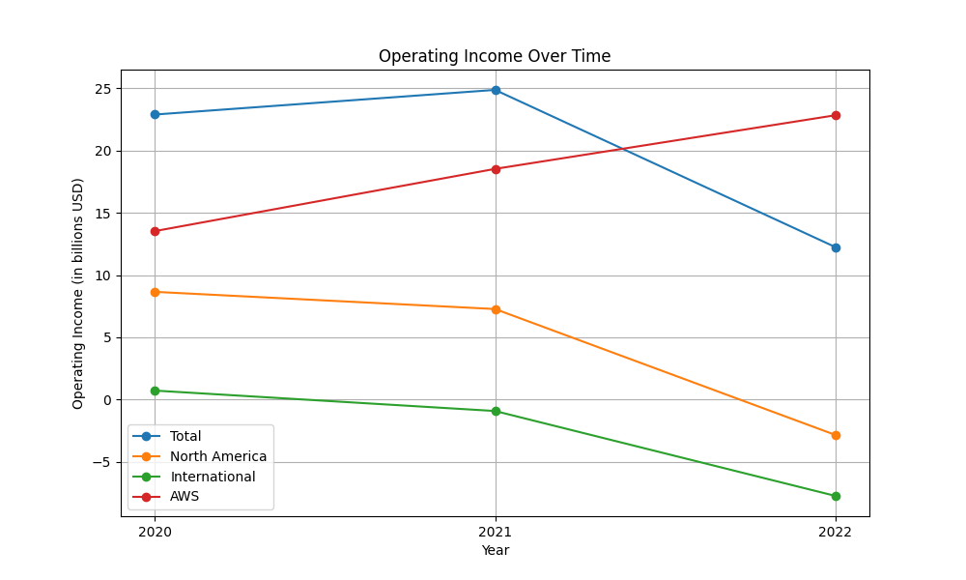
Operating Income figures

Slide 7
Cash Flow
Over the period from 2020 to 2022, Amazon's cash flow reflects significant investment activities and changes in financing. - Operating Activities: The net cash provided by operating activities decreased from $66.1 billion in 2020 to $46.3 billion in 2021 and remained relatively stable at $46.8 billion in 2022. This stability in 2022 despite a net income loss was due to adjustments like higher depreciation and amortization, stock-based compensation, and other non-cash items. - Investing Activities: The cash used in investing activities was substantial, decreasing from $(59.6) billion in 2020 to $(58.2) billion in 2021 and further to $(37.6) billion in 2022. This reflects the company's investments in property and equipment, especially advancing its technology infrastructure and fulfillment network. - Financing Activities: The net cash flow from financing activities shifted from $(1.1) billion in 2020 to $6.3 billion in 2021 and increased further to $9.7 billion in 2022, driven by proceeds from debts despite increased repayments and stock repurchases. Amazon demonstrates a robust capacity to generate operating cash flow while heavily reinvesting in its infrastructure and managing its financing to support growth initiatives.

Slide 8
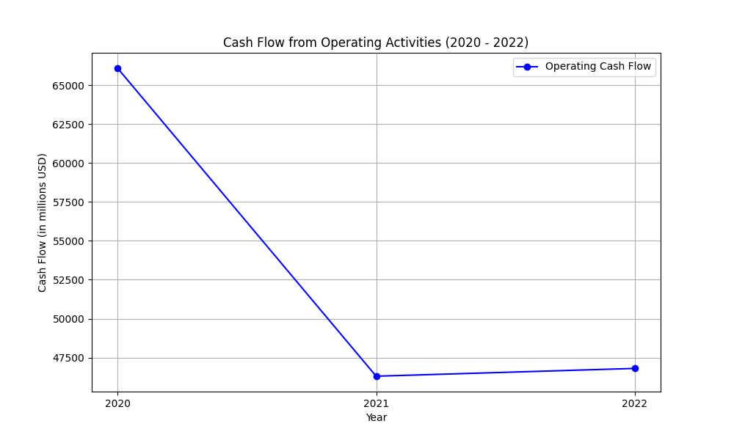
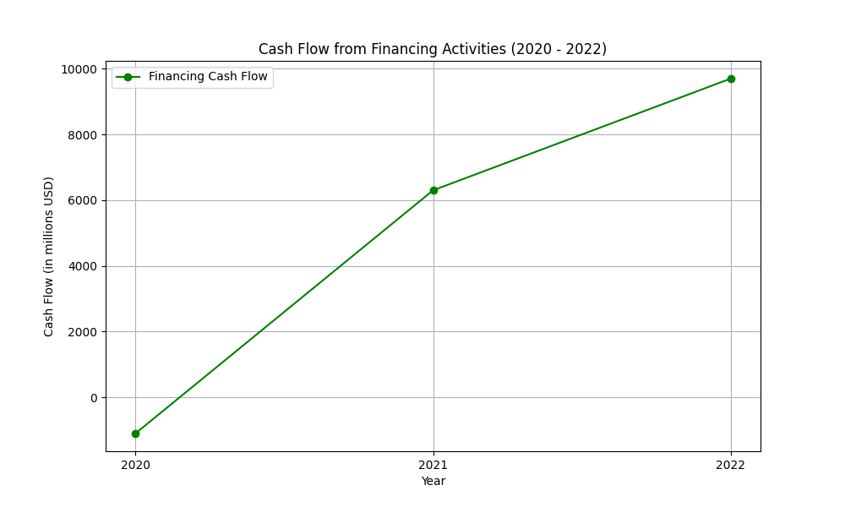
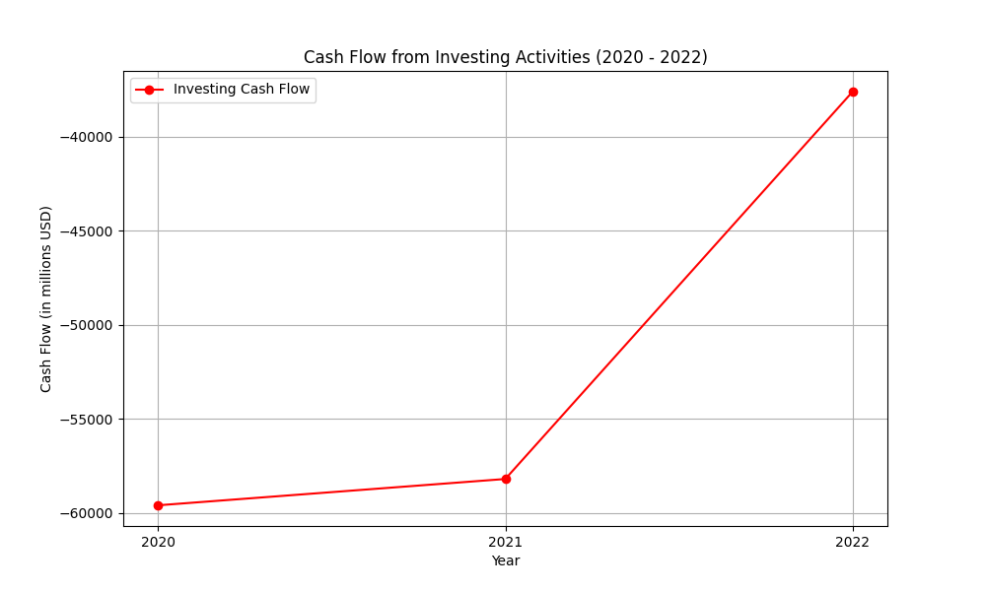
Cash Flow figures

Slide 9
Sentiment Analysis Results
Overall: 48
Positive: 0.0
Neutral: 0.82
Negative: 0.05

