Slide 1
Amazon.com, Inc.【4:0†source】 Analysis

Slide 2
Business Overview
Over the years, Amazon has significantly evolved its business model. Initially, in 1997, Amazon focused predominantly on online book sales, offering customers a broader selection than physical stores. By 2015, the company had diversified substantially, launching Amazon Business to cater to B2B sales, tapping into the office supplies and bulk items market. This segment now drives about $35 billion in annualized gross sales. Amazon has continually expanded its offerings. Notable ventures include Amazon Fresh, targeting the $800 billion U.S. grocery market, and Amazon Pharmacy, launched in 2020 to address the online pharmaceutical market. Additionally, Amazon Web Services (AWS), which started in 2006, has become a major growth driver, offering a broad set of on-demand technology services and resulting in a 29% revenue growth by 2022. These developments highlight Amazon's shift from a pure online retailer to a multifaceted tech and service company, enhancing its portfolio with physical stores, cloud services, and B2B-focused solutions.

Slide 3
Operating Income
Amazon's operating income has been fluctuating over the years. In 2020, the operating income was $22,899 million. It increased slightly to $24,879 million in 2021. However, in 2022, there was a significant decline in operating income to $12,248 million. Breaking it down by segments, in the North America segment, the operating income was $8,651 million in 2020. This decreased to $7,271 million in 2021 and turned into an operating loss of $2,847 million in 2022. In the International segment, the operating income was $717 million in 2020. However, it turned into an operating loss of $924 million in 2021 and further worsened to an operating loss of $7,746 million in 2022. In contrast, Amazon Web Services (AWS) showed a positive trend. Operating income was $13,531 million in 2020, which increased to $18,532 million in 2021 and further to $22,841 million in 2022. Overall, the decline in consolidated operating income in 2022 was due to increased fulfillment and shipping costs, technology and content costs, and general operating expenses, impacting both the North America and International segments negatively.

Slide 4
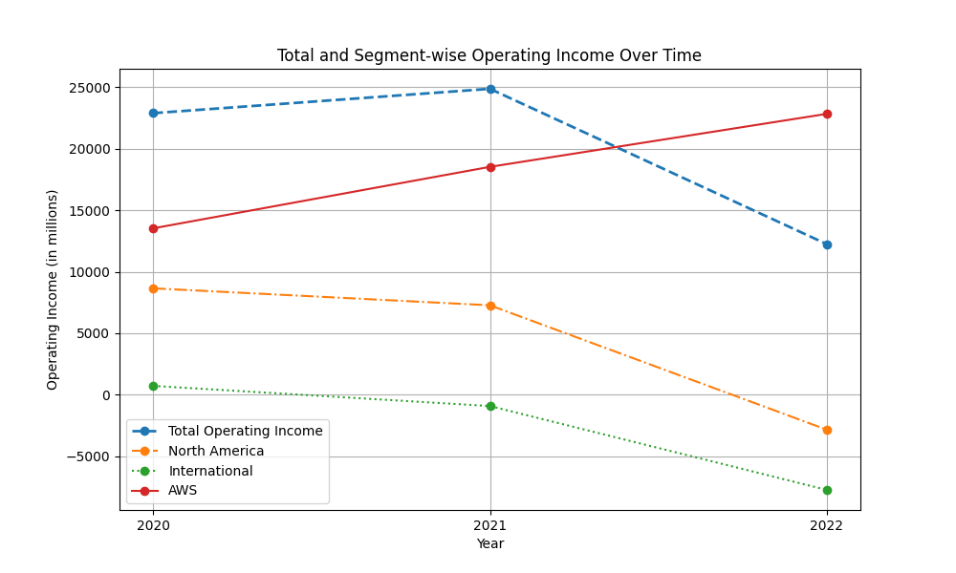
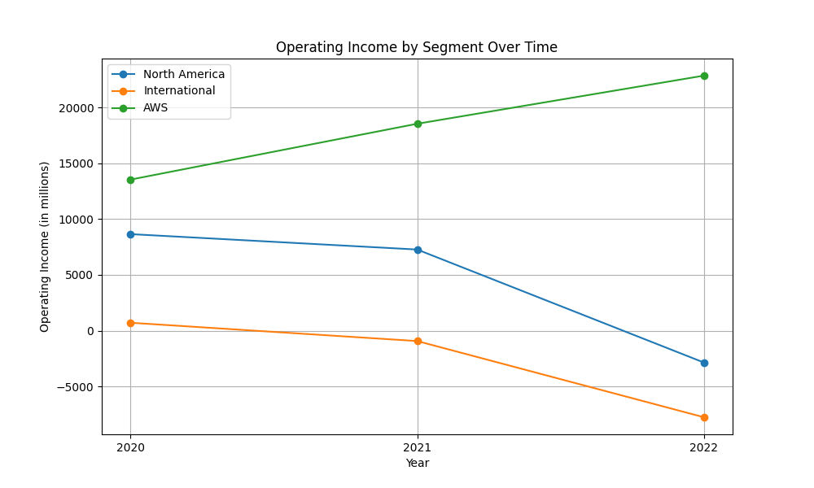
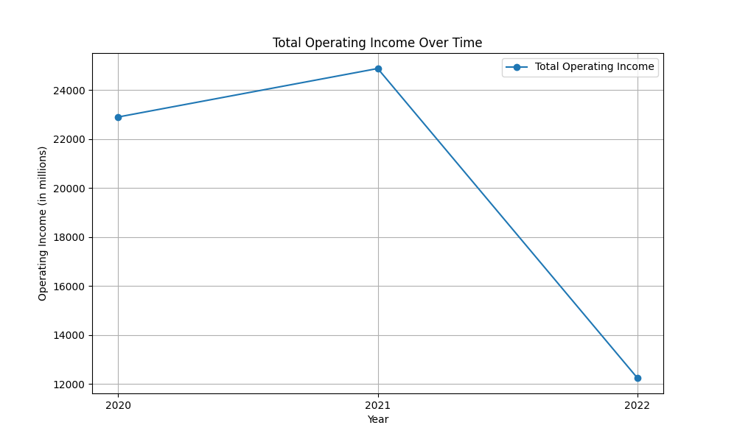
operatingincome figures

Slide 5
Business Overview
Amazon has experienced substantial changes in its business focus from 1997 to 2022. Initially, Amazon's primary business was selling books online, which allowed it to offer a wider selection than physical bookstores, significantly enhancing customer value and experience. By 2015, Amazon had greatly diversified, launching Amazon Business to cater to the B2B market. This segment, which deals with products like office supplies and bulk items, grew to generate around $35 billion in annualized gross sales by 2022. Furthermore, Amazon expanded into the grocery business with Amazon Fresh and acquired Whole Foods Market. This initiative aimed to capture a portion of the $800 billion U.S. grocery market. Additionally, the launch of Amazon Pharmacy in 2020 marked a significant step towards entering the online pharmaceutical market. Amazon Web Services (AWS), launched in 2006, has become a key growth driver, offering various on-demand tech services. By 2022, AWS revenue increased by 29%, further emphasizing its role as a major component of Amazon's business model. As a result, Amazon has transformed from an online book retailer to a global leader in e-commerce, cloud services, and logistics. This decade-long journey showcases Amazon's adaptability and commitment to innovating and expanding its business horizons.

Slide 6
Business Overview
Amazon's business overview has evolved significantly from 1997 to 2022. Initially, Amazon's mission in 1997 was to offer a wide selection of books online, providing customers with extensive choices beyond physical stores. The company's customer base grew exponentially, with sales increasing from $15.7 million in 1996 to $147.8 million in 1997. By 2015, Amazon had diversified substantially. The launch of Amazon Business marked a shift to B2B sales, which reached $35 billion in annualized gross sales by 2022. Additionally, Amazon ventured into the grocery market with Amazon Fresh and Whole Foods to capture parts of the $800 billion U.S. grocery market. In 2020, Amazon expanded further by launching Amazon Pharmacy, tapping into the online pharmaceutical sector. The rise of Amazon Web Services (AWS) has been a significant growth driver since its inception in 2006, offering a comprehensive set of on-demand technology services. By 2022, AWS contributed notably to Amazon's revenue, underscoring its critical role. These shifts illustrate Amazon's transformation from an online book retailer to a diverse tech and service giant, continuously innovating and expanding its market presence across various sectors.

Slide 7
Operating Income
Amazon's operating income has experienced notable changes from 2020 to 2022. In 2020, the operating income was $22,899 million, which saw a slight increase to $24,879 million in 2021. However, 2022 marked a significant decline, with operating income dropping to $12,248 million. Segment-wise, the North America segment's operating income was $8,651 million in 2020, reducing to $7,271 million in 2021, and further plummeting to an operating loss of $2,847 million in 2022. The International segment had an operating income of $717 million in 2020 but turned into losses of $924 million in 2021 and $7,746 million in 2022. Conversely, Amazon Web Services (AWS) showed consistent growth in operating income, reporting $13,531 million in 2020, $18,532 million in 2021, and $22,841 million in 2022. The significant decline in consolidated operating income in 2022 was primarily due to increased fulfillment, shipping, and technology costs, impacting both the North America and International segments. Overall, while AWS showed positive growth, the losses in other segments led to the overall decline in operating income.

Slide 8
operatingincome figures

