Slide 1
Amazon.com, Inc. Analysis

Slide 2
Business Overview
Amazon's business has evolved significantly over time. Initially, Amazon focused on offering a wide range of products and services, including merchandise, digital content, and electronic devices. The company has also provided services like cloud computing, storage, and fulfillment. Over the years, Amazon has expanded its market by pursuing large retail segments and experimenting with new ventures like Amazon Fresh in the grocery segment and Amazon Pharmacy in healthcare. Furthermore, it has strengthened its e-commerce capabilities through ventures like Amazon Business, launched in 2015, which now drives approximately $35 billion in annualized gross sales. Amazon’s approach to its business operations focuses on long-term, sustainable growth in free cash flows through increasing sales and efficient cost management. The company emphasizes improving the customer experience by lowering prices, expanding product selection, and enhancing delivery efficiency. Despite the macroeconomic challenges such as inflation and supply chain constraints, Amazon remains committed to investing in new technologies and market opportunities. This ongoing evolution demonstrates Amazon's strategic adaptation to market demands and growth opportunities.

Slide 3
Revenue
From 2020 to 2023, Amazon's revenue has seen consistent growth. In 2020, the total net sales were $386,064 million. This increased to $469,822 million in 2021, representing a 22% year-over-year growth. By 2022, the net sales reached $513,983 million, a 9% increase from the previous year. Finally, in 2023, the net sales were $574,785 million, reflecting a growth rate of 12% compared to 2022. The breakdown of sales across segments shows that the North America segment has consistently delivered the highest revenue, growing from $279,833 million in 2021 to $352,828 million in 2023. The International segment's performance has been more volatile, with net sales decreasing from $127,787 million in 2021 to $118,007 million in 2022, before increasing to $131,200 million in 2023. AWS has maintained steady growth, with revenue increasing from $62,202 million in 2021 to $80,096 million in 2022, and $90,757 million in 2023. The overall increase in revenue can be attributed to factors such as increased unit sales driven by better price, selection, and convenience for customers, along with significant growth in AWS and advertising services.

Slide 4
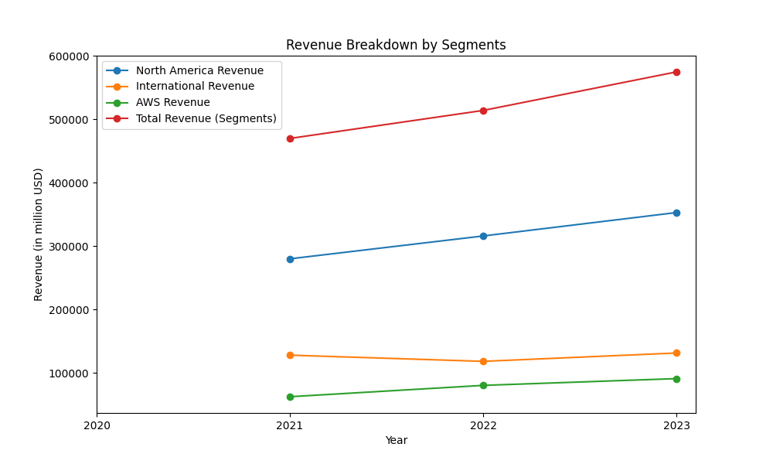
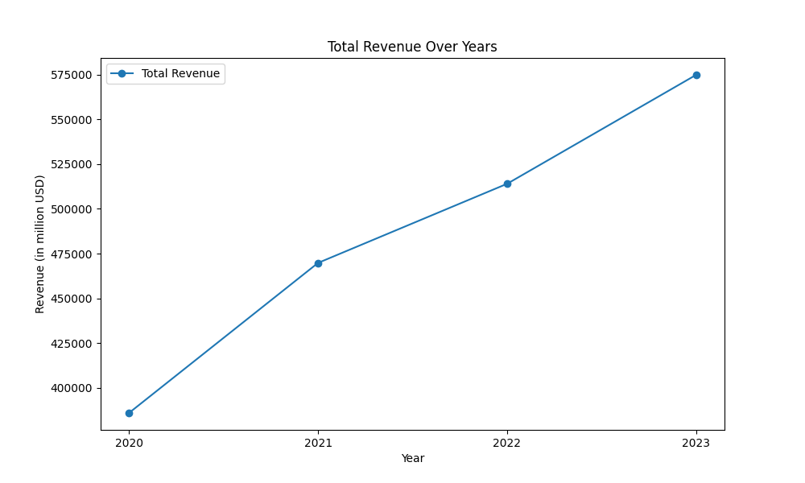
Revenue figures

Slide 5
Operating Income
The operating income of the company has demonstrated significant volatility over the period from 2021 to 2023. In 2021, the consolidated operating income was $24.9 billion. However, in 2022, it almost halved to $12.2 billion due to increased costs across various segments, particularly in the North America and International divisions. By 2023, the operating income rebounded strongly to $36.9 billion, primarily driven by substantial improvements in the North America segment, which swung from a loss of $2.8 billion in 2022 to an income of $14.9 billion. This rebound was attributed to increased unit sales and advertising sales, despite higher shipping and fulfillment costs. The AWS (Amazon Web Services) segment consistently grew its operating income from $18.5 billion in 2021 to $24.6 billion in 2023, reflecting increased sales and significant investment in technology infrastructure. Conversely, the International segment saw a reduction in operating loss from $7.7 billion in 2022 to $2.7 billion in 2023 due to increased sales and better cost management. These fluctuations highlight the company's reliance on North America and AWS for profitability, and the impact of cost management and sales growth on operating income.

Slide 6
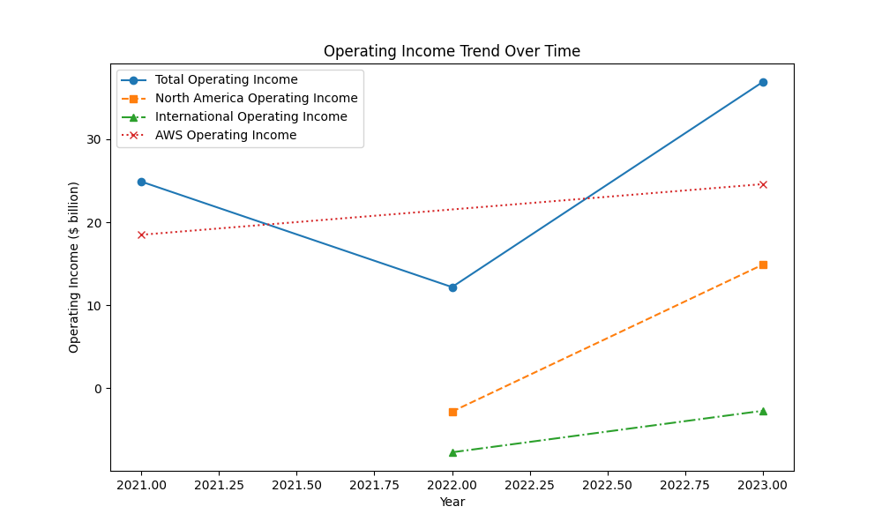
Operating Income figures

Slide 7
Cash Flow
Amazon's cash flow from operating activities exhibited fluctuations over the reported period. In 2021, the net cash provided by operating activities was $46.3 billion. This figure saw a slight increase in 2022, reaching $46.8 billion, before significantly jumping to $84.9 billion in 2023. The increase in 2023 was primarily driven by higher net income (excluding non-cash expenses) and improvements in working capital. Investing activities consistently saw outflows across the years. In 2021, net cash used in investing activities was $58.2 billion, which decreased to $37.6 billion in 2022 but then increased again to $49.8 billion in 2023. These outflows were mainly due to significant purchases of property and equipment and also included acquisitions and investments in marketable securities. Financing activities, on the other hand, showed variability. In 2021, there was a net cash inflow of $6.3 billion, which increased to $9.7 billion in 2022, before turning into a significant outflow of $15.9 billion in 2023. This shift in 2023 was due to a combination of increased debt repayments and reduced issuance of new debt. Overall, despite the fluctuations in investing and financing activities, the substantial growth in cash generated from operating activities in 2023 marks a notable positive change in Amazon's cash flow dynamics over the analyzed period.

Slide 8
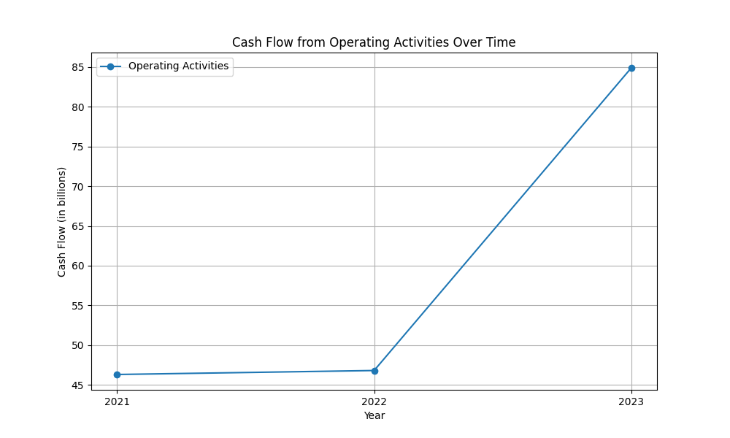
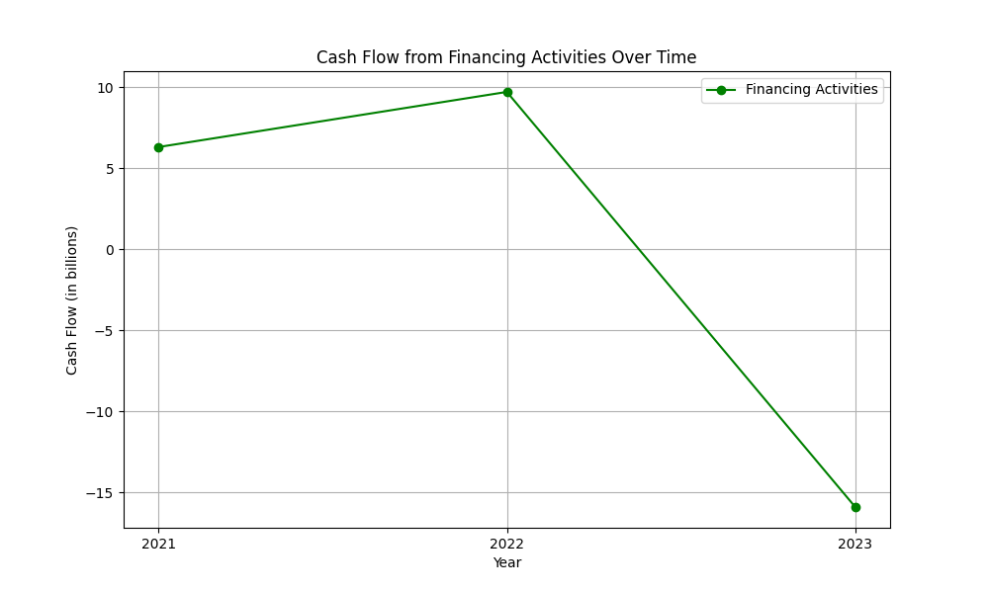
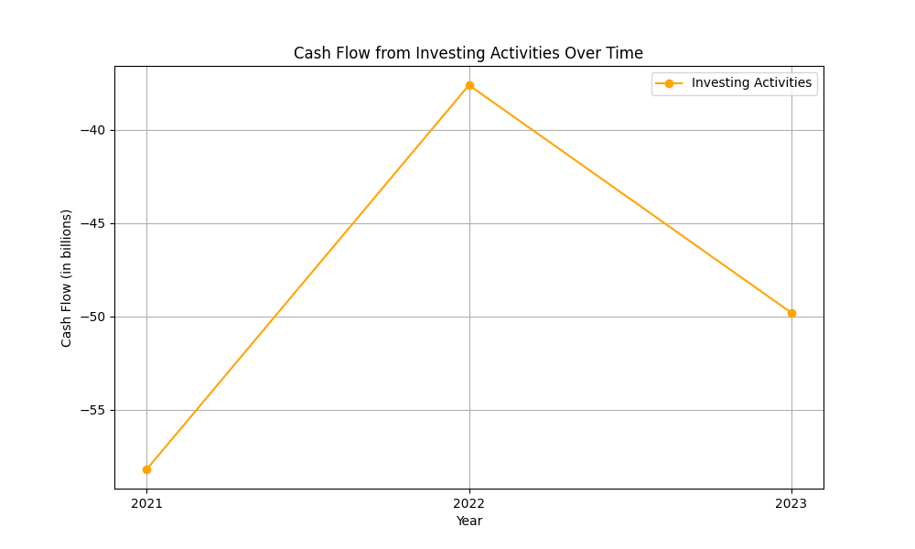
Cash Flow figures

Slide 9
PBT Margin
To analyze the Profit Before Tax (PBT) margin of the company over time, we look at the operating income and net sales for the relevant years. 2020: - Consolidated Operating Income: $24,879 million - Net Sales: $469,822 million - PBT Margin = (Operating Income / Net Sales) × 100 = ($24,879 / $469,822) × 100 = 5.29% 2021: - Consolidated Operating Income: $24,879 million - Net Sales: $469,822 million - PBT Margin = (Operating Income / Net Sales) × 100 = ($24,879 / $469,822) × 100 = 5.29% 2022: - Consolidated Operating Income: $12,248 million - Net Sales: $513,983 million - PBT Margin = (Operating Income / Net Sales) × 100 = ($12,248 / $513,983) × 100 = 2.38% 2023: - Consolidated Operating Income: $36,852 million - Net Sales: $574,785 million - PBT Margin = (Operating Income / Net Sales) × 100 = ($36,852 / $574,785) × 100 = 6.41% The PBT margin has shown significant variability over the years. It remained relatively stable at around 5.3% in 2020 and 2021, fell sharply to 2.38% in 2022, and then increased substantially to 6.41% in 2023. This fluctuation is primarily attributed to changes in operating income.

Slide 10
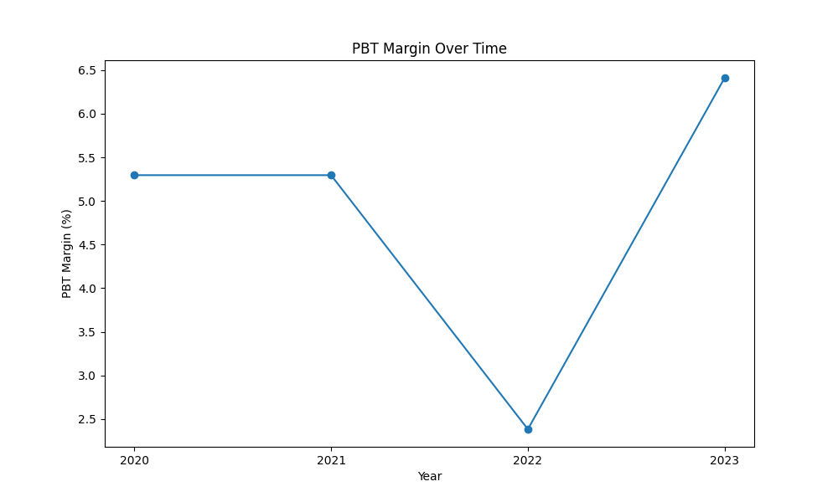
PBT Margin figures

Slide 11
Sentiment Analysis Results
Overall: 47
Positive: 0.0
Neutral: 0.78
Negative: 0.06

