Slide 1
Amazon.Com, Inc. Analysis

Slide 2
Business Overview
Amazon's business has evolved significantly over time. Initially focused on online book sales in 1997, with a highlight of achieving $147.8 million in sales and 1.5 million customer accounts by the end of 1997, the company expanded into numerous categories. By 2022, Amazon had diversified into e-commerce, cloud computing (AWS), digital streaming, and physical stores, serving multiple customer segments including consumers, sellers, developers, enterprises, content creators, and advertisers. Amazon's strategic investments have propelled growth in sectors like grocery with Amazon Fresh and Whole Foods, and business procurement with Amazon Business, launched in 2015 and driving $35 billion in annual sales by 2022. Newer ventures include Amazon Pharmacy and the healthcare sector. The company's focus on long-term customer value, competitive pricing, and fast delivery, supported by its vast distribution network and technology infrastructure, reflects its unwavering commitment to operational excellence and innovation. Amazon's expansion into international markets and varied product segments underscores its adaptive and scalable business model.

Slide 3
Revenue
Amazon's revenue has shown significant growth over the years. In 2020, the total annual revenue was $386.06 billion, which increased by approximately 21.7% to $469.82 billion in 2021, and then saw a further increase of about 9.4% to $513.98 billion in 2022. The primary components contributing to this revenue include Online Stores, Physical Stores, Third-party Seller Services, Subscription Services, Advertising Services, and AWS (Amazon Web Services). AWS, in particular, showed robust growth, increasing its contribution from $45.37 billion in 2020 to $80.10 billion in 2022. North America remains the largest segment, contributing $315.88 billion in 2022. However, the International segment saw a slight decline in revenue in 2022 compared to 2021, mainly due to currency exchange rates. This consistent revenue increase reflects Amazon’s successful strategy of expanding its customer base, improving product selection and services, and leveraging its diverse business segments to drive sales. Despite some macroeconomic challenges, Amazon has managed to sustain a steady revenue growth trajectory.

Slide 4
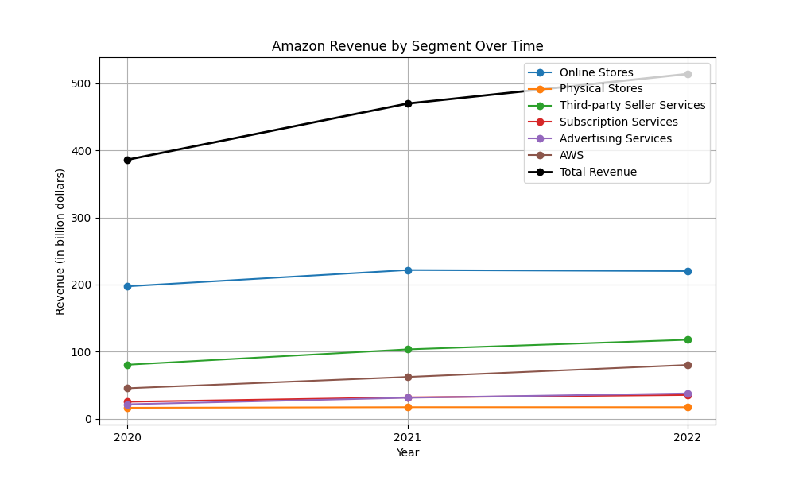
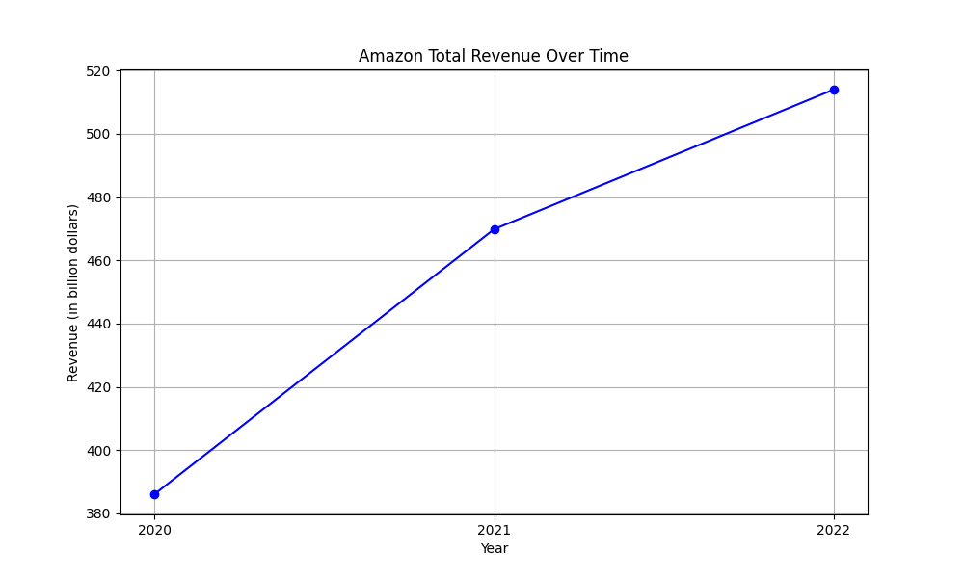
Revenue figures

Slide 5
Operating Income
Amazon's operating income has shown significant fluctuations over the past three years. In 2020, Amazon reported an operating income of $22.899 billion. This increased slightly to $24.879 billion in 2021 despite the continuing pressures of the COVID-19 pandemic on global supply chains. However, 2022 saw a substantial decline in operating income, which dropped to $12.248 billion. This decline was driven by increased operating expenses outpacing net sales growth. Regionally, North America experienced a drastic turn from an operating income of $7.271 billion in 2021 to a loss of $2.847 billion in 2022, impacted by elevated fulfillment and shipping costs, amongst other factors. The International segment saw a worsening loss, from $924 million in 2021 to $7.746 billion in 2022, exacerbated by changes in foreign currency exchange rates. In contrast, AWS (Amazon Web Services) continued its profit growth trajectory, increasing operating income from $18.532 billion in 2021 to $22.841 billion in 2022, bolstered by increased sales and improved cost structure productivity.

Slide 6
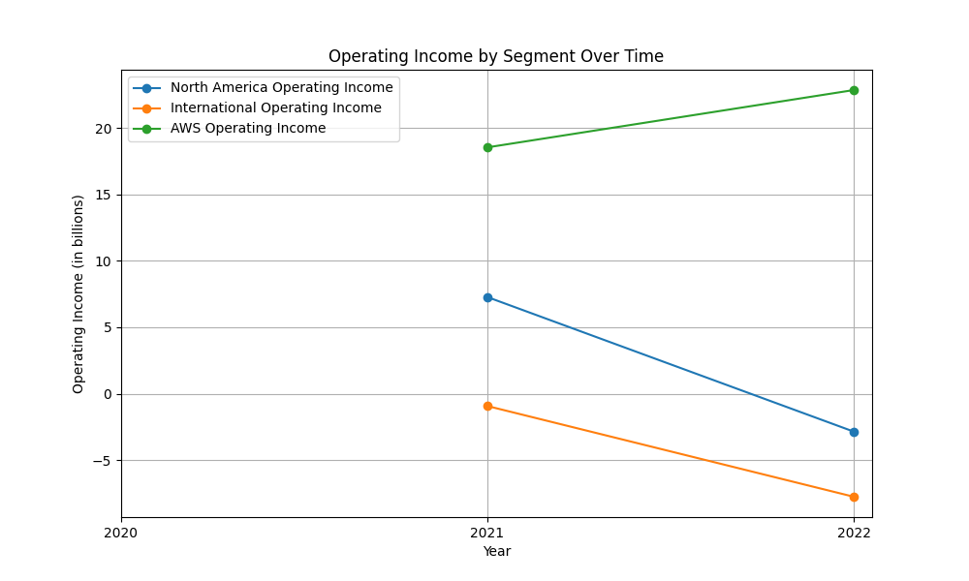
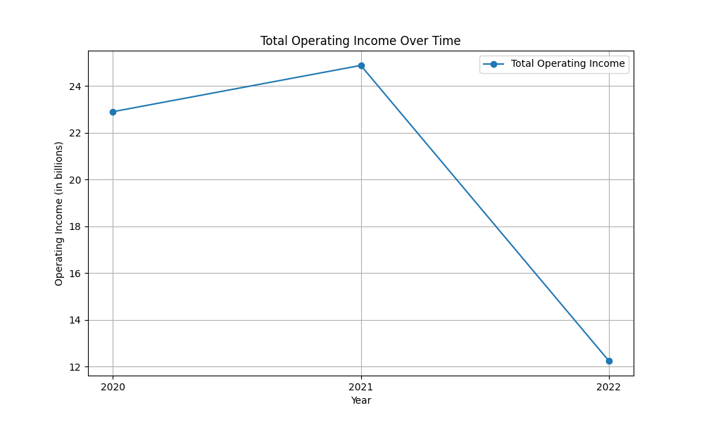
Operating Income figures

Slide 7
Cash Flow
Over the years 2020 to 2022, Amazon's cash flow exhibited several notable trends. Operating Activities: The cash provided by operating activities remained relatively stable between 2021 and 2022 at approximately $46.3 billion and $46.8 billion respectively, despite a decrease from $66.1 billion in 2020. This stability in 2021-2022 can be attributed to increased net income (excluding non-cash expenses) partially offset by fluctuations in working capital, including inventory and accounts receivable. Investing Activities: Net cash used in investing activities was substantial, amounting to $(58.2) billion and $(37.6) billion in 2021 and 2022, respectively. This decline mainly resulted from varying purchases, sales, and maturities of marketable securities. The increase in cash capital expenditures, prominently for technology infrastructure and AWS support, is also a significant factor. Financing Activities: Financing activities demonstrated cash provisions of $6.3 billion in 2021 and an increase to $9.7 billion in 2022. This was largely driven by proceeds from short- and long-term debt, with 2022 seeing higher cash inflows from financing activities compared to the previous year. Overall, Amazon has managed its cash flows with a focus on sustaining operating cash flow while significantly investing in technology and infrastructure, supporting the long-term growth strategy.

Slide 8
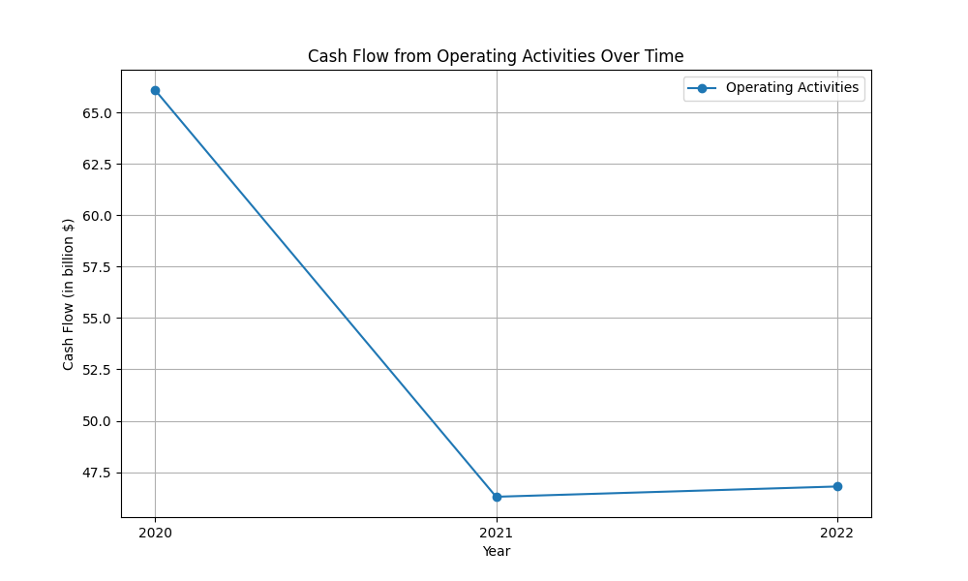
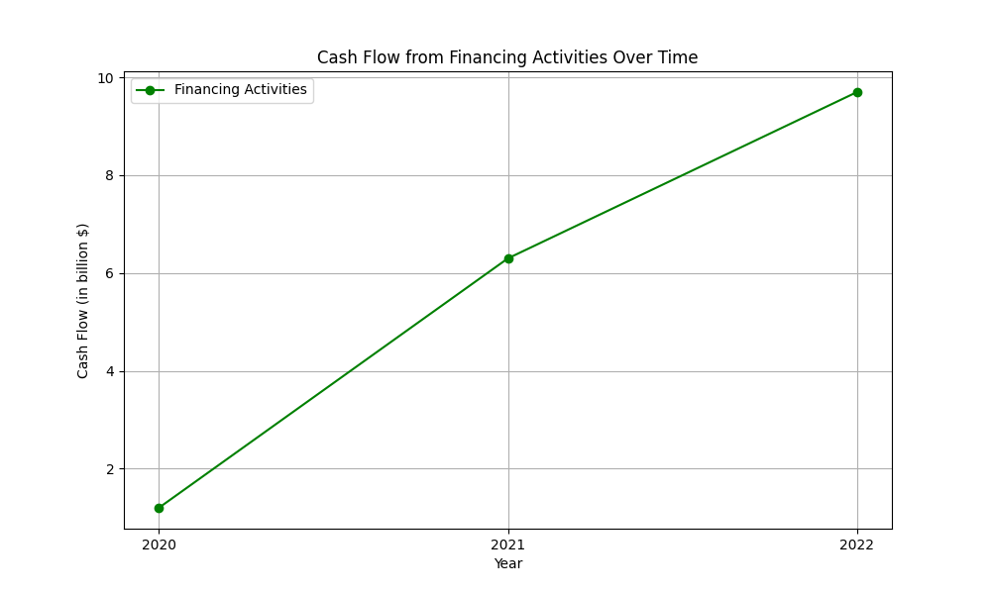
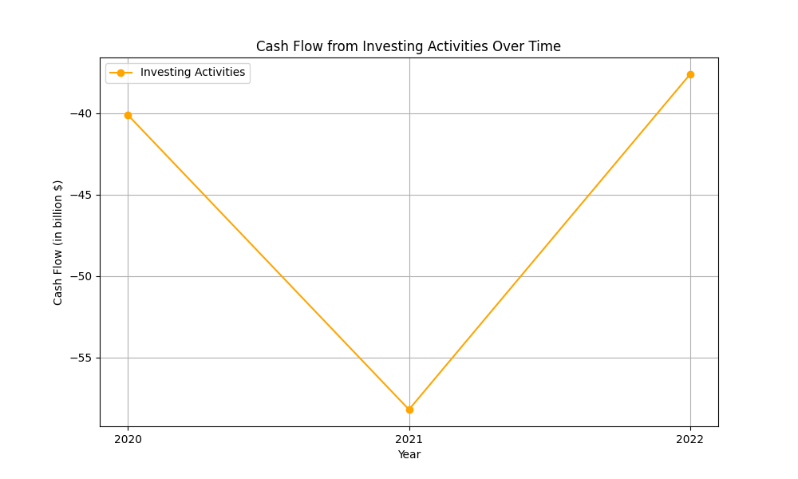
Cash Flow figures

Slide 9
Sentiment Analysis Results
Overall: 52
Positive: 0.15
Neutral: 0.6
Negative: 0.12

