Slide 1
Amazon.Com, Inc. Analysis

Slide 2
Business Overview
Amazon's business has significantly evolved over time, reflecting diversification and expansion. Initially focusing on book sales, Amazon increased its product range and introduced new features like 1-Click shopping and gift certificates. By 2022-2023, it offered an extensive range of products through both in-house and third-party sellers, and services including AWS, fulfillment, and advertising. Investments in grocery and physical stores through Whole Foods and Amazon Fresh signify a strategic move to capture a more substantial share of the $800 billion US grocery market. Amazon also deepened its business-to-business engagement with Amazon Business launched in 2015, achieving $35 billion in annualized gross sales by 2022. Recent ventures such as Amazon Pharmacy and the satellite internet initiative Kuiper show a continued drive to diversify beyond traditional e-commerce. Overall, Amazon's business strategy has shifted from a single-category online retailer to a multi-dimensional service provider and global retail giant.

Slide 3
Revenue
Amazon's revenue has shown significant growth over recent years. In 2020, the total revenue was $386.06 billion. This increased to $469.82 billion in 2021, reflecting a year-over-year growth of 22%. By 2022, Amazon's revenue had further increased to $513.98 billion, marking a 9% rise from the previous year. In 2023, the revenue continued its upward trend, reaching $574.79 billion, representing a 12% increase from 2022. The revenue contributions come from various segments, including North America, International, and AWS. In 2023, North America generated $352.83 billion, International contributed $131.20 billion, and AWS had $90.76 billion in revenue. The year-over-year growth rates for these segments in 2023 were 12%, 11%, and 13%, respectively. This consistent increase in revenue highlights Amazon's robust business model, leveraging its diverse revenue streams, including retail sales, third-party seller services, subscription services, advertising services, and AWS. This strong performance demonstrates Amazon's ability to adapt and thrive in varying economic conditions and maintain its global market leadership.

Slide 4
Operating Income
From the financial statements provided, Amazon's operating income has experienced notable fluctuations over recent years. In 2020, the operating income was $22.9 billion, which increased to $24.9 billion in 2021. However, 2022 saw a significant reduction to $12.2 billion, marking a substantial decline. This reduction was primarily caused by increased operating expenses, particularly in North America and International segments. By 2023, the consolidated operating income rebounded strongly to $36.9 billion, driven by improvements in all segments: North America, International, and AWS. Specifically, North America saw a dramatic shift from a loss of $2.8 billion in 2022 to an income of $14.9 billion in 2023. The International segment, though still at a loss, improved considerably from a loss of $7.7 billion in 2022 to $2.7 billion in 2023. AWS consistently performed well, with its operating income increasing from $22.8 billion in 2022 to $24.6 billion in 2023.

Slide 5
PBT Margin
The Profit Before Tax (PBT) Margin is an important metric to assess a company's profitability before accounting for income taxes. Based on the data provided: 1. In 2021, Amazon reported an operating income of $24.9 billion with consolidated net sales of $469.822 billion. The PBT Margin for 2021 is approximately 5.30%. 2. In 2022, Amazon's operating income decreased to $12.248 billion while the net sales increased to $513.983 billion. The PBT Margin for 2022 is approximately 2.38%. 3. In 2023, Amazon's operating income significantly increased to $36.852 billion with net sales reaching $574.785 billion. The PBT Margin for 2023 is approximately 6.41%. To calculate the PBT Margin, the formula used is: \[ \text{PBT Margin} = \frac{\text{Operating Income}}{\text{Net Sales}} \times 100 \] For 2021: \[ \text{PBT Margin 2021} = \left( \frac{24.9}{469.822} \right) \times 100 = 5.30\% \] For 2022: \[ \text{PBT Margin 2022} = \left( \frac{12.248}{513.983} \right) \times 100 = 2.38\% \] For 2023: \[ \text{PBT Margin 2023} = \left( \frac{36.852}{574.785} \right) \times 100 = 6.41\% \] The PBT Margin saw a decline from 2021 to 2022 but recovered significantly by 2023, indicating improved profitability despite challenging market conditions in 2022.

Slide 6
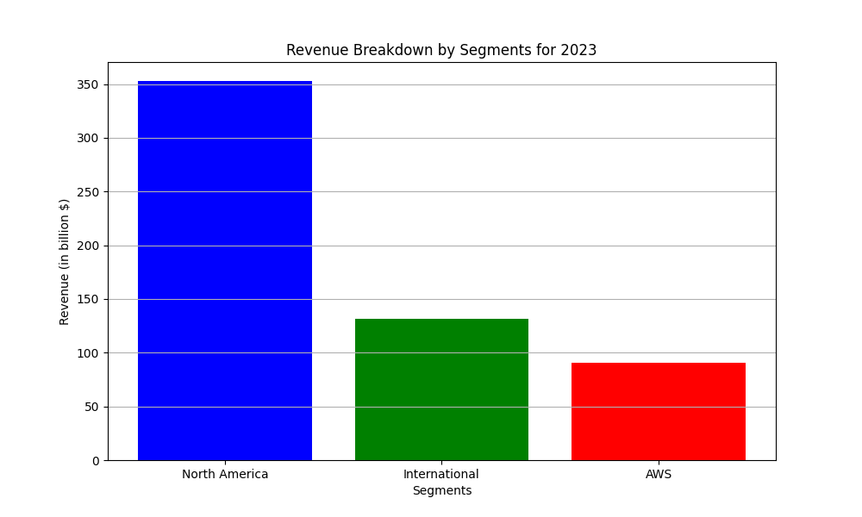
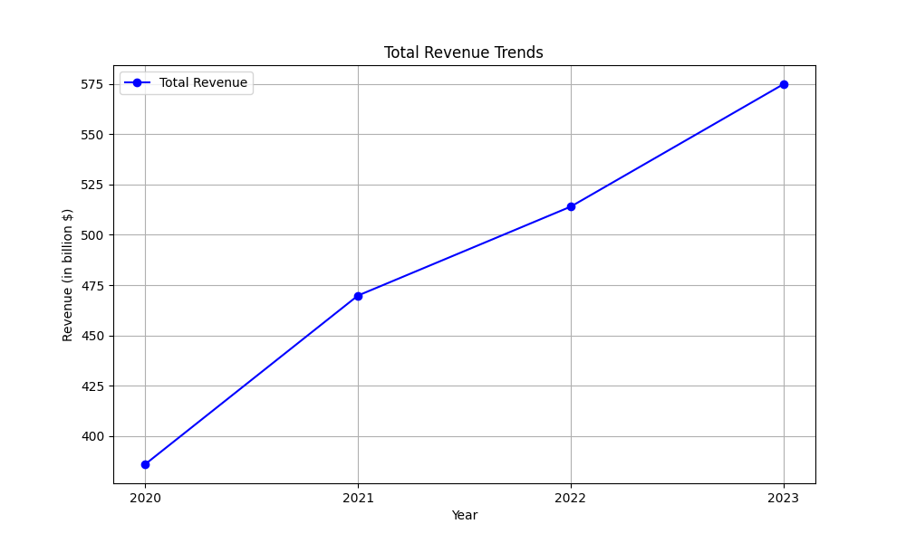
revenue figures

Slide 7
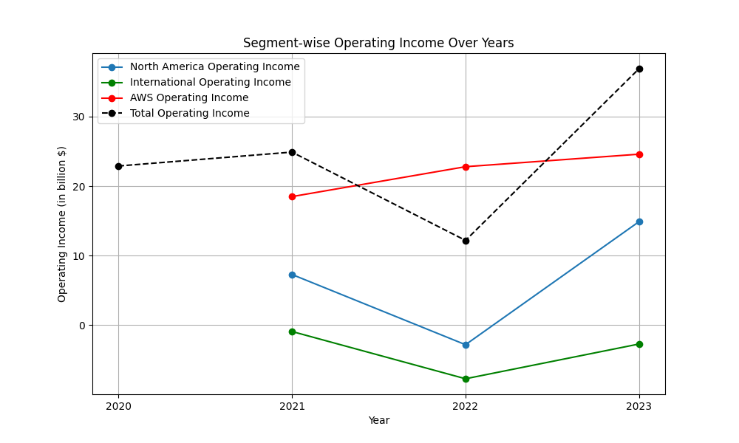
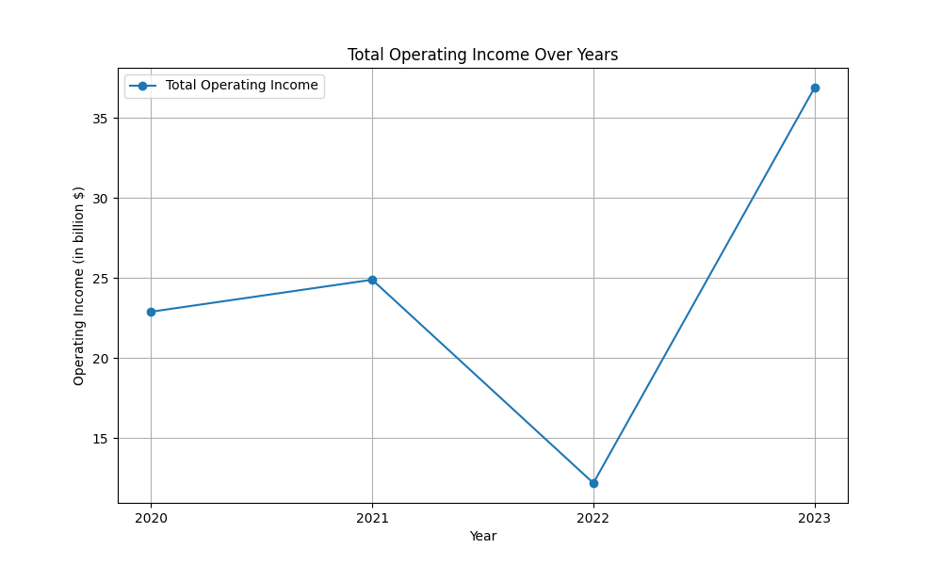
operatingincome figures

Slide 8
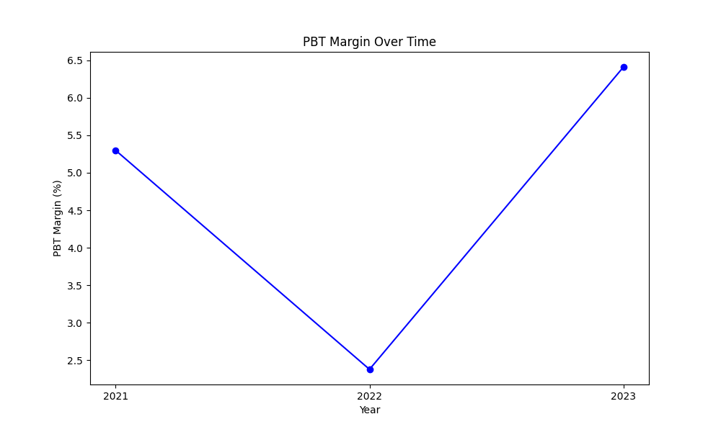
pbtmargin figures

