Slide 1
Company Analysis

Slide 2
Business Overview
Amazon's business overview has significantly evolved since its inception. Initially focused on online book sales, the company diversified into various product categories, e-commerce services, and technology offerings. In 1997, Amazon declared its ambition to provide a comprehensive online shopping experience, leveraging the nascent web environment to enhance selection and convenience. At that time, sales grew from $15.7 million in 1996 to $147.8 million in 1997. By 2022, Amazon's operations had expanded into three primary segments: North America, International, and Amazon Web Services (AWS). The primary revenue sources encompassed merchandise sales, third-party seller services, and digital content. In 2022, net sales in North America reached $315.88 billion, $118.01 billion internationally, and AWS contributed $80.09 billion. Amazon has forayed into grocery with Amazon Fresh and Whole Foods Market, an $800 billion market segment in the US. Amazon Business, launched in 2015, also recorded $35 billion in annualized gross sales by serving diverse organizational needs. Overall, Amazon's strategic expansion into new product lines and global markets has shaped it into a multifaceted tech and retail giant, reflecting its commitment to long-term growth and innovation.

Slide 3
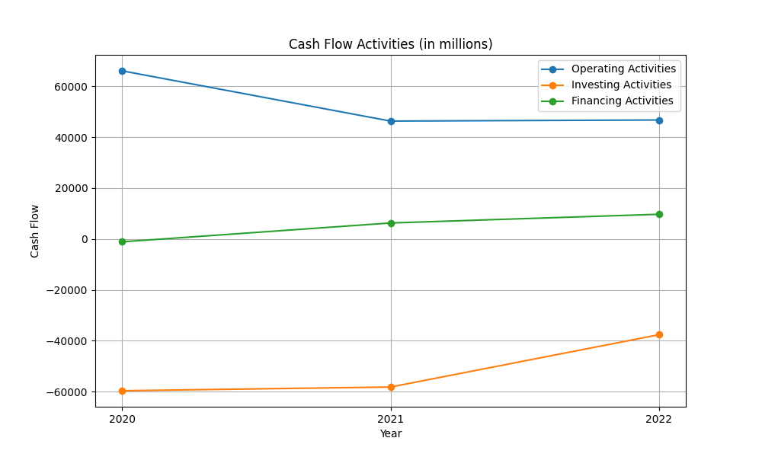
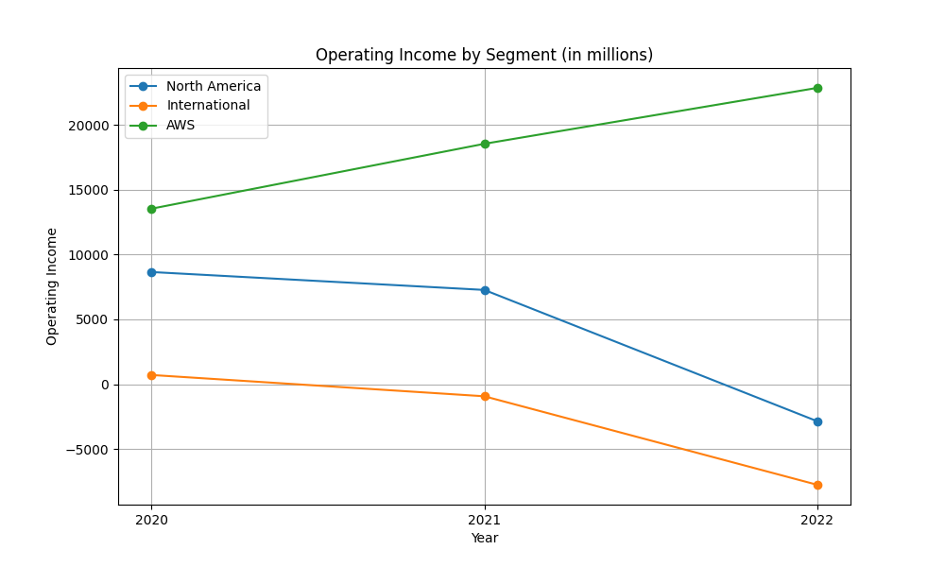
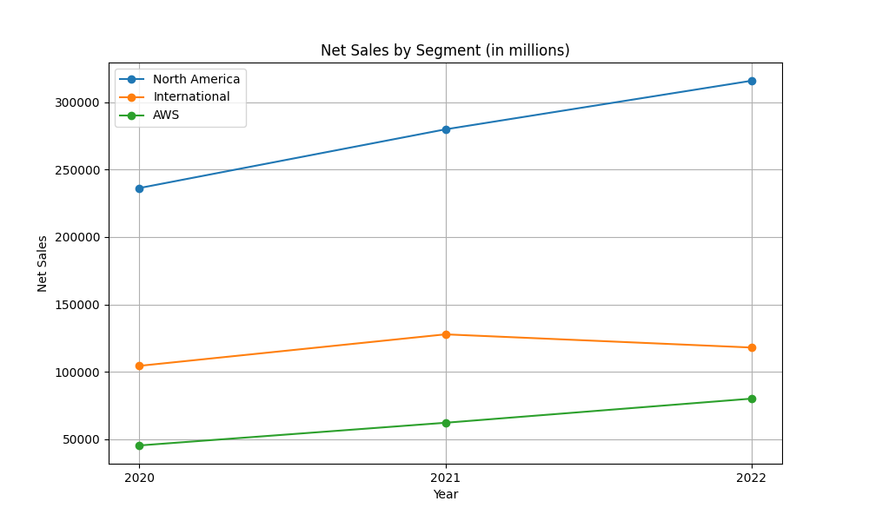
overview figures

Slide 4
Cash Flow
Over the past three years, Amazon's cash flow dynamics have evolved significantly. Net cash provided by operating activities was $66.1 billion in 2020 but decreased to $46.3 billion in 2021 and remained relatively flat at $46.8 billion in 2022. This decline is largely attributed to increased expenses, such as higher employee compensation and fulfillment costs. Investing cash flows have shown more variability. In 2020, net cash used in investing activities was $59.6 billion, which increased to $58.2 billion in 2021, but improved to $37.6 billion in 2022. This fluctuation is primarily due to heightened marketable securities purchases and increased capital expenditures for technology infrastructure and fulfillment capacity. Financing cash flows reflect substantial activity as well, with $9.7 billion provided in 2022, up from $6.3 billion in 2021 and an outflow of $1.1 billion in 2020. This rise is attributable to increased proceeds from short-term and long-term debt. Overall, Amazon has seen decreases in operational cash inflows and fluctuating investing outflows, balanced by an increase in financing activities reflecting strategic borrowing to support growth initiatives.

Slide 5
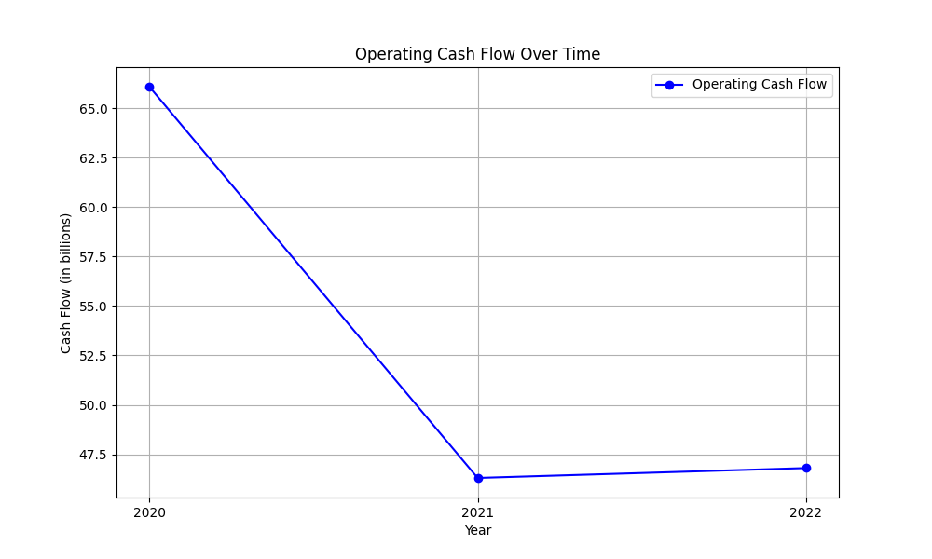
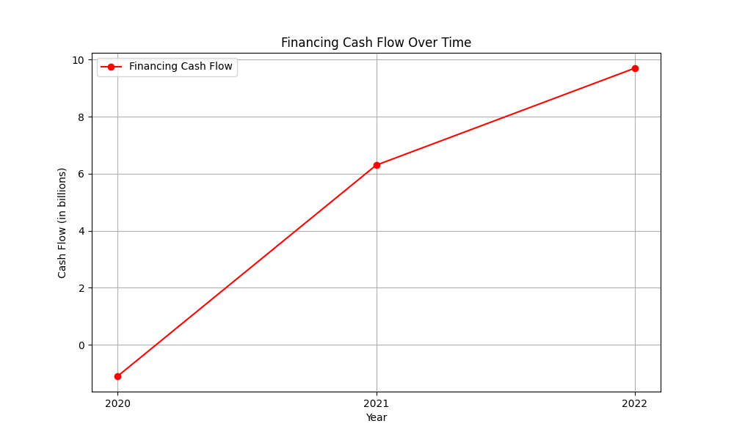
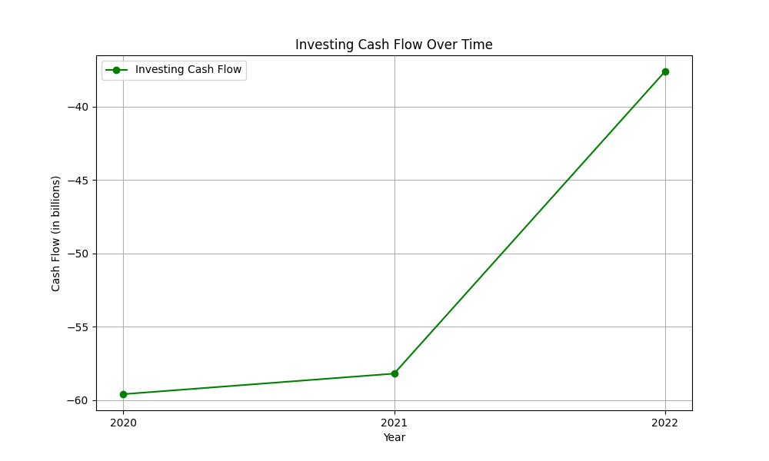
cashflow figures

