Slide 1
Company Analysis

Slide 2
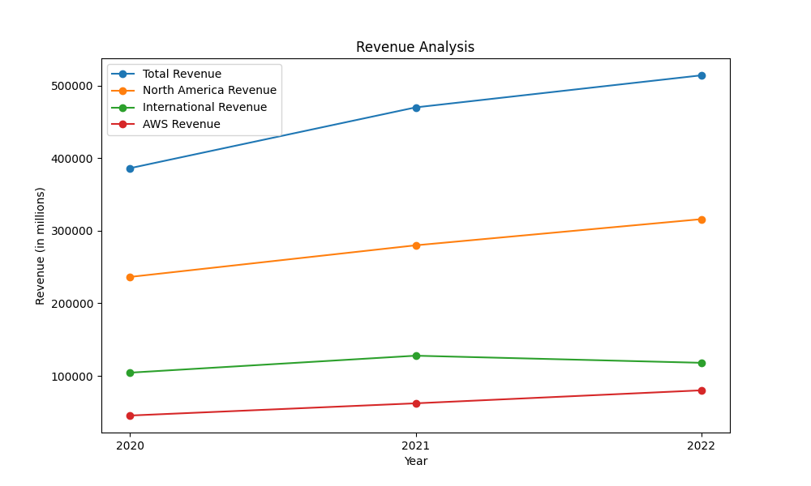
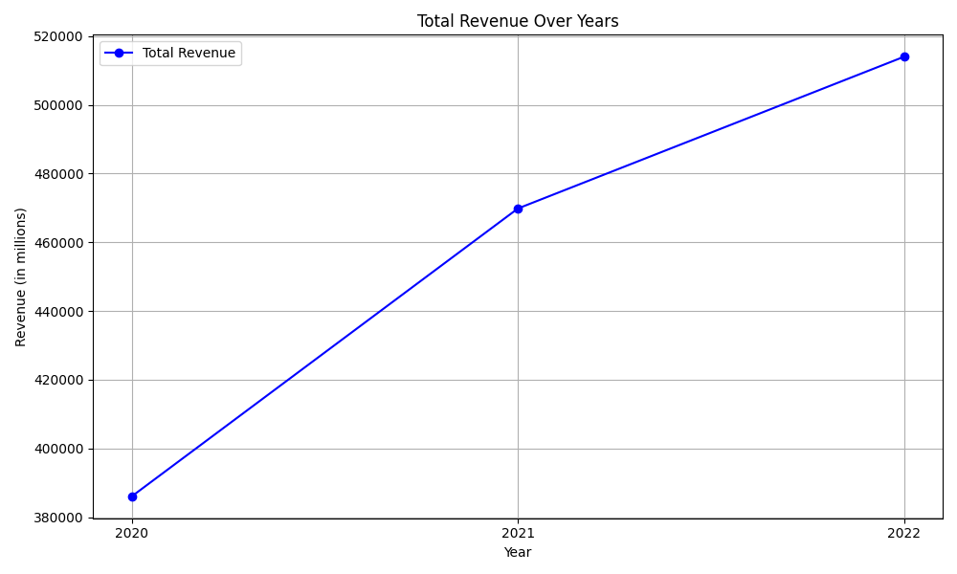
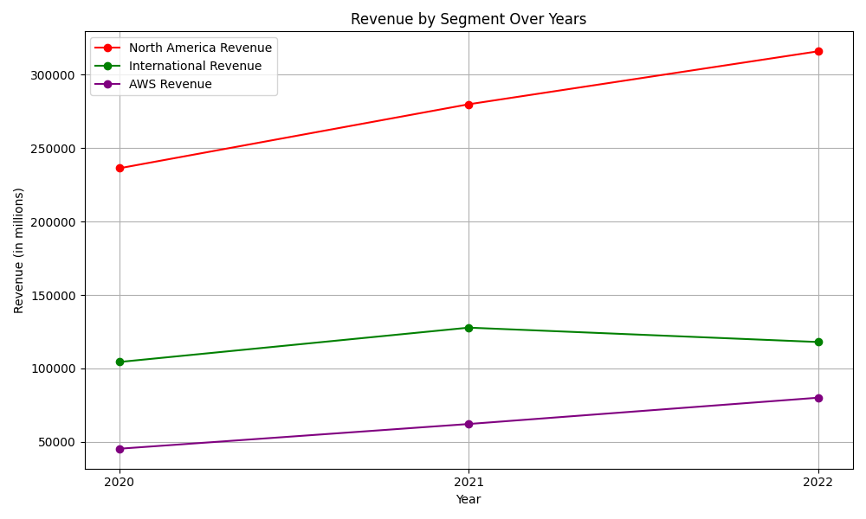
Revenue Analysis
From 2020 to 2022, Amazon's consolidated net sales increased from $386 billion in 2020 to $514 billion in 2022. Segment-wise, North America saw sales grow from $236 billion to $316 billion (34% growth), AWS sales rose from $45 billion to $80 billion (78% growth), while International sales grew modestly from $104 billion to $118 billion (13% growth). Operating income shows a varying trend: $22.9 billion in 2020, $24.9 billion in 2021, and a drop to $12.2 billion in 2022. The International segment reported the biggest losses in 2022, with a negative operating income of $7.7 billion from less than $1 billion in 2021. AWS consistently improved operating income, contributing $18.5 billion in 2021 and $22.8 billion in 2022. Year-on-year percentage net growth was 22% in 2021 and 9% in 2022. Notably, from 2021 to 2022, North America grew 13%, AWS saw a 29% increase, whereas International experienced an 8% decrease. Service sales, which include AWS, advertising services, and subscription services, contributed significantly to this growth, rising from $170 billion in 2020 to $271 billion in 2022. In terms of profitability, net income fluctuated significantly, reporting net losses in 2022 of $2.7 billion compared to net income of $33.4 billion in 2021 and $21.3 billion in 2020.

Slide 3
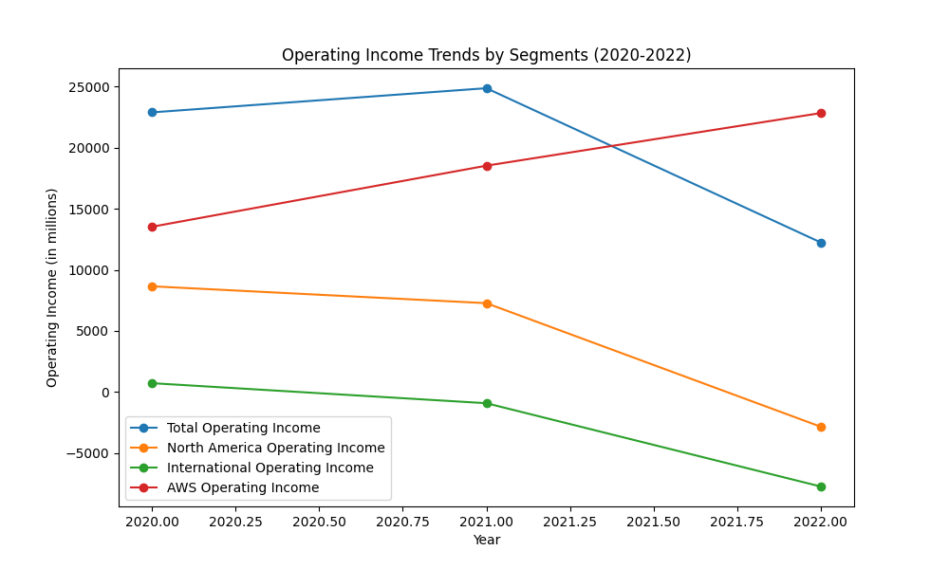
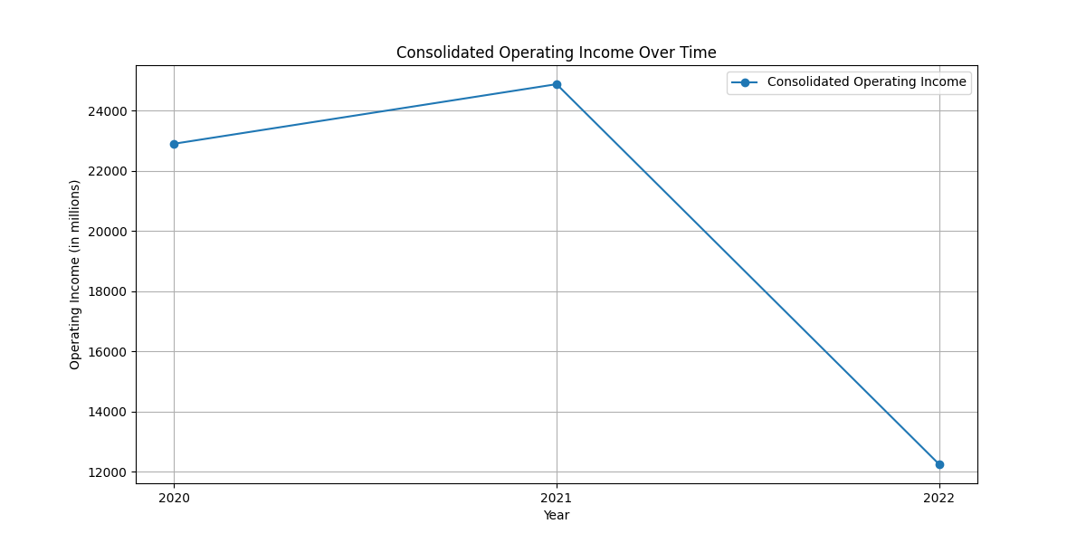
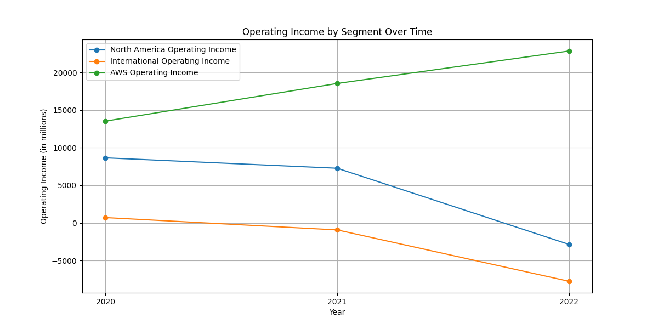
Operating Income Analysis
Amazon's operating income has shown significant fluctuations from 2020 to 2022. In 2020, the operating income stood at $22.899 billion, which increased to $24.879 billion in 2021. However, in 2022, the operating income significantly dropped to $12.248 billion. Segment-wise analysis reveals different trends. North America's operating income decreased from $7.271 billion in 2021 to an operating loss of $2.847 billion in 2022. This shift was mainly due to increased costs related to fulfillment, shipping, and technology investments. The International segment also mirrored this trend, moving from an operating loss of $924 million in 2021 to a further loss of $7.746 billion in 2022. Conversely, AWS (Amazon Web Services) saw its operating income rise from $18.532 billion in 2021 to $22.841 billion in 2022, driven by a combination of increased sales and improved cost structure productivity.

Slide 4
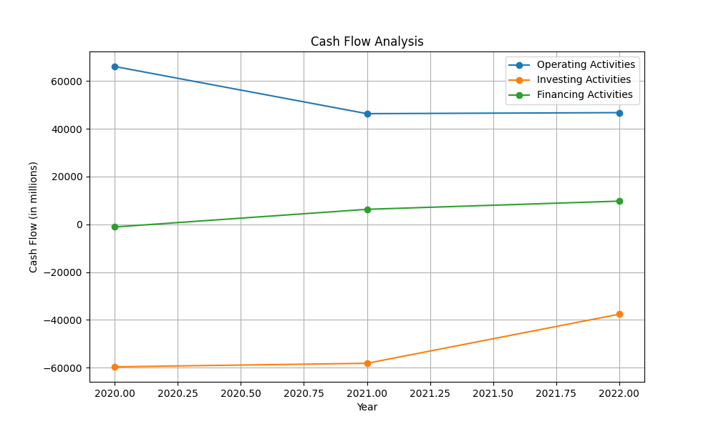
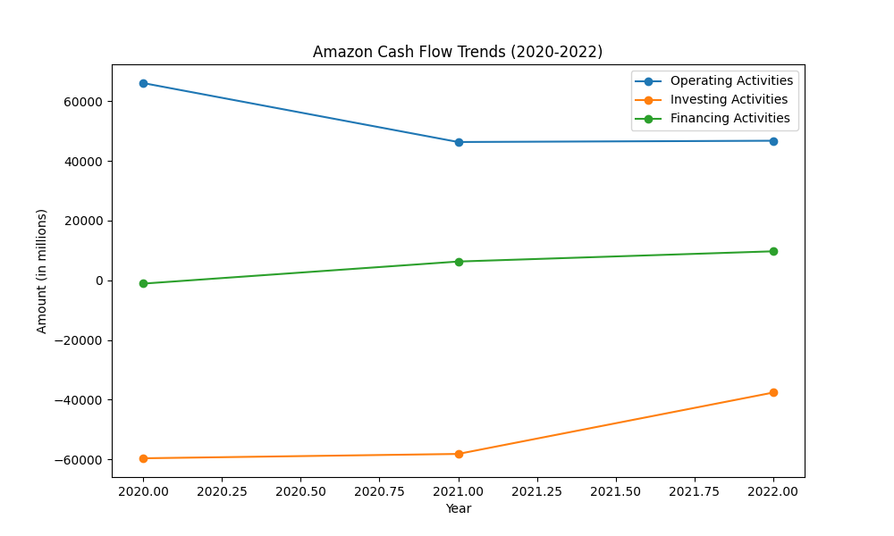
Cash Flow Analysis
The cash flow of Amazon has experienced notable changes over the years 2020, 2021, and 2022. In terms of operating activities, cash provided was $66.1 billion in 2020, which then reduced to $46.3 billion in 2021 and remained relatively stable at $46.8 billion in 2022. The decline from 2020 to 2021 is primarily attributed to changes in net income and working capital. Cash used in investing activities has also varied significantly. In 2020, cash used was $(59.6) billion, which increased to $(58.2) billion in 2021, and further decreased to $(37.6) billion in 2022. These investments were directed towards property and equipment purchases, reflecting continued investments in technology infrastructure and fulfillment capacity. On the financing front, cash provided was $(1.1) billion in 2020, then increased to $6.3 billion in 2021, and further to $9.7 billion in 2022. The fluctuations in these figures were driven primarily by proceeds from debt and repayments, along with finance leases. Finally, the total cash, cash equivalents, and restricted cash increased from $36.5 billion at the end of 2020 to $54.3 billion by the end of 2022, demonstrating a substantial increase in liquidity over this period.

Slide 5
Other KPIs
- PBT Margin: For 2021 and 2022, the operating income (used here as a proxy for PBT) was $24.9 billion and $12.2 billion, respectively, with net sales of $469.8 billion and $514 billion. The PBT margins are approximately 5.3% for 2021 and 2.4% for 2022. - Cost of Risk: The impairments and expenses in 2022 were $1.24 billion (impairments of $1.1 billion and $140 million in lease terminations). For 2021, specific cost of risks figures not directly available, making it challenging to compare. - Net Interest Margin: Not explicitly provided in the data. The information related to interest paid and interest components can indirectly suggest activities, but explicit calculations remain limited. - Return on Tangible Equity (ROTE): With net income of $33.4 billion for 2021 and net loss of $2.7 billion for 2022 coupled with stockholders' equity values ($138.2 billion in 2021 and $146 billion in 2022), ROTE was positive for 2021 but negative for 2022. These KPIs reflect a significant decrease in performance year-over-year, with substantial drops in profitability margins and increased costs of risk in 2022.

Slide 6
KPI Plots

