Slide 1
Company Analysis

Slide 2
Revenue Analysis
revenue

Slide 3
Operating Income Analysis
operatingincome

Slide 4
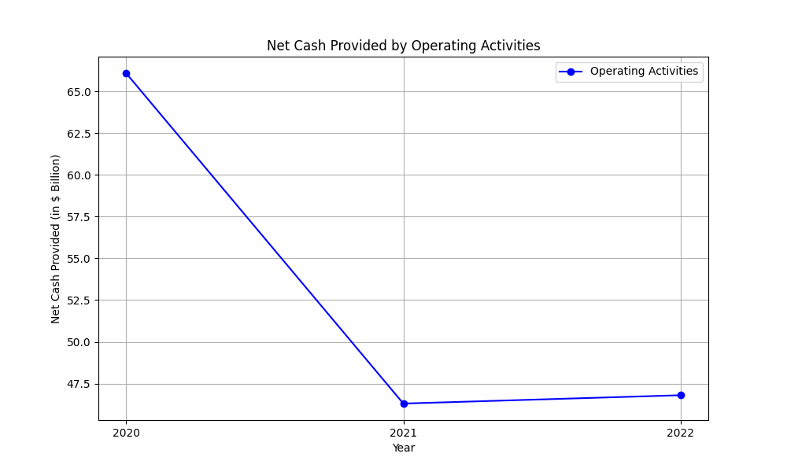
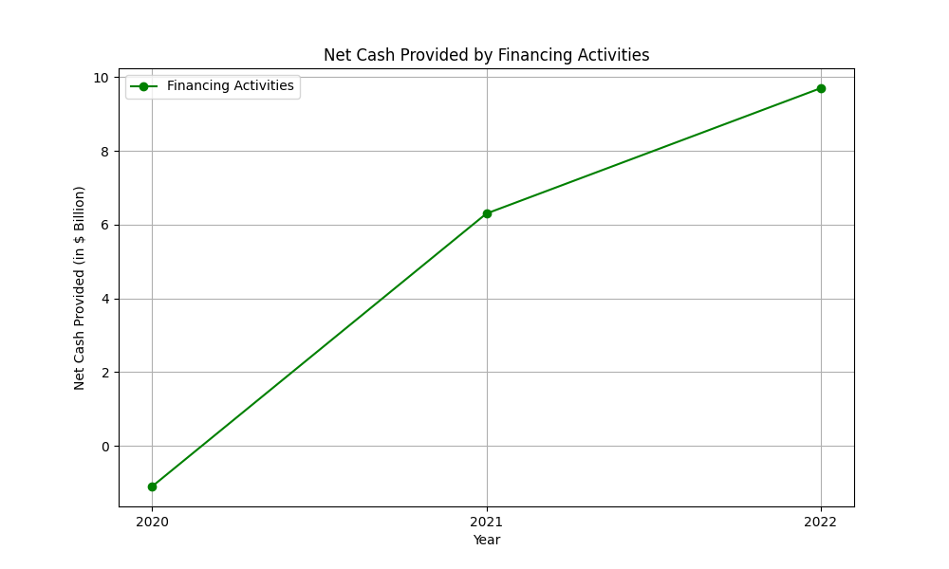
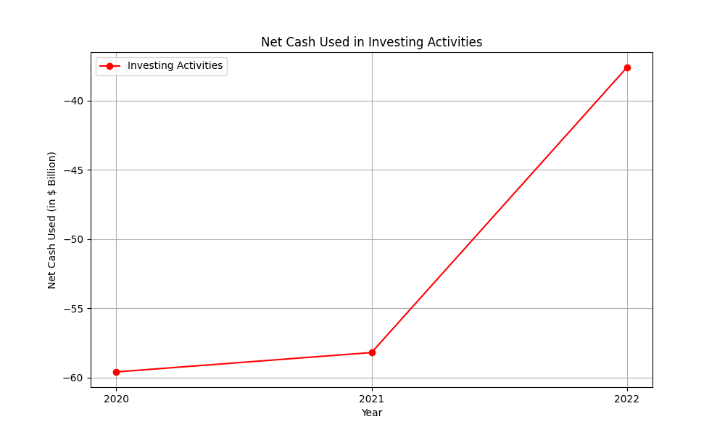
Cash Flow Analysis
The cash flow of Amazon has undergone significant changes over the past three years. 1. Operating Activities: It saw a net cash provided of $66.1 billion in 2020, which decreased to $46.3 billion in 2021 and stabilized at $46.8 billion in 2022. The slight increase in 2022 was primarily due to higher net income adjustments excluding non-cash expenses, offset by working capital changes. 2. Investing Activities: Net cash used in investing activities was $(59.6) billion, $(58.2) billion, and $(37.6) billion in 2020, 2021, and 2022, respectively. The fluctuations were mainly due to variations in purchases, sales, and maturities of marketable securities, and increased spending on technology infrastructure and acquisitions. 3. Financing Activities: Cash provided by financing activities was $(1.1) billion in 2020, which increased to $6.3 billion in 2021 and $9.7 billion in 2022. This growth was driven by increased proceeds from short-term and long-term debt and stock repurchases, despite higher repayments of debt and finance leases. Overall, Amazon’s cash flow has been influenced by its investments in technology and infrastructure, debt management, and strategic acquisitions, reflecting its focus on long-term growth despite short-term variabilities.

Slide 5
Other KPIs
kpis

Slide 6
KPI Plots

