Slide 1
Company Analysis

Slide 2
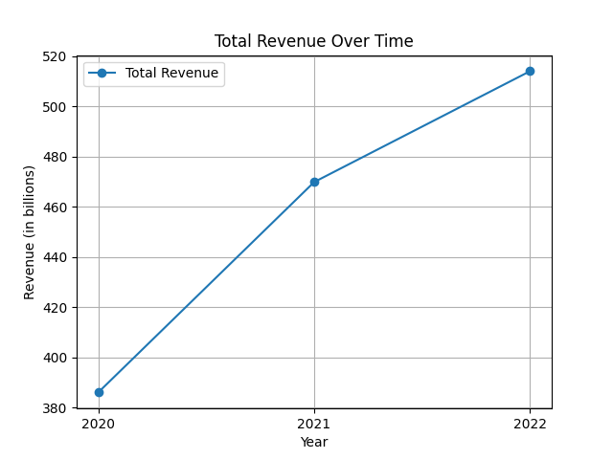
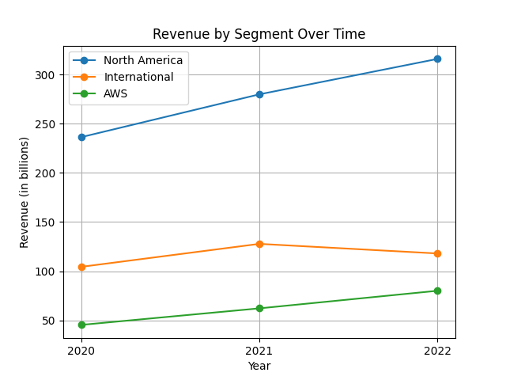
Revenue Analysis
Amazon's revenue has shown significant growth over the years across various segments and services. Key figures and trends from the period 2020 to 2022 include: 1. Consolidated Net Sales: Increased from $386.06 billion in 2020 to $513.98 billion in 2022, reflecting a compound annual growth rate (CAGR) of approximately 15.6%. 2. Revenue Segments: - North America: Revenue grew from $236.28 billion in 2020 to $315.88 billion in 2022, indicating Amazon's strong presence and expansion in its primary market. - International: Peaked at $127.79 billion in 2021 but declined to $118.01 billion in 2022, likely due to adverse foreign currency exchange rates and other macroeconomic challenges. - AWS (Amazon Web Services): Demonstrated the highest growth rate, with revenue soaring from $45.37 billion in 2020 to $80.10 billion in 2022, showcasing the increasing reliance on cloud services. 3. Revenue Breakdown by Services: - Online Stores: Consistently the largest revenue stream but relatively flat in recent years, from $222.08 billion in 2021 to $220.00 billion in 2022. - Third-party Seller Services: Significantly increased from $80.46 billion in 2020 to $117.72 billion in 2022. - Subscription Services: Grew from $25.21 billion in 2020 to $35.22 billion in 2022, driven by Amazon Prime and other subscription-based services. - Advertising Services: Notably rose from $19.77 billion in 2020 to $37.74 billion in 2022, highlighting Amazon's lucrative advertising business. - AWS: As mentioned, saw remarkable growth, underlining its critical contribution to Amazon’s overall revenue. The data clearly illustrates Amazon's diversified revenue streams, with AWS and third-party services being key growth drivers in recent years. This shift reflects an increasing dependency on cloud infrastructure and the growing dominance of Amazon's marketplace platform.

Slide 3
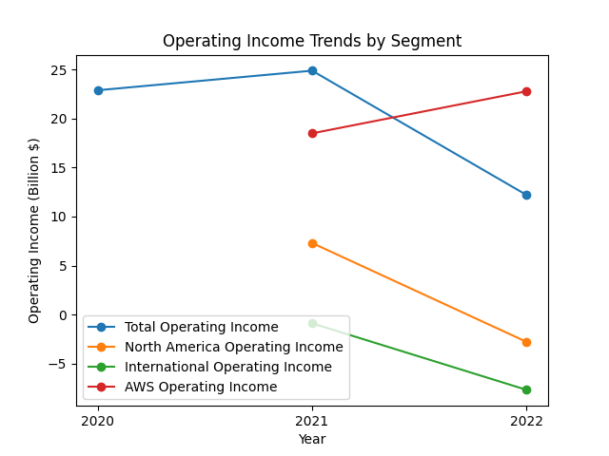
Operating Income Analysis
The operating income of the company has exhibited significant variance over the past years. In 2020, the consolidated operating income was $22.9 billion. This increased to $24.9 billion in 2021 but dropped to $12.2 billion in 2022. In 2021, the North America segment’s operating income was $7.3 billion, which then swung to a loss of $2.8 billion in 2022. The International segment also saw a notable deterioration from an operating loss of $0.9 billion in 2021 to $7.7 billion in 2022. Conversely, AWS demonstrated consistent growth, with operating income rising from $18.5 billion in 2021 to $22.8 billion in 2022. The decline in North America and International operating income in 2022 is attributed to increased fulfillment and shipping costs, investments in the fulfillment network, higher transportation costs, wage rates and incentives, and elevated technology and content expenses. However, AWS's growth was driven by increased sales and cost structure productivity, though partially offset by higher payroll and technology infrastructure spending.

Slide 4
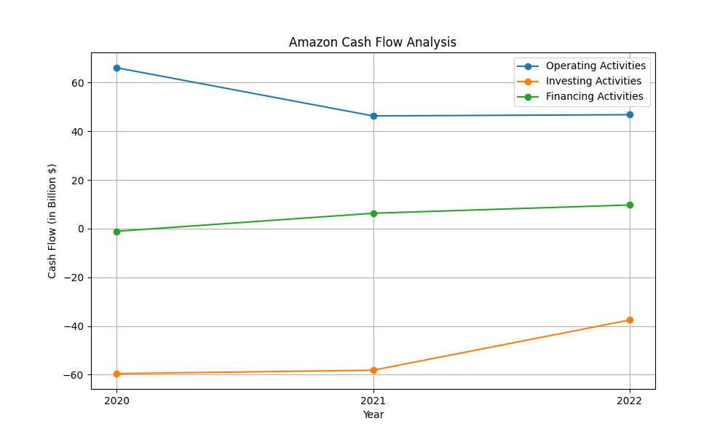
Cash Flow Analysis
Over the years, Amazon's cash flow has experienced notable changes. Cash from operating activities was $66.1 billion in 2020, but decreased to $46.3 billion in 2021 and marginally increased to $46.8 billion in 2022. This fluctuation in operating cash flow is eventually attributable to variations in net income, which surged from $21.3 billion in 2020 to $33.4 billion in 2021, before plummeting to a net loss of $2.7 billion in 2022. Investing activities consistently reported negative cash flow, with outflows of $59.6 billion in 2020, $58.2 billion in 2021, and $37.6 billion in 2022, primarily driven by capital expenditures and acquisitions. Notably, property and equipment purchases escalated from $40.1 billion in 2020 to $63.6 billion in 2022. Financing activities show a different trend, swinging from cash outflows of $1.1 billion in 2020 to inflows of $6.3 billion in 2021 and $9.7 billion in 2022. Financing cash flow was influenced by debt proceeds and repayments alongside stock repurchases. Overall, while operational cash remained significant, Amazon intensified investments and leveraged financing activities to support its expansive infrastructure and growth initiatives.

Slide 5
Other KPIs
KPI Analysis #PBT Margin: Profit Before Tax (PBT) for 2021 was $24.9 billion, and for 2022 it was $12.2 billion. PBT margins are calculated as follows: - 2021: PBT margin = PBT / Net Sales = 24,879 / 469,822 = 5.29% - 2022: PBT margin = PBT / Net Sales = 12,248 / 513,983 = 2.38% #Income to Cost Ratio: The income to cost ratio is calculated as Operating Income / Operating Expenses: - 2021: 24,879 / 444,943 = 0.056 - 2022: 12,248 / 501,735 = 0.024 #Net Interest Margin: Net interest margin (Interest Income - Interest Expense) / Average Earning Assets: Interest Income was not explicitly stated, but there were expenses for interest on debt and finance leases: - 2022: Interest on debt $1,561, finance leases $374, and total net interest expenses were $1,935 million. #Return on Tangible Equity (ROTE): Return on Tangible Equity is calculated as follows: (Net Income - Dividends) / Tangible Equity: - 2021: ((33,364) / (138,245 - Goodwill of $4.9B and intangibles)) = ((33,364) / (138,245 - 4,900)) = 25.8% - 2022: ((-2,722) / (146,043 - Goodwill of $9.616B and intangibles)) = ((-2,722) / (146,043 - 9,616)) = -1.97% Amazon experienced a decline in its PBT margin and income to cost ratio due to rising costs and lower operating income.

Slide 6
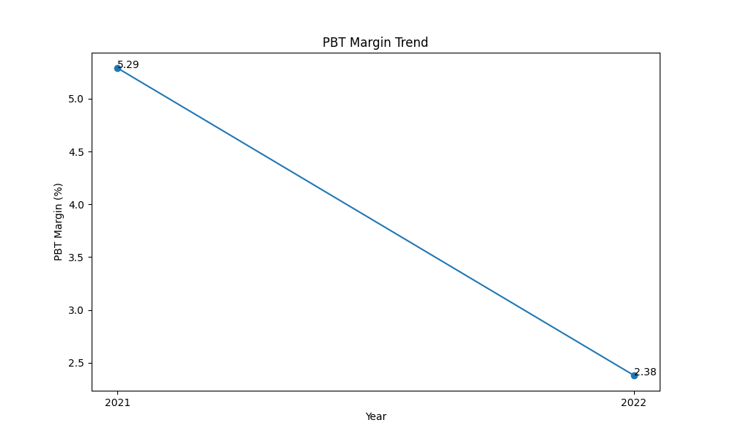
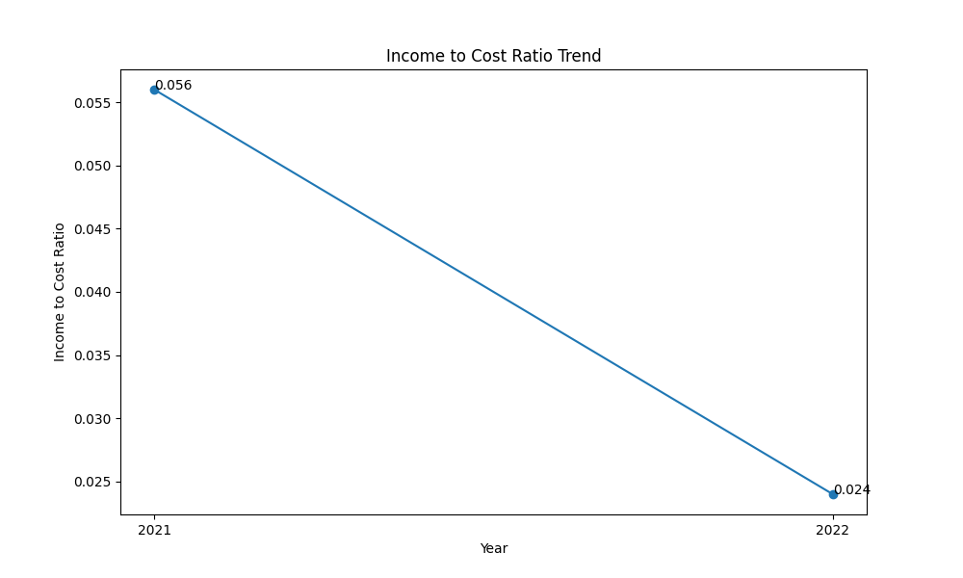
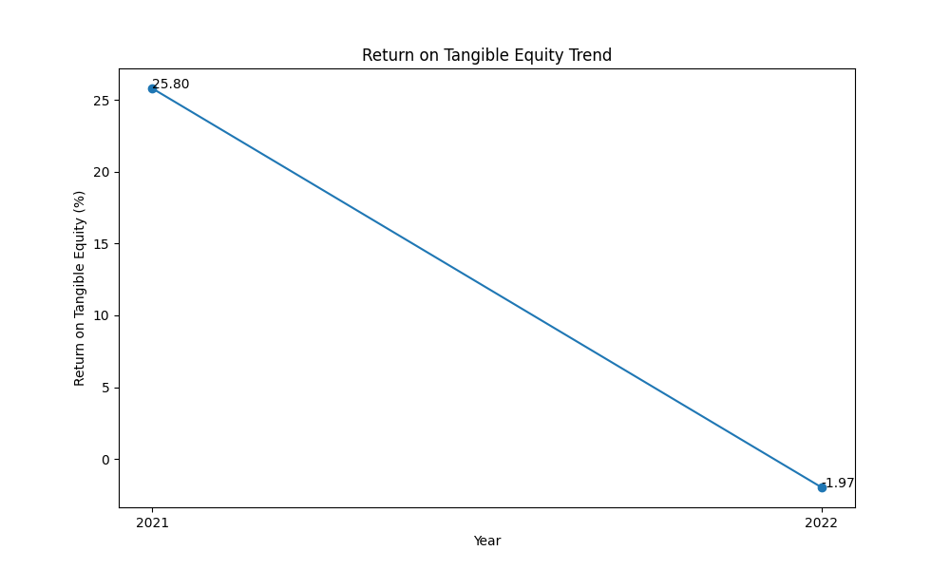
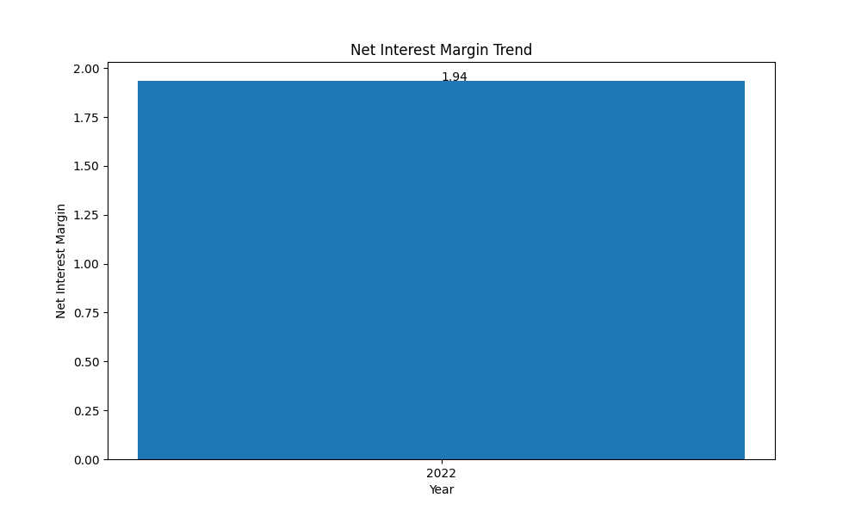
KPI Plots

