Slide 1
Amazon.Com, Inc. Analysis

Slide 2
Business Overview
Amazon's business overview has consistently evolved to adapt to market trends and customer demands. Initially, Amazon started as an online book retailer in 1994, aiming to offer a broader selection and greater convenience than physical bookstores. With a dogged focus on customer satisfaction, Amazon swiftly expanded into various product categories and started offering millions of unique products through both its direct sales and third-party sellers. In recent years, Amazon has honed its logistics and warehousing capabilities, which allowed it to provide faster delivery services. This includes co-sourced and outsourced arrangements globally. Amazon Web Services (AWS), launched in 2006, has grown into one of the company's most profitable segments, offering computing power, storage, and various other services to enterprises of all sizes . Amazon has also ventured into the grocery sector with Amazon Fresh and acquired Whole Foods Market in 2017, aiming to capture more of the grocery market by blending online convenience with physical stores . More recently, they have introduced Amazon Business, targeting enterprise customers by streamlining procurement processes across office supplies and more . Moreover, the company is continually exploring new ventures like healthcare with Amazon Pharmacy and tech innovation initiatives such as Project Kuiper. This dynamic strategy highlights Amazon's adaptive business model and relentless focus on innovation and customer satisfaction.

Slide 3
Revenue
Amazon's revenue has shown significant growth over the years 2020 to 2022, with varying rates across different segments and regions. In 2020, the company reported total net sales of $386.1 billion, which increased by 21% to $469.8 billion in 2021, and then further by 9.4% to $514.0 billion in 2022. Breaking down by segments, North America generated $236.3 billion, $279.8 billion, and $315.9 billion in net sales for 2020, 2021, and 2022 respectively, showing consistent growth. The International segment reached $104.4 billion in 2020, peaking at $127.8 billion in 2021 before dropping to $118.0 billion in 2022 due to currency fluctuations. Amazon Web Services (AWS) also saw significant growth with net sales of $45.4 billion in 2020, rising to $62.2 billion in 2021 and $80.1 billion in 2022, demonstrating its role as a key driver of Amazon's revenue growth.

Slide 4
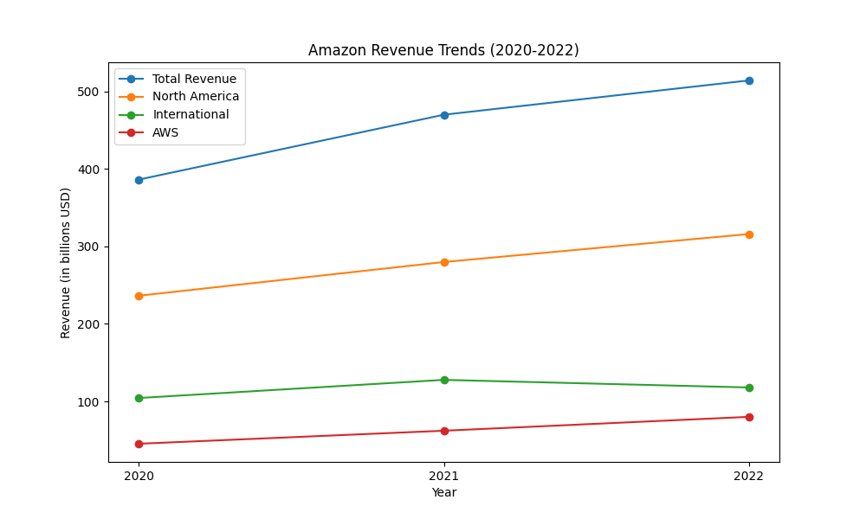
revenue figures

Slide 5
Operating Income
The operating income of Amazon.com, Inc. has fluctuated significantly over the years. In 2020, the operating income was $22.9 billion. This figure rose to $24.9 billion in 2021 but then dramatically fell to $12.2 billion in 2022. For a more detailed breakdown, the North America segment experienced an operating income of $8.7 billion in 2020, which decreased to $7.3 billion in 2021, and sharply turned into a loss of $2.8 billion in 2022. The International segment saw a modest operating income of $0.7 billion in 2020, turned to a loss of $0.9 billion in 2021, and significantly worsened to a loss of $7.7 billion in 2022. On the other hand, the AWS segment consistently grew, with operating incomes of $13.5 billion in 2020, $18.5 billion in 2021, and $22.8 billion in 2022. The drastic decline in operating income for 2022 was primarily due to increased fulfillment and shipping costs, investments in the fulfillment network, wage rate increases, and higher technology and content costs. Conversely, AWS's improved performance was mainly driven by increased sales and cost structure productivity.

Slide 6
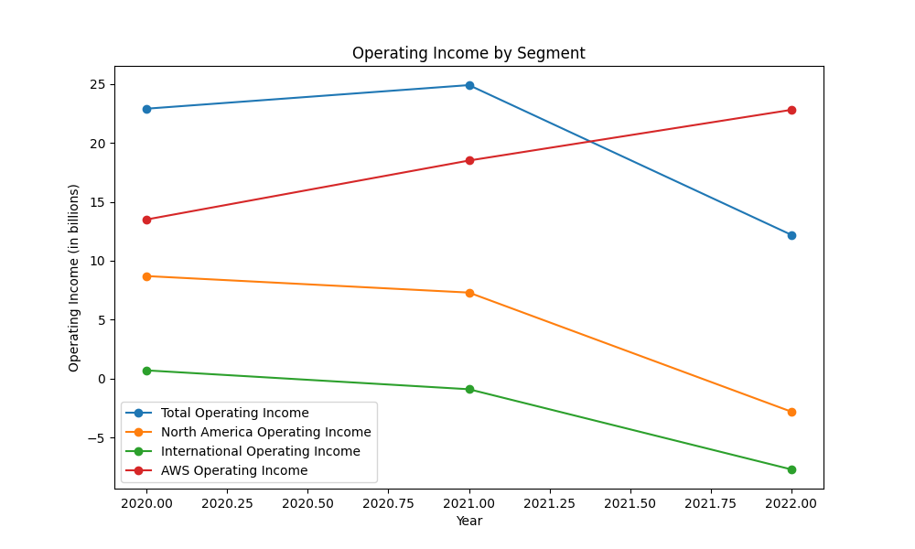
operatingincome figures

Slide 7
Cash Flow
Amazon's cash flow has shown substantial variability and changes over the years. Operating Activities: - 2020: $66.1 billion - 2021: $46.3 billion - 2022: $46.8 billion The decrease from 2020 to 2021 and stability from 2021 to 2022 is primarily attributed to changes in net income, excluding non-cash expenses, and fluctuations in working capital. Investing Activities: - 2020: $(59.6) billion - 2021: $(58.2) billion - 2022: $(37.6) billion Amazon's cash used in investing activities primarily reflects significant investments in technology infrastructure and capacity to support the AWS business growth and fulfillment network. Financing Activities: - 2020: $(1.1) billion - 2021: $6.3 billion - 2022: $9.7 billion The increase is mainly due to proceeds from long-term debt and short-term debt. Notably, there were repayments of finance leases and financing obligations. Free Cash Flow: - 2021: $(9.1) billion - 2022: $(11.6) billion The decline in free cash flow reflects the growing expenditures on property and equipment. Overall, Amazon’s strategy to focus on long-term growth through substantial capital investments while maintaining solid operating cash flow underpins its cash flow trends. This wide-ranging approach ensures liquidity and supports the company’s expansive initiatives across its varied businesses.

Slide 8
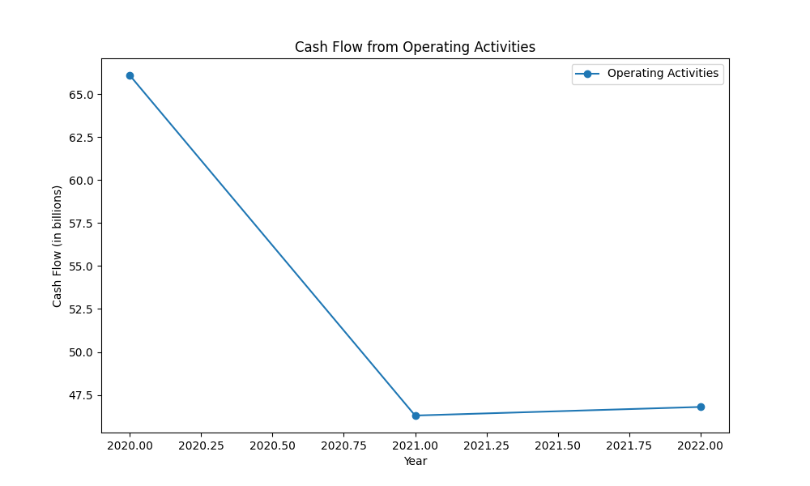
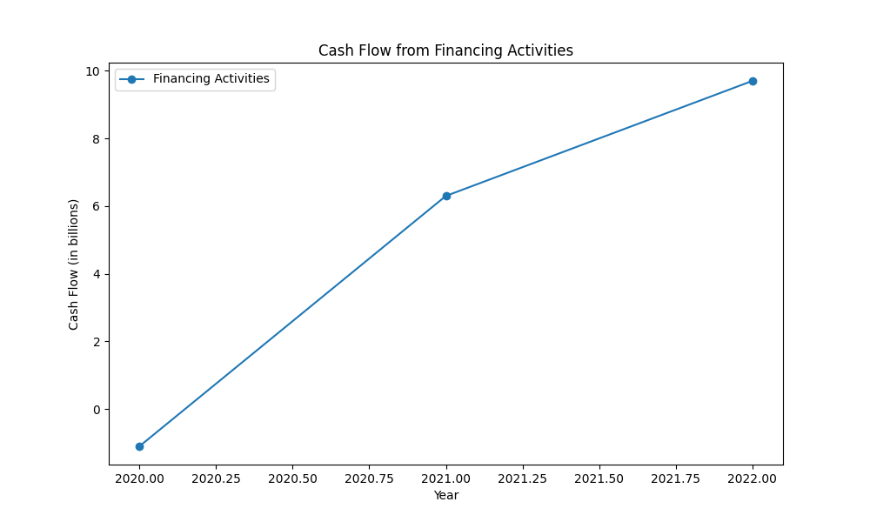
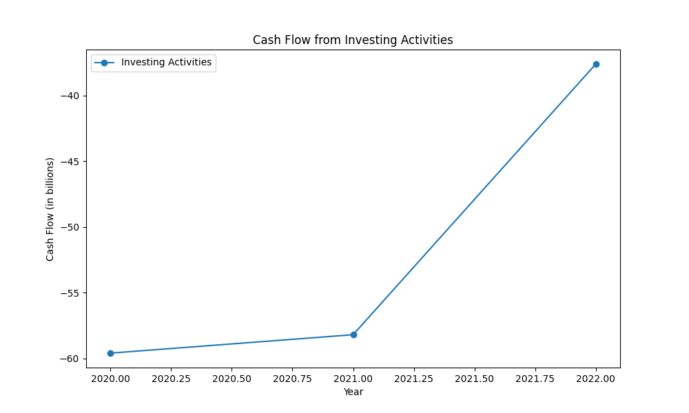
cashflow figures

Slide 9
Business Overview
Amazon's business overview has evolved significantly since its inception in 1994. Originally an online bookstore, Amazon quickly expanded its product lines to include categories like music, video, electronics, and toys by the late 1990s. This product diversification was complemented by geographical expansion, including entering markets in Europe, Asia, and South America. Over the years, Amazon ventured into diverse sectors. The launch of Amazon Web Services (AWS) in 2006 revolutionized cloud computing, making it a significant profit center. Further investments in logistics and fulfillment networks enhanced its delivery capabilities, including same-day and two-day shipping. The acquisition of Whole Foods Market in 2017 marked its entry into the grocery sector, alongside the development of Amazon Fresh, aiming to blend online and physical grocery experiences. Amazon has also made strides in healthcare with the launch of Amazon Pharmacy in 2020 and the acquisition of One Medical in 2022, reflecting its ambition to improve primary care experiences. The introduction of innovative initiatives like Project Kuiper, aimed at providing global broadband, exemplifies Amazon's long-term vision and continuous innovation. Overall, Amazon's adaptive strategy and relentless focus on customer satisfaction have fueled its growth and diversification.

Slide 10
Revenue
Amazon's revenue showcased robust growth from 2020 to 2022, albeit with varying dynamics across different segments and regions. The total net sales increased from $386.1 billion in 2020 to $513.98 billion in 2022, representing an annual growth rate of 16.2%. In terms of segments, North America experienced consistent growth with revenues increasing from $236.3 billion in 2020 to $315.9 billion in 2022. Contrarily, the International segment saw fluctuations, growing from $104.4 billion in 2020 to $127.8 billion in 2021, before declining to $118.0 billion in 2022, influenced by currency fluctuations. AWS stood out as a significant growth driver, with revenues rising from $45.4 billion in 2020 to $80.1 billion in 2022, marking an 76.4% increase over the period. Notably, the growth in AWS revenue was driven by increased customer usage and long-term customer contracts.

Slide 11
revenue figures

Slide 12
Operating Income
The operating income of Amazon.com, Inc. has significantly varied across different time frames and business segments. In 2020, the total operating income was $22.9 billion, which increased to $24.9 billion in 2021 but dropped sharply to $12.2 billion in 2022. Looking at individual segments, the North America segment reported an operating income of $8.7 billion in 2020. This number decreased to $7.3 billion in 2021 and then plummeted to a loss of $2.8 billion in 2022. The International segment experienced a modest operating income of $0.7 billion in 2020, which turned into a loss of $0.9 billion in 2021 and worsened to a loss of $7.7 billion in 2022. The AWS segment remained more stable and showed continuous growth with operating incomes of $13.5 billion in 2020, $18.5 billion in 2021, and $22.8 billion in 2022. The decline in operating income in 2022 primarily resulted from increased fulfillment and shipping costs, investments in the fulfillment network, wage rate increases, and higher technology and content costs. The AWS segment's improved performance, however, was mainly driven by increased sales and cost structure productivity. These financial dynamics highlight the fluctuating nature of Amazon's profitability across different segments and years.

Slide 13
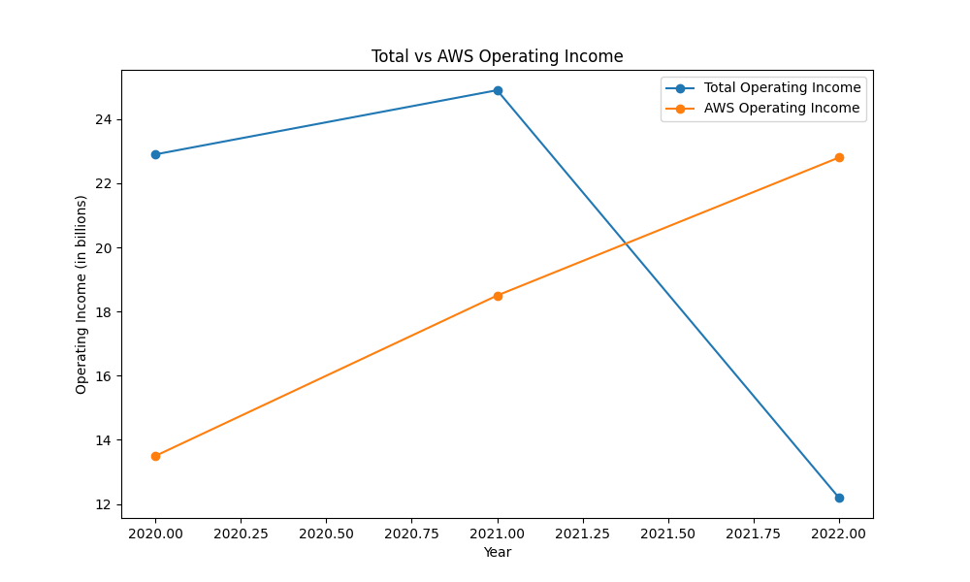
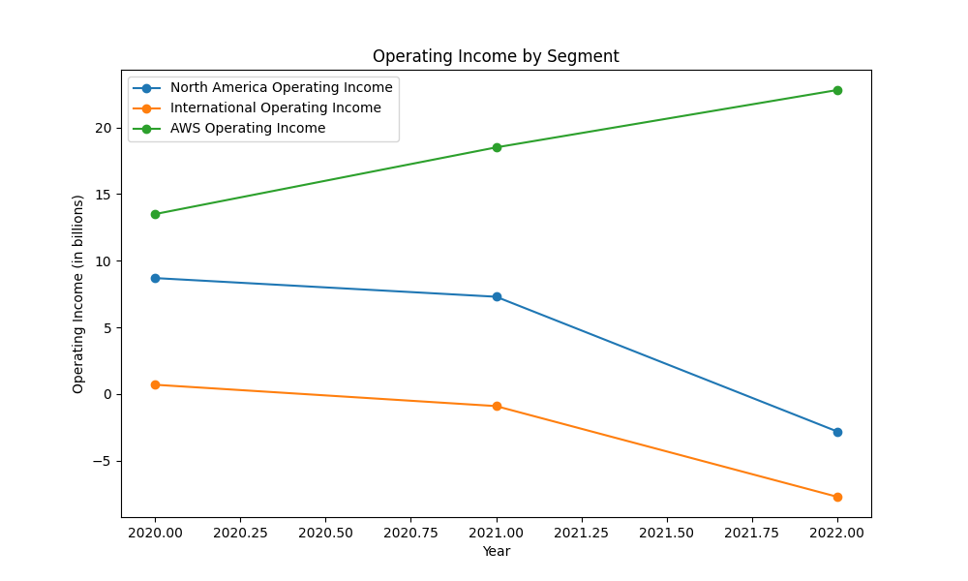
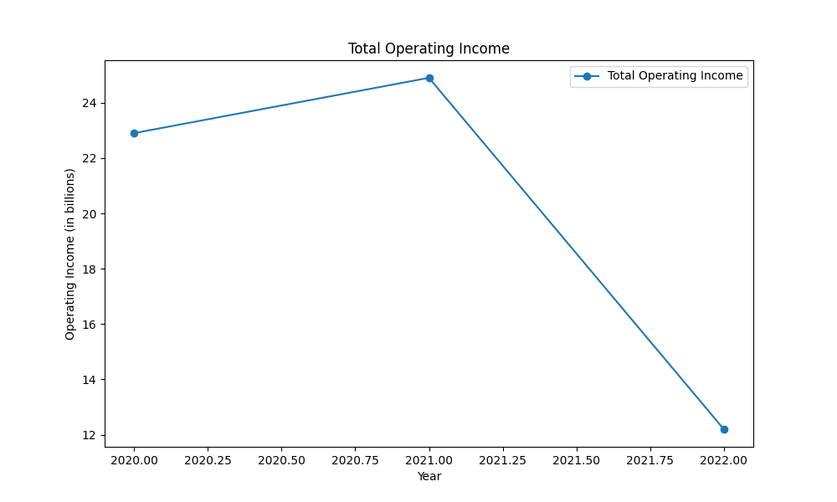
operatingincome figures

Slide 14
Cash Flow
Amazon's cash flow has shown significant changes over the analyzed years. Operating Activities: - 2020: \$66.1 billion - 2021: \$46.3 billion - 2022: \$46.8 billion The decline from 2020 to 2021 ($19.8 billion) and stability from 2021 to 2022 indicate fluctuations in net income and working capital changes. Investing Activities: - 2020: \$59.6 billion used - 2021: \$58.2 billion used - 2022: \$37.6 billion used Significant investments primarily in technology infrastructure and fulfillment networks. Financing Activities: - 2020: \$1.1 billion used - 2021: \$6.3 billion provided - 2022: \$9.7 billion provided Increased financing activities mainly due to debt proceeds. Free Cash Flow: - 2021: \$9.1 billion used - 2022: \$11.6 billion used The downward trend in free cash flow results from increasing property and equipment expenditures. Overall, Amazon's strategy focuses on long-term growth through heavy investments, while maintaining substantial operating cash flow reflects a balanced approach to supporting expansive business initiatives.

Slide 15
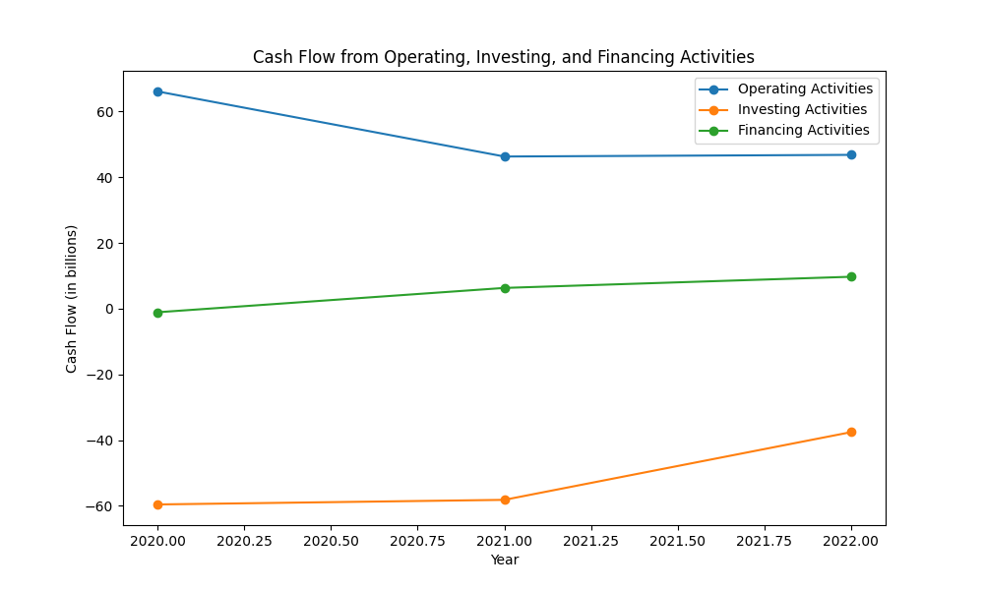
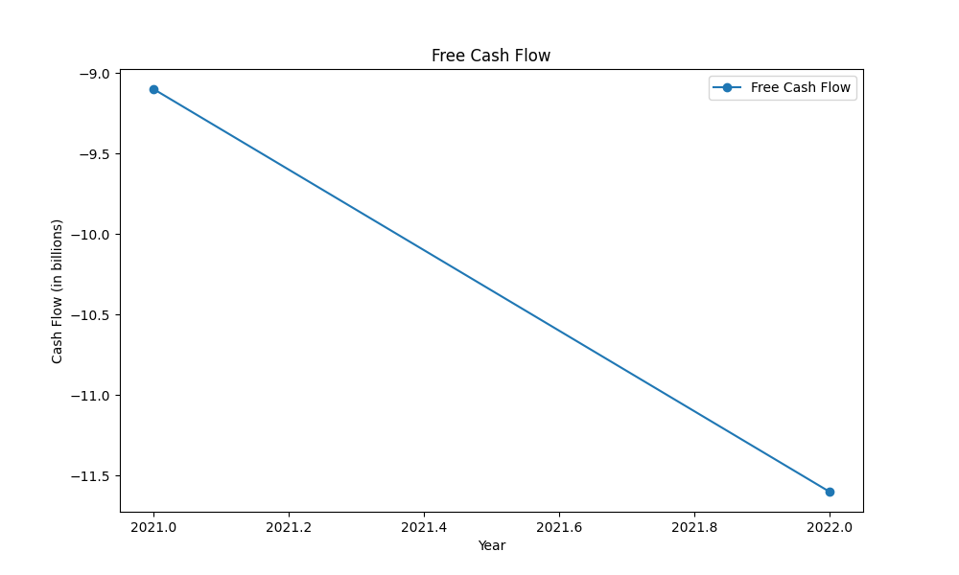
cashflow figures

