Slide 1
Amazon.com, Inc. Analysis

Slide 2
Business Overview
Amazon's business overview has evolved significantly over time. Initially launched as an online bookstore in 1994, the company rapidly expanded to offer a wide range of products, including electronics, apparel, and home goods. By leveraging technology and focusing on customer experience, Amazon introduced features like customer reviews, personalized recommendations, and one-click purchasing. Over the years, the company diversified its business model, entering new markets such as cloud computing with Amazon Web Services (AWS) in 2006, which quickly became a significant revenue driver. In addition to e-commerce and cloud services, Amazon ventured into physical retail with the acquisition of Whole Foods Market in 2017, aiming to revolutionize grocery shopping. Amazon also explored healthcare services and digital advertising. Through acquisitions and strategic investments, the company continually broadened its product and service offerings, enhancing convenience and value for customers. The strategic emphasis on innovation, customer focus, and operational excellence has been the cornerstone of Amazon's growth, transforming it from a simple online retailer into a global technology giant dominating various sectors such as e-commerce, cloud computing, and digital services.

Slide 3
Revenue
Between 2020 and 2022, Amazon's revenue exhibited substantial growth, reflecting the company's expanding market presence and diversified offerings. The total consolidated revenue increased from $386.06 billion in 2020 to $469.82 billion in 2021, and further to $513.98 billion in 2022. North America consistently contributed the largest segment of net sales, growing from $236.28 billion in 2020 to $279.83 billion in 2021, and reaching $315.88 billion in 2022. The AWS (Amazon Web Services) segment followed, with impressive growth from $45.37 billion in 2020 to $62.20 billion in 2021, and $80.10 billion in 2022. This growth was primarily driven by increased customer usage, despite some pricing changes. Meanwhile, the International segment grew from $104.41 billion in 2020 to $127.79 billion in 2021, but saw a decline to $118.01 billion in 2022, reflecting the impact of foreign currency exchange rate changes. Overall, Amazon's diverse revenue streams from online and physical stores, third-party seller services, subscription services, advertising, and AWS have enabled consistent revenue growth over the observed period.

Slide 4
PBT MARGIN
The PBT (Profit Before Tax) margin of Amazon has exhibited significant changes over the years. Here is the data extracted from the financial statements: Years for Analysis: - 2020, 2021, and 2022 PBT Calculation: PBT is derived by taking the operating income and adding/subtracting other non-operating incomes/expenses. Data from 2020 to 2022: - 2020: - Operating Income: $22.9 billion - Other Income (Expense), Net: $2.3 billion - Revenue: $386.1 billion - Sum: $25.2 billion - PBT Margin = 25.2 / 386.1 = 6.5% - 2021: - Operating Income: $24.9 billion - Other Income (Expense), Net: $14.6 billion - Revenue: $469.8 billion - Sum: $39.5 billion - PBT Margin = 39.5 / 469.8 = 8.4% - 2022: - Operating Income: $12.2 billion - Other Income (Expense), Net: $(16.8) billion (loss) - Revenue: $514.0 billion - Sum: $(4.6) billion (loss) - PBT Margin = -4.6 / 514.0 = -0.9% Analysis: From the data above, the PBT margin saw an increasing trend from 2020 (6.5%) to 2021 (8.4%), due to a substantial rise in other income. However, in 2022, Amazon experienced a dramatic decline to a negative PBT margin (-0.9%), mainly attributed to significant losses in other income, reflecting challenges in marketable equity security valuations and increased operating expenses. This illustrates how variability in both operational performance and non-operational factors such as market investments can affect Amazon's financial health across years.

Slide 5
Operating Income
Amazon's Operating Income has shown significant fluctuations over the observed timeframe. It increased from $22.9 billion in 2020 to $24.9 billion in 2021 before decreasing dramatically to $12.2 billion in 2022. Breaking it down by segment, the North America segment's operating income decreased from $7.3 billion in 2021 to a loss of $2.8 billion in 2022. This decline is primarily attributed to increased fulfillment and shipping costs, as well as higher technology, content and operational expenses. The International segment fared worse, shifting from a loss of $0.9 billion in 2021 to a loss of $7.7 billion in 2022. The substantial increase in loss is mainly due to elevated fulfillment and shipping costs and the negative impact of changes in foreign currency exchange rates. Conversely, AWS has demonstrated continuous growth, with operating income climbing from $13.5 billion in 2020 to $18.5 billion in 2021, and further to $22.8 billion in 2022. Improvements in cost structure productivity and increased sales volume contribute to this positive trend, indicating a robust performance in the AWS segment.

Slide 6
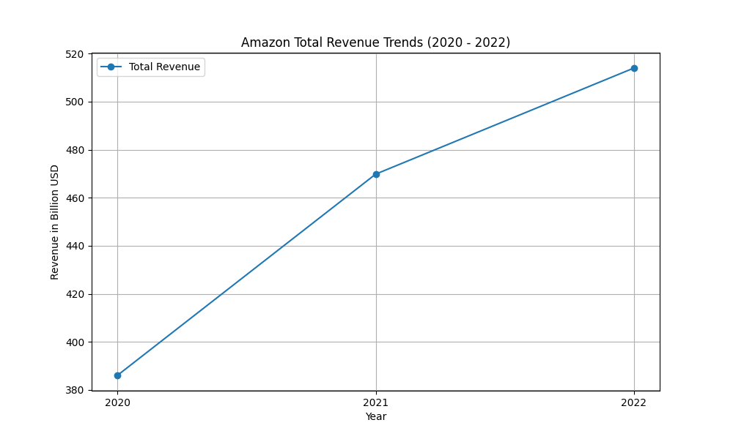
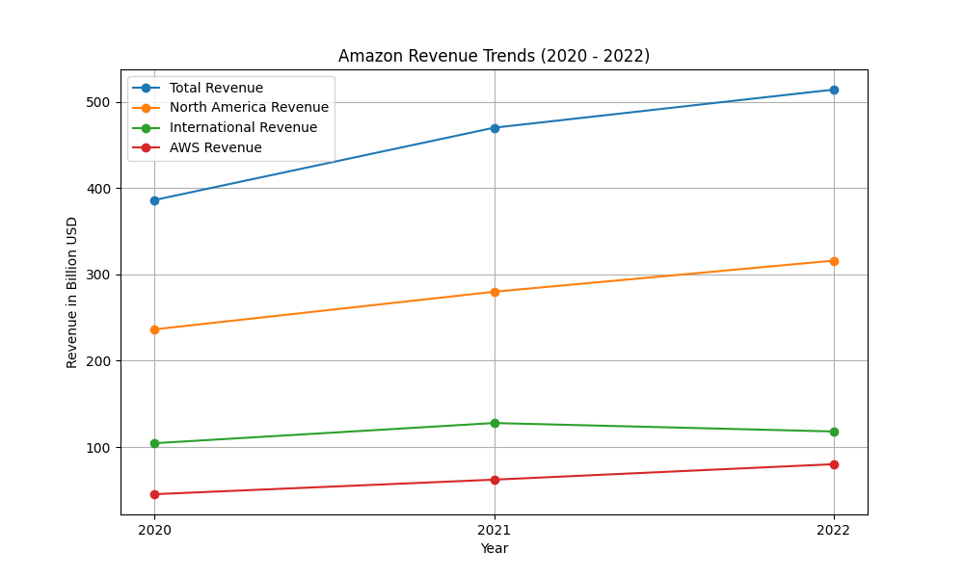
revenue figures

Slide 7
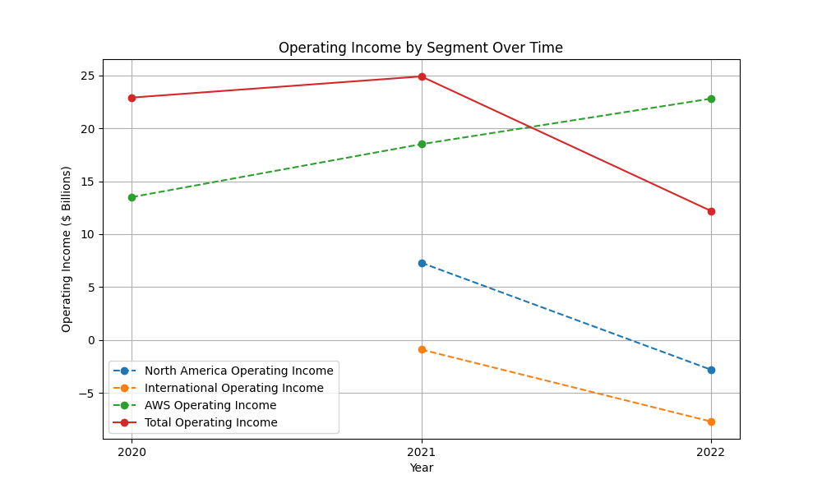
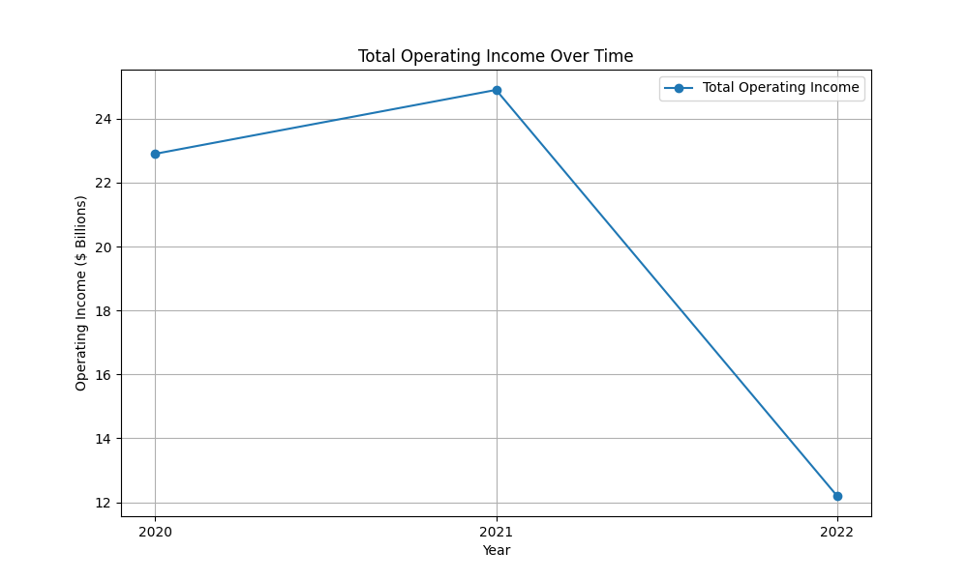
operatingincome figures

Slide 8
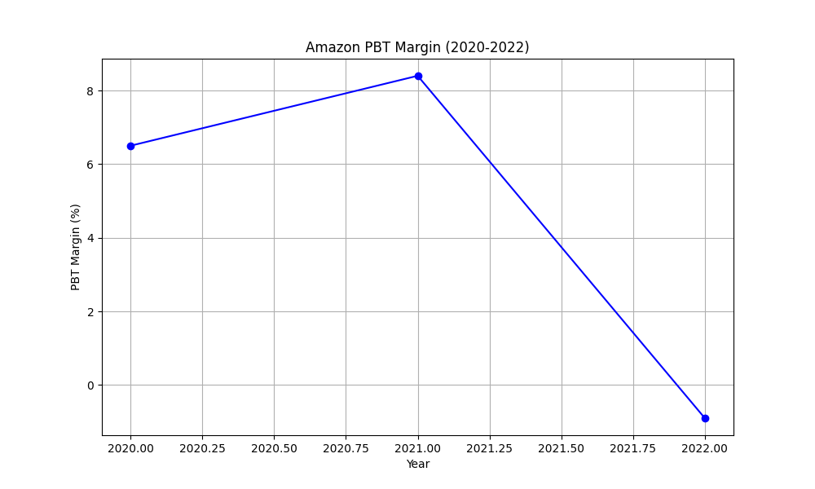
pbtmargin figures

