Slide 1
Company Analysis

Slide 2
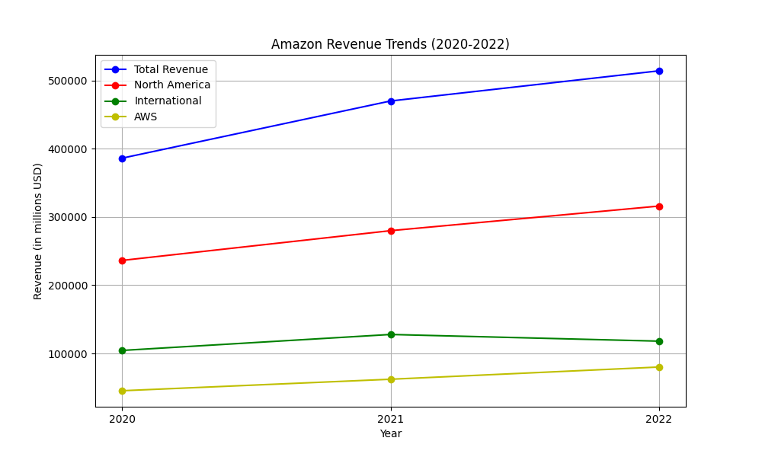
Revenue Analysis
Amazon's revenue has shown consistent growth from 2020 to 2022. The net sales increased from $386.06 billion in 2020 to $469.82 billion in 2021 (a 22% increase), and further to $513.98 billion in 2022 (a 9% increase)【4†source】【16†source】. The growth was primarily driven by the North America and AWS segments. North America's net sales increased from $236.28 billion in 2020 to $279.83 billion in 2021, and $315.88 billion in 2022. AWS sales grew significantly from $45.37 billion in 2020 to $62.20 billion in 2021, reaching $80.10 billion in 2022【16†source】【16†source】. The primary revenue streams for Amazon include online stores, physical stores, third-party seller services, subscription services, advertising services, and AWS. Among these, AWS showed the highest growth rate, increasing from $45.37 billion in 2020 to $80.10 billion in 2022【16†source】. Geographically, the United States was the largest contributor to net sales, growing from $263.52 billion in 2020 to $356.11 billion in 2022【12†source】. Revenue derived from services such as third-party seller services, subscription services, and advertising services also saw substantial increases, highlighting the diversified growth avenues beyond traditional retail【12†source】. Derivatives of the trend include the proportional growth contributions of AWS and service-based revenues, indicating a shift in business focus towards high-margin technology services.

Slide 3
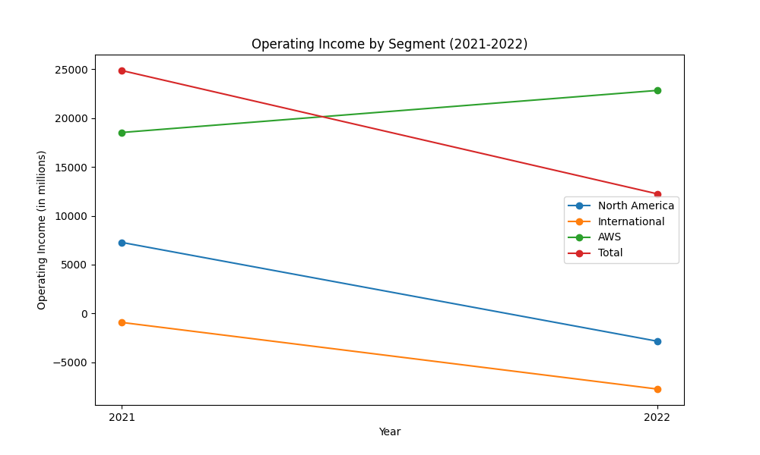
Operating Income Analysis
Amazon's operating income over recent years has shown significant fluctuations. In 2020, the company's operating income was $22.9 billion. This increased slightly in 2021 to $24.9 billion. However, in 2022, the operating income dropped notably to $12.2 billion (source: Amazon 2022 Annual Report, page 37)【4:0†source】【4:4†source】. A breakdown of operating income by segment reveals further insights. In North America, operating income decreased drastically from $7.271 billion in 2021 to an operating loss of $2.847 billion in 2022. Similarly, the International segment experienced a deepened operating loss, going from -$924 million in 2021 to -$7.746 billion in 2022. Conversely, Amazon Web Services (AWS) saw an increase in operating income from $18.532 billion in 2021 to $22.841 billion in 2022 (source: Amazon 2022 Annual Report, page 24)【4:8†source】【4:10†source】. This decline in overall operating income is attributed mainly to increased fulfillment and shipping costs, technology and content investments, and higher wage rates in both North America and International segments. Meanwhile, AWS's growth has helped mitigate some of these adverse impacts due to improved sales and cost structure productivity (source: Amazon 2022 Annual Report, page 24)【4:13†source】【4:16†source】.

Slide 4
Other KPIs
- PBT Margin (Net income / Net sales): - 2021: $33,364M / $469,822M = 7.1% - 2022: -$2,722M / $513,983M = -0.5% The PBT margin significantly decreased from 7.1% (2021) to -0.5% (2022) due to a net loss in 2022【4:0†source】【4:8†source】. - Income to Cost Ratio (Net income / Total operating expenses): - 2021: $33,364M / $444,943M = 7.5% - 2022: -$2,722M / $501,735M = -0.5% The income to cost ratio dropped from 7.5% in 2021 to -0.5% in 2022, indicating inefficiencies and increased expenses【4:0†source】【4:8†source】. - Return on Tangible Equity (Net income / Average stockholders' equity): - 2021: $33,364M / (($138,245M + $93,404M) / 2) = 28.9% - 2022: -$2,722M / (($146,043M + $138,245M) / 2) = -1.9% ROE fell from 28.9% in 2021 to -1.9% in 2022, driven by net losses in 2022【4:0†source】【4:11†source】. - Net Interest Margin (Interest income - Interest expense / Earning assets): - Implementation details not available due to lack of disaggregated interest income data. There was a general decline in profitability and return metrics, primarily influenced by increased costs, inefficiencies, and net losses reported in 2022 compared to 2021.

