Slide 1
Predictive Maintenance of Industrial Machinery
Presented By:
Devanjana Ghosh Academy Of Technology
MCA

Slide 2
OUTLINE
Problem Statement
Proposed System/Solution
System Development Approach
Algorithm & Deployment
Result (Output Image)
Conclusion
Future Scope
References

Slide 3
Problem Statement
Modern industries rely on machinery that may unexpectedly fail, causing production downtime, increased costs, and significant disruptions to production lines. Traditional reactive maintenance strategies are often insufficient, leading to longer repair times and unplanned shutdowns. This project aims to predict various types of failures (e.g., tool wear, heat dissipation, power failure) before they happen using real-time sensor data from machines. Early identification of faults can reduce maintenance costs, improve equipment life and efficiency, and enable industries to implement condition-based maintenance strategies. By leveraging predictive analytics, industries can shift from reactive to proactive maintenance, enhancing productivity and operational reliability.

Slide 4
Proposed Solution
The proposed system addresses the challenge of predicting industrial machinery failures by leveraging machine learning and IBM Cloud technologies. The solution is built and deployed using IBM Watson Studio with the help of AutoAI for automated pipeline generation and optimization.
Data Collection:
Utilize the Kaggle dataset with sensor readings such as rotational speed, torque, temperature, and tool wear. Collect real-time operational data from machines.
Data Preprocessing:
Handle missing values, normalize data, and encode categorical features. Perform feature selection to improve model performance.Machine Learning Algorithm:
Model Selection and Training:
Snap Random Forest Classifier was selected as the best-performing model. Achieved 99.7% accuracy on the holdout dataset with high precision and recall scores across all classes.
Deployment:
Deploy the model on IBM Watson Studio using IBM Cloud Lite services. Use AutoAI for model optimization and performance tuning.
Evaluation:
Model performance was validated using metrics like ROC curves, confusion matrix, and precision-recall curves. The finalized model was deployed on IBM Cloud as a REST API for real-time predictions.
Result: Model Accuracy is 99.7% (Holdout score)

Slide 5
System Approach
To address the challenge of predicting machinery failures, a cloud-based automated machine learning workflow was implemented. The solution leverages IBM Cloud services to handle data processing, model building, evaluation, and deployment, ensuring scalability, automation, and real-time monitoring for industrial use.
System Requirements:
IBM Cloud Lite account with Watson Studio enabled
AutoAI for automated model generation and evaluation
IBM Cloud Object Storage for dataset hosting and retrieval
Deployment space for publishing and testing REST APIs
Libraries & Tools Used:
IBM Watson Studio’s AutoAI (built-in models like Snap Random Forest, Decision Tree)
Python (for additional metrics, visualization, and preprocessing using Pandas, Scikit-learn, Matplotlib)
REST API interface for integration with industrial systems and dashboards.
This approach enables predictive maintenance by automating the entire ML lifecycle — from data ingestion to real-time failure prediction, helping industries reduce downtime and maintenance costs.

Slide 6
Algorithm & Deployment
Algorithm Selection:
Snap Random Forest Classifier was chosen as the primary algorithm for its ability to handle complex and nonlinear patterns effectively in multi-class classification problems. It was the top-performing model among several tested using AutoAI, including SVM, Logistic Regression, and Decision Tree.
Data Input:
The model was trained using the attributes such as Air Temperature,
Process Temperature, Type (categorical) etc which extracted from the dataset.
Training Process:
Data preprocessing included handling null values and normalizing numerical features.
AutoAI handled model selection and hyperparameter tuning across multiple pipelines.
Prediction Process:
The deployed model accepts real-time machine input data in JSON or CSV format. It predicts the most likely failure type (e.g., tool wear, power failure) with a corresponding confidence score.
The results are visualized and can be used for alerting and triggering maintenance tasks.

Slide 7
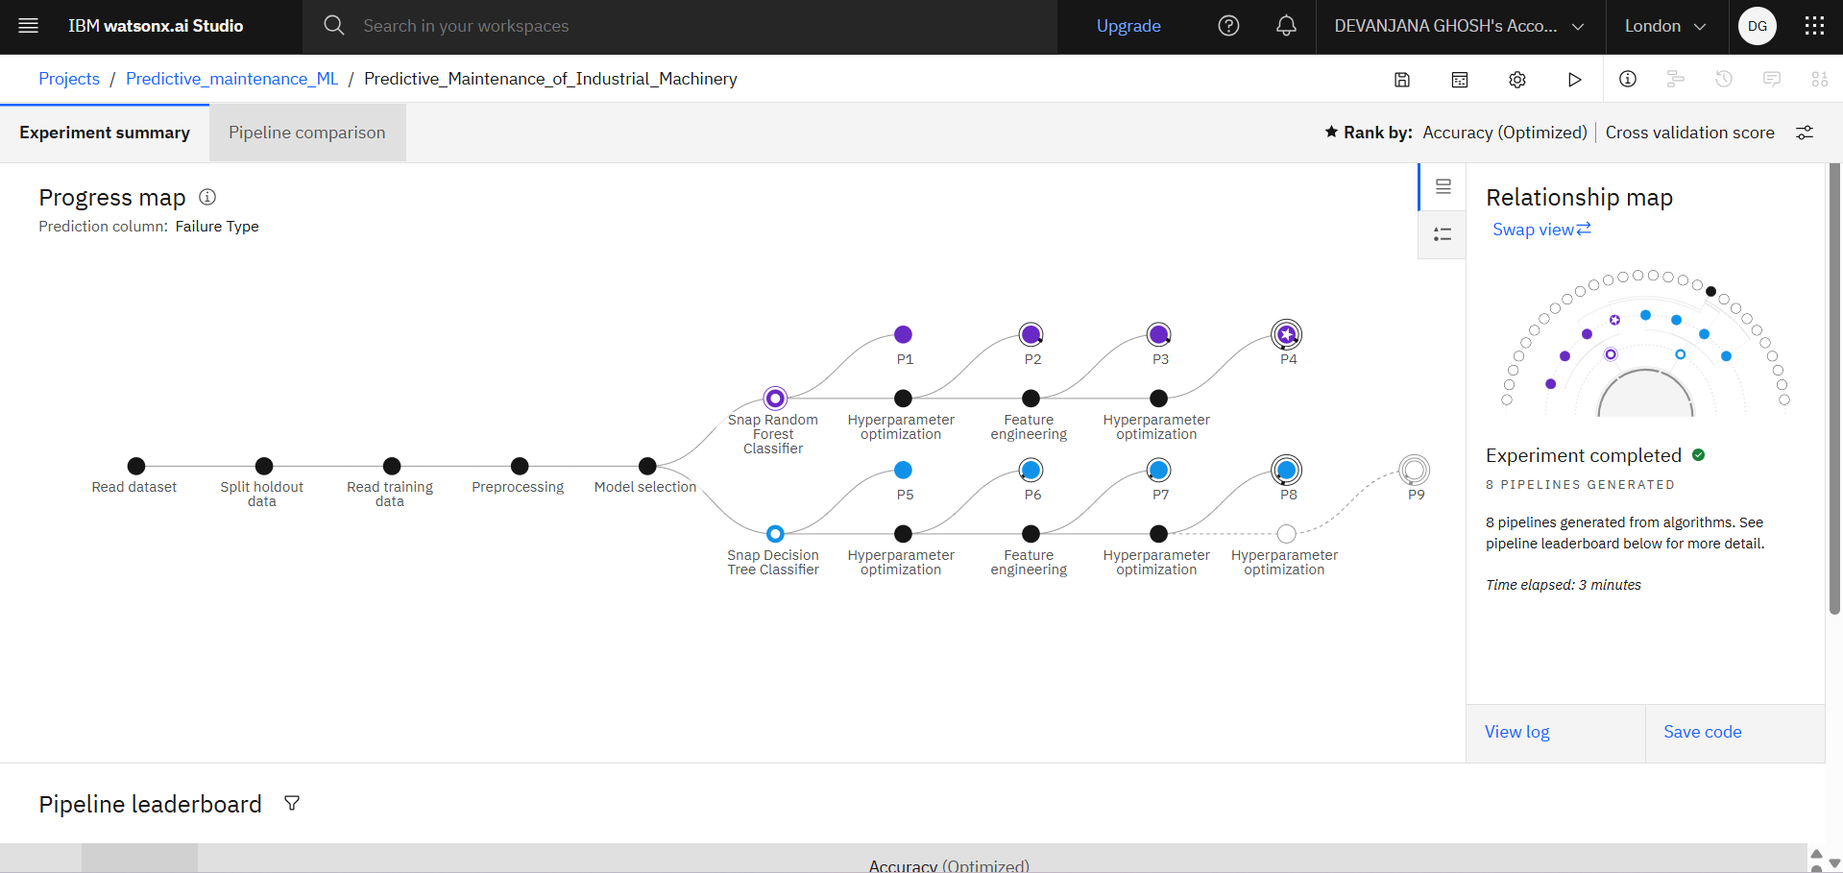
Result
Model Accuracy: 99.7% (Holdout score)

Slide 8
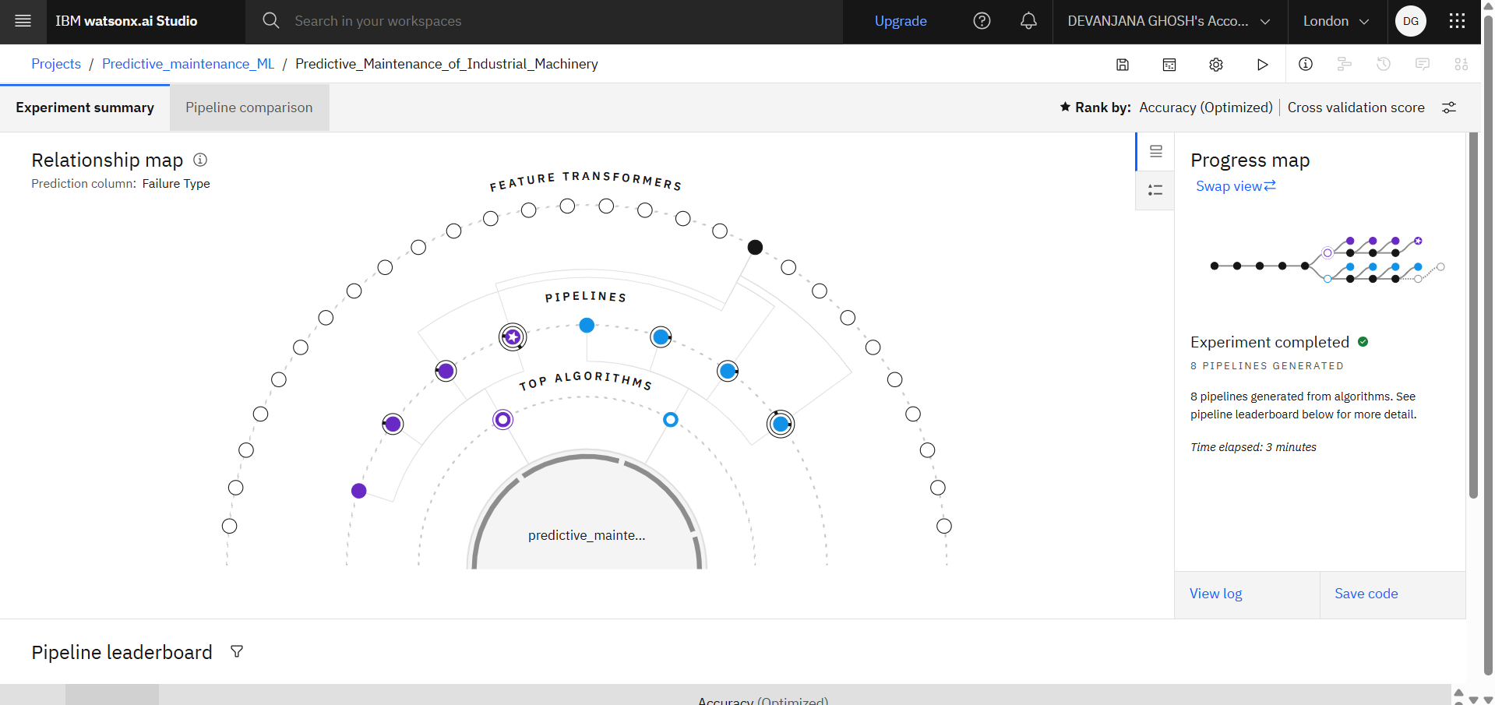

Slide 9
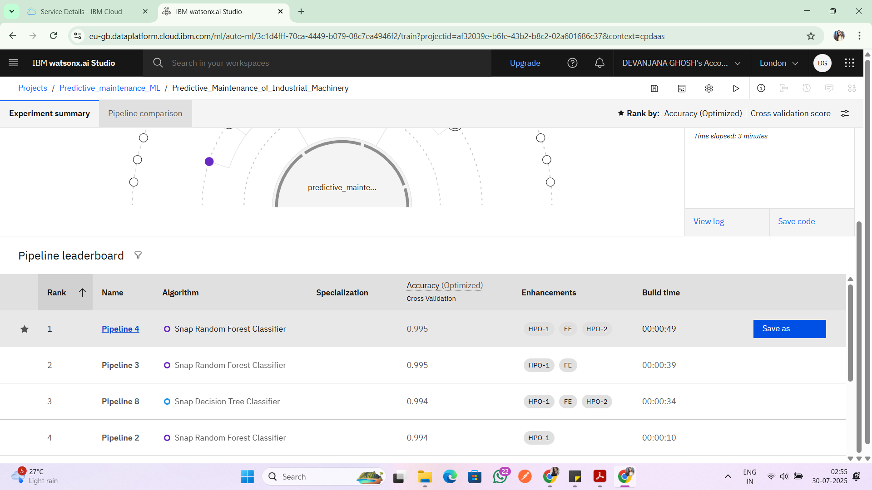

Slide 10
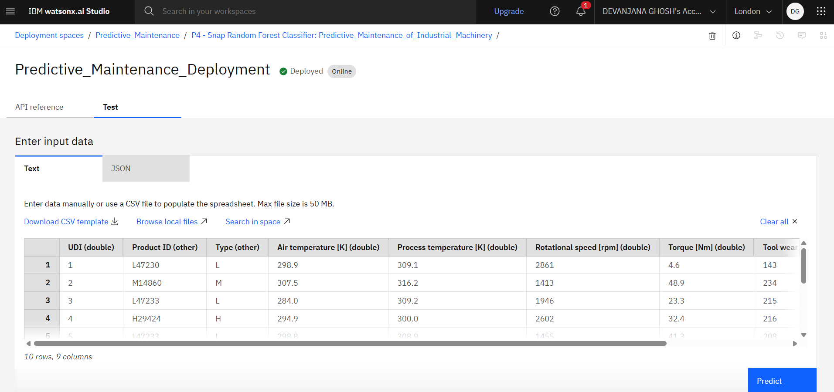

Slide 11
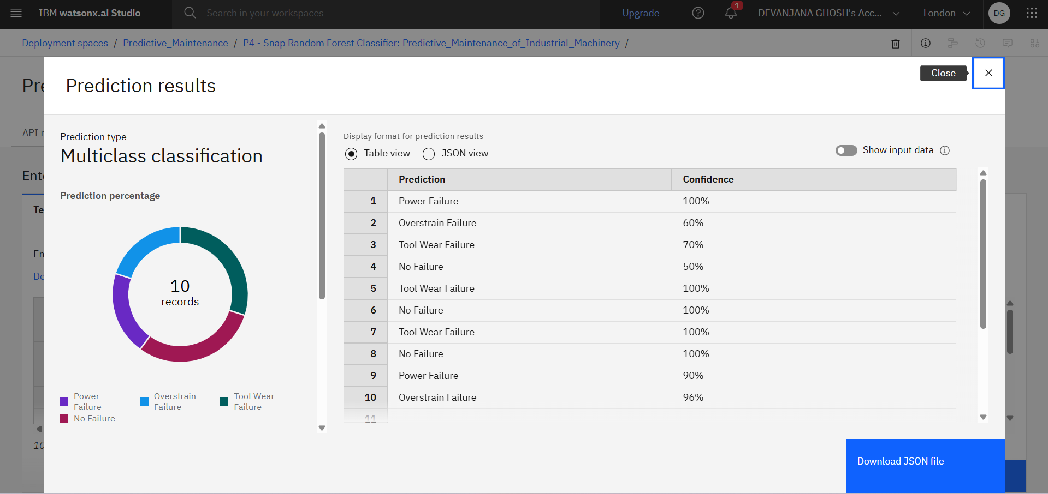

Slide 12
Conclusion
The project successfully developed and deployed a predictive maintenance system using IBM Watson Studio and AutoAI on IBM Cloud Lite. The Snap Random Forest Classifier demonstrated exceptional performance in classifying multiple machine failure types with a holdout accuracy of 99.7%. This solution not only minimizes machine downtime and operational costs but also enhances equipment reliability and extends machinery lifespan. The seamless integration of REST APIs further enables real-time predictions and alerts for industrial teams, fostering smarter and more responsive maintenance strategies.

Slide 13
Future scope
The current system forms a solid base for predictive maintenance and can be enhanced further. Future improvements include using LSTM/GRU models for better time-series predictions, deploying models on edge devices for faster response, and integrating multimodal data like images or sound for deeper insights. The solution can be extended across industries and linked with smart schedulers for automated maintenance. A real-time IBM Cloud dashboard can also improve monitoring and decision-making.

Slide 14
References
Kaggle Dataset – Predictive Maintenance Dataset
IBM Watson Studio Documentation
AutoAI Overview in Watson Studio

Slide 15
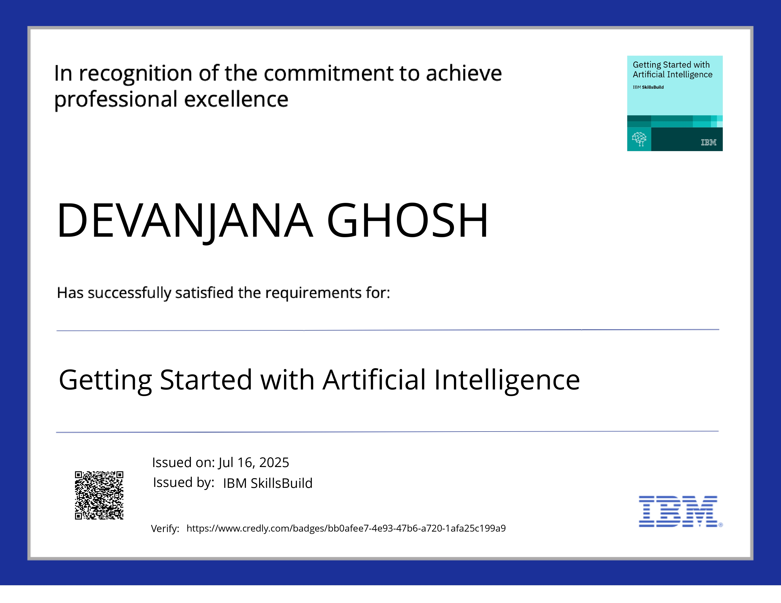
IBM Certifications

Slide 16

IBM Certifications

Slide 17

IBM Certifications

Slide 18
THANK YOU

