Slide 1
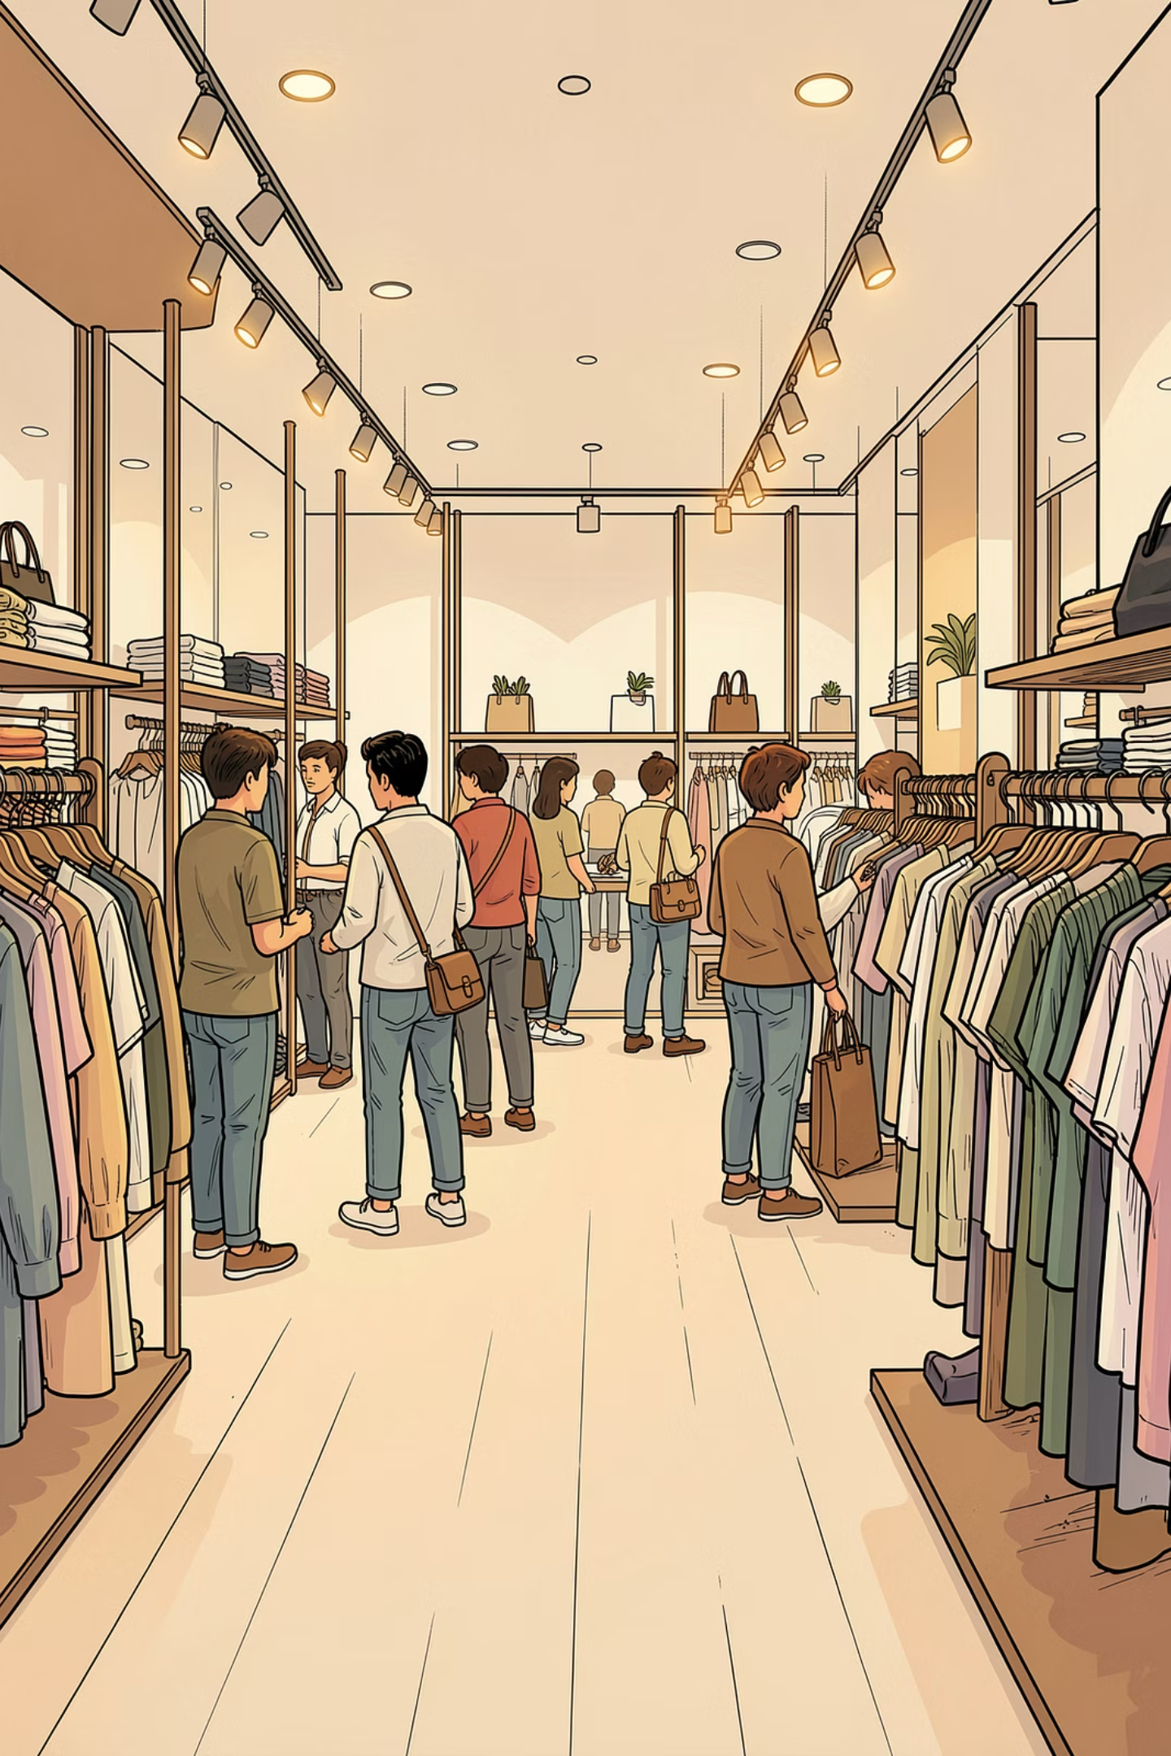
Customer Shopping Behavior Analysis
A comprehensive data-driven study of 3,900 transactions across product categories — uncovering spending patterns, customer segments, product preferences, and subscription behavior to guide strategic business decisions.
DATA ANALYSIS PROJECT
PYTHON · SQL · POWER BI

Slide 2
Dataset at a Glance
The dataset contains 3,900 rows and 18 columns, covering customer demographics, purchase details, and shopping behavior. Only 37 values were missing — all in the Review Rating column.
3,900
18
Total Purchases
Features
Transactional records analyzed
Columns spanning demographics, purchases, and behavior
37
25
Missing Values
Unique Items
All in Review Rating — imputed by category median
Products across 4 categories
Demographics
Purchase & Behavior
Age, Gender, Location
Subscription Status
Item, Category, Amount, Season, Size, Color
Discount, Previous Purchases, Frequency, Review Rating, Shipping Type

Slide 3

Data Preparation in Python
The analysis pipeline began in Python with pandas for data loading, cleaning, and feature engineering before loading into MySQL.
01
Load & Explore
Imported dataset with pandas; used df.info() and .describe() for structure and statistics.
02
Handle Missing Data
Imputed 37 missing Review Rating values using the median rating per product category.
03
Standardize & Engineer
Renamed columns to snake_case; created age_group bins and purchase_frequency_days. Verified discount_applied and promo_code_used were redundant — dropped the latter.
04
Database Integration
Connected Python to MySQL and loaded the cleaned DataFrame for SQL analysis.

Slide 4
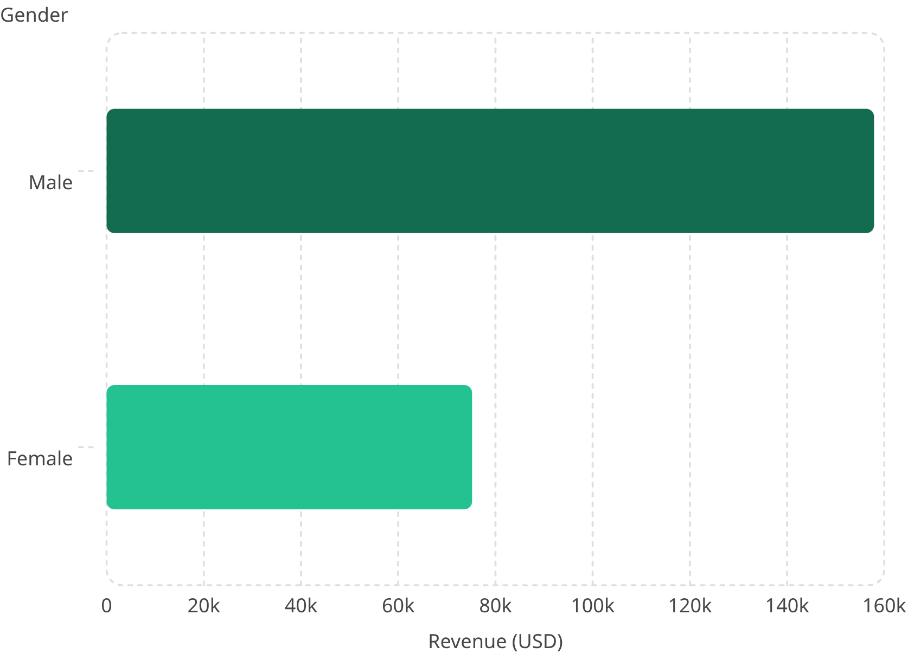
Revenue by Gender & High-Spending Discount Users
Revenue by Gender
High-Spending Discount Users
Customers who used discounts but still spent above the average purchase amount ($59.76) represent high-value, deal-seeking shoppers — a prime segment for loyalty incentives.
Customer ID
Purchase Amount
2
$64
3
$73
4
$90
7
$85
9
$97
12
$68
13
$72
Male customers generated $157,890 in revenue — more than double female customers at $75,191. This aligns with the gender split: 2,652 male vs. 1,248 female records.
16
$81

Slide 5
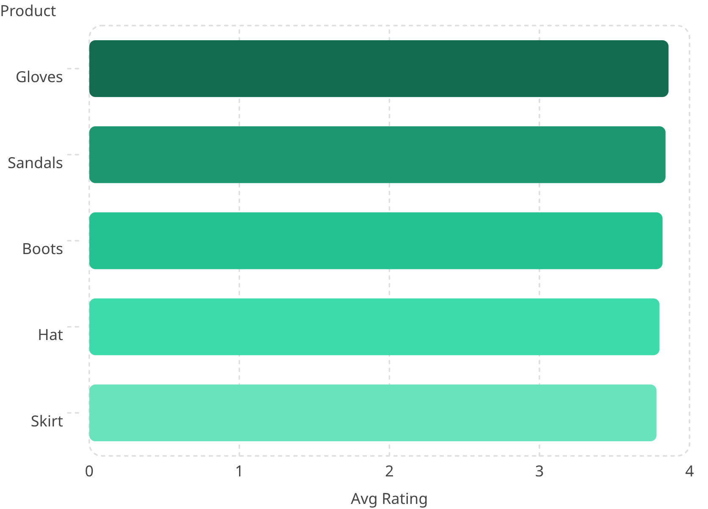
Top-Rated Products & Shipping Analysis
Top 5 Products by Average Rating
Shipping Type Comparison
Express shipping customers spend slightly more on average than Standard shipping customers — a meaningful signal for targeting.
Express
Standard
Avg. Purchase: $60.48
Avg. Purchase: $58.46
Express users spend $2.02 more per transaction on average — a segment worth targeting with premium offers.
Overall average rating: 3.75. Top products cluster tightly between 3.78–3.86, indicating consistent customer satisfaction across categories.

Slide 6
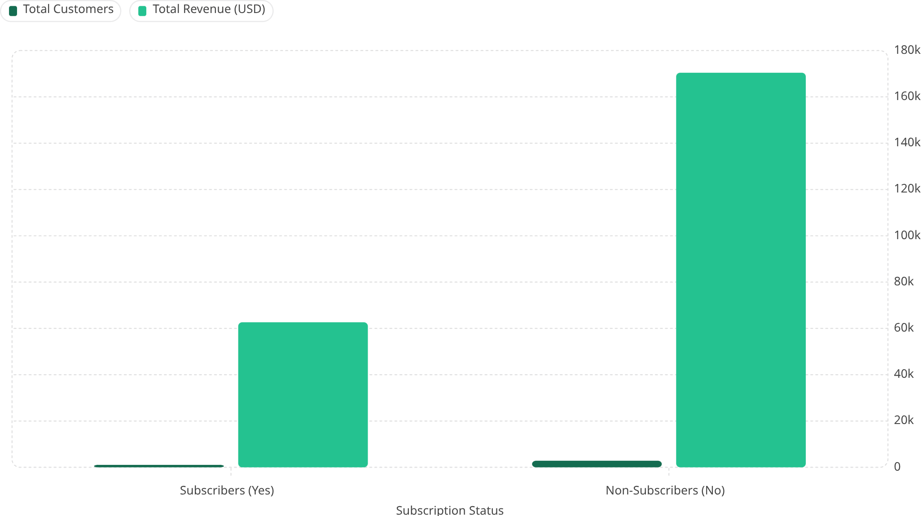
Subscribers vs. Non-Subscribers
While subscribers represent only 27% of customers (1,053 vs. 2,847 non-subscribers), their behavior reveals a key opportunity: non-subscribers drive 73% of total revenue but have a slightly higher average spend ($59.87 vs. $59.49), suggesting untapped conversion potential.
Average Spend
Revenue Share
Repeat Buyers
Subscribers: $59.49 | Non-Subscribers: $59.87 — nearly identical, indicating subscription status doesn't significantly affect per-transaction value.
Non-subscribers account for 73% of total revenue ($170,436). Converting even a fraction would significantly boost recurring revenue.
Of customers with >5 purchases, 2,518 are non-subscribers vs. 958 subscribers — a large pool for subscription conversion campaigns.

Slide 7
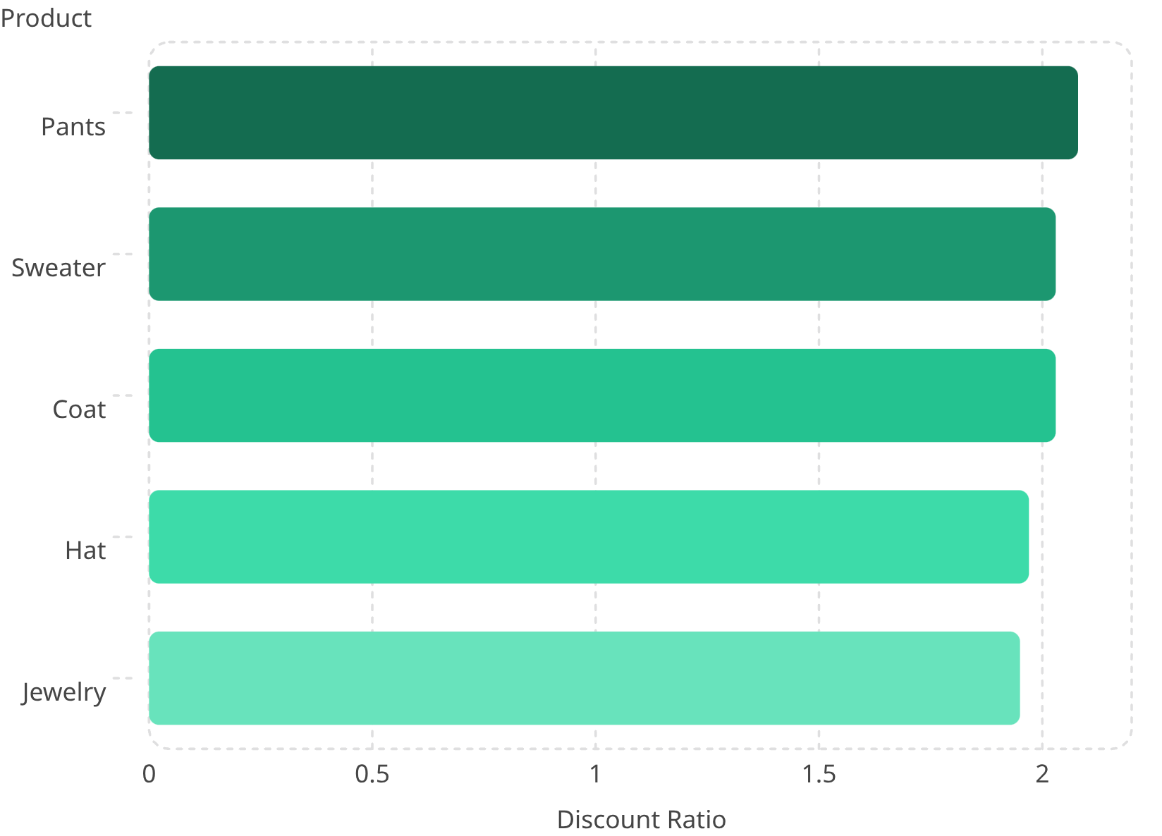
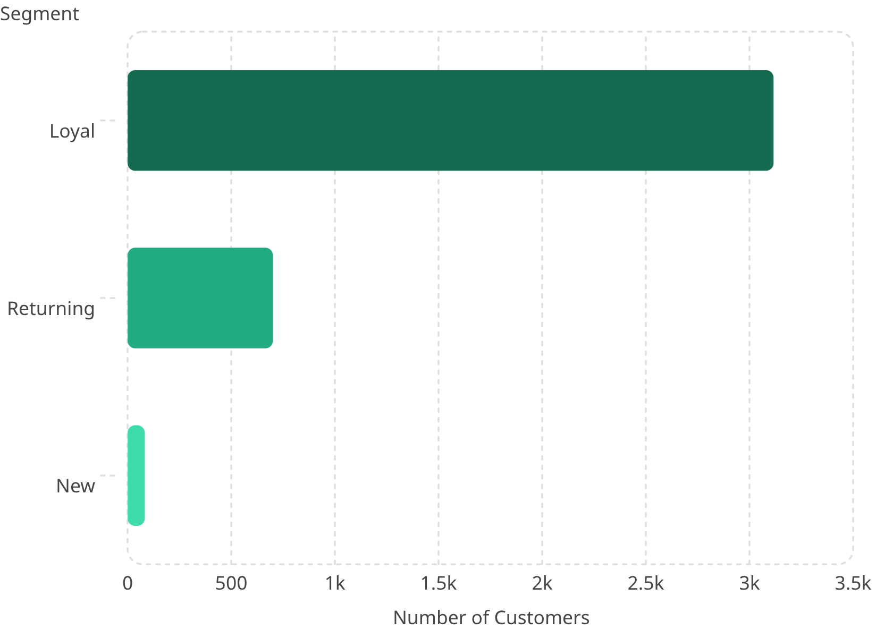
Discount-Dependent Products & Customer Segmentation
Top 5 Discount-Dependent Products
Customer Segmentation
These products had the highest percentage of purchases with discounts applied — indicating strong price sensitivity.
Customers classified into New, Returning, and Loyal segments based on purchase history.
80% of customers are Loyal (3,116), with only 83 New customers — a mature base with low acquisition. Focus should shift to retention and upsell.

Slide 8
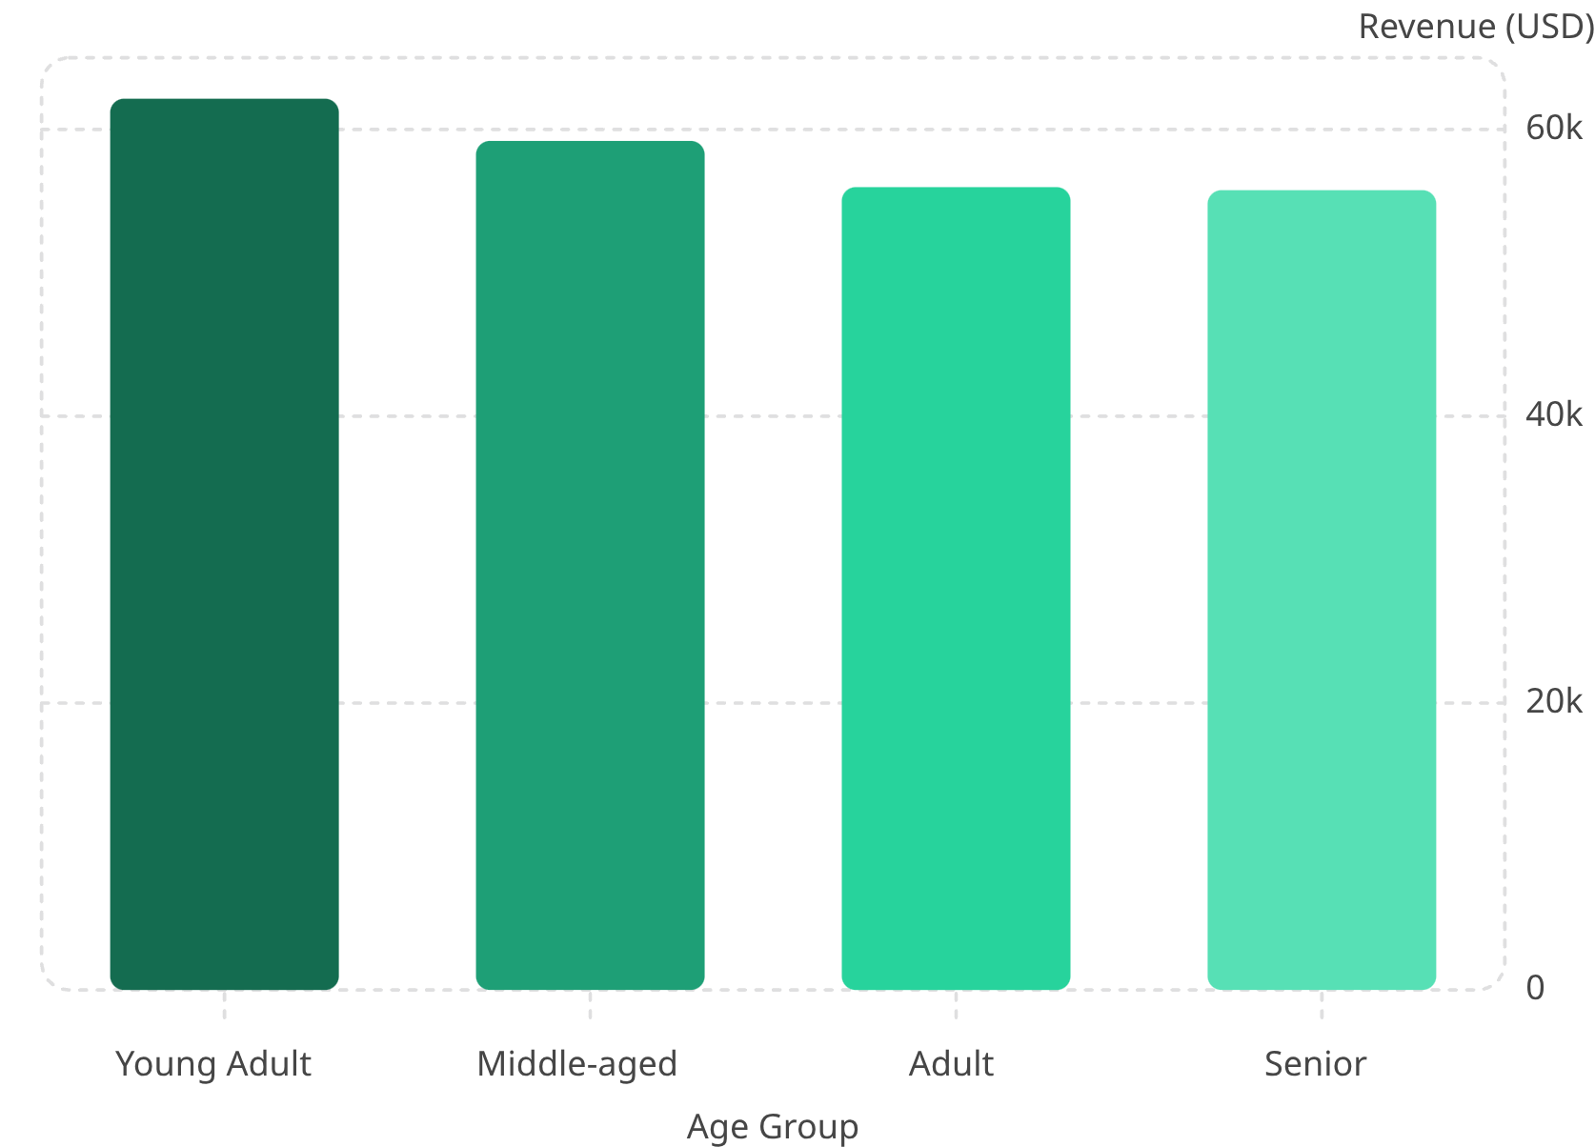
Top Products by Category & Revenue by Age Group
Top 3 Products per Category
Revenue by Age Group
Category
Top Products
Accessories
Jewelry, Belt, Sunglasses
Clothing
Blouse, Pants, Shirt
Footwear
Sandals, Shoes, Sneakers
Outerwear
Jacket, Coat
Clothing dominates with 1,737 purchases — the largest category by volume.
Revenue is surprisingly evenly distributed across age groups. Young Adults lead at $62,143, but the gap to Seniors ($55,763) is only ~11% — no single age group dominates.

Slide 9
Power BI Dashboard
An interactive Power BI dashboard was built to present all insights visually, with filters for subscription status, gender, category, and shipping type.
Key Metrics
Subscription Breakdown
Avg. Purchase: $59.76 | Avg. Rating: 3.75 | Total Customers: 3,900
Donut chart: 27% Subscribers vs. 73% Non-Subscribers
Category Analysis
Age Group Insights
Bar charts for Revenue & Sales across Clothing, Accessories, Footwear, and Outerwear
Horizontal bar charts comparing Sales & Revenue across Young Adult, Middle-aged, Adult, and Senior segments

Slide 10
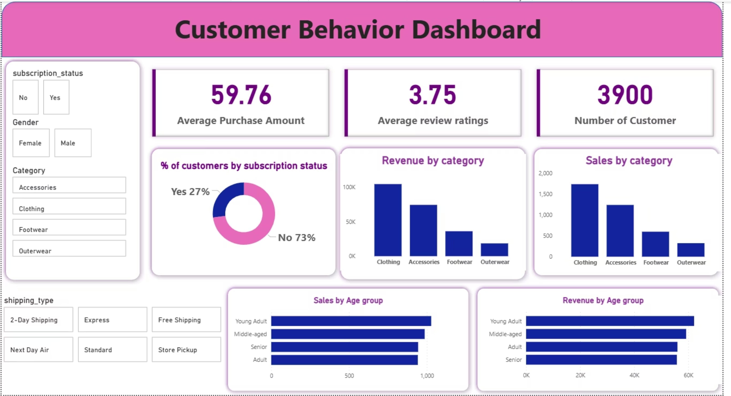

Slide 11


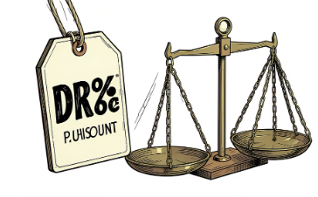

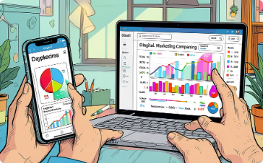
Business Recommendations
Five strategic actions derived from the analysis to drive revenue, retention, and customer lifetime value.
Boost Subscriptions
Customer Loyalty Programs
Review Discount Policy
Product Positioning
Promote exclusive subscriber benefits. With 2,518 repeat buyers unsubscribed, conversion campaigns could unlock significant recurring revenue.
Reward repeat buyers to move them into the "Loyal" segment. 80% are already loyal — deepen engagement with tiered rewards.
Pants, Sweaters, and Coats show high discount dependency. Balance sales boosts with margin control — consider targeted rather than blanket discounts.
Highlight top-rated products (Gloves, Sandals, Boots) and best-sellers (Blouse, Sandals, Jewelry) in marketing campaigns to leverage existing customer satisfaction.
Targeted Marketing
Focus on high-revenue age groups (Young Adults lead at $62,143) and Express shipping users who spend $2+ more per transaction on average.

