Slide 1

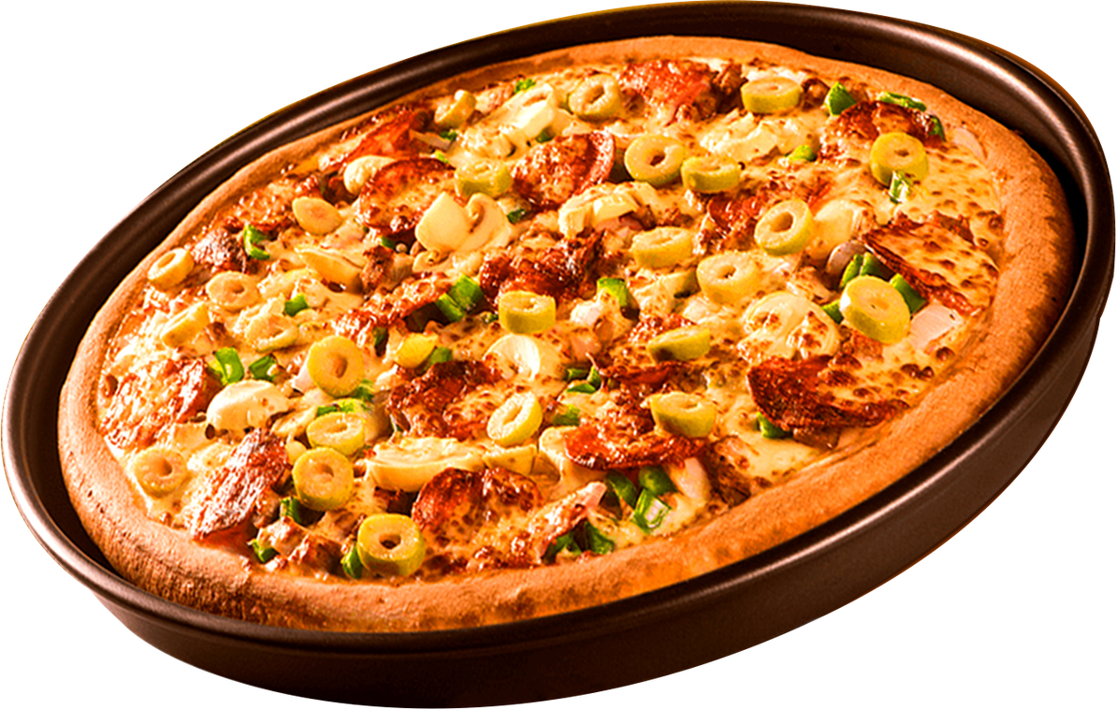


Presented by Devank Verma
PIZZA SALES ANALYSIS
WHERE EVERY SLICE TELLS A STORY

Slide 2

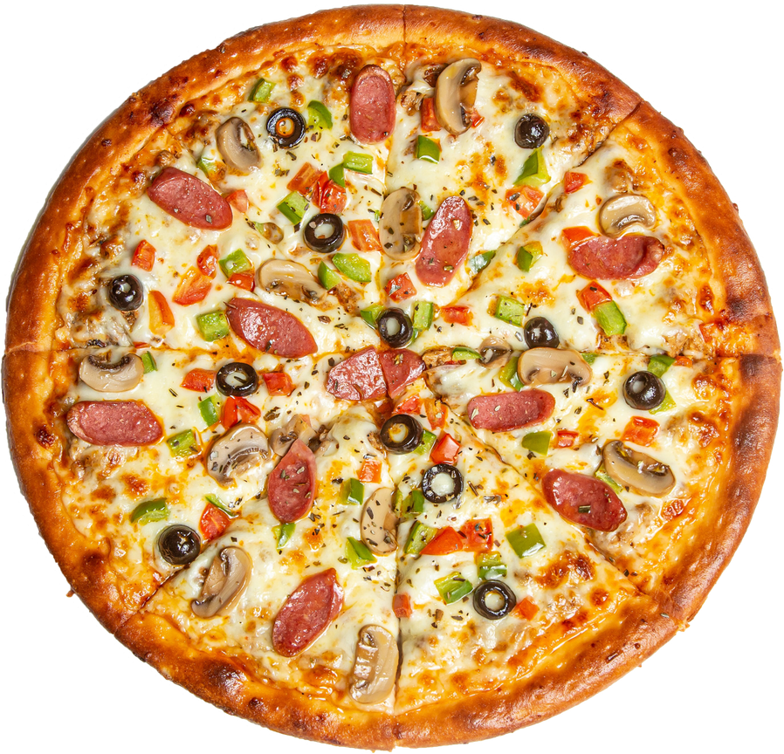
INTRODUCTUION
Home
Contact
In today’s data-driven world, understanding customer behavior and sales trends is crucial for business success, especially in the highly competitive food industry. This project focuses on analyzing pizza sales data to extract meaningful insights that can drive informed business decisions. Using structured SQL queries, key metrics such as top-selling pizzas, peak order times, and revenue distribution were identified. These insights were then visualized using Power BI, resulting in an interactive and dynamic dashboard. The aim of this project is to demonstrate how raw data can be transformed into actionable insights through the integration of data analysis and business intelligence tools.

Slide 3


TOOLS USED
01
02
03
MYSQL
POWERBI

Slide 4


KPI’S REQUIRMENT
About
Contact
TOTAL_REVENUE

Slide 5
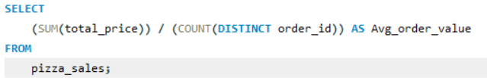
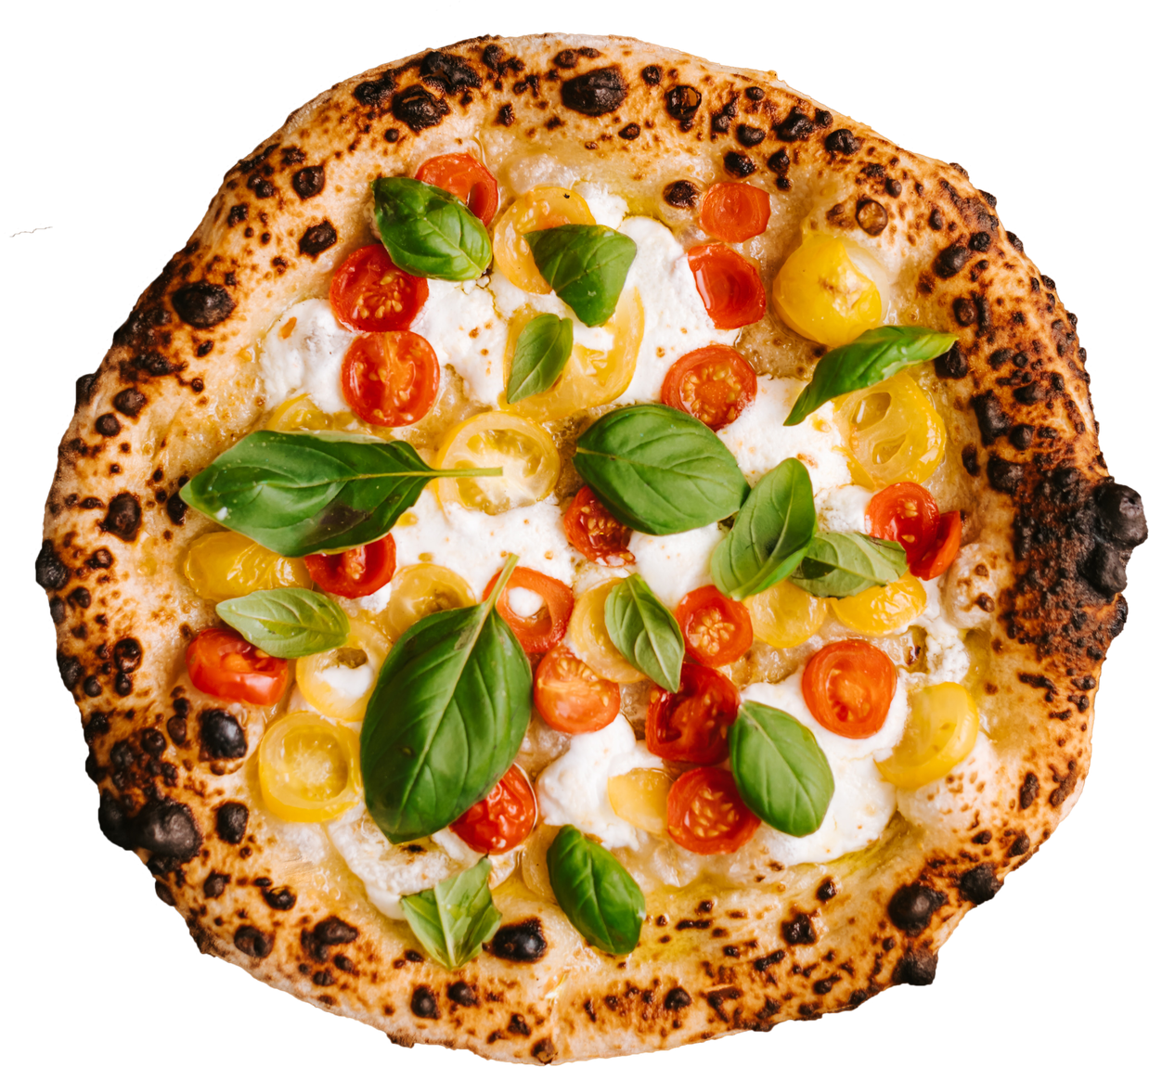

AVG_ORDER_VALUE
Home
About
Contact

Slide 6
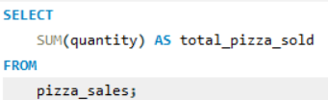
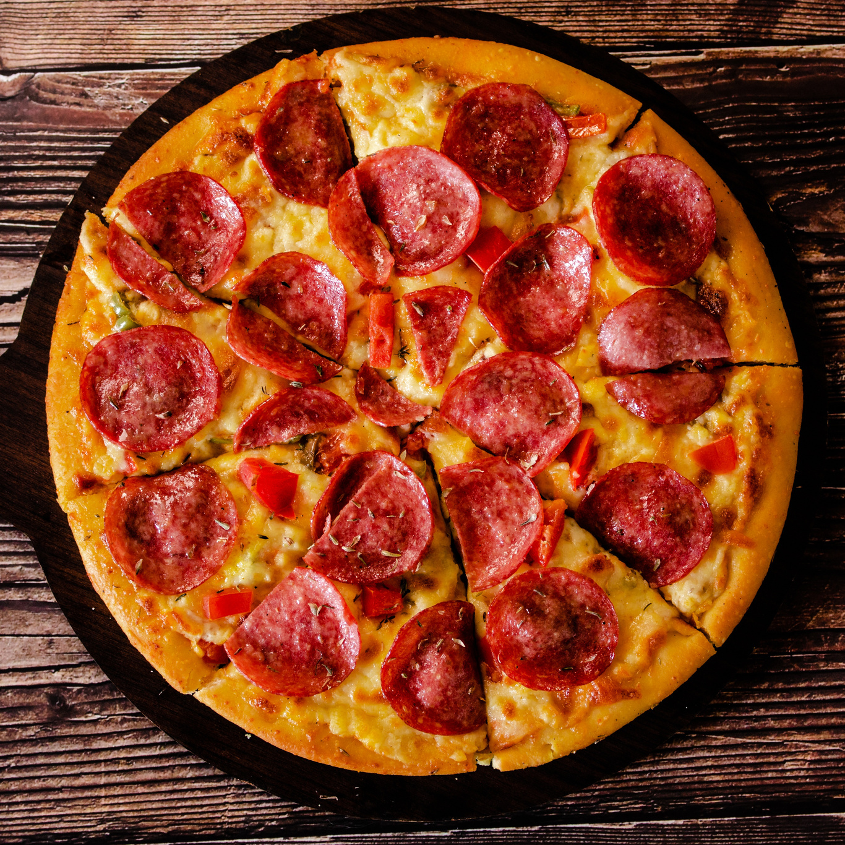

TOTAL_PIZZAS_SOLD

Slide 7
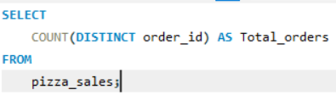
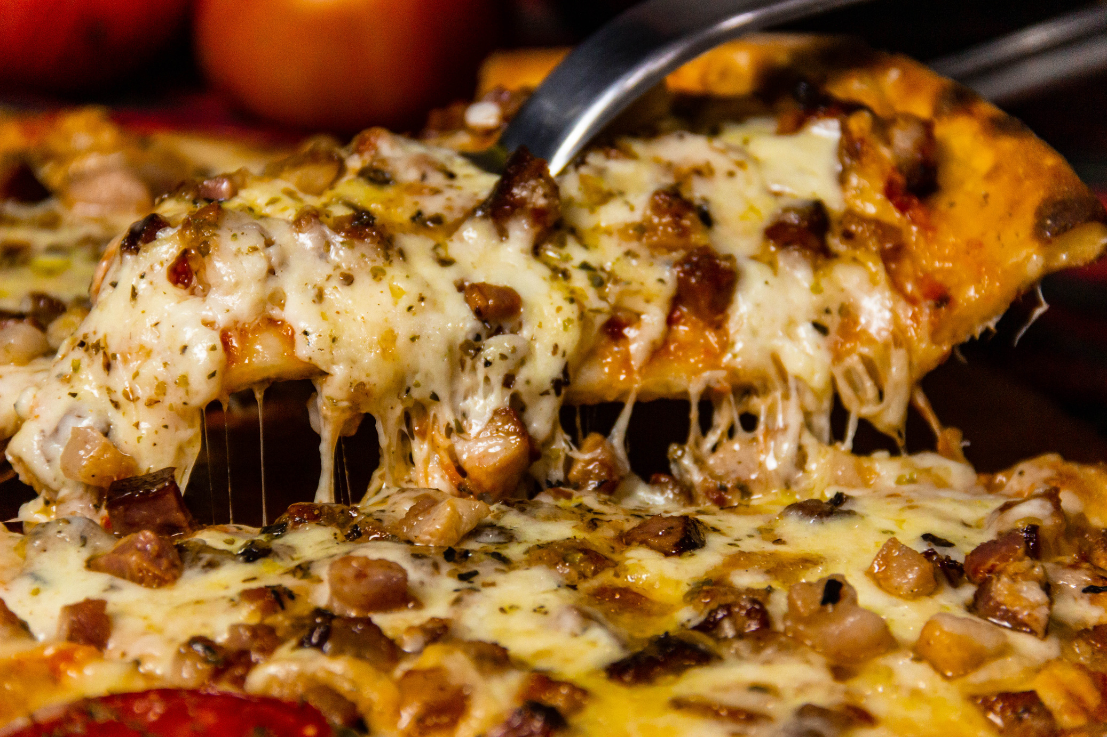

TOTAL_ORDERS

Slide 8
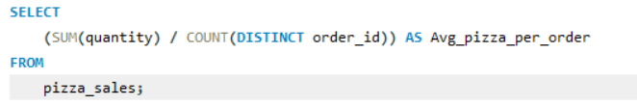

AVG_PIZZAS_PER_ORDERS

Slide 9
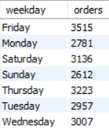
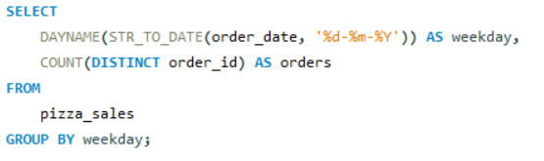
CHARTS REQUIRMENT
About
Contact
DAILY TRENDS FOR TOTAL ORDERS

Slide 10
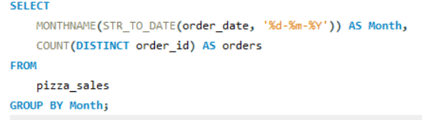
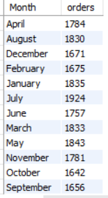
MONTHLY TRENDS FOR TOTAL ORDERS
Home
About
Contact

Slide 11
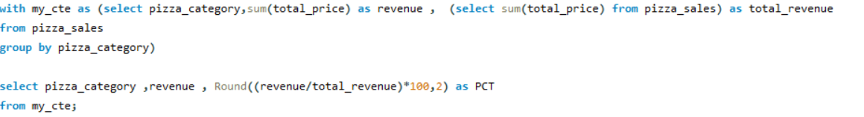
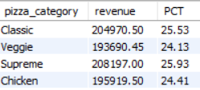
% OF SALES BY PIZZA CATEGORY

Slide 12
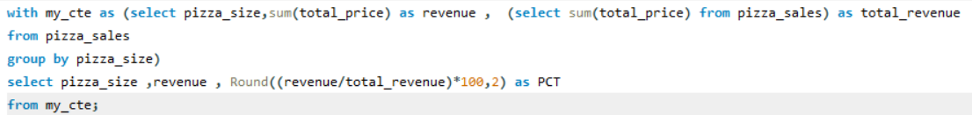
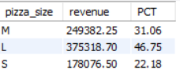
% OF SALES BY PIZZA SIZE

Slide 13
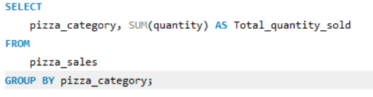
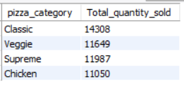
TOTAL PIZZAS SOLD BY PIZZA CATEGORY

Slide 14
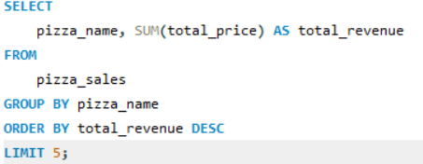
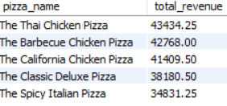
TOP 5 PIZZAS BY REVENUE
About
Contact

Slide 15
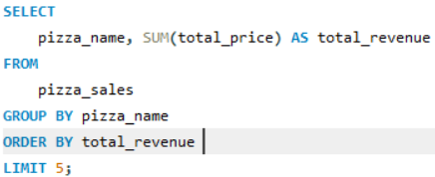
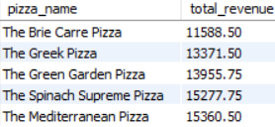
BOTTOM 5 PIZZAS BY REVENUE
About
Contact

Slide 16
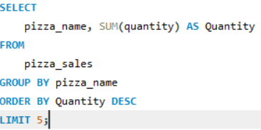
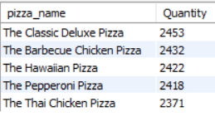
TOP 5 PIZZAS BY QUANTITY
About
Contact

Slide 17
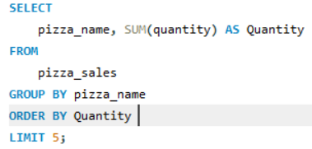
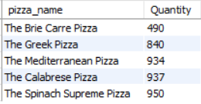
BOTTOM 5 PIZZAS BY QUANTITY
About
Contact

Slide 18
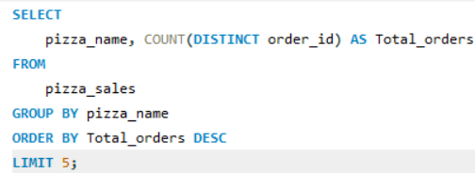
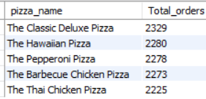
TOP 5 PIZZAS BY ORDERS
About
Contact

Slide 19
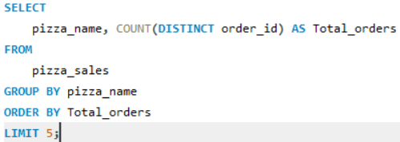
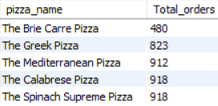
BOTTOM 5 PIZZAS BY ORDERS
About
Contact

Slide 20
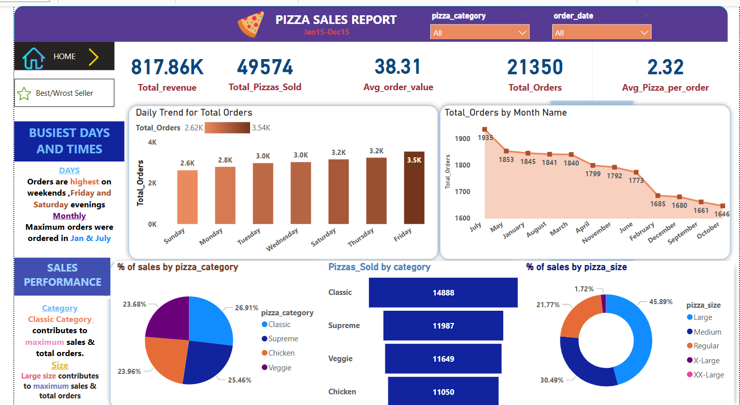
DASHBOARD(HOME)

Slide 21
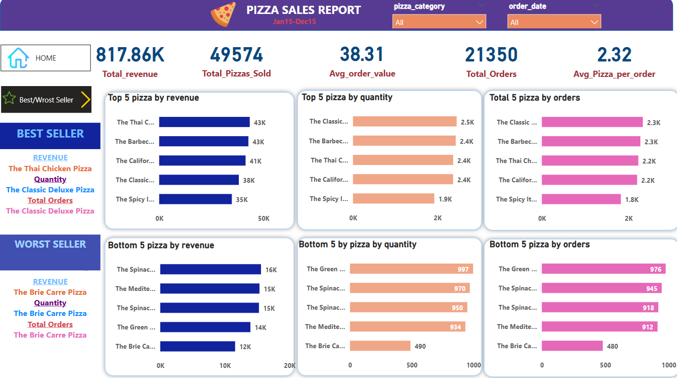
DASHBOARD(BEST/WORST SELLER)

Slide 22
INSIGHTS & UNDERSTANDING
Home
Contact
This analysis is the result of a combined approach using both SQL-based data extraction and Power BI-driven visualization. SQL queries were used to explore the raw pizza sales data and generate key metrics such as total revenue, top/worst performing pizzas, peak order days, and category-wise performance. These queries helped uncover granular insights like the number of pizzas sold per order, daily order trends, and monthly performance distribution.
Once the data was structured and cleaned using SQL, it was imported into Power BI where the insights were brought to life through intuitive and interactive dashboards. The final visualizations clearly highlight that the Classic Deluxe Pizza was the most ordered, Thai Chicken Pizza brought in the highest revenue, and orders peaked on Fridays and weekends.
This end-to-end workflow showcases how powerful insights can be generated by combining backend data processing (SQL) with front-end visualization (Power BI), enabling better business decisions.

Slide 23
STEPS TO BE TAKEN TO INCREASE PIZZA SALES
Home
Contact
Based on the insights derived from the data, several actionable steps can be taken to boost pizza sales. First, more focus should be given to promoting the top-performing pizzas, especially the Classic Deluxe and Thai Chicken variants, through combo offers and upselling. Second, since orders are highest on Fridays and weekends, targeted marketing campaigns (like discounts or limited-time offers) can be run during these peak periods to further capitalize on demand. Third, underperforming pizzas such as the Brie Carre and Mediterranean should either be improved through customer feedback or removed to optimize the menu. Additionally, since large-sized pizzas drive the maximum revenue, bundle deals encouraging larger sizes can increase order value. Lastly, more awareness around the Classic category (which dominates in quantity and revenue) can be created to attract more repeat customers. These strategic moves, based on data-driven insights, can significantly enhance overall pizza sales and customer engagement.
This end-to-end workflow showcases how powerful insights can be generated by combining backend data processing (SQL) with front-end visualization (Power BI), enabling better business decisions.

Slide 24
THANK YOU
FOR ATTENTION

